Slide 1
FIRE SOUND!

Slide 2
READY AIM FIRE 9:05 AM
You haven’t left yet have you.

Slide 3
It’s time to implement your Survival Plan. You planned not to stay and defend your property.
READY AIM FIRE 9:05 AM

Slide 4
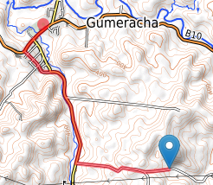
READY AIM FIRE 9:05 AM
Here is a map of the lowest risk route to a Last Resort Refuge. You have walked this route ten times.

Slide 5
You planned to take your dog but leave your chooks at home to roast.
READY AIM FIRE 9:05 AM

