Slide 2
PING!

Slide 3
READY AIM FIRE 9:05 AM
Do you remember where your last resort bushfire refuge is?

Slide 4
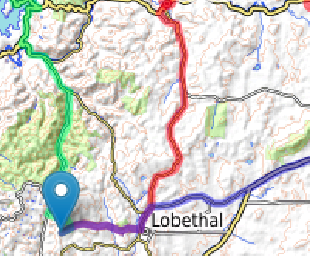
READY AIM FIRE 9:08 AM
Here’s the map from your Bushfire Survival Plan.

Slide 5
READY AIM FIRE 9:05 AM
Walking your dog to your nearest refuges will help you get to know the routes. That way you’ll be confident you know where you’re going when the time comes.

