Slide 1
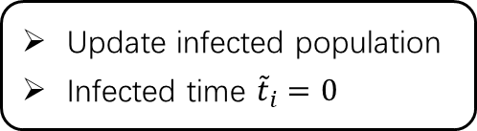
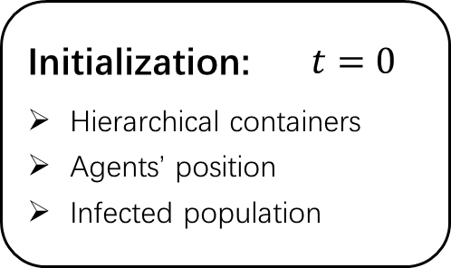
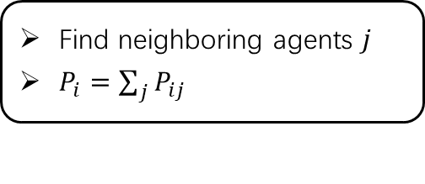








For all agents
Initialization: $t=0$
Hierarchical containers
Agents’ position
Infected population
$$P_{lv}(l)\prod_{j≤l}{P_{j}(k_{j})}$$
$$rd≤P_{mi} ?$$
yes
Movement:
Choose level $l$
Choose containers $k_{j}, j≤l$
Update agent position
Start
no
End
yes
no
Infection:
$$t>T ?$$
Find neighboring agents $j$
$P_{i}=\sum_{j}{P_{ij}}$
For infected agents
$$t=t+1$$
$${\tilde{t}}_{i}={\tilde{t}}_{i}+1$$
$$rd≤P_{i} ?$$
no
Recovery:
Update infected population
no
$${\tilde{t}}_{i}>T_{inf} ?$$
Update infected population
Infected time ${\tilde{t}}_{i}=0$
yes
yes
$$rd<R_{i} ?$$

