Slide 1

Name
Made by Jessye
The content was taken from
Teens 1 Content Revision 3.
Adapted Content Revision 3
1. Complete the sentences with the words below:
a. ________ do you love green? Because it’s my favorite color.
i. What
ii. Why
b. ________ has a lot of candies? Lara has a lot of candies.
i. Where
ii. Who
c. ________ cousins do you have? I have five cousins. And you?
i. Where
ii. How many
d. ________ Money does he need? He needs R$100 reais.
i. How much
ii. When
1.1 Glue the right ‘a lot of’ or ‘a lot’ tag on the spaces below to complete the sentence
e.
f.
Maria has ________ friends.
Julian studies_________.
2. Match the right Object Pronoun to the right Subject and complete the sentences:
Object Pronouns
Subjects
Us
I
a. I love _____________. (He)
Me
You
b. Mariana wants to talk to ___________ (I)
You
He
c. I think I have to invite ____________. (They)
Him
She
d. We don’t want to speak about ____________. (She)
Them
It
It
We
Her
They

Slide 2



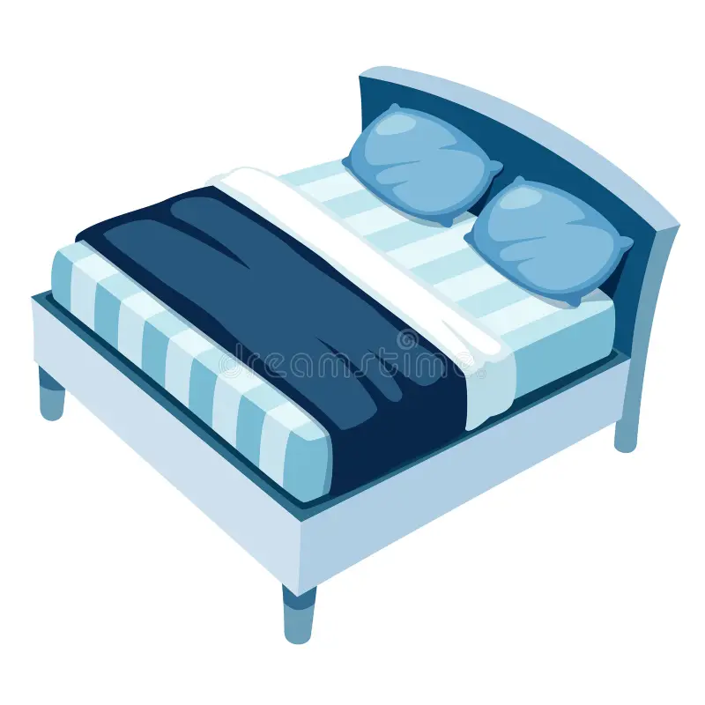
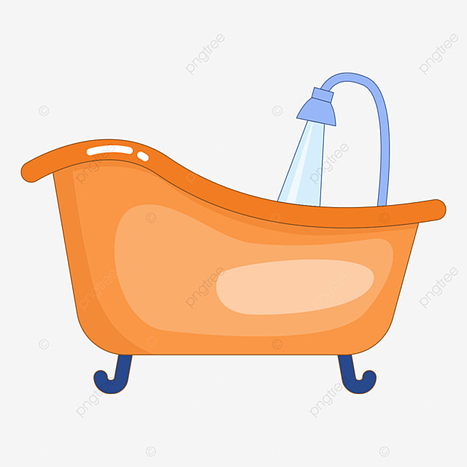
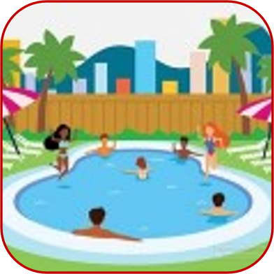
3. Write a word in English that starts with the letter following the tip :
B
G
A
Verb
Color
Fruits
F
C
J
Family Member
Animal
Clothes
4. Listen and pick the right image:
a.
b.
c.
4.1. How do I say in English?
4.1. How do I say in Portuguese?
a. Viver
a. Wash
b. Quarto
b. Comedy
c. Brasileiro
c. Picture
ok = Right
d. Revista
d. In the Garage
/ = Partially Right
x = Wrong

Slide 3
A lot
A lot of

