Slide 1
How Much Do We Know About
Meteorite Landings on Earth?
Yukie Kajita & Jess Yoder

Slide 2
How Much Do We Know About Meteorites?
“If you spot a meteor shower, what you’re actually seeing is an icy comet’s leftovers that crash into Earth’s atmosphere… When Earth passes through these cascades of comet waste, the bits of debris - which can be as small as grains of sand - pierce the sky at such speed that they burst, creating a celestial fireworks display.”
St. Fleur, Nicholas (2020, May 4) Eta Aquarids: Watch Halley’s Comet’s Meteor Shower Peak in Night Skies. NY Times. https://www.nytimes.com/2020/05/04/science/eta-aquarids-meteor-shower.html

Slide 3
How Much Do We Know About Meteorites?
“Most meteoroids that enter the atmosphere burn up completely as meteors. In some cases, however, the meteoroid does not completely burn up, and the object actually makes it to Earth’s surface. The chunk that survived its fiery journey is called a meteorite.”
Gregersen, Erik. What’s the Difference Between a Meteoroid, a Meteor, and a Meteorite? Brittanica. https://www.britannica.com/story/whats-the-difference-between-a-meteoroid-a-meteor-and-a-meteorite

Slide 4
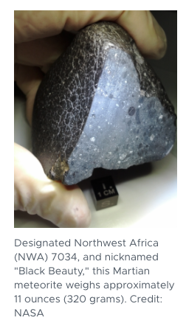
Questions We Found Interesting & What Motivated us to answer them
Project Description:
We were interested in exploring Meteorite Landings Data from NASA, Data.Gov. to examine how many meteorites were landed on earth.
We were also interested in looking at articles about meteorites published in NYT.
Research Questions to Answer:
1) How Many Meteorites Were Found?
2) Which Meteorites Were Found in the Earliest Year?
3) What Sizes of Meteorites Were Found So Far?
4) Where Were the Biggest Meteorites’ Landing Spots?
5) What Types of Meteorites Do We Have?
6) Which Countries Found More Meteorites?
7) Is There a Difference on The # of Meteorites Between Northern vs Southern Hemispheres?
8) How Many Articles About Meteorites Were Published in NYT? What Were the Contents?

Slide 5
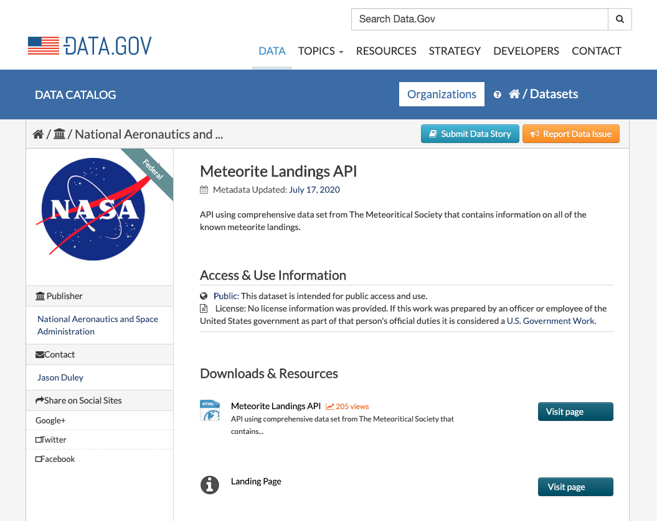
Data Exploration & Clean Up Process - 1. NASA Part
Obtained data from DATA.GOV
CSV File was available!

Slide 6
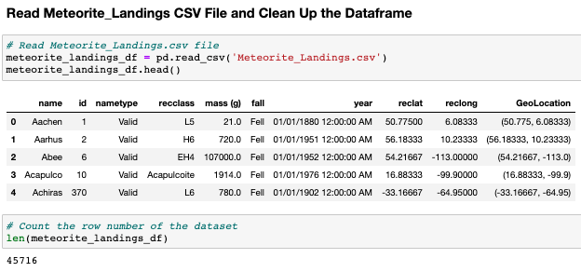
Data Exploration & Clean Up Process - NASA Part
Total Data Rows were 45,716
Data included: Name, ID, Nametype, Recclass (Meteorite Type), Mass (g), Geolocation with Latitude and Longitude, Year (Recorded)

Slide 7
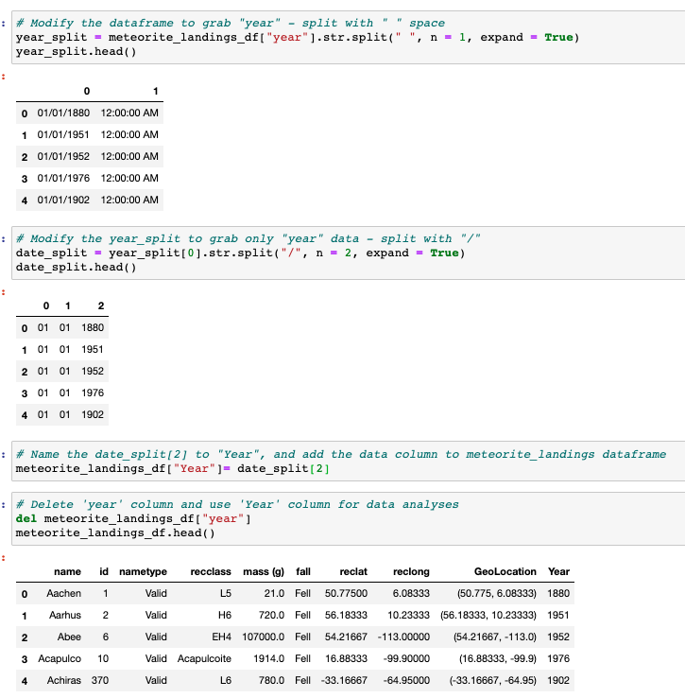
Data Exploration & Clean Up Process - NASA Part
Year Column - Removed Date and Time

Slide 8
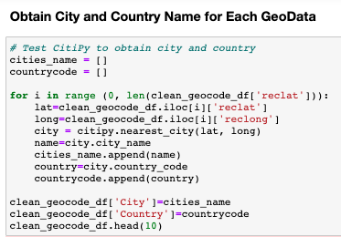
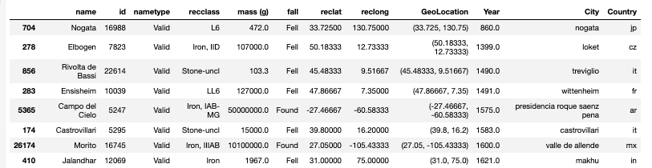
Data Clean Up and Organization
Year Column - Removed Date and Time
Obtained City and Country Name using ‘citipy’

Slide 9
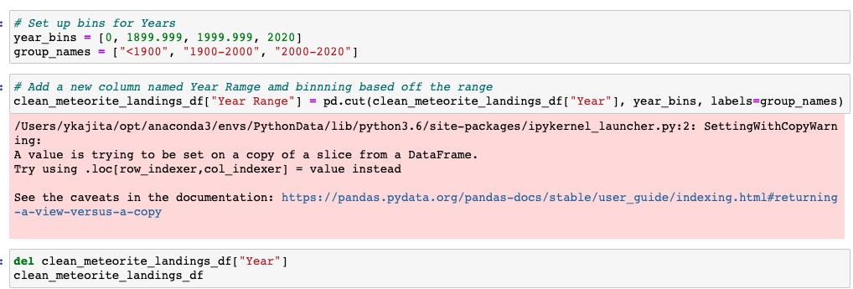
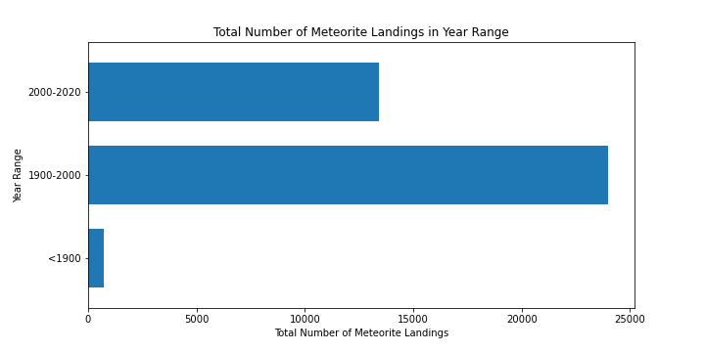
Question 1 - How Many Meteorites Were Recorded?

Slide 10

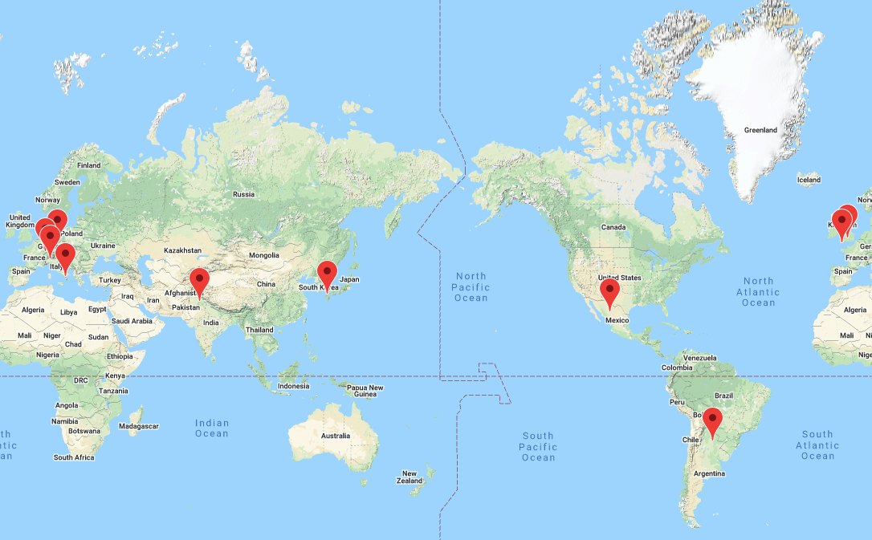
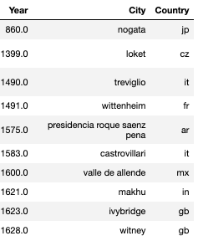
Question 2 - Which Meteorites Were Found in the Earliest Year?
Notes:
Map here?

Slide 11
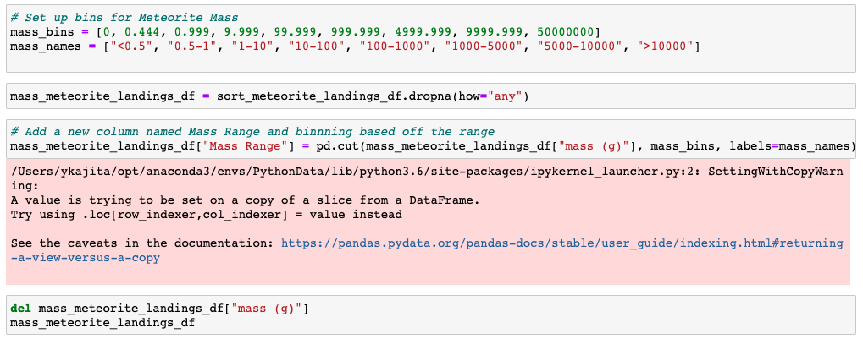
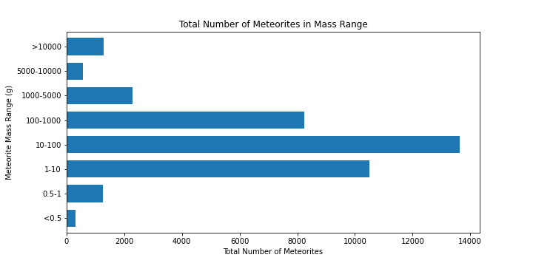
Question 3 - What Sizes of Meteorites Were Found?

Slide 12

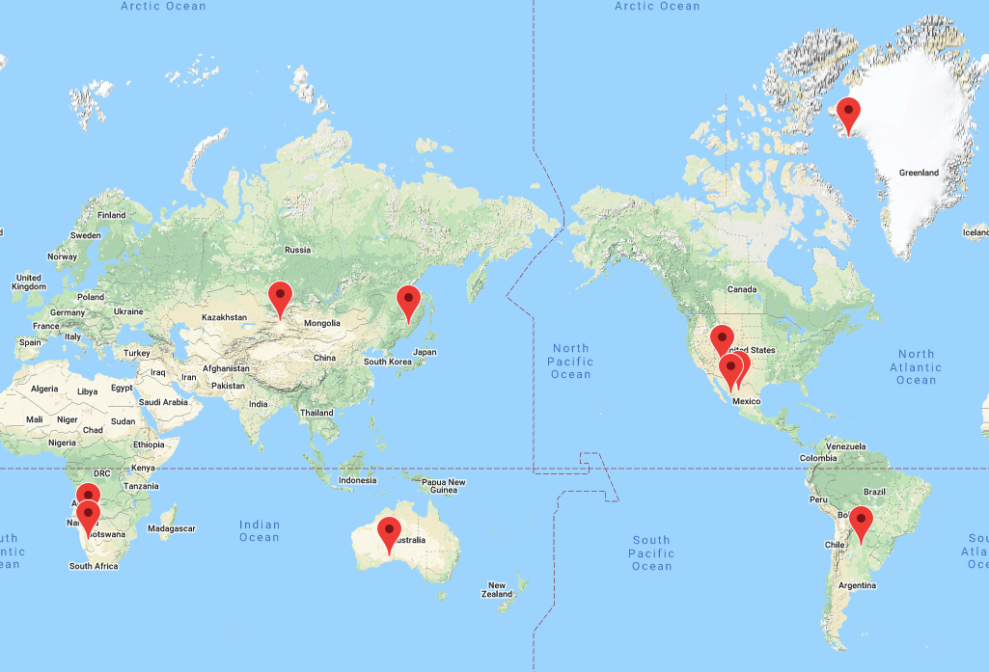
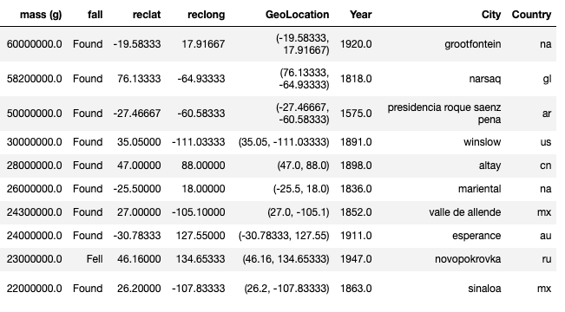
Question 4 - Where Were the Largest Meteorites’ Landing Spots?
Notes:
Map here?

Slide 13

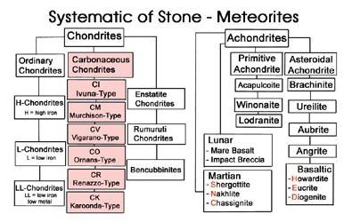
Question 5 - What Types of Meteorites Do We Have?
Total Meteorite Types:
Chondrites: Pre-planetary rocks
Rocks that formed about 4.5 billion years ago in the
solar system
Achondrites: Pieces of a differentiated planetary bodies, like the
Moon or Mars.
Image from Meteoriten.com
Information source from Caslabs.case.edu

Slide 14
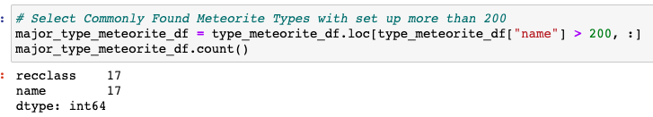
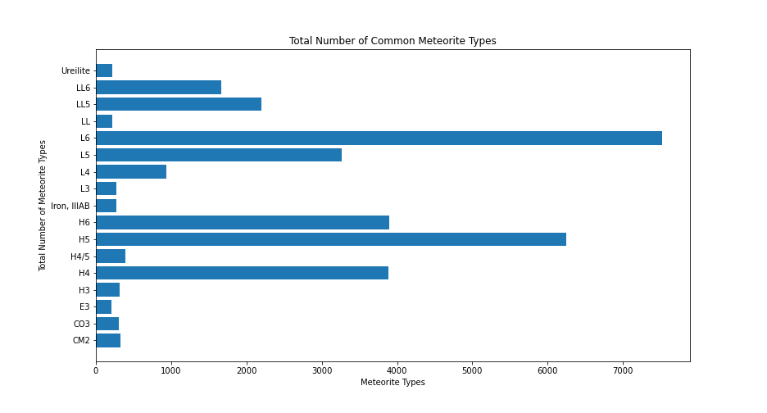
Question 5 - Common Types of Meteorites
Image from Meteoriten.com

Slide 15
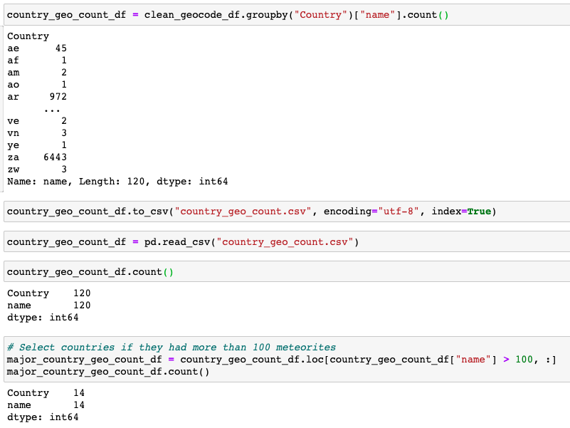
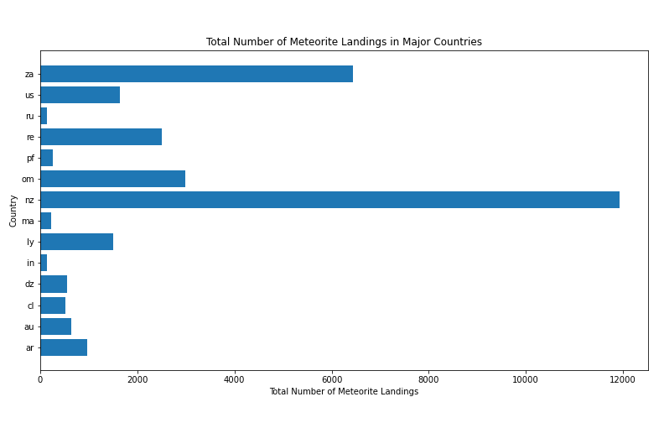
Question 6 - Which Countries had More Meteorites’ Landings?
Notes:
We could put Jess’ Map here?

Slide 16
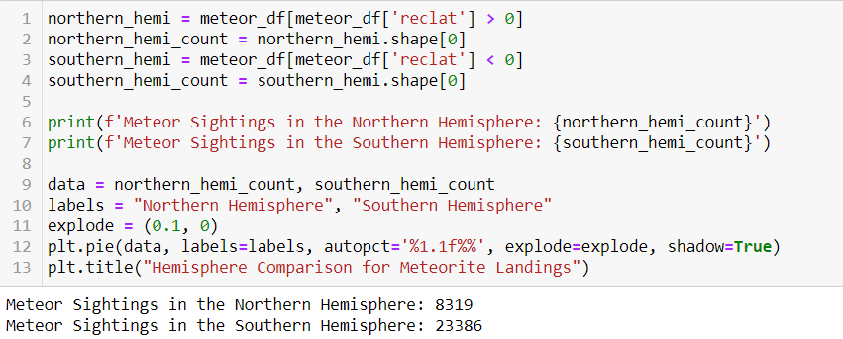
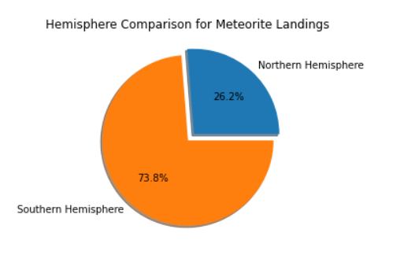
Question 7 - Northern vs Southern Hemisphere Comparison
Notes:
Jess Map Here?

Slide 17
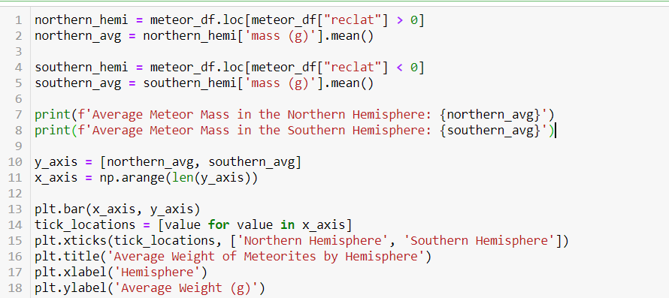
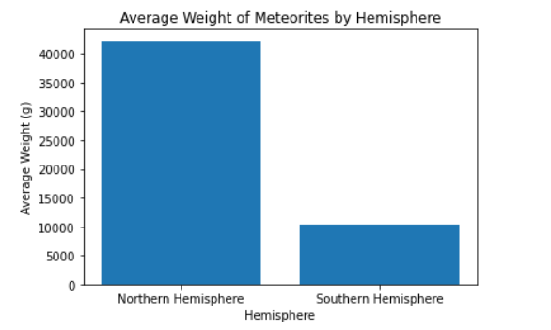
Question 7 - Northern vs Southern Hemisphere Comparison
Notes:
Jess Map Here?

Slide 18
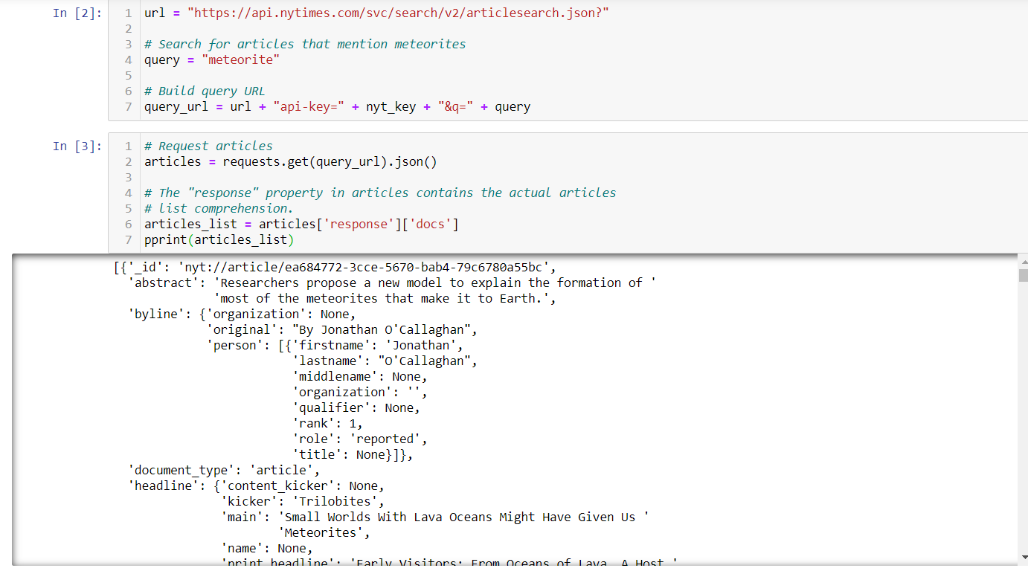
Question 8 - How Many Articles About Meteorites Published in NYT?
Data Exploration & Clean Up Process - 2. NYT Part
Searched NYT API for New York Times articles using the keyword “meteorite.”
The NYT Article Search found 11 articles from 2003-2020
Notes:
Jess here?

Slide 19
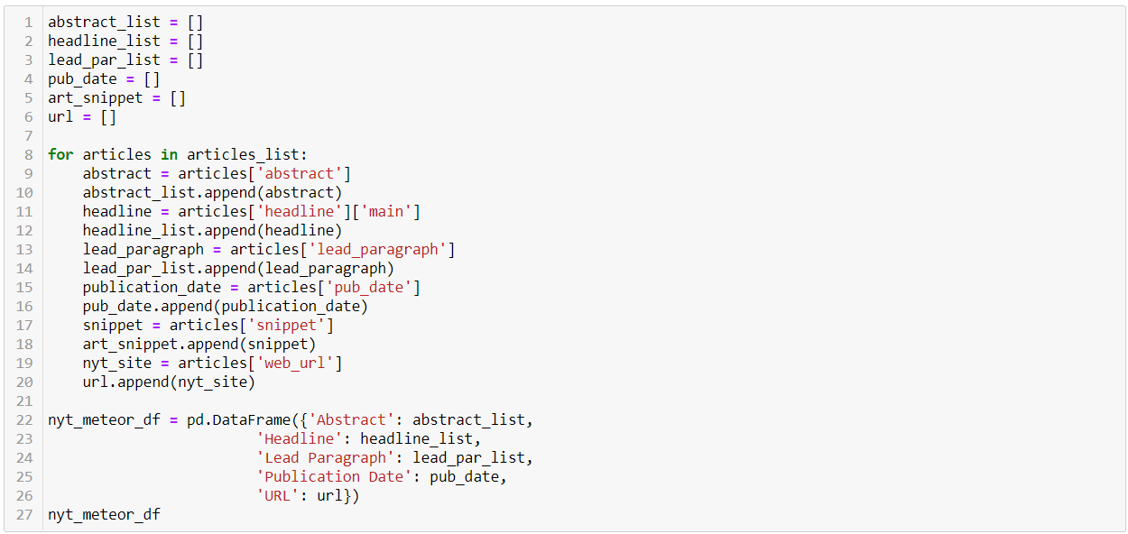
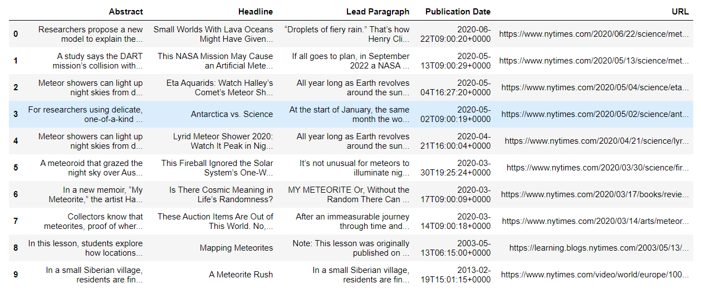
Question 9 - How Many Articles About Meteorites Published in NYT?
Using a For Loop enabled us to pull out useful information from each article.
We then used that information to form a dataframe to display information and research the full article at a later time.

Slide 20
Question 9 - Article Contents
Where Meteor Showers Come From
“If you spot a meteor shower, what you’re usually seeing is an icy comet’s leftovers that a crash into Earth’s atmosphere. Comets are sort of like dirty snowballs: As they travel through the solar system, they leave behind a dusty trail of rocks and ice that lingers in space long after they leave….
“A general rule of thumb with meteor showers: You are never watching the Earth cross into remnants from a comet’s most recent orbit. Instead, the burning bits come from the previous passes….
“That’s because it takes time for debris from a comet’s orbit to drift into a position where it intersects with Earth’s orbit, according to Bill Cooke, an astronomer with NASA’s Meteoroid Environment Office.”
St. Fleur, Nicholas (2020, May 4) Eta Aquarids: Watch Halley’s Comet’s Meteor Shower Peak in Night Skies. NY Times. https://www.nytimes.com/2020/05/04/science/eta-aquarids-meteor-shower.html

Slide 21
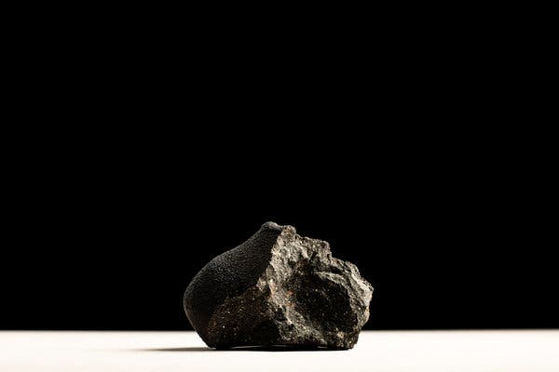

Question 9 - Article Contents
“Collectors of every financial means can afford meteorites - it could be as cheap as $5,” said Mendy Ouzillou, vice president of the International Meteorite Collectors Association.
“And then there are those who regard them as art sculpted by the universe…
“‘These things are going to be looked at for their aesthetic quality as much as for what their inherent value is based on their scientific importance,’ said Craig Kissick, director of nature and science at Heritage in Dallas, which sells several hundred meteorites each year… Its highest sale topped $300,000.”
Coyne, Kevin (2020, March 14) These Auction Items are Out of This World. No, Really. NY Times. https://www.nytimes.com/2020/03/14/arts/meteorites-collectors-auction-christies.html

Slide 22
Conclusions & Implications of Our Findings
So far, 45,716 meteorite landings were recorded.
More meteorites’ data was available since 1950, probably, more technology available to collect meteorites’ data (satelites, geolocation systems, international data exchange etc.)
Common meteorites were 10-100g, and Common types of meteorites were Chondrites, Pre-planetary rocks
New Zealand and South Africa had more meteorite landings records; therefore, southern hemisphere had more meteorite landing records than northern hemisphere
Article search: The NYT Article Search found 11 articles from 2003-2020. Compared with the meteorites’ scientific records, the number of articles of meteorites looks much smaller. We could have used other article search engines; however, we lost two team members during the project week, and we could not explore other article search sources.
It was intriguing to know the monetary value of meteorites, and people are trying to find and sell meteorites!

