Slide 1




Group 5
Machine Learning Project
Jia Si & Fangyi Wang

Slide 2
Analysis Objective
Problem Type: Regression, as the task involves predicting a continuous variable, the sale price of houses.
Goal: Build a model that can learn from the historical data of home sales to predict prices for new or unseen homes based on their attributes (Supervised Learning)
Applications: This kind of model can be particularly useful for real estate agents, buyers, and sellers to help them understand the market value of properties and make informed decisions. It is also valuable for economists and urban planners studying housing market dynamics.

Slide 3
Data Characteristics
Total Features: 79
Total Observations:
Training Data: 1460
Testing Data: 1459
Target Variable: Sale Price is the target variable that models are trained to predict.
Challenges and Considerations
Feature Engineering: Given the wide range of features, transforming raw data into useful predictors is requirement, including handling categorical variables, dealing with missing values, and creating interaction terms if necessary.
Model Selection and Evaluation: Various models can be tested, from simple linear regression to more complex ensembles like Random Forest and Gradient Boosting Machines.
Overfitting and Generalization: With many features, there is a risk of overfitting, where the model performs well on training data but poorly on unseen data. Techniques such as cross-validation, regularization, and pruning of decision trees can help in building models that generalize better to new data.

Slide 4
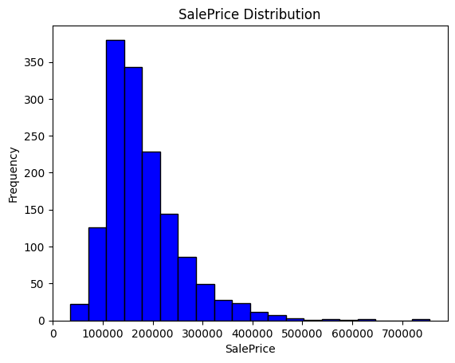
Data Cleaning
SalePrice distribution is long right tail so that use the log(SalePrice) as target.
Advantage: Normalize the distribution, Improve model performance.
2. 99% data missing: delete the variable.(PoolQC)
3. Categorical Variables
(1) if here is NA categorical in the data description, use the NA replace the NAN. (Alley, FireplaceQu,Fence ,)
(2) if there is no ‘NA’ or ‘None’ categorical in the data description, fill by the mode . (Electrical)
4.Numerical Variables: fill by mean (LotFrontage)
5. Features groups that have strongly relationship: whether the missing value is the same, whether lack them in the same level.
'GarageQual', 'GarageCond', 'GarageFinish', 'GarageType'& ‘MasVnrType’ and ‘MasVnrArea’: their missing part(rows) is the same,filling the missing value together with ‘NA’
'BsmtQual', 'BsmtCond', 'BsmtFinType1', ‘BsmtExposure’, ‘BsmtFinType2’: the first 3 missing part is the same (37 rows), but the last two are not (38 missing&missing parts are different). find the different missing part of ‘BsmtExposure’, ‘BsmtFinType2’, replace based on their variables to make sure all 37 missing rows are same and finally fill together with ‘NA’
6. Numerical Categorical Variables
Missing year: replace with 0 (GarageYrBlt)

Slide 5
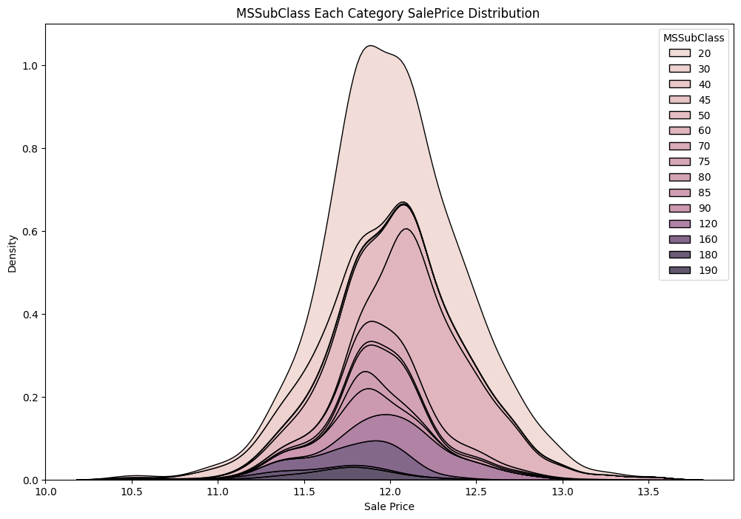
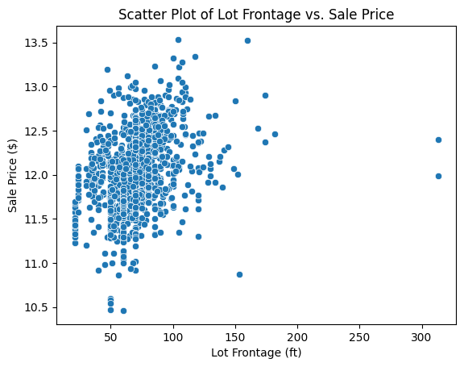
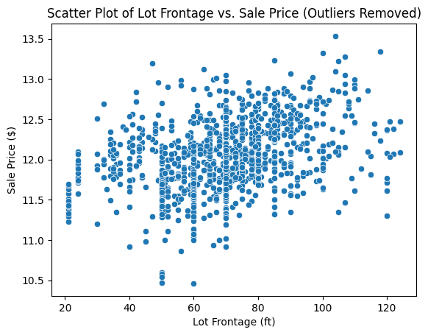
Feature Selection
1. Beginning: almost see each value’s relationship with the sale price, but there is shortcomings: Not Clear!

Slide 6
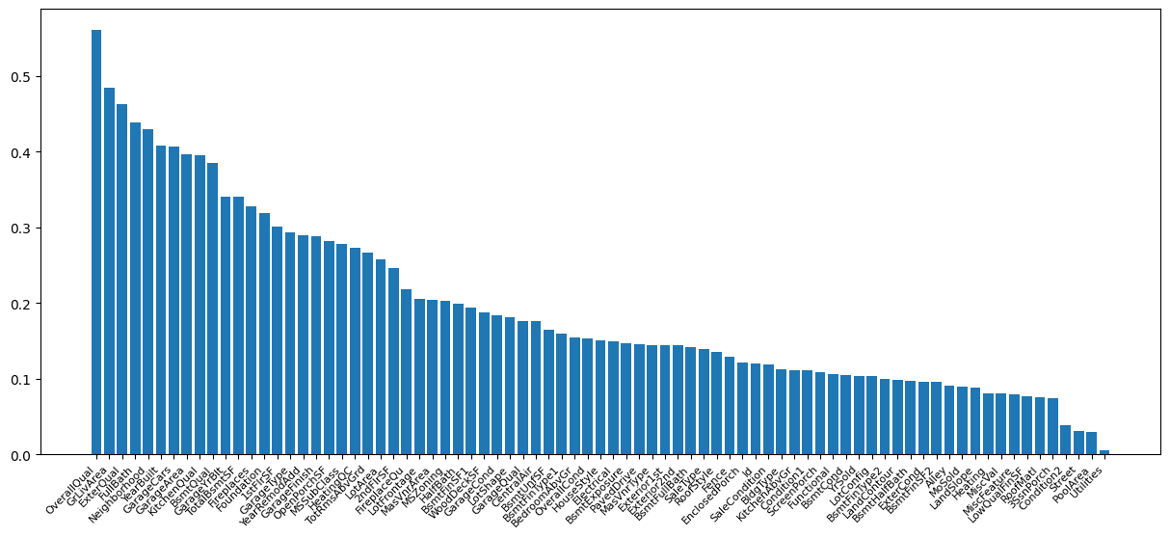
Feature Selection
2. Statistic Method
Maximum Information Coefficient (MIC) Scores

Slide 7
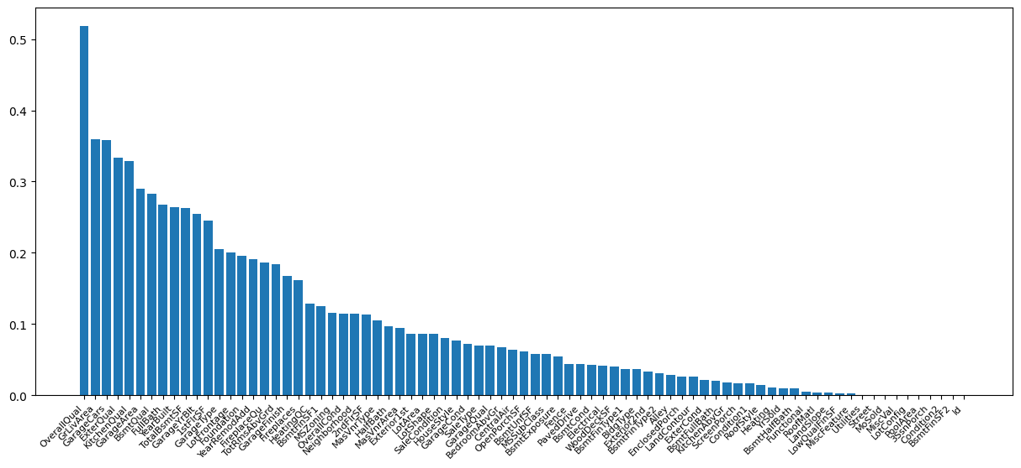
Feature Selection
2. Statistic Method
(2) Mutual Information Scores

Slide 8
Feature Selection
3. Final Feature Selection
small feature group(32)
large feature group(51)
The feature importance from XGboost is tailored for XGboost model so that cannot use that to decide the variable selection for other models. Also, since MIS views ID as the most useless variable comparing to MIC. Also after validation of several features, MIS is more reliable. we only choose the MIS as the final decision based on the structure of geologic fault data, selecting variables before "Extenrior2nd"， or before "LotShape".

Slide 9
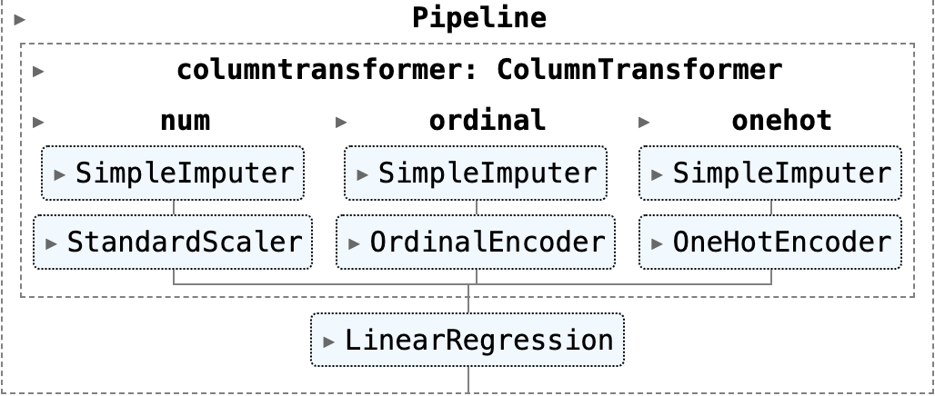
Model Construction
For Small & Large Feature Group: Use the pipeline to:
standard scale the Numerical Variables,
Ordinal Encoder to transform the an order pattern objective variables,
OneHot Encoder to deal with non-order objective variables by binary columns.
Example:

Slide 10
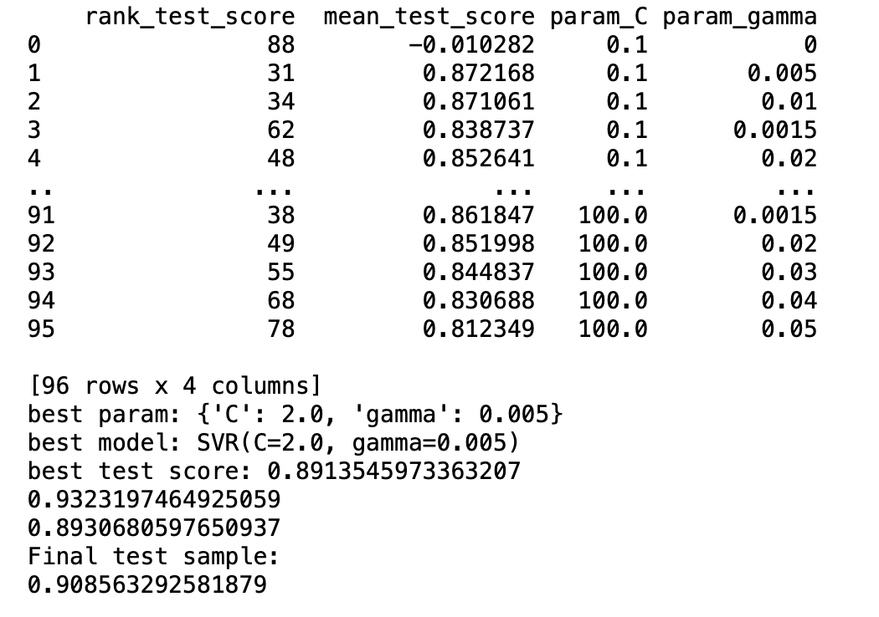
Model Construction
Data
2.
Train 75%
Test 25%
Training model 75%*75%
Validation
75%*25%
Report 25%
Use the gridsearch to training different models based on the different parameters combinations
Through the validation score, decide the best parameter and model
Report the best model performance for the testing data.

Slide 11
Models Performance
Parameter Adjustment: Make sure the reverse U shape fo the relationship R2 and rank number more flat making sure the model stability
Linear Regression
Small Group Features
Mean Train R^2 Score: 0.893
Mean Test R^2 Score: -14112655125710364475392.000
Final test sample score: 0.9033197872031596
Large Group Features
Mean Train R^2 Score: 0.910
Mean Test R^2 Score: -159700966994250974625792.000
Final test sample score: -24002249470098.02

Slide 12
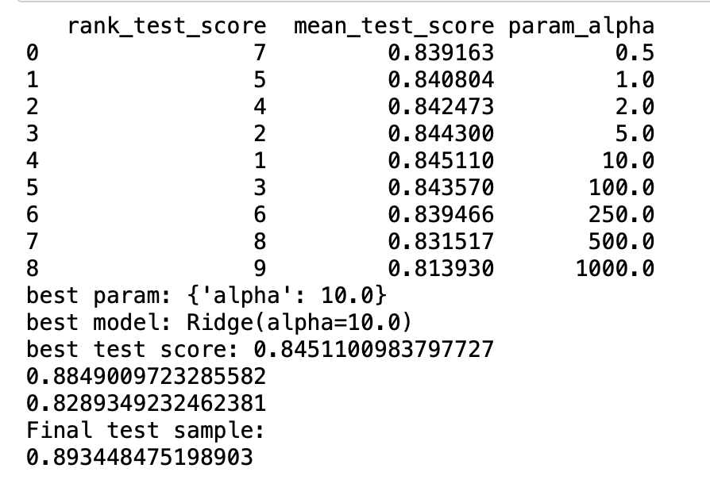
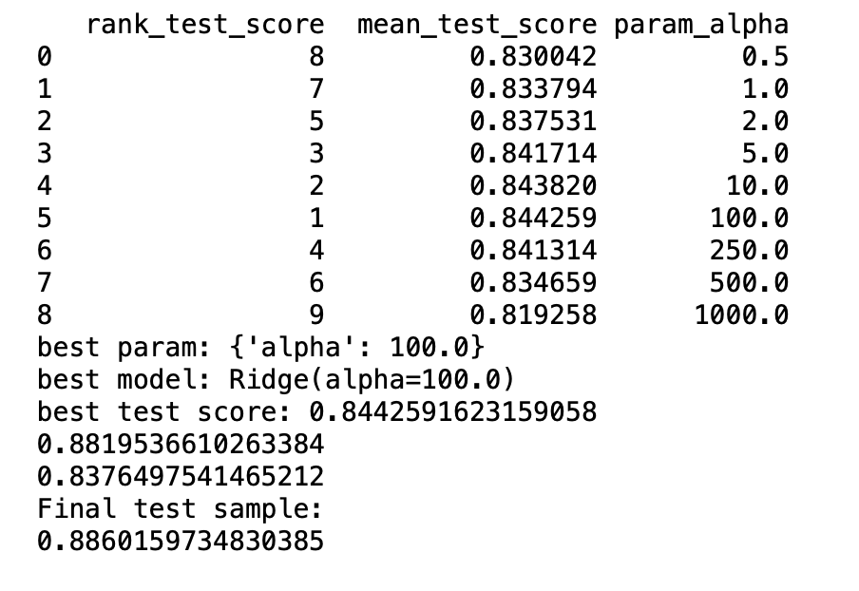
Models Performance
2. Ridge Regression
Small Group Features Large Group

Slide 13
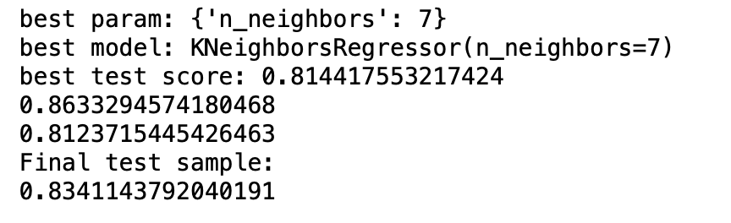
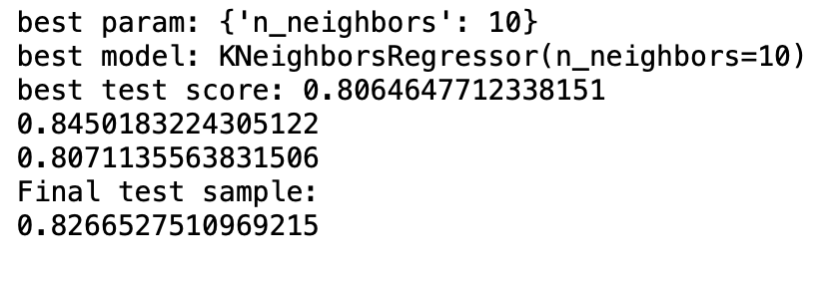
Models Performance
3. K Neighbors Regressor
Small Group Features Large Group

Slide 14
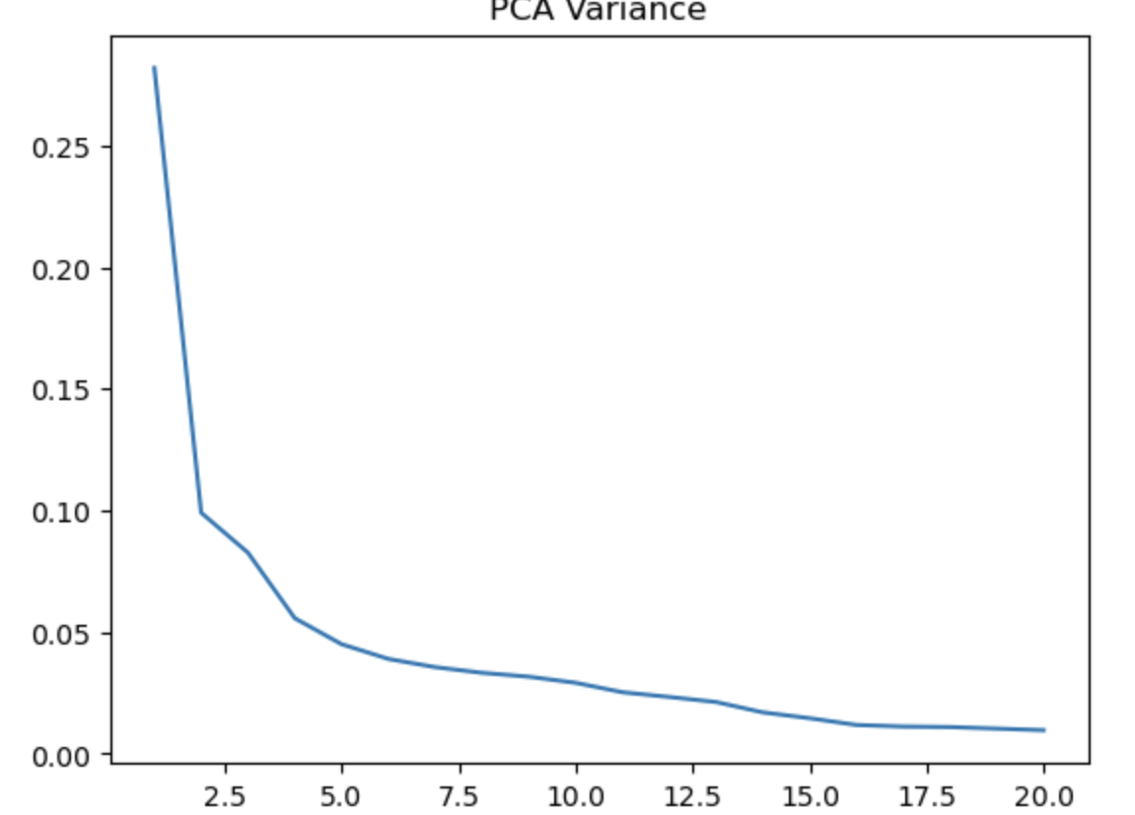
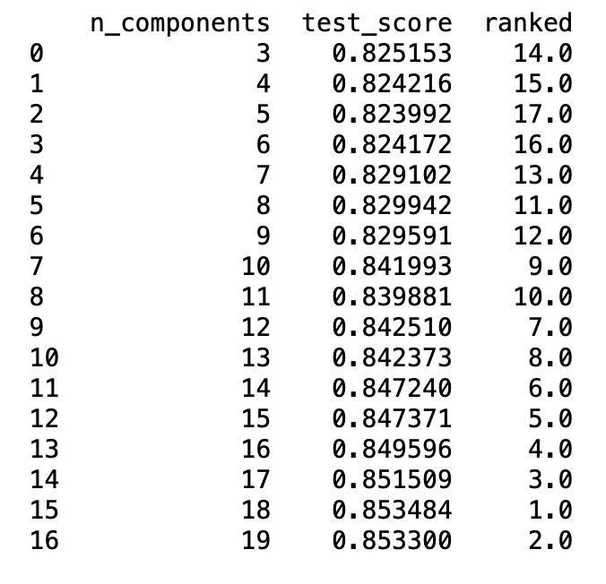
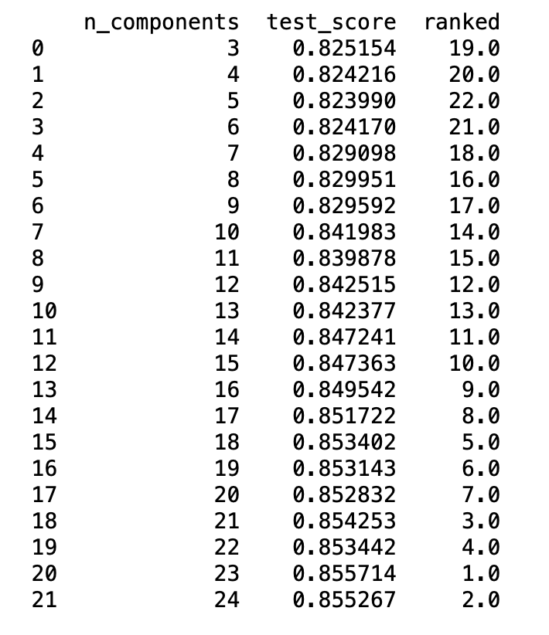
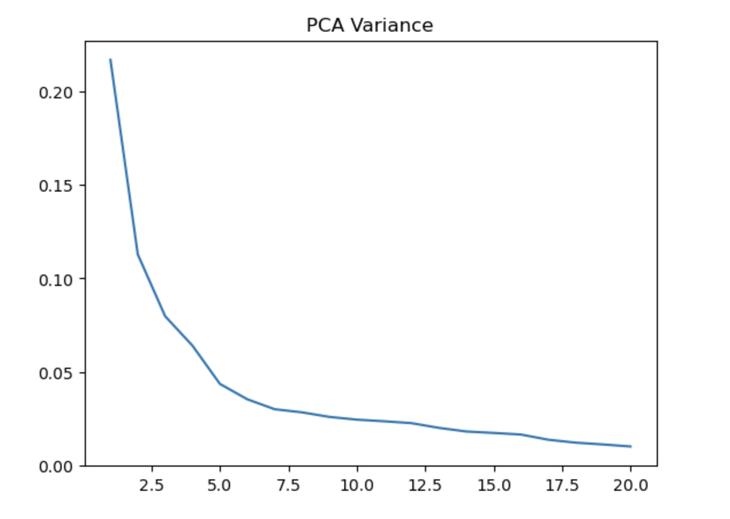
Models Performance
4. Principal Component Regression
Small Group Features
Large Group Features

Slide 15
Models Performance
5. Support Vector Regression
Small Group Features Large Group
best param: {'C': 2.0, 'gamma': 0.005}
best model: SVR(C=2.0, gamma=0.005,kernel="rbf")
best test score: 0.8913545973363207
0.9323197464925059
0.8930680597650937
Final test sample:
0.908563292581879
best param: {'C': 0.7, 'gamma': 0.005}
best model: SVR(C=0.7, gamma=0.005,kernel="rbf")
best test score: 0.8934883653745795
0.9314628129768978
0.8937740255686187
Final test sample:
0.9073583814276647

Slide 16
Models Performance
6. Kernel Ridge Regression
Small Group Features Large Group
best param: {'alpha': 0.005, 'gamma': 0.005, 'kernel': 'rbf'}
best model: KernelRidge(alpha=0.005, gamma=0.005, kernel='rbf')
best test score: 0.25255411732456995
0.973957390407581
0.1359018560678345
Final test sample:
0.8288374400991949
best param: {'alpha': 0.005, 'gamma': 0.005, 'kernel': 'rbf'}
best model: KernelRidge(alpha=0.005, gamma=0.005, kernel='rbf')
best test score: -0.02156702412636243
0.9891149414820958
-0.06284990265226321
Final test sample:
0.7258046920769865

Slide 17
Models Performance
7. Decision Tree
Small Group Features Large Group
best param: {'max_depth': 15, 'min_samples_leaf': 15}
best model: DecisionTreeRegressor(max_depth=15, min_samples_leaf=15, min_samples_split=5)
best test score: 0.751336072345139
Mean Train R^2 Score: 0.8533471727667358
Mean Test R^2 Score: 0.7474733225563359
Final test sample score: 0.8114279101537112
best param: {'max_depth': 15, 'min_samples_leaf': 10}
best model: DecisionTreeRegressor(max_depth=15, min_samples_leaf=10, min_samples_split=5)
best test score: 0.7490119622137056
Mean Train R^2 Score: 0.8847245233589847
Mean Test R^2 Score: 0.7494145129140581
Final test sample score: 0.8110543469461486

Slide 18
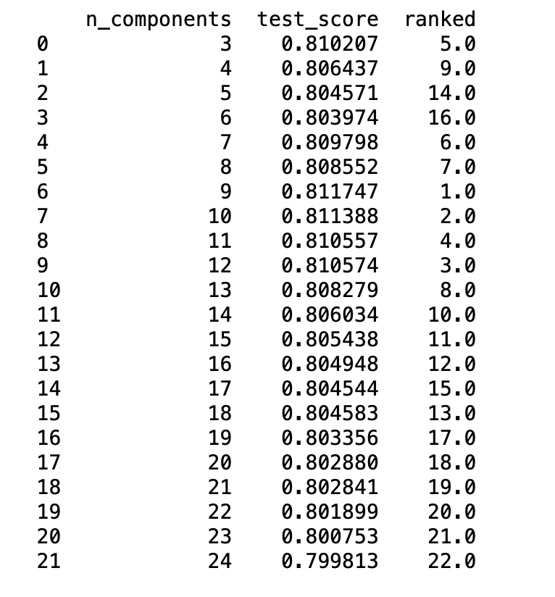
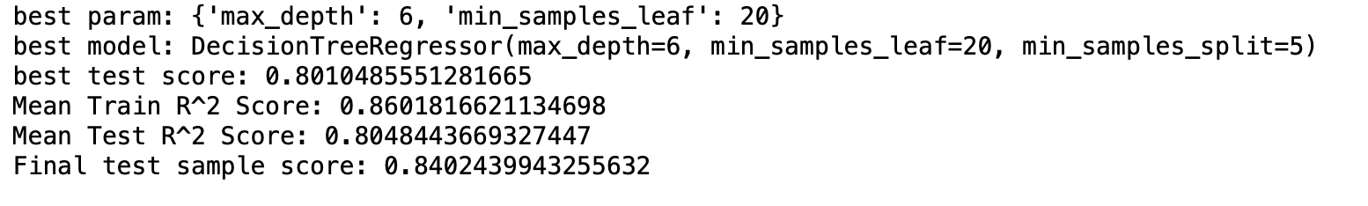
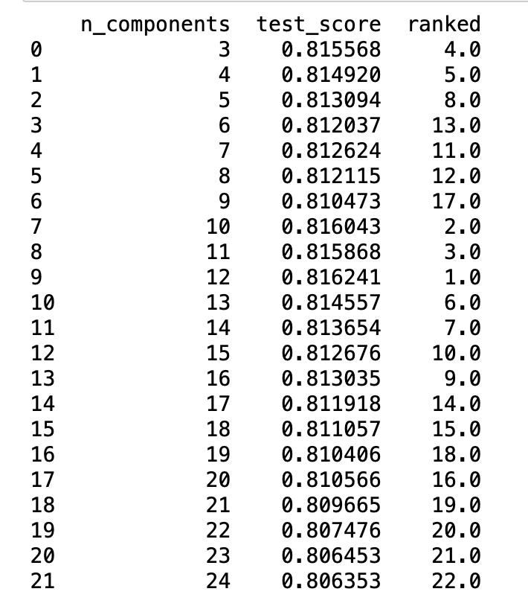
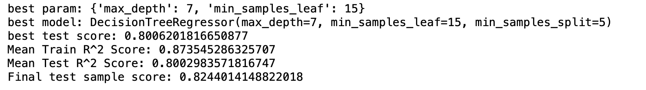
Models Performance
8. Principal Component Decision Tree
Small Group Features
Large Group Features

Slide 19
Models Performance
8. Principal Component Decision Tree
Small Group Features
Large Group Features

Slide 20
Models Performance
9.Random Forest
Small Features
best param: {'max_depth': 20, 'max_features': 25, 'n_estimators': 100}
best model: RandomForestRegressor(max_depth=20, max_features=25, random_state=42)
best test score: 0.8627224348609214
Mean Train R^2 Score: 0.9802697394164207
Mean Test R^2 Score: 0.8602699687482773
Final test sample score: 0.8780796149064063
Large Features
best param: {'max_depth': 20, 'max_features': 75, 'n_estimators': 100}
best model: RandomForestRegressor(max_depth=20, max_features=75, random_state=42)
best test score: 0.8627083764143414
Mean Train R^2 Score: 0.980475383837717
Mean Test R^2 Score: 0.8648964836326809
Final test sample score: 0.8823986373242663

Slide 21
Models Performance
10.Bayesian Regression
Small Features
Mean Train R^2 Score: 0.8867966743008254
Mean Test R^2 Score: 0.8149551426017719
Final test sample score: 0.8933029091433172
Large Features
Mean Train R^2 Score: 0.9002748574402375
Mean Test R^2 Score: 0.8255451102505704
Final test sample score: 0.8913335175093263

Slide 22
Models Performance
11.XGBOOST
Small Features
Mean Train R^2 Score: 0.99993384622472
Mean Test R^2 Score: 0.8383198338986625
Final test sample score: 0.8834557565437353
Large Features
Mean Train R^2 Score: 0.9999453753696714
Mean Test R^2 Score: 0.8424325755344404
Final test sample score: 0.8873644427779019

Slide 23
Models Performance
12.Gradient Boosting Regressor
Small Features
Best parameters: {'learning_rate': 0.1, 'max_depth': 2, 'n_estimators': 200}
best model: GradientBoostingRegressor(max_depth=2, n_estimators=200, random_state=42)
Best cross-validation score: 0.871
Final test sample score: 0.8931600587461638
Large Features
Best parameters: {'learning_rate': 0.05, 'max_depth': 3, 'n_estimators': 200}
best model: GradientBoostingRegressor(learning_rate=0.05, n_estimators=200, random_state=42)
Best cross-validation score: 0.870
Final test sample score: 0.902420934571331
13.StackingRegressor(random_forest,svr,ridge)
Small: Final test sample score: 0.9028396663763525
Large:Final test sample score: 0.9010305564982765

Slide 24
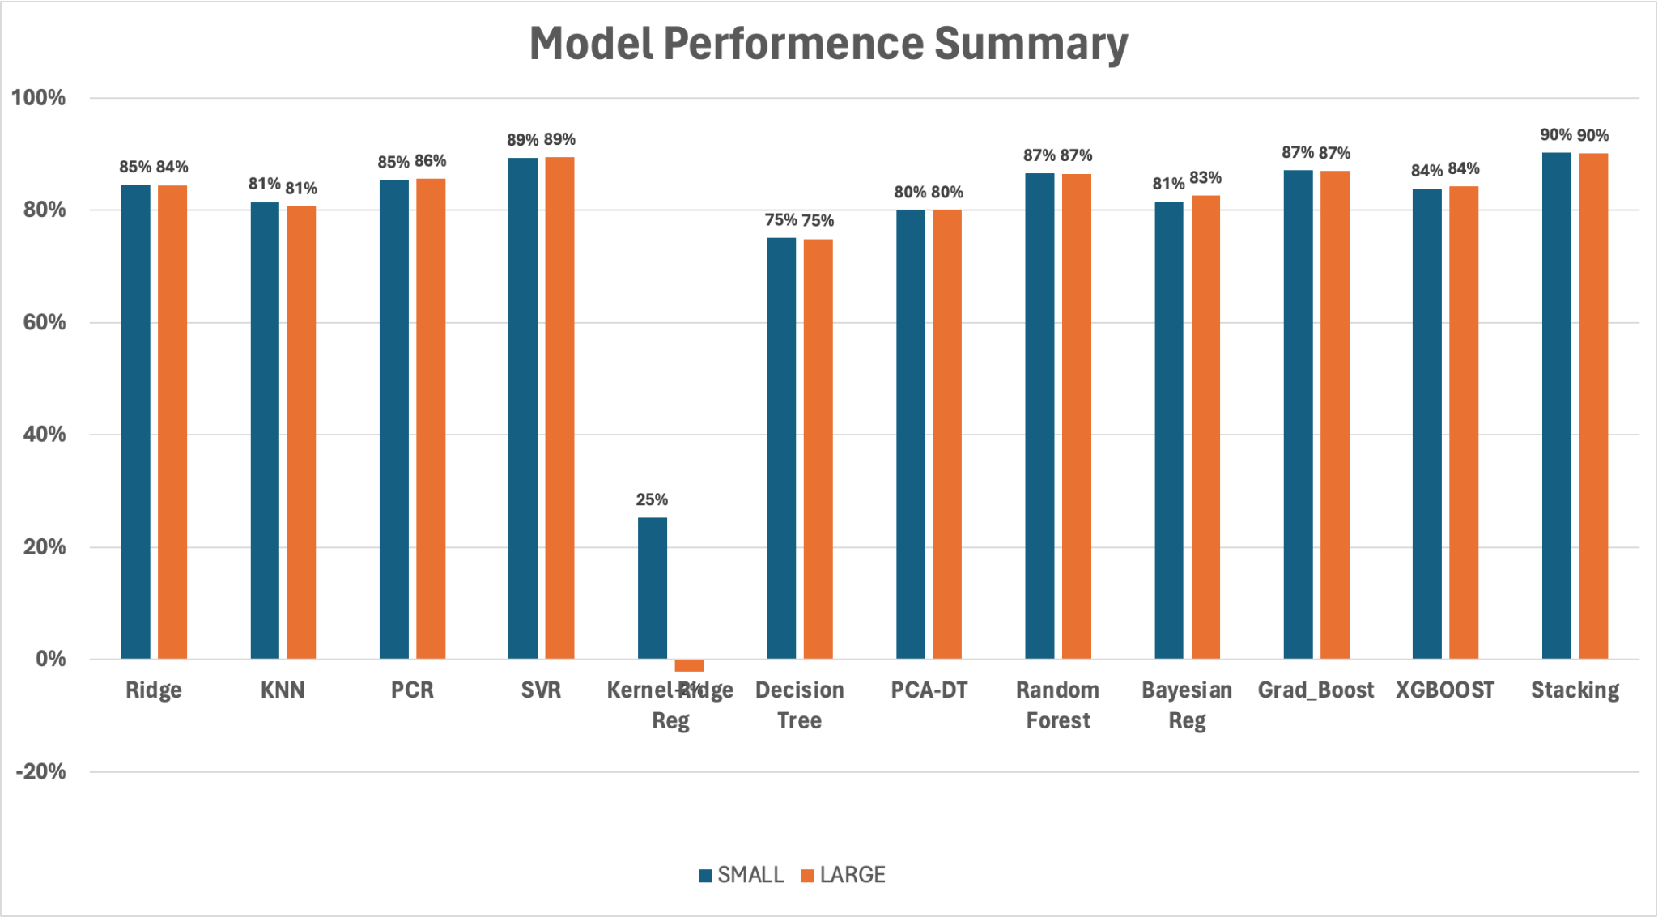
Models Performance Summary

Slide 25
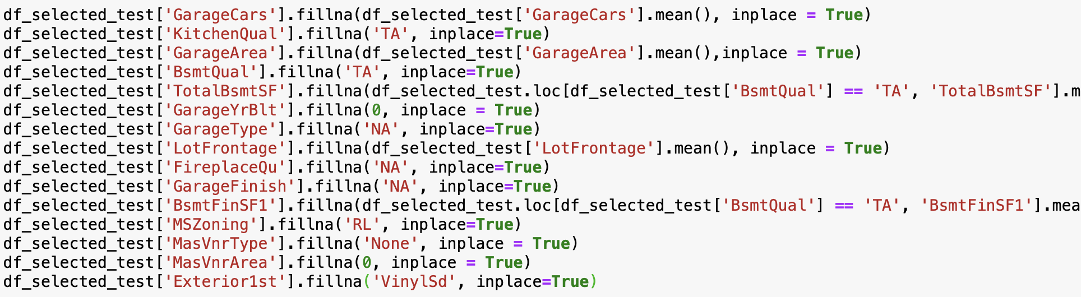
Testing Data Selection & Result
1. Select small features group as selected features (32 features)
'OverallQual', 'GrLivArea', 'GarageCars', 'ExterQual', 'KitchenQual', 'GarageArea', 'BsmtQual', 'FullBath', 'YearBuilt', 'TotalBsmtSF', 'GarageYrBlt', '1stFlrSF', 'GarageType', 'LotFrontage', 'Foundation', 'YearRemodAdd', 'FireplaceQu', 'TotRmsAbvGrd', 'GarageFinish',’'Fireplaces', 'HeatingQC', 'BsmtFinSF1', 'MSZoning', 'OverallCond, 'Neighborhood', '2ndFlrSF', 'MasVnrType', 'HalfBath', 'MasVnrArea', 'Exterior1st', 'LotArea', 'LotShape'
2.Data Cleaning: same logic with the training data.

Slide 26
Testing Data Selection & Result
3. Final Model Used (with the same pipeline structure)
SVR 0.15286
Random Forest 0.15594
Stacking(RF, SVR, Ridge) 0.16525
GradientBoostingRegressor 0.17069

Slide 27
Insight
Black Box: DIFFICULT to INTERPRETING.
SVR performance is even similar to advanced model like random forest.
Reason: Data Structure
(SalePrice is the continuous changing numbers rather than part by part)

