Slide 1
Global Food Price Analysis
Exploratory data analysis of 743,914 market price records using Python
Jessy VM
Notes:
Intro: this project is an EDA on a global food price dataset, done in a Jupyter notebook with Pandas and Matplotlib.

Slide 2
What I set out to do
2
1
Understand the data
Tools used
Check the size, columns, and structure of a large food price dataset
Python
Pandas
Matplotlib
Jupyter Notebook
2
Clean it
Find missing values and duplicates, and fix the gaps
3
Explore patterns
Get summary statistics and see how records are spread over the years

Slide 3
The dataset
3
743,914
18
321
1992–2017
records (rows)
columns
different commodities
years covered
What each record holds
Location: country, region (adm1_name), market
Commodity: name, unit of measure (e.g. KG), price type (Retail)
Price: mp_price with its currency, plus month and year
Source: e.g. WFP
Notes:
Loaded from Food_Prices.csv with latin1 encoding. Example records are Afghan bread prices in AFN and South Sudan fuel and sesame prices in SSP.

Slide 4
My workflow
4
1
2
3
Load CSV
Inspect shape and columns
Check missing and duplicates
4
5
6
Clean missing values
Summary statistics
Visualize

Slide 5
Data cleaning
5
Missing values found
What I did
13,949
Filled missing regions with "Unknown" instead of deleting rows
Re-checked: missing values dropped to 0 in every column
Checked duplicates with duplicated() and drop_duplicates()
empty values in adm1_name (region). All other 17 columns had zero.
Notes:
Keeping the rows with Unknown region means no price data is lost.

Slide 6
Price statistics (mp_price)
6
0
175
4,196
5,833,333
Lowest
Median
Average
Highest
What this tells us
The average (4,196) is far above the median (175), so a few huge values pull it up
Prices are recorded in 61 different currencies and units, so raw prices are not directly comparable
The zero prices and extreme maximum are worth checking as possible outliers

Slide 7
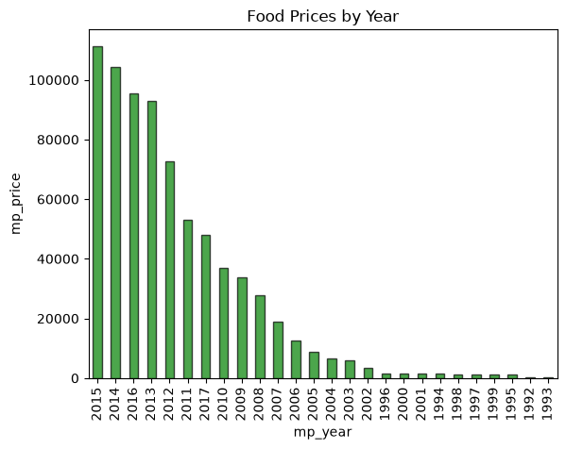
Records per year
7
What the chart shows
2015 has the most records (over 100,000)
2012 to 2016 hold the bulk of the data
Before 2003 there are very few records
2017 has noticeably fewer records than 2013 to 2016
Notes:
Bar chart of mp_year value counts, built with Matplotlib. It shows how many records exist per year.

Slide 8
Key takeaways
What I found
Future scope
Large dataset: 743,914 rows and 18 columns
Only one column had missing data, now fixed
Prices are heavily skewed by mixed currencies
Data is concentrated between 2012 and 2016
Convert prices to one currency (e.g. USD)
Handle outliers and zero prices
Track price trends for single commodities
Try price forecasting models

