Slide 1

JavaScript
Fundamentals
Week 1 – Full-time DPP Course

Slide 2
Welcome
Manuel Cubuca
Technical Trainer
Email: manuelc@justit.co.uk

Slide 3

Classroom Rules
There are no rules – we all adults
Just respect each other
Work together
Collaborate and create lasting friendships

Slide 4
Health & Safety
If you feel unwell please let me know
Info about the building
Careful with cables and drinks
Get breaks away from the screen
Make sure you comfortable

Slide 5
Class Structure
Start at 9:30am
Break in between (10-15 min)
Lunch break at 1pm (for an hour)
Break in between (10-15 min)
We finish at 4:30pm

Slide 6
Week 1 Overview
JavaScript and GitHub
The fundamentals of the JavaScript programming language. You will be using the GitHub account when building your small projects. You will also be introduced to Bootstrap framework to help you quickly and efficiently build responsive webpages.

Slide 7
Week 1 Overviewcont.
Our aim
At the end of this week it is anticipated you will have the knowledge and skills to independently write simple JavaScript programs and the knowledge to extend beyond this in the future.

Slide 8
Short history of JavaScript
For a detailed but short history of JavaScript click the button below to access the W3C website.
Also, have a look at JavaScript versioning links.
JavaScript versions (ECMAScript compatibility table)
Article about versions
JavaScript History

Slide 9








Why should I learn JavaScript
JavaScript is rapidly taking over as the programming language for the Web, with very popular JS Frameworks.
Have you heard about Apache Cordova?

Slide 10
Resources
Pluralsight video tutorials
JavaScript & jQuery – HTML5 & CSS3 (book)
W3 Schools
Mozilla Developer Network
Stack Overflow

Slide 11
My Approach
Learn how to walk before running!
Who is the only person that started running before learning how to walk?

Slide 12
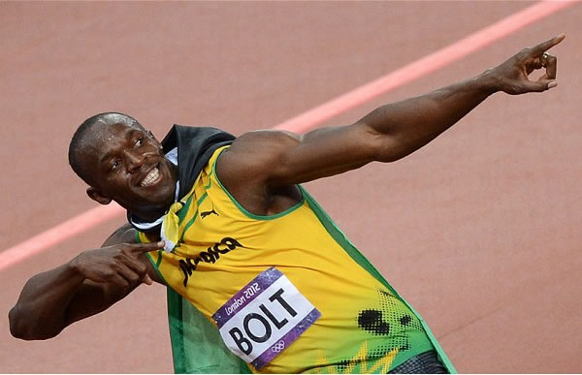
Usain Bolt

Slide 13
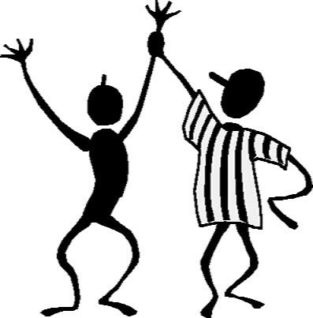
Practice and Practice…

Slide 14

The Queen’s Chair

Slide 15
Full-time DPP
Introductions
Tell me a little bit about yourself…

Slide 16
What’s JavaScript
A programming language to apply interactivity to web pages – JavaScript is the web programming language
Is an interpreted programming language (meaning it doesn’t need to be compiled such as Java or C)
JavaScript is executed on the client’s computer/browser (PHP or Ruby on Rails – they run on the server)
It’s also Object Based – an Object Oriented Programming language (but you don’t need to use it like that)

Slide 17
JavaScript is NOT Java!
Similar names but completely different programming languages.
Java is much more complex and considered a high level programming language.
Java is on the same category as C and C++
JavaScript is what we call a Scripting language (lightweight, programming language with first-class functions)

Slide 18
JavaScript Use
Insert content in an HTML webpage dynamically
Make Webpages responsive
Detected browser info
Validate forms
Create animations, scrollers, slideshows etc.
Build Apps with JavaScript Frameworks (AngularJS, ReactJS, BackboneJS, NodeJS (JavaScript server side technology)

Slide 19
To Run JavaScript
All the modern web browsers
Google Chrome
Mozilla Firefox (own JavaScript with Mozilla Developer Network)
Safire
Internet Explorer
To write JavaScript code all you need is a text editor and give the file a .js extension to save it as a JavaScript file.
Utilise FREE online JavaScript editors like JS Fiddle
Use text editors such as Notepad++, Sublime Text, Brackets, Textmate (for Mac), etc.)

Slide 20
JavaScript Course Overview
Variables
Operators
Data Types
Arrays
Functions
Decisions & Loops
Scope
Program Flow
DOM
Events
Objects
Prototypes
JavaScript OOP
JSON & Ajax
API’s
Assessment

Slide 21
Part 1 Learning Material
JavaScript Syntax
What are Variables?
JavaScript Range of Operators
The concept of Data Types
What is an Array?
Functions and Methods
The Conditions and Loops Concepts
JavaScript Scope
JavaScript Coding Sequence

Slide 22
Part 1 Learning Objectives
Learners would have a good understanding of:
How JavaScript programs are constructed
How to assign variables and distinguish data types
Familiarity with JavaScript operators
Manipulate the special variable array and its methods
The application of functions and methods
Local and global variables
Sequence, Selection and Iteration

Slide 23
JavaScript First Exercise
Collect 2 number values from a user and display the larger of those numbers on the webpage.
WHAT DO YOU KNOW ABOUT JAVASCRIPT?

Slide 24
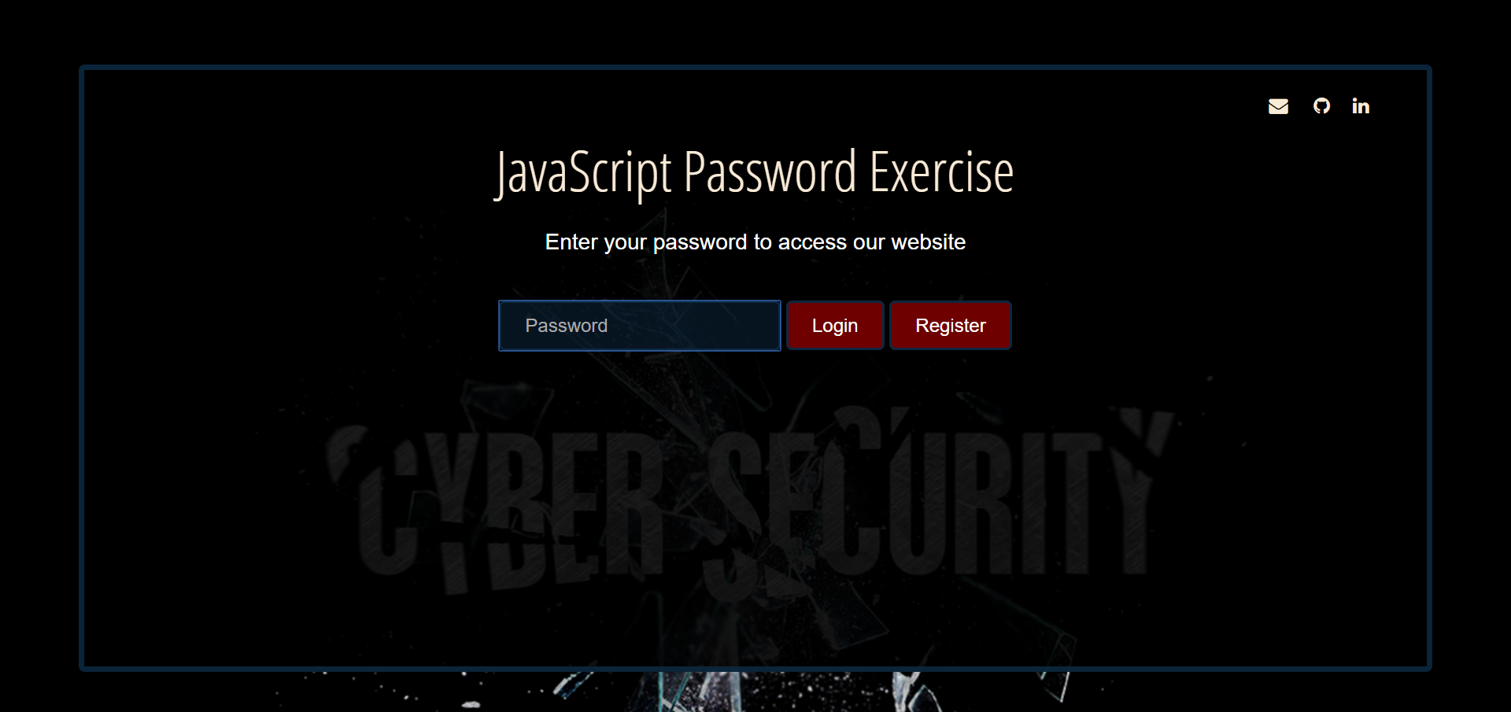
JavaScript Password Exercise
Hands on training

Slide 25
What’s the DOM
The Document Object Model
But what’s it? A language, is it part of JavaScript
Is an application programming interface (API) for valid HTML and well-formed XML documents…
It really doesn’t help much
So let’s take it piece by piece

Slide 26
What’s the Document
Simple means the page, not the website but the webpage
Can be represented in different way, that means the HTML source code and the browser display or view of the webpage.
These two representations are the webpage is what we mean by document.

Slide 27
What are the Objects
Object is just a thing, anything that can be treated as an individual piece
The elements, the components the individual pieces of this document.
Therefore we will have a JavaScript term for every piece or every object at whatever level it makes sense, from the entire document to the smallest piece.

Slide 28
What’s the Model
Is the diagram structure of the document
Take any HTML document and represent it as a tree structure.
Then how do you call the pieces of the structure and how do we describe the relationship between them?

Slide 29
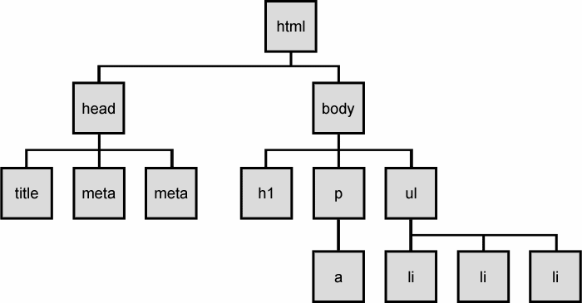
What’s the Model cont.

Slide 30
What’s the Model cont.
The model is a set of terms we can agree on, basically set of Standards
Agreed-upon set of terms that describes exactly how to interact with the pieces of a webpage.
This set of STANDARDS we call it the DOM, so the agreed terms allows JavaScript to interact and navigate within any webpage.

Slide 31
Nodes and Elements
There are 12 nodes type on the DOM
We have different kind of nodes such as body tag, comments, attributes even simple text.
But we really interested in 3: Element, Attributes and Text.

Slide 32
Nodes and Elements cont.
<ul id=“optionList”>
<li>This is the first option</li>
<li>This is the second option</li>
<li>This is the third option</li>
</ul>

Slide 33
How to get an Element Node
How to write JavaScript to get access to one of this nodes?
The main question to ask is the node UNIQUE?
Is the element you are after is unique in the document, that means it has an id.
Then you can grab it in JavaScript with the most important method of the DOM.

Slide 34
Accessing Elements
Methods that return a single element node:
document.getElementById(“someId”);
var myElement = document.getElementById(“abc”);
document.querySelector(“css selector”);
var myElement = document.querySelector(“li.myList”);

Slide 35
Accessing Elements cont.
Methods that return one or more elements (as a nodelist):
document.getElementsByClassName (“class”);
var myElement = document.getElementsByClassName(“abc”);
document.getElementsByTagName(“a”);
var myListItems = document.getElementsByTagName(“li”);
document.querySelectorsAll(“css slector”);
var myListItems = document.querySelectorsAll(“li.myList”);

Slide 36
Events and Event Listeners
Events are already happening, they been happening all along:
When a user clicks a button
When the page loads
When the move they mouse
Click a form field
Scroll the screen
A keypress

Slide 37
Event Names
onload
onclick
onmouseover
onblur
onfocus
Function pageLoaded () {
// write a function to listen to // the event
}

Slide 38
Handling Events
Method 1
myElement.onclick = function() { // unanimous function
// your event handler code
// later on when the user clicks then do something
} ; // the semicolon is because is a statement
Method 2
document.addEventListener(‘click’, myFunction, false);
// click rather than onclick, can add listener to multiple events.

Slide 39
What is JSON
JSON stands for JavaScript Object Notation
THE MOST POPULAR DATA TYPE ON THE WEB
The JSON syntax is very similar to JavaScript object notation but it is not an object.
JSON format is just plain text often used to send data from a server to a web page
JSON is a format for sending, receiving and storing data
JSON is language independent, code to read and generate JSON data can be written in any language

Slide 40
What is JSON cont.
{
"data":[
{
"car":"Mercedes",
"driver":"Lewis",
"wins":2
},
{
"circuit":"Monaco",
"pointsystem":[
{
"firstplace":25,
"secondplace":18,
"thirdplace":15
}
],
"teams":11
}
]
}
Example of a JSON file
You should avoid using functions in JSON, the functions will lose their scope, and you would have to use eval() to convert them back into functions

Slide 41
JSON data types
a string
a number
JSON object
an array
a boolean
null
JSON values cannot be one of the following data types:
a function
a date
undefined

Slide 42
JSON build-in functions
JSON.parse()
Used to convert any JSON received from the server into JavaScript objects.
JSON.stringify()
Used to convert any JavaScript object into JSON format, and send JSON to the server.

Slide 43
JSONP
JSONP stands for JSON with Padding.
Cross-domain policy can cause issues when requesting data from another domain
Requesting an external script from another domain does not have this issue.
JSONP uses this advantage, and request files using the script tag instead of the XMLHttpRequest object.
<script src="demo_jsonp.php">

Slide 44
Callback Function
When you have no control over the server file, how do you get the server file to call the correct function?
Sometimes the server file offers a callback function as a parameter:
function clickButton() { var s = document.createElement("script"); s.src = "jsonp_demo_db.php?callback=myDisplayFunction"; document.body.appendChild(s); }

Slide 45
JSON resources
JSON Formatter and Validator
JSON Formatter Chrome Add-on
Find JSON files online also GitHub public repositories
Now let’s practice

Slide 46
GitHub Account
https://github.com/biatoSalo
Enter the URL above in your browser window to access the course material.
Open the Training repository and download the passwordLearner folder.

