Slide 1


Green Pace
Security Policy Presentation
Developer: Jester Cruz
CS 405 | Project Two
Notes:
Hi, I'm Jester Cruz. Here's Green Pace's security policy and how we tested one of its key coding standards.

Slide 2

OVERVIEW: DEFENSE IN DEPTH
Layered prevention + detection + response
Why standardize?
• Shared rules as Green Pace grows
• Repeatable reviews and testing
• Fewer coding and design gaps
• Attack surface: Inputs, databases, memory operations, and external interfaces.
• Assume vulnerabilities exist: Apply multiple controls to prevent, detect, and contain attacks.
Notes:
As Green Pace grows, shared rules prevent inconsistent security choices. Our attack surface includes inputs, databases, memory, and external interfaces. Assuming vulnerabilities may exist, defense in depth combines secure code, testing, monitoring, and response.

Slide 3
THREATS MATRIX
Risk grouping
Likely STD-002, STD-003, STD-004, STD-005, STD-006, STD-007, STD-008, STD-009, STD-010 | Priority STD-004 and STD-005
Low priority None | Unlikely STD-001
10 secure coding standards
9 likely
2 priority
1 unlikely
No Standards rated Low Priority. STD-001 has the lowest thread level (2).
Notes:
Our ten standards include nine likely risks and one unlikely risk, STD-001. None are low priority. SQL injection, STD-004, and use-after-free, STD-005, are the highest risks at level five. The priority box highlights those two.

Slide 4
10 PRINCIPLES
1. Validate Input Data
6. Least Privilege
Mapped: 001, 002, 003, 004, 008
No direct STD mapping*
2. Heed Compiler Warnings
7. Sanitize for Other Systems
No direct STD mapping*
Mapped: 004
3. Architect for Security
8. Practice Defense in Depth
No direct STD mapping*
Mapped: 002–010
4. Keep It Simple
9. Effective Quality Assurance
Mapped: 003, 005, 006, 007, 009, 010
Mapped: 001–010
5. Default Deny
10. Adopt Secure Coding Standard
No direct STD mapping*
Mapped: 001–010
Principles 2, 3, 5, and 6 are supported through development practices, system architecture, and access-control policies. Additional coding standards may strengthen their implementation.
Notes:
Our ten principles cover input validation, compiler warnings, secure design, simplicity, default deny, least privilege, sanitization, defense in depth, quality assurance, and secure standards. This slide shows which standards support each. Four principles lack a direct coding-standard mapping, although other policy practices support them.

Slide 5
CODING STANDARDS
1. STD-004 SQL injection
6. STD-009 Object lifetime
Level 5
Level 4
2. STD-005 Use-after-free
7. STD-010 Resource cleanup
Level 5
Level 4
3. STD-002 Signed overflow
8. STD-006 Assertion side effects
Level 4
Level 3
4. STD-003 String buffer safety
9. STD-007 Catch by reference
Level 4
Level 3
5. STD-008 Container bounds
10. STD-001 Enumeration casting
Level 4
Level 2
Ordering: Project One threat level first; direct exploitability and business impact resolve ties.
Notes:
We rank standards by threat level. SQL injection and use-after-free are level five. Level four covers integer overflow, strings, container bounds, object lifetime, and resource cleanup. Assertion side effects and exception handling are level three; enumeration casting is level two. High-impact risks come first.

Slide 6
ENCRYPTION POLICIES
AT REST
IN FLIGHT
IN USE
Encrypt sensitive stored files, databases and backups.
Restrict key access and separate keys from protected data.
Use TLS for connections handling sensitive or authenticated traffic.
Protect information crossing systems and trust boundaries.
Limit sensitive information in memory, protect processes and restrict access.
Use platform protections when practical.
Encryption is one layer—not a replacement for authorization, testing or monitoring.
Notes:
At rest, we encrypt sensitive files, databases, and backups, keeping encryption keys protected. In flight, TLS secures network traffic. In use, we restrict access to processes and minimize exposed data. Encryption works alongside testing and access controls.

Slide 7
TRIPLE-A POLICIES
AUTHENTICATION
AUTHORIZATION
ACCOUNTING
Verify who is requesting access.
Require approved logins and secure authentication for services and administrative actions.
Define what each identity can do.
Apply least privilege to files, databases, user creation and sensitive changes.
Record what happened and when.
Log sign-ins, permission changes, database edits and access to sensitive files.
Triple-A turns identity, access restrictions and auditable evidence into repeatable controls.
Notes:
Triple-A means authentication, authorization, and accounting. Authentication verifies identity. Authorization enforces least privilege. Accounting logs sign-ins, permission changes, database edits, and sensitive file access so unusual activity can be investigated.

Slide 8
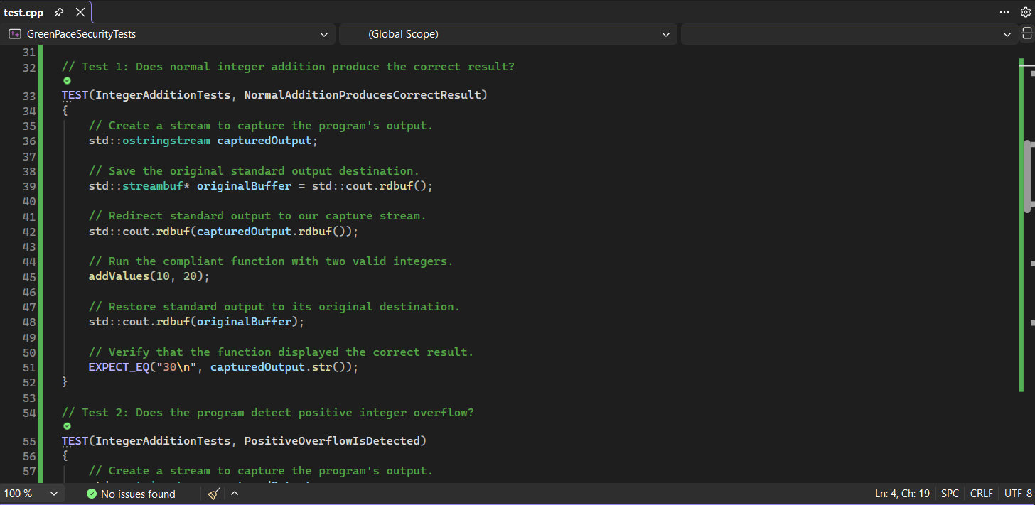
Unit Testing
Does normal addition produce the correct result?
STD-002-CPP · GoogleTest · source test evidence
TEST 1
Input: addValues(10, 20)
Expected: 30
Noncompliant: PASS
Compliant: PASS
Next: test zero, mixed signs and multiple small values.
Notes:
For this demonstration, we focused on STD-002-CPP, which requires developers to prevent signed integer overflow and underflow. We used GoogleTest to compare compliant and noncompliant C++ code. Our first test checks whether ten plus twenty equals thirty. Both versions passed, showing that normal addition works correctly. In the future, we could expand this test to include zero and mixed-sign inputs.

Slide 9
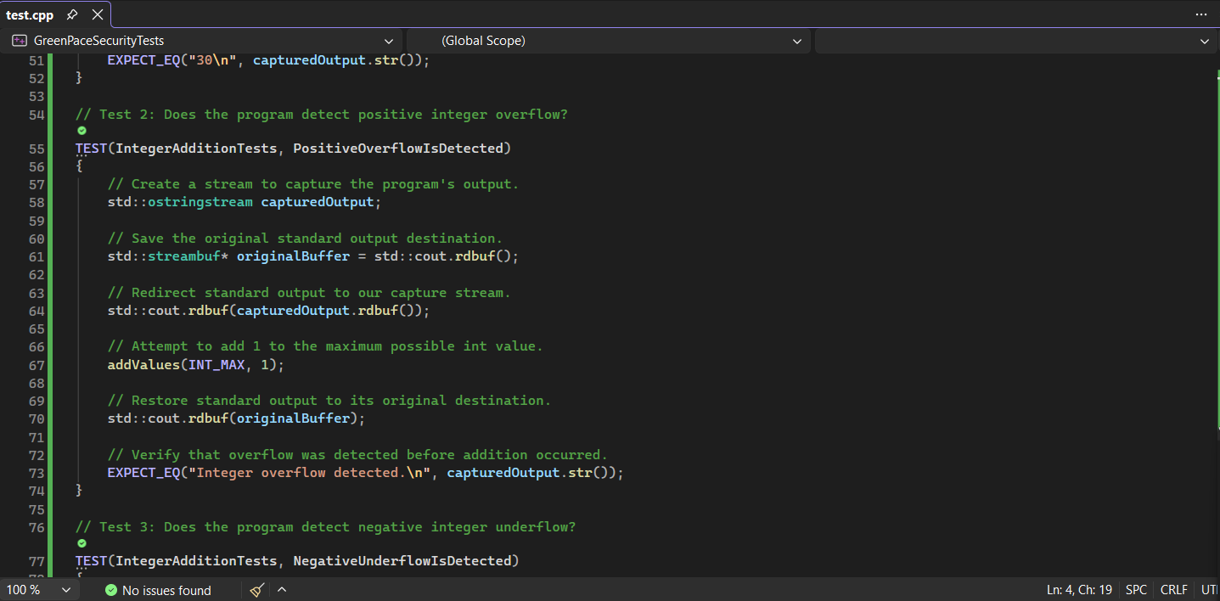
Unit Testing
Does the program detect positive integer overflow?
STD-002-CPP · GoogleTest · source test evidence
TEST 2
Input: addValues(INT_MAX, 1)
Expected: overflow warning
Noncompliant: FAIL
Compliant: PASS
Observed unsafe output: −2147483648
Next: add more upper-bound values and use Clang UBSan.
Notes:
Test two attempts INT_MAX plus one. Secure code must warn instead of adding. The vulnerable function failed and printed a negative number in our run; the corrected version passed. Additional boundary tests and UBSan could strengthen detection.

Slide 10
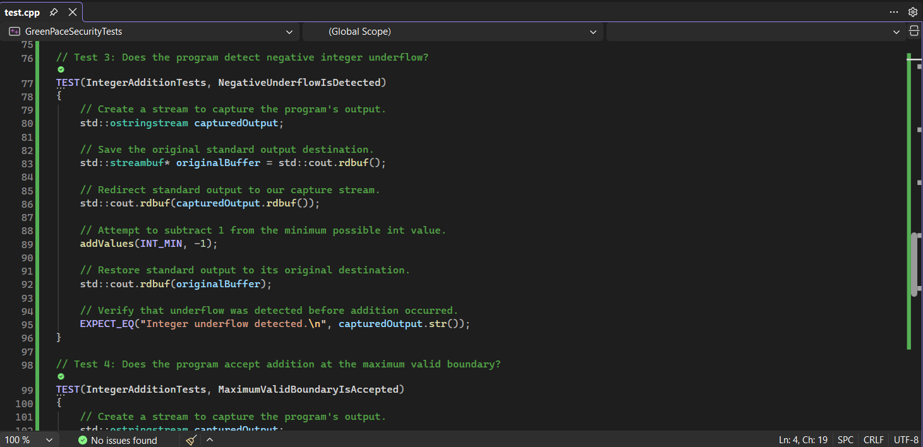
Unit Testing
Does the program detect negative integer underflow?
STD-002-CPP · GoogleTest · source test evidence
TEST 3
Input: addValues(INT_MIN, -1)
Expected: underflow warning
Noncompliant: FAIL
Compliant: PASS
Next: test negative boundaries and run in CI.
Notes:
Test three attempts INT_MIN minus one. The vulnerable version failed to warn about underflow, while the corrected version passed. Next, we'd add more negative boundary cases to continuous integration.

Slide 11
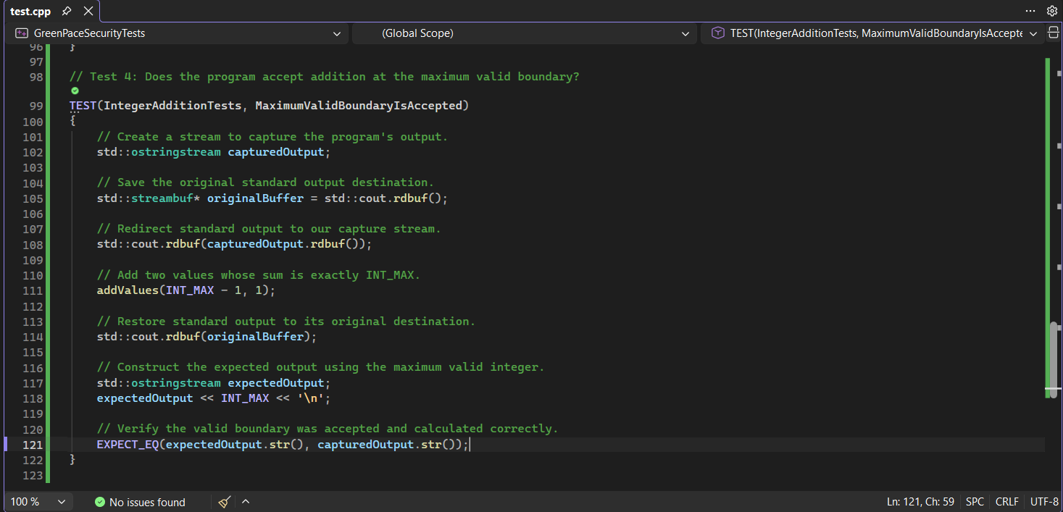
Unit Testing
Does the program accept the maximum valid boundary?
STD-002-CPP · GoogleTest · source test evidence
TEST 4
Input: addValues(INT_MAX - 1, 1)
Expected: exactly INT_MAX
Noncompliant: PASS
Compliant: PASS
Next: test the exact INT_MIN boundary too.
Notes:
Test four checks the exact maximum valid result: INT_MAX minus one, plus one. Both implementations passed. That matters because security checks must still allow valid inputs. We could also test INT_MIN.

Slide 12
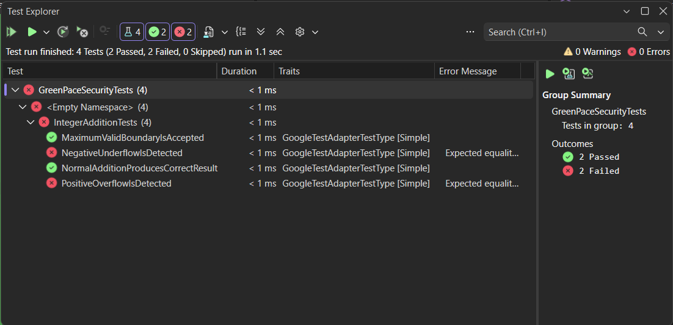
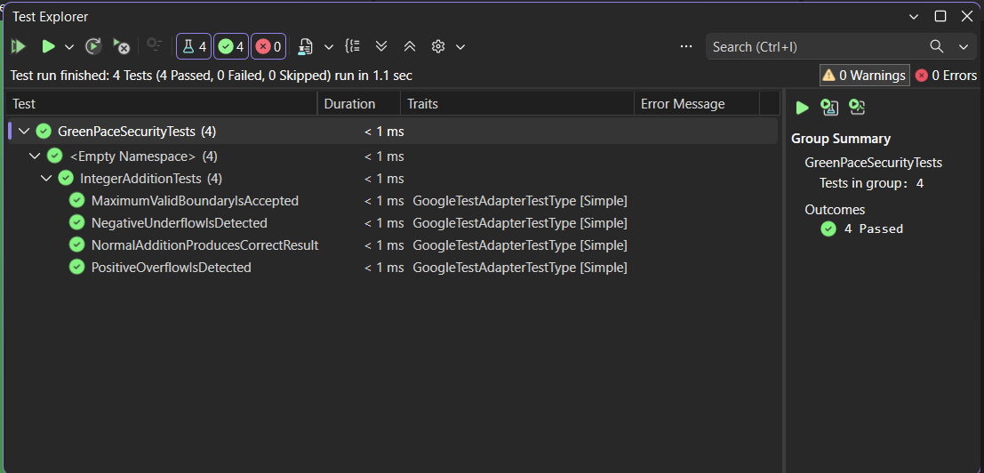
TEST EVIDENCE: BEFORE AND AFTER
NONCOMPLIANT TEST RESULTS
COMPLIANT TEST RESULTS
2 passed, 2 failed
4 passed, 0 failed
Failure detail: expected overflow warning, but observed −2147483648 in this Visual Studio run.
Notes:
The actual Test Explorer results show two passes and two failures for the vulnerable implementation. After restoring the guards, all four passed. This confirms the tests can identify missing protection and verify a fix, although tests can't prove complete security.

Slide 13

AUTOMATION SUMMARY
Policy checks run at every stage—not only at release.
Notes:
Security checks belong throughout DevSecOps. Compiler diagnostics and static scans run during coding and builds. GoogleTest and sanitizers run during verification. Integration tests follow before release. High-risk findings should block deployment and remain documented.

Slide 14
TOOLS
CREATE + BUILD
VERIFY
Compiler diagnostics; Clang-Tidy; Clang Static Analyzer; CodeQL.
GoogleTest behavioral and boundary tests; ASan; Clang UBSan.
PRE-PRODUCTION
PROMOTE + MONITOR
Integration, malicious-input and sanitizer-enabled test suites.
Block high-priority failures; preserve reports; review audit logs.
GoogleTest was demonstrated here; other listed analyzers are recommended automated pipeline controls.
Notes:
GoogleTest verifies expected behavior, and we ran it here. Clang-Tidy, Clang Static Analyzer, and CodeQL can inspect source code. AddressSanitizer identifies memory errors; UBSan helps detect undefined arithmetic. Those other tools are recommendations, not tests we ran.

Slide 15
RISKS AND BENEFITS
SQL INJECTION · LEVEL 5
USE-AFTER-FREE · LEVEL 5
TEST AUTOMATION
Act now: use parameterized queries and scan SQL flows.
Wait: potential unauthorized queries, data exposure and greater cleanup cost.
Act now: enforce object lifetime rules and sanitizer tests.
Wait: crashes, undefined behavior and possible exploit paths.
Act now: add repeatable tests and CI checks.
Wait: regressions can persist until release; setup does require time.
Residual risk remains: tests cannot prove the absence of every vulnerability.
Notes:
Fixing SQL injection and use-after-free early reduces the risk of data exposure and crashes. Waiting can make remediation more expensive. Automated checks take setup time, but prevent avoidable regressions. No single tool catches everything.

Slide 16
RECOMMENDATIONS
POLICY GAPS
NEXT IMPROVEMENTS
No explicit STD mapping yet for compiler warnings, secure architecture, default deny or least privilege.
Dependency and supply-chain controls also need coverage.
Create enforceable standards for those areas.
Add threat modeling, SAST, dependency scanning and CI gates.
Use NIST SSDF and OWASP ASVS as guidance.
Evidence-supported recommendations: NIST SP 800-218 (2022); OWASP ASVS 5.0 (2025).
Notes:
Current gaps include stronger rules for compiler warnings, architecture, default deny, and least privilege. We should add threat modeling and dependency scanning. NIST's Secure Software Development Framework and OWASP's verification standard provide guidance for these improvements.

Slide 17
CONCLUSIONS
STANDARDIZE: A repeatable policy gives the development team shared expectations.
DETECT: Overflow and underflow tests exposed missing security protections in the noncompliant code.
REMEDIATE: The same four tests passed after restoring the compliant function.
IMPROVE: Integrate SSDF/ASVS-informed updates and continuous security review.
Security is maintained throughout development—not added at the end.
Notes:
To conclude, consistent rules and early testing help Green Pace catch problems before release. Our two failing security tests showed the missing safeguards; rerunning all four verified the correction. Continuous review keeps the policy useful.

Slide 18
REFERENCES
Ballman, A. (2017). SEI CERT C++ coding standard (2016 ed.). Carnegie Mellon University.
Software Engineering Institute. (2016). SEI CERT C coding standard. Carnegie Mellon University.
Software Engineering Institute. (n.d.). STR02-C: Sanitize data passed to complex subsystems. https://cmu-sei.github.io/secure-coding-standards/
Souppaya, M., Scarfone, K., & Dodson, D. (2022). Secure Software Development Framework (NIST SP 800-218). https://doi.org/10.6028/NIST.SP.800-218
OWASP Foundation. (2025). OWASP Application Security Verification Standard (Version 5.0.0). https://github.com/OWASP/ASVS/releases
GoogleTest. (n.d.). GoogleTest primer. https://google.github.io/googletest/primer.html
Green Pace. (2026). Secure development policy.
Notes:
The sources are listed here. Thanks for listening.

