Slide 1

Ai in big 4’s
Submitted By:
Jestin John

Slide 2
introduction
In an era of escalating financial risks and regulatory scrutiny, the Big 4 firms Deloitte, PwC, EY, KPMG are turning to Artificial Intelligence (AI) to transform audit compliance, fraud detection, and risk management.
This project leverages real-world data to uncover how AI adoption impacts audit effectiveness, employee satisfaction, and financial outcomes.
This study utilizes data from the” Big 4 Financial Risk & Compliance dataset”, integrating AI-driven audit analytics, risk assessment, and compliance tracking into an interactive Power BI dashboard. By analyzing patterns such as high-risk case frequency, fraud detection rates, revenue impact, and AI adoption trends, this project aims to provide actionable insights that enhance proactive risk management and regulatory compliance.
Through visualizations Clustered column chart ,stacked area chart , pie chart the dashboard empower decision-makers to monitor well-being in real time and make data-informed interventions .which help audit partners, compliance officers, and corporate decision-makers to monitor risk exposure in real time and make data-driven interventions

Slide 3
objective
Track and analyze: financial risk and compliance metrics across Big 4 firms (Deloitte, PwC, EY, KPMG)
Monitor trends: in high-risk cases, fraud incidents, and compliance violations (2020-2025)
Evaluate effectiveness: of AI adoption in auditing processes
Compare performance :between firms and industries Healthcare, Finance, Tech, Retail
Identify risk patterns :to improve audit strategies and resource allocation
Support data-driven decisions: for compliance and fraud prevention
Benchmark revenue impact: of audit engagements
Provide actionable insights: through interactive visualizations
Key Features

Slide 4
Who Can Use This Dashboard
Big 4 leadership :strategic planning, performance tracking
Audit & compliance teams :risk assessment, process improvement
Regulatory bodies :oversight, policy adjustments
Corporate clients :vendor selection, risk evaluation
Data analysts & researchers: trend analysis, predictive modeling

Slide 5
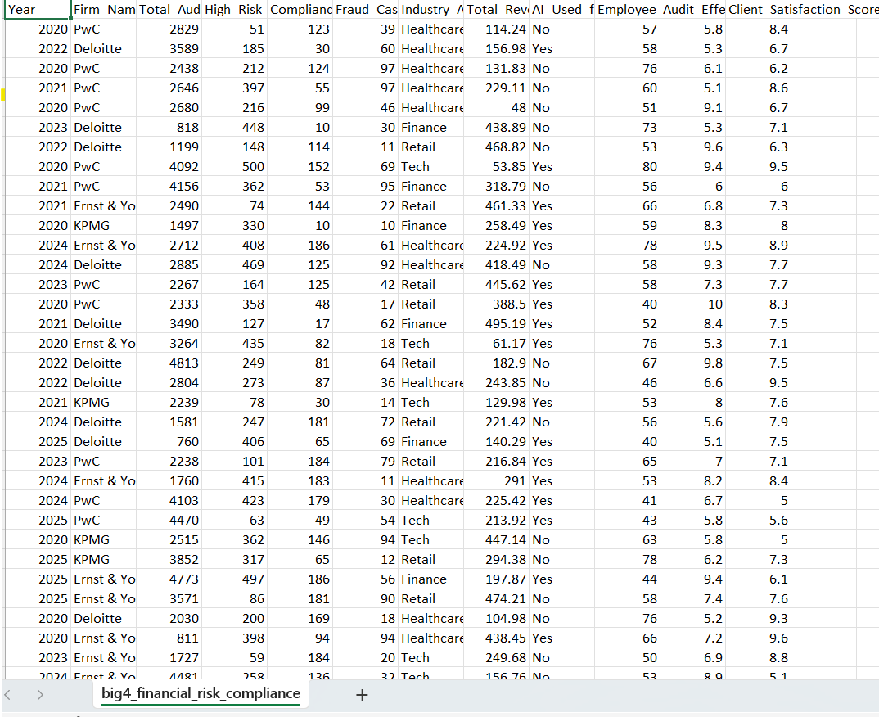
dataset

Slide 6
Key details
Year–The year the audit data was recorded 2020 to 2025.
Firm Name– The Big 4 firm PwC, Deloitte, Ernst & Young, KPMG
Z
Total Audit Engagements – Total number of audits conducted.
High Risk Cases– Number of high-risk audit cases.
Compliance Violations – Count of compliance violations found.
Fraud Cases Detected – Number of fraud cases uncovered.
Industry Affected – Industry sector Healthcare, Finance, Retail, Tech.
Total Revenue Impact – Financial impact of audits (in $ millions).
AI Used for Auditing – Whether AI was used (Yes/No).
Employee Workload – Measure of employee workload (likely a score or hours).
Audit Effectiveness Score – Rating of audit quality ( 1-10).
-Client Satisfaction Score – Client feedback score (1-10).

Slide 7
Criteria used
Average workload of employees - - Clustered column chart
Sum of High Risk Cases, Sum of Compliance Violations and Sum of Fraud Cases by firm - Clustered column chart
Revenue Impact - Table
Sum of High Risk Cases, Sum of Compliance Violations and Sum of Fraud Cases by Year –Scattered Area Chart
Industry having fraud case - Pie chart
Audit Engagement -Card

Slide 8
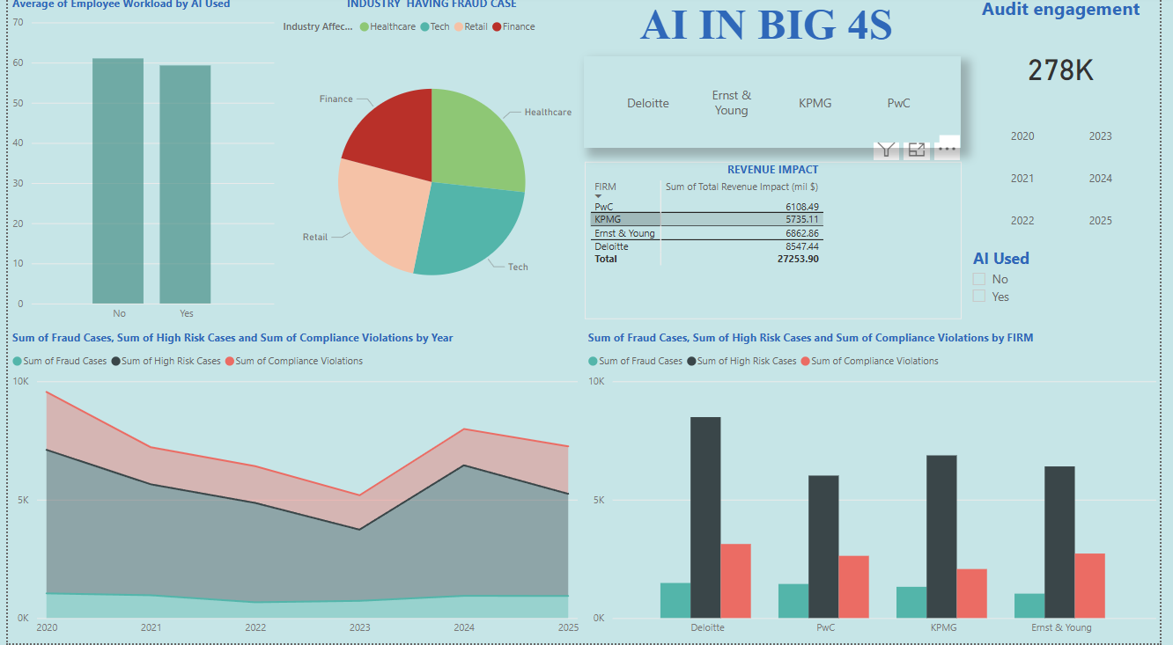
dashboard

Slide 9
conclusion
Study highlights how data visualization and interactive dashboards can turn complex audit and compliance data into actionable intelligence for the Big 4 firms. By leveraging Power BI, stakeholders can:
With monitoring risk exposure in real-time through trends in high-risk cases, fraud detection, and compliance violations found that increase of high risk case and fraud cases while using AI
By Comparing performance across firms, industries, and years found that each firm have industry dominance in one industry.
By evaluating AI’s impact on audit effectiveness, efficiency, and client satisfaction introducing of ai brings a positive change.
Employee workload has decreased of majority of firms while using AI.
Audit outcomes outcome has increased in fraud detection and high risk case also decrease in compliance while using AI .
Clients are more satisfied after the AI in Consulting
Efficiency of firm and employee increased after the ai
Influence of Human is needed to find Compliance violation

Slide 10
suggestions
Implementing AI will increase the efficiency of firm and employees
Try to increase investment in HR and AI in PwC
Implementing AI will increase client satisfaction
Implementing AI will decrease finding compliance violation
Consult firms which have large market share because the tend to find more efficiency than other form on that particular industry

Slide 11
THANK
YOU

