Slide 1

Guide to Network Security First Edition
Chapter Four
Firewall Technologies and Administration

Slide 2
Objectives
Describe what a firewall does
Explain how a firewall restricts access to a network
List the types of firewall protection as well as the types of firewall implementations and the ways they are used
Describe how firewall rules are created and how they are used to control the behavior of the firewall
Explain how intrusion detection and prevention systems are related and how they may be made to interact with one another

Slide 3
Introduction
Firewall
Combination of hardware and software components
Firewall security tasks
Restrict traffic between networks
Provide a checkpoint
Record network activity

Slide 4
Firewall Overview
Firewall functions
Enable authorized traffic to pass through
Block unauthorized traffic
Firewalls filter packets of digital information as they attempt to pass through network boundary

Slide 5
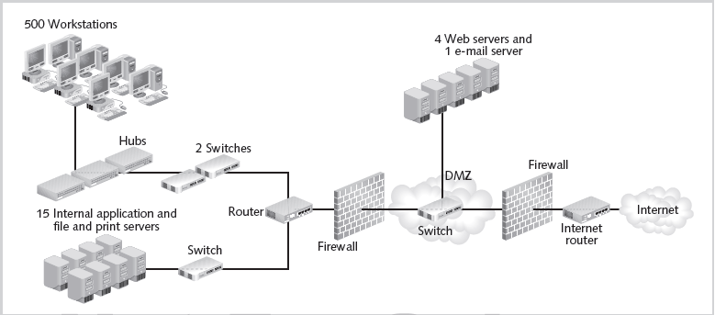
Figure 4-1 General firewall architecture
© Cengage Learning 2013

Slide 6
Firewall Overview (cont’d.)
Firewall advanced features
Scanning for viruses
Repairing infected files
Sending alert messages
Providing a VPN link
Authenticating users
Shielding hosts inside the network
Caching data
Filtering content

Slide 7
Firewall Uses
Major firewall applications
Protects a system
Prevent viruses and Trojan horses from entering a system
Alert user when attachment containing a virus is found
Restricts access to the network
Perimeter: boundary between two zones of trust
Common to install a firewall at the perimeter

Slide 8
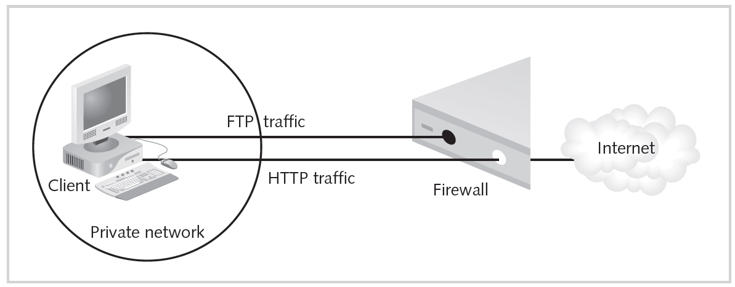
Figure 4-2 Firewall at the perimeter
© Cengage Learning 2013

Slide 9
Firewall Uses (cont’d.)
Major firewall applications (cont’d.)
Extends the network
Extranet: extended network sharing part of an organization’s network with a third party
Firewall an ideal endpoint for virtual private network
Most secure configuration shown in Figure 4-3

Slide 10
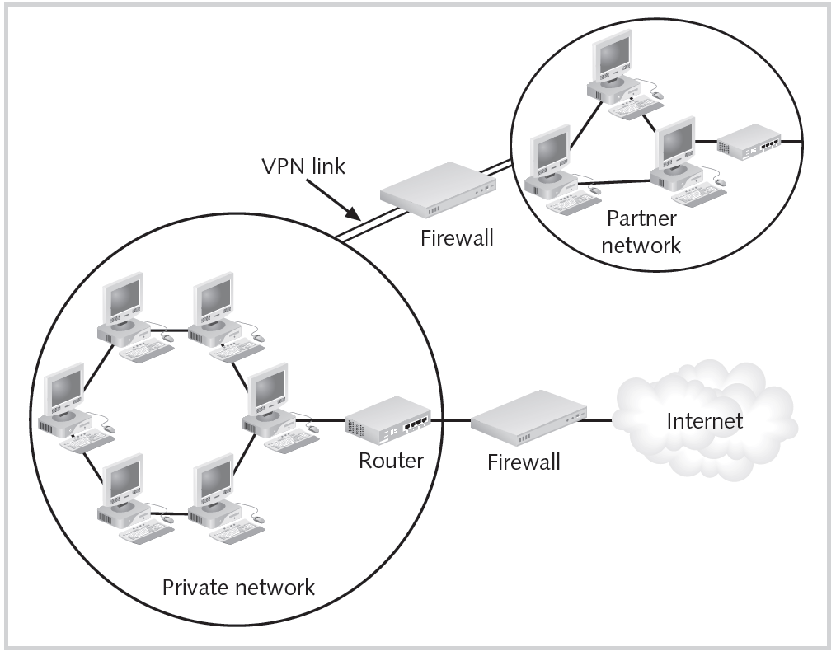
Figure 4-3 VPN perimeters
© Cengage Learning 2013

Slide 11
Firewall Uses (cont’d.)
Major firewall applications (cont’d.)
Prevents malicious traffic from leaving the network
Users could visit malicious Web site and install malware
Malware can attack other organizations from inside network
Provides more precise control for employees using external resources

Slide 12
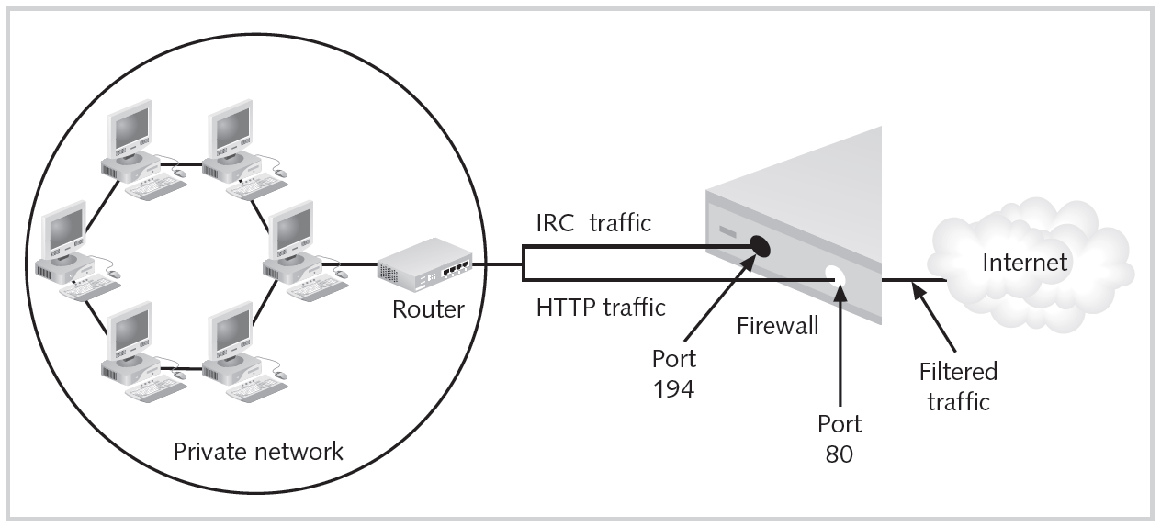
Figure 4-4 Outbound packet filtering
© Cengage Learning 2013

Slide 13
Firewall Uses (cont’d.)
Major firewall applications (cont’d.)
Protects critical resources
Firewalls segment networks within an organization
Different types of servers separated by firewalls
Enables an audit trail
Log files record attempted intrusions
Review log files regularly
Provides authentication
Authentication process can be performed at the firewall
Protect credentials using encryption

Slide 14
How do Firewalls Work?
Firewalls perform two basic security functions
Packet filter
Application proxy

Slide 15
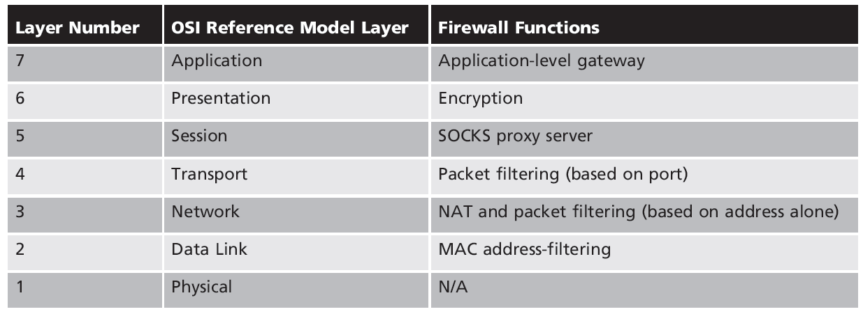
Table 4-1 Network layers and firewalls
© Cengage Learning 2013

Slide 16
Protocols
Internet Protocol (IP)
Rules control overall flow of IP traffic through a network
Internet Control Message Protocol (ICMP)
Used to report transmission errors
User Datagram Protocol (UDP)
Handles message addressing
Transmission Control Protocol (TCP)
Provides connections for error checking
Enables assurance of transmission success

Slide 17
Ports
Network subaddress
Number between zero and 65,535
Well-known ports (1023 and below)
Used for common services
Ephemeral ports (1024 through 65,535)
Dynamically assigned as needed
No special meaning outside the connection using them

Slide 18
Packet-Filtering Firewalls
Packet filtering: key function of any firewall
Types of information in the frame and the packet
Header
Data
Trailer (footer)
Packet-filtering firewall functions at the IP level
Determines whether to reject, drop, or allow a packet
Uses set of rules programmed into the firewall

Slide 19
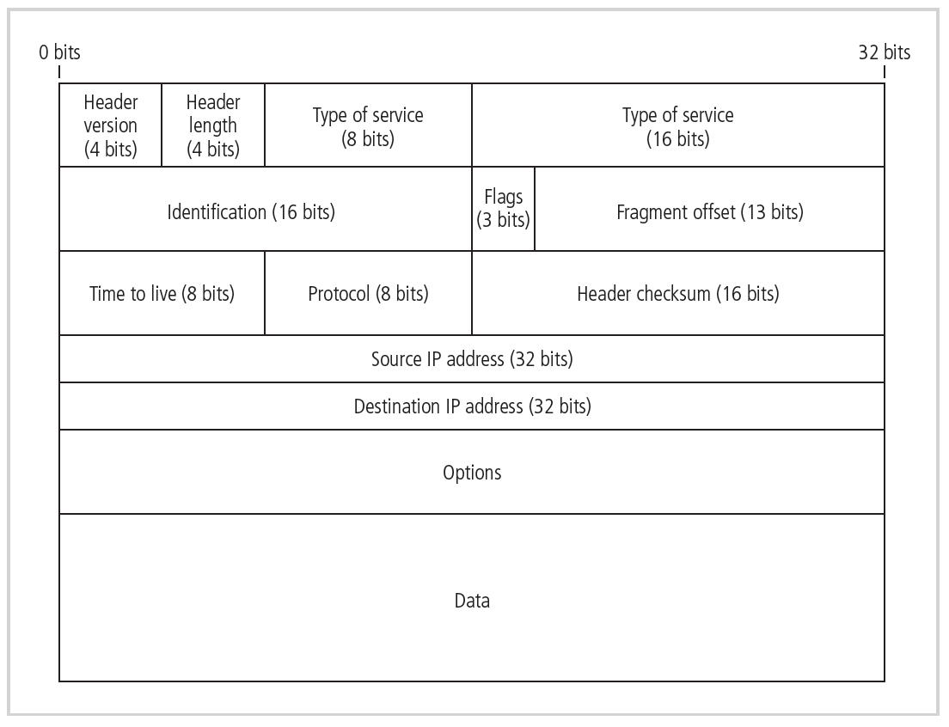
Figure 4-5 IPv4 packet structure
© Cengage Learning 2013

Slide 20
Packet-Filtering Firewalls (cont’d.)
Packet-filtering rules
Simple models examine destination and source address
Enforce address restrictions as defined in ACLs
Rule specifies protocol, address or range, and desired firewall action
Rules are executed in order
Later rules can override a previous rule
Best practice: start with rule to drop all incoming traffic
Notes:
An access control list (ACL) is a table that tells a computer operating system which access rights each user has to a particular application.

Slide 21
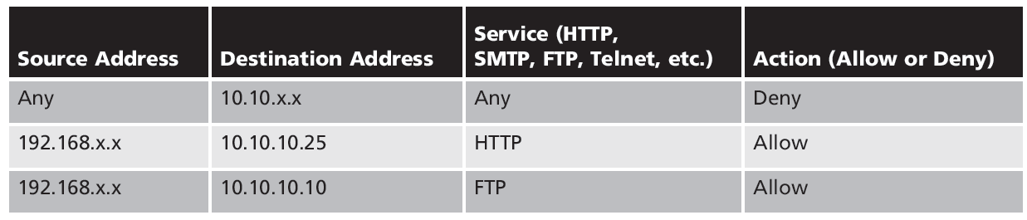
Table 4-2 Sample firewall rule and format
© Cengage Learning 2013

Slide 22
Packet-Filtering Firewalls (cont’d.)
Packet-filtering best practices
Outbound source address must be in internal network
Outbound destination address must not be in internal network
Inbound packet source address not in internal network
Inbound packet destination address in internal network
Other best practices on Pages 144-145 of the text

Slide 23
Packet-Filtering Firewalls (cont’d.)
Stateless packet-filtering firewalls
Stateless inspection ignores state of the connection:
Between internal and external computers
Blocks or allows packets based on header information only

Slide 24
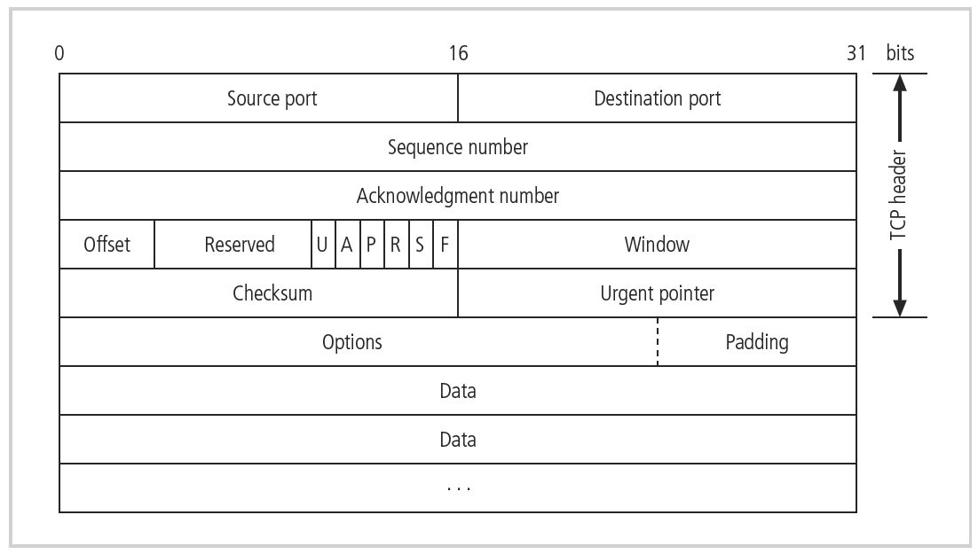
Figure 4-6 TCP packet structure
© Cengage Learning 2013

Slide 25
Packet-Filtering Firewalls (cont’d.)
Packet-filtering router
Ability to restrict a specific service
Standard in most routers
Unable to detect whether packet headers have been modified
IP spoofing
Falsification of the source IP address

Slide 26
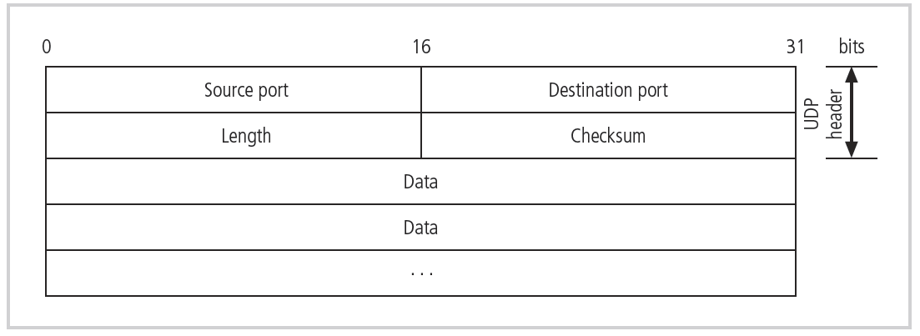
Figure 4-7 UDP packet structure
© Cengage Learning 2013

Slide 27
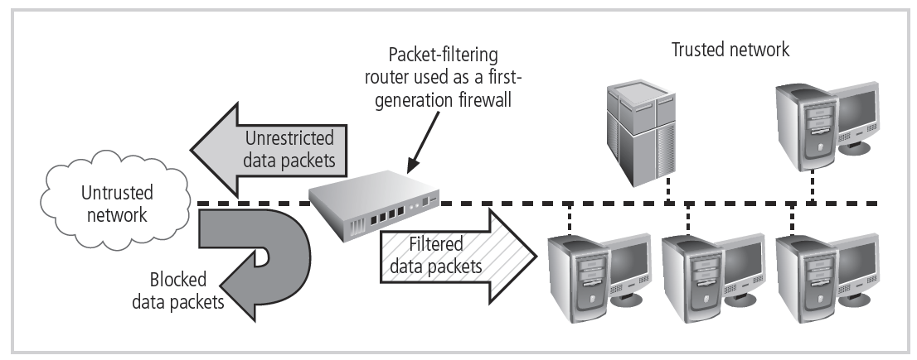
Figure 4-8 Packet-filtering router
© Cengage Learning 2013

Slide 28
Packet-Filtering Firewalls (cont’d.)
Stateful packet-filtering firewalls
Examine data in the packet
Examine state of the connection between internal and external computers
State table tracks state and context of each packet
Records which station sent what packet and when
Stateful packet filtering
Allows incoming packets sent in response to internal requests

Slide 29
Packet-Filtering Firewalls (cont’d.)
Disadvantage of stateful packet-filtering
Additional processing required to manage packets and verify against state table
Dynamic stateful filtering firewalls
Make changes to filtering rules based on events as they happen

Slide 30
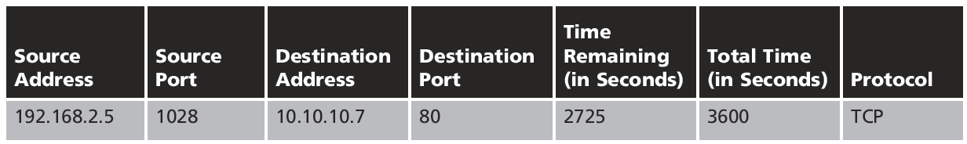
Table 4-3 State table entries
© Cengage Learning 2013

Slide 31
Application-Level Gateways
Also called proxy server
Works at the application layer
Intermediary between two systems
Control the way applications inside the network access external networks
Notes:
proxy server is a server (a computer system or an application) that acts as an intermediary for requests from clients seeking resources from other servers.

Slide 32
Application-Level Gateways (cont’d.)
Other application-level gateway tasks
Load balancing
IP address mapping
Filtering specific content
URL filtering
Fragmentation attack prevention

Slide 33
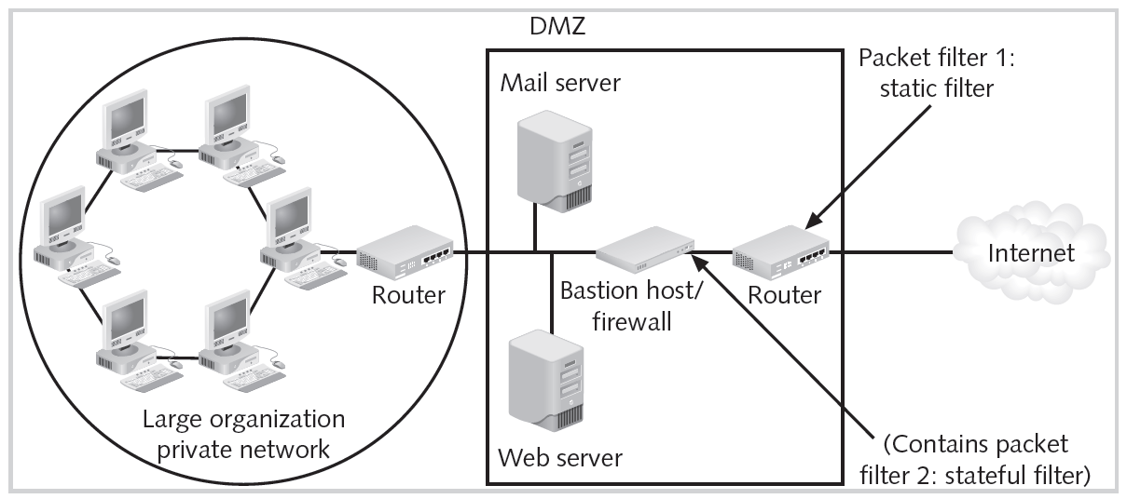
Multi-Layer Filtering
Figure 4-9 Multiple packet filters
© Cengage Learning 2013
Notes:
a DMZ or demilitarized zone is a physical or logical subnetwork that contains and exposes an organization's external-facing services to a larger and untrusted network, usually the Internet.

Slide 34
Multi-Layer Filtering (cont’d.)
Deep packet inspection
Combines stateful packet filtering with ability to analyze protocols for inconsistencies
Disadvantage of multi-layer filtering
Longer processing time

Slide 35
Circuit-Level Gateways
Operate at the transport layer
Do not usually examine traffic
Create tunnels connecting specific processes or systems

Slide 36
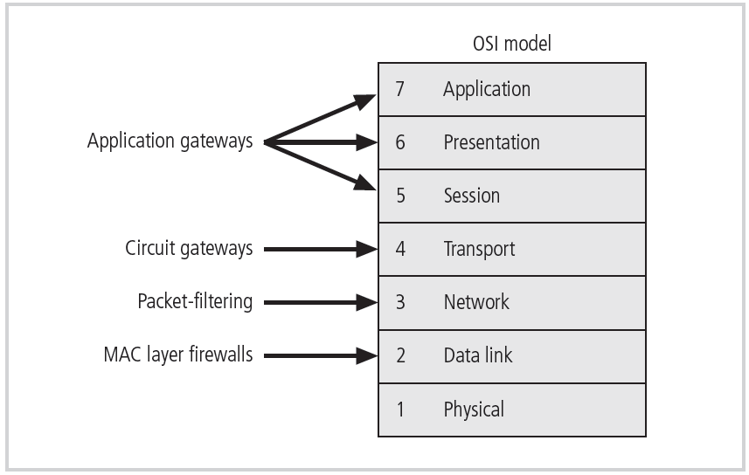
Figure 4-10 Firewalls in the OSI model
© Cengage Learning 2013

Slide 37
Firewall Form Factors
Form factor categorization
Grade: residential or commercial
Hardware-based, software-based, appliance-based
Commercial-grade firewalls
Most are dedicated appliances
Some are general computer systems with custom software
Residential-grade firewalls
Software on user’s computer
Simplified dedicated appliance

Slide 38
Firewall Appliances
Stand-alone, self-contained
Combine hardware and software
Firewall rules stored in NVM(Network Visibility Module)
Configurable
Available each time device is restarted
Examples of firewall appliances
Cisco Systems Adaptive Security Appliance
Fortinet Fortigate
McAfee Firewall Enterprise

Slide 39
Firewall Appliances (cont’d.)
Firewall systems
Application software configured for the firewall application
Installed on general computer or specialized hardware
Examples of commercial-grade firewall packages
Check Point Software Technologies Firewall Software Blade
Barracuda Networks NG Firewall

Slide 40
Firewall Appliances (cont’d.)
Virtual firewalls
Same features as traditional firewall
Located on a virtual server
Implemented as a virtual security appliance
Examples of virtual firewalls
Juniper Networks vGW Series
Altor v4.0
McAfee Firewall Enterprise, Virtual Appliance

Slide 41
Firewall Appliances (cont’d.)
Small office/home office firewall appliances
Residential-grade firewall
Broadband gateway or DSL/cable modem router
Recent advancements
Broadband firewall combined with features of wireless access point and stackable LAN switches
Some systems include packet-filtering, port-filtering, and simple intrusion detection systems

Slide 42
Firewall Appliances (cont’d.)
Firewall software
Examines communication on its installed system
Free firewall tools on the Internet
Most run on free operating systems
Examples: Windows Firewall, Application Firewall, Netfilter and iptables, ZoneAlarm Free Firewall

Slide 43
Firewall Architectures
Four common architectural implementations
Packet-filtering routers
Screened host firewalls
Dual-homed firewalls
Screened subnet firewalls
Best firewall configuration depends on:
Objectives of the network
Organization’s ability to develop and implement architecture
Available budget

Slide 44
Packet-Filtering Routers
Simple and effective
Drawbacks
Lacks auditing capability
Lacks strong authentication
Complex ACLs can degrade network performance
Notes:
ACL: network access control list (ACL) is an optional layer of security that acts as a firewall for controlling traffic in and out of a subnet.

Slide 45
Screened Host Firewalls
Packet-filtering router is combined with a separate dedicated firewall
Router prescreens packets and minimizes load on internal proxy

Slide 46
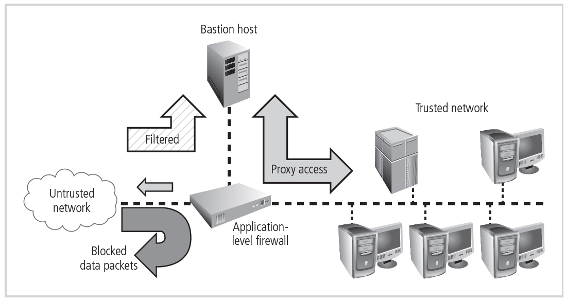
Screened Host Firewalls (cont’d.)
Figure 4-16 Screened host architecture
© Cengage Learning 2013

Slide 47
Dual-Homed Host Firewalls
Bastion host contains two NICs
One NIC connected to the external network
One NIC connected to the internal network
Network address translation
Mapping real, valid, external IP addresses to special ranges of nonroutable internal IP addresses

Slide 48
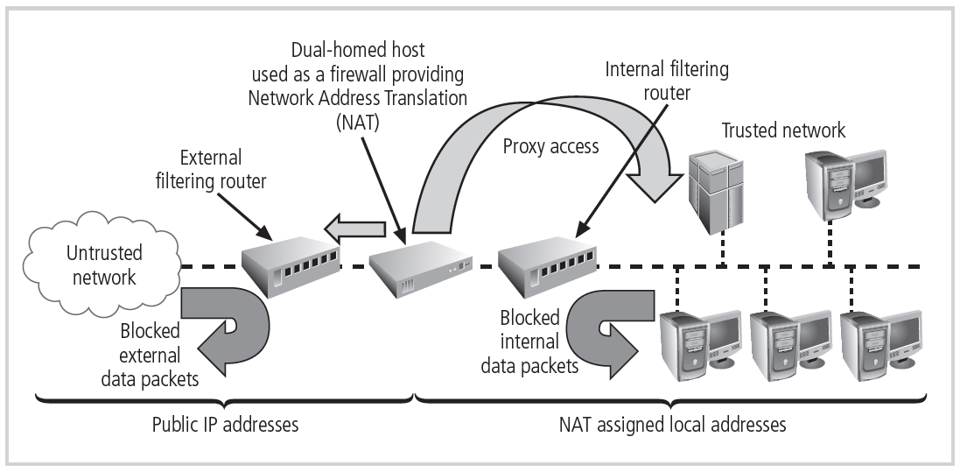
Dual-Homed Host Firewalls (cont’d.)
Figure 4-17 Dual-homed host
© Cengage Learning 2013

Slide 49
Screened Subnet Firewalls (with DMZ)
Dominant architecture in use today
DMZ
Dedicated port on the firewall device or connected to a screened subnet
Extranet
DMZ segment with additional authentication and authorization controls

Slide 50
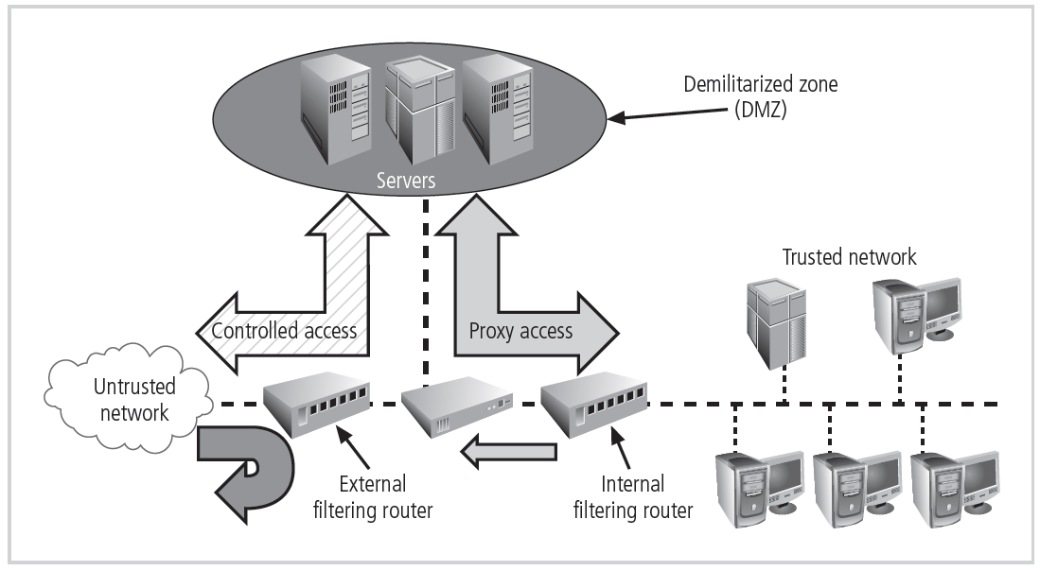
Screened Subnet Firewalls (cont’d.)
Figure 4-18 Screened subnet
© Cengage Learning 2013

Slide 51
Limitations of Firewalls
Firewalls should be part of an overall security plan
Used in conjunction with other forms of protection
Firewall infrastructure considerations
Packet filtering has limitations
Firewalls can be circumvented
Key concepts include defense-in-depth and principle of least privilege
Firewalls must be kept updated with latest patches
Firewall rules can be complex

Slide 52
Limitations of Firewalls (cont’d.)
Firewall infrastructure considerations (cont’d.)
Firewall placement is crucial
Firewalls are not substitutes for security policy
Trained administrators must understand network protocols and the security policy
Firewalls will introduce latency

Slide 53
Summary
Firewall can be hardware, software, or a combination of the two
Firewalls filter the transmission of information packets
Application-level gateways control the way applications inside the network access external networks
Firewall categorization types include generation and form factor
Firewalls can have different network connection architectures

