Slide 1


Enhancing Instruction Prefetching
via Cache and TLB Management
Alexandre Valentin Jamet¹, Georgios Vavouliotis², Martí Torrents¹,
Dimitrios Chasapis¹, Marc Casas¹
¹Barcelona Supercomputing Center, ²Computing Systems Lab, Huawei Technologies AG, Switzerland
alexandre.jamet@bsc.es

Slide 2

Executive Summary
Contemporary server workloads have massive instruction footprint
Significant pressure on front-end structures
Mitigation techniques:
L1i prefetching (e.g., FNL+MMA, Barça, EPI, FDiP)
TLB prefetching (e.g., Morrigan)
Prefetch-aware cache replacement policy (e.g., PACIPV, PACMAN)
Limitations in L1i page-cross prefetching mechanisms:
Address translation latency becomes a bottleneck
Insufficient utilization of lines brought by the L1i prefetcher in the L2C
Our approach
Extend the sTLB with a buffer dedicated to translations brought by L1i prefetchers
Adapt the L2C replacement to accommodate lines brought by L1i prefetchers
Notes:
Quickly span through the problem of modern workloads (i.e., large data footprint).
Then, go on to explaining the different techniques available to workaround these problems:
Off-Chip Prediction (Predicting load demand accesses for cache hits)
Data Prefetching coupled with Adaptive Filtering (Improving prefetching for adaptive workload handling)
Cache bypassing (Selective bypass strategies for system performance)
Disruptive cache designs (Innovative architectures for efficiency and performance)

Slide 3
Front-End Bottlenecks
Contemporary server workloads exhibit large instruction footprints
Footprint growing by ~30% per year
Front-end structures (i.e., L1i, TLBs) lag behind the demand of these workloads
More PTEs required to map the instruction footprint
L1i and sTLB misses dominate front-end stalls. Around 10% of total execution cycles in server workloads.
Notes:
Here, we mention that modern workloads (and particularly GAP) put large load on the cache hierarchy.

Slide 4
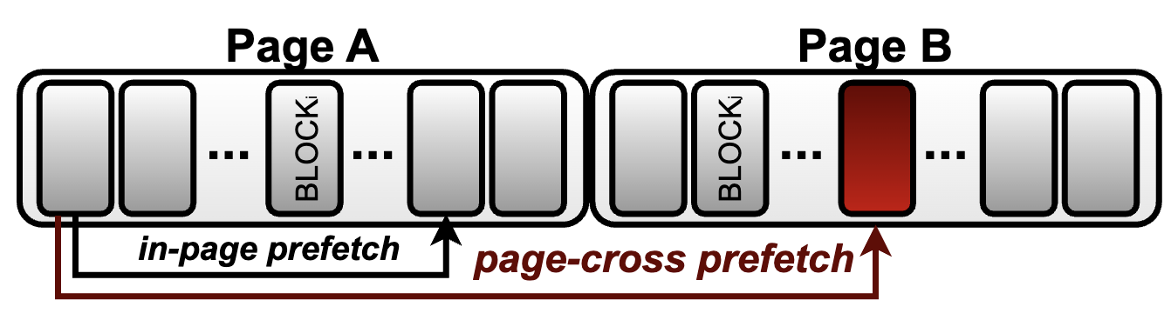
Impact of L1i Prefetching on TLBs
[HPCA2025]: To Cross, or Not to Cross Pages for Prefetching?
Cross-page prefetching consists in prefetching beyond page boundaries:
An address translation might be needed.
Notes:
Here, we mention that modern workloads (and particularly GAP) put large load on the cache hierarchy.

Slide 5
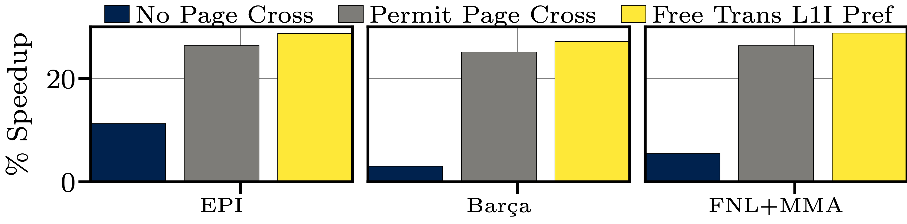
Impact of L1i Prefetching on TLBs
Allowing instruction prefetchs to cross page boundaries delivers higher performance
The ideal scenario deliver even higher performance
Addressing the cost of address translation for these prefetches can deliver additional performance.
Notes:
Here, we mention that modern workloads (and particularly GAP) put large load on the cache hierarchy.

Slide 6
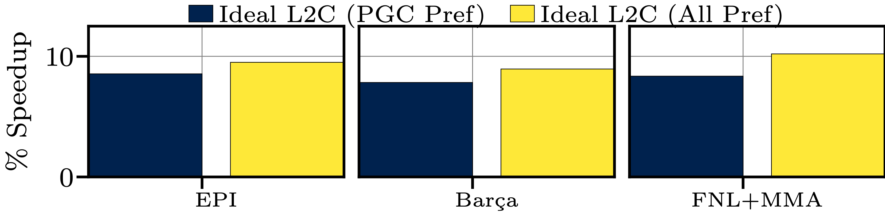
Impact of L1i Prefetching on L2C Management
We show that code lines brought by both in-page and cross-page prefetch requests incur pressure on the L2C;
Appropriate management of code lines has significant performance potential.
Adequate management of all lines brought by L1i prefetch requests shows higher benefits.
Notes:
Here, we mention that modern workloads (and particularly GAP) put large load on the cache hierarchy.

Slide 7
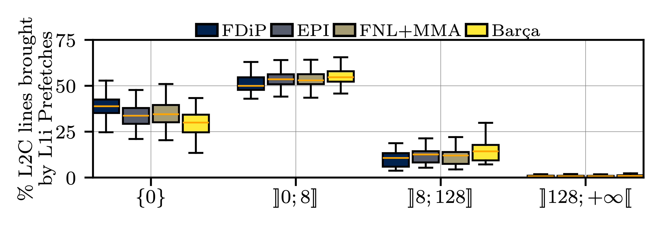
Reuse of Prefetched Code Lines
We analyze the reuse of code lines in the L2C;
A significant portion of codes lines brought by L1i Prefetch are dead on arrival;
Other lines experience a significant amount of reuse before eviction.
Lines brought by L1i prefetches experience variable reuse patterns and call for a smart policy.
Notes:
Here, we mention that modern workloads (and particularly GAP) put large load on the cache hierarchy.

Slide 8
IP-CaT: A Framework to coordinate instruction prefetching
Mitigating prefetch address translation costs yields higher performance:
We introduce the tPB to optimize cross-page translations.
tPB
L1i prefetches exhibit variable reuse, requiring an intelligent policy:
We propose TIPRP to manage L2C code lines via a variation of set-dueling
TIPRP
We combine tPB and TIPRP in a single proposal: IP-CaT.
Notes:
Here we summarise the findings to transition to the design proposal.

Slide 9
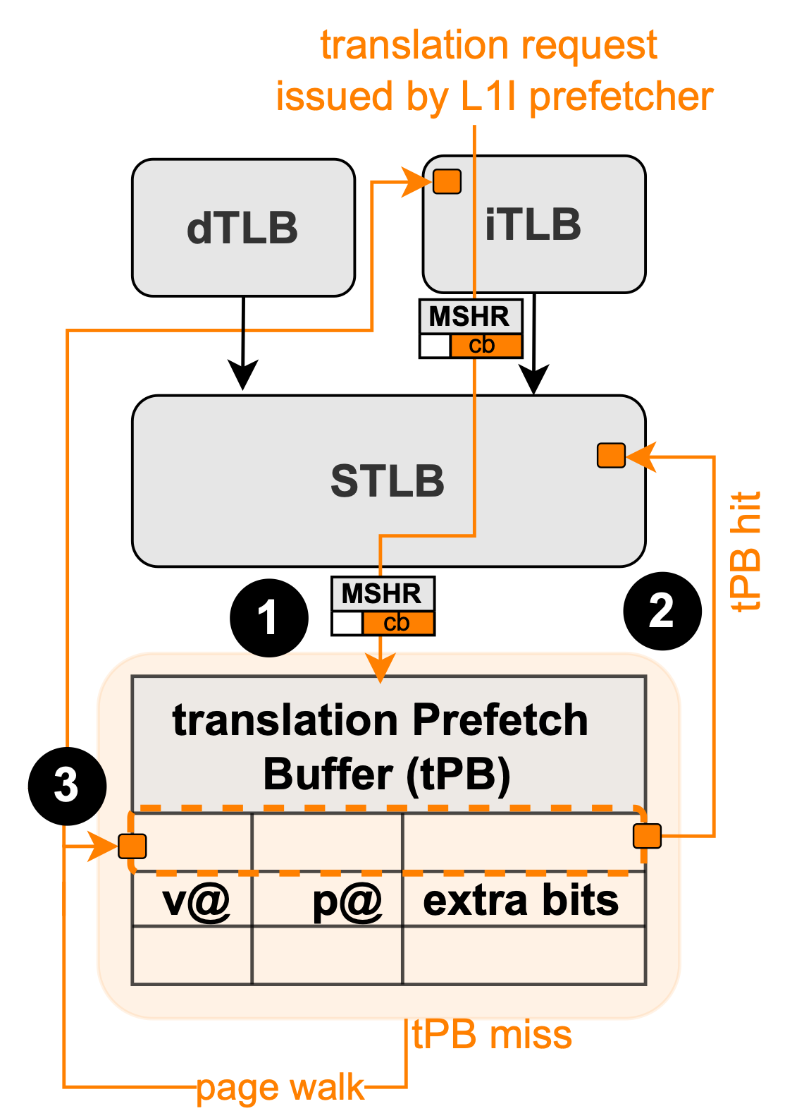
tPB: Accelerating Address Translation for Cross-Page Instruction Prefetches
The tPB is a 64-entry buffer for cross-page prefetch translations;
(1) tPB is looked up upon a miss in iTLB and STLB:
(2) tPB hit, the entry is inserted in the sTLB;
(3) tPB miss, a page table walk fills the tPB, which then updates the iTLB.

Slide 10
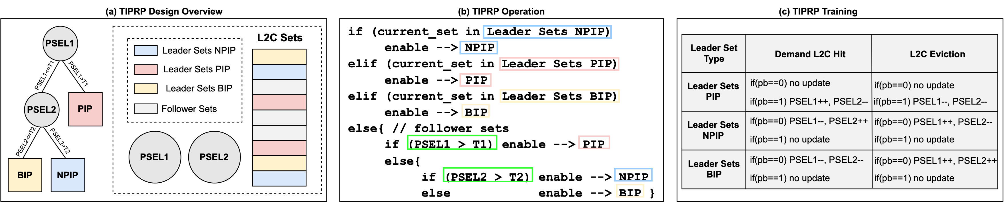
TIPRP: Smart Management of L2C Instruction Lines
TIPRP is made of three sub-policies:
PIP —> Prioritizes lines brought by L1i prefetch requests
NPIP —> Deprioritizes lines brought by L1i prefetch requests;
BIP —> Lines brought by L1i prefetch requests bypass the L2C;
The L2C is managed using a variation of set-dueling:
Each sub-policy is applied in separate sets and competes to determine which is the best at a given time
Events signaling a positive/negative behaviour for lines brought by L1i prefetch requests update PSEL1 and PSEL2
Decision tree is designed to provide a continuum of policies

Slide 11
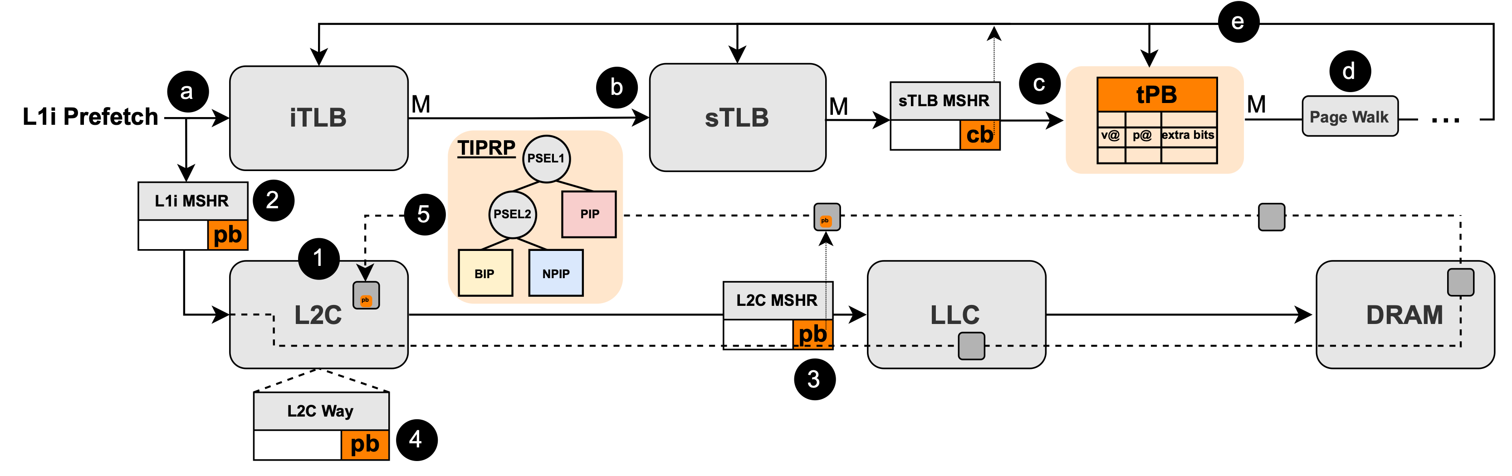
IP-CaT: Synergistic TLB and Instruction Cache Management
The iTLB is looked up upon an L1i prefetch request
iTLB miss —> STLB miss —> tPB look up
Upon a tPB miss, a page walk is initiated
Address translation stored in iTLB and tPB when linked to an L1i cross-page prefetch request
Otherwise, stored in iTLB and STLB
Upon a tPB hit, the entry is inserted in the STLB
TIPRP decides which sub-policy to enable in the following sets of the L2C
c.f., TIPRP component

Slide 12
Experimental Setup
ChampSim simulator (GitHub)
Considered µ-architectures:
Cascade Lake
Zen 4
Workloads
Qualcomm & Server (105 workloads)
SimPoints methodology
Single-core evaluation
Multi-page size evaluation
Multi-core evaluation
Component | Parameters | Latency
ITLB | 64-entry, 4-way | 1cc
DTLB | 64-entry, 4-way | 1cc
STLB | 3584-entry, 14-way | 8cc
L1 I-Cache | 32KB, 8-way | 4cc
L1 D-Cache | 32KB, 8-way, Berti Prefetcher | 4cc
L2 Cache | 1MB, 8-way | 10cc
LLC | 4MB/core, 8-way | 20cc
DRAM | 4GB, tRP=tRCD=tCAS=24cc | variable
*Representative of a Zen4 µ-arch.
Notes:
Here, we simply describe the simulation set-up.

Slide 13
Alternative Techniques
Designs evaluated:
CHiRP
Morrigan
CLIP
EMISSARY
PACIPV
PACMAN
SRRIP (L2C)
DRRIP
SHiP++
Mockingjay
IP-CaT (our design)
Considered L1i Prefetchers:
EPI
FNL+MMA
Barça
Notes:
The alternative techniques we are considering.

Slide 14
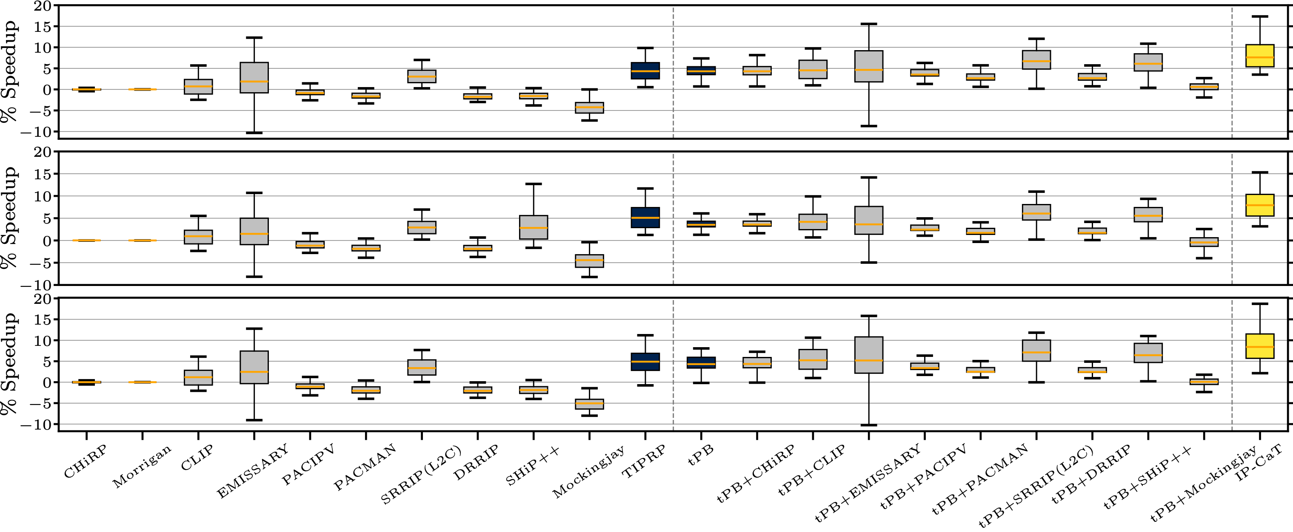
Single-Core Evaluation | Performance
Considering EPI in a single-core scenario, IP-CaT outperforms all evaluated designs
TIPRP leverages 2.9% geomean speed-up
IP-CaT (tPB+TIPRP) leverages 6.1% geomean speed-up

Slide 15
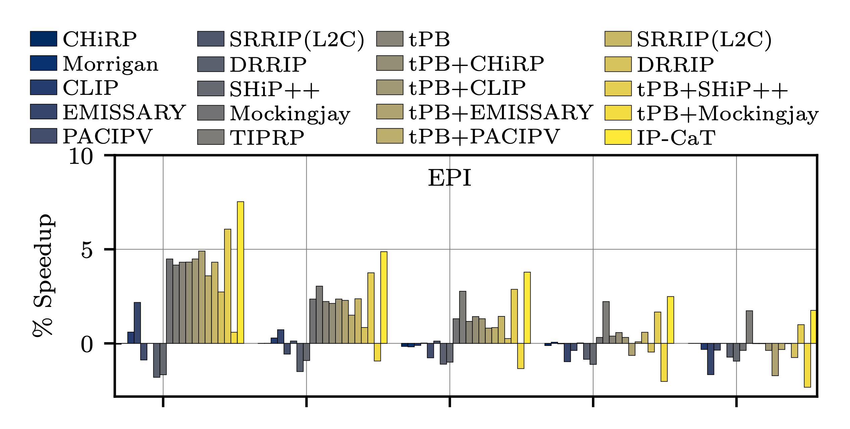
Multi-Page Size Evaluation | Performance
We evaluate scenarios where 0%, 70%, 80%, 90%, and 100% of the memory footprint is mapped to large pages;
In all considered scenarios, IP-CaT outperforms all considered designs:
When using more large pages, TIPRP provides most of the performance improvements;
Trends are similar considering other L1i prefetcher (i.e., Barça, and FNL+MMA).

Slide 16
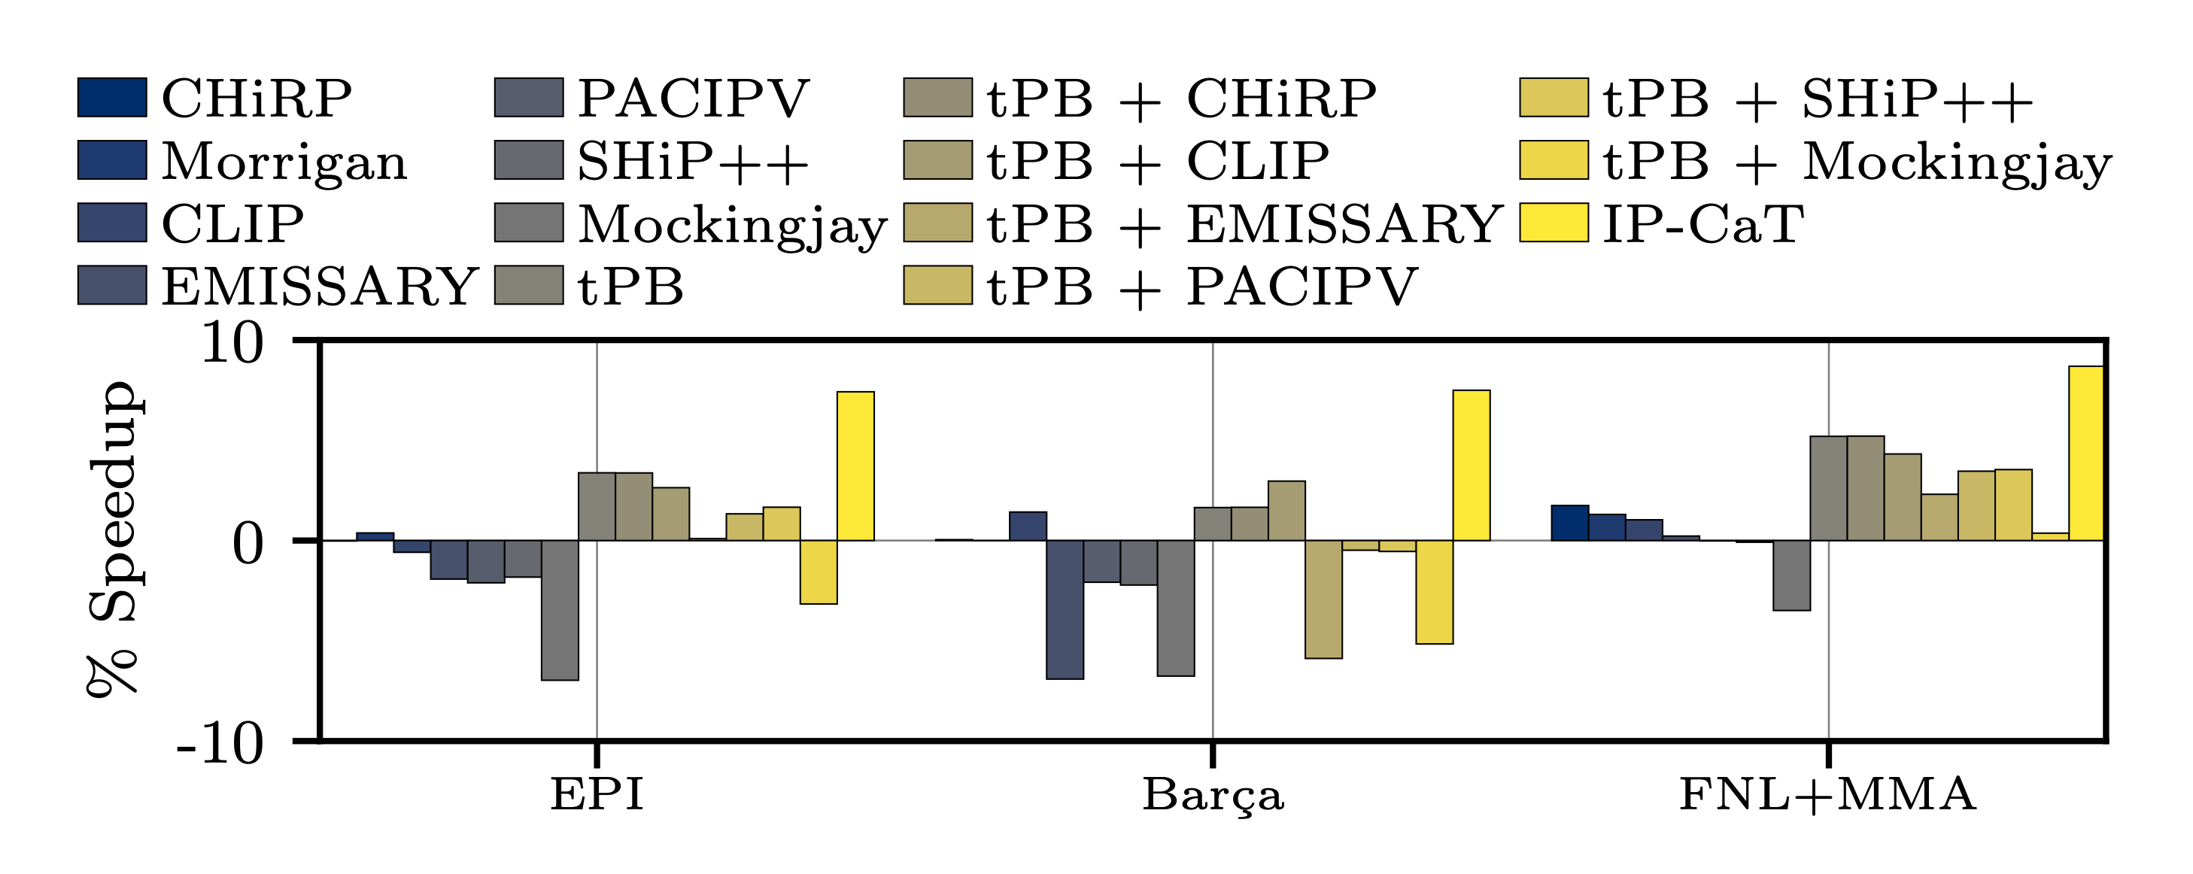
Multi-Core Evaluation | Performance
We evaluate IP-CaT against other techniques in a 4-core scenario:
In all considered scenarios, IP-CaT outperforms all considered designs

Slide 17
Conclusions
We show that the address translation latency of L1i cross-page prefetch requests undermines the benefits of these prefetchers.
We propose the first work to orchestrate TLB and cache management to maximize the benefits of L1i prefetchers.
This work generalises to any L1i prefetchers.

Slide 18
Thank you for your attention!
Paper available here:
Enhancing Instruction Prefetching via Cache and TLB Management — ISCA’26

Slide 19
Acknoledgments/ Fundings
Alexandre Valentin Jamet acknowledges his AI4S fellowship within the “Generación D” initiative by Red.es, Ministerio para la Transformación Digital y de la Función Pública, for talent attraction (C005/24-ED CV1), funded by NextGenerationEU through PRTR.

