Slide 1






A Two Level Neural Approach Combining Off-Chip Prediction with Adaptive Prefetch Filtering
alexandre.jamet@bsc.es
Alexandre Valentin Jamet¹, Georgios Vavouliotis², Lluc Alvarez¹, Daniel A. Jiménez³, Marc Casas¹
¹Barcelona Supercomputing Center
²Huawei Zurich Research Center
³Texas A&M University
Notes:
Simply introducing the paper’s title and the authors. Quick.

Slide 2

Executive Summary
Emerging workloads (e.g., graph processing) have massive data footprints
Significant pressure on the caches
Latency Tolerance Techniques:
Off-Chip Prediction (e.g., Hermes (MICRO’22))
Data Prefetching (e.g., PPF (ISCA’19))
Cache bypassing (e.g., Multiperspective Reuse Prediction (MICRO’17))
Disruptive cache designs (e.g., Distill Cache (HPCA’07))
Notes:
Quickly span through the problem of modern workloads (i.e., large data footprint).
Then, go on to explaining the different techniques available to workaround these problems:
Off-Chip Prediction (Predicting load demand accesses for cache hits)
Data Prefetching coupled with Adaptive Filtering (Improving prefetching for adaptive workload handling)
Cache bypassing (Selective bypass strategies for system performance)
Disruptive cache designs (Innovative architectures for efficiency and performance)

Slide 3
Executive Summary
Emerging workloads (e.g., graph processing) have massive data footprints
Significant pressure on the caches
Latency Tolerance Techniques:
Off-Chip Prediction (e.g., Hermes (MICRO’22))
Data Prefetching (e.g., PPF (ISCA’19))
Cache bypassing (e.g., Multiperspective Reuse Prediction (MICRO’17))
Disruptive cache designs (e.g., Distill Cache (HPCA’07))
Limitations in Off-Chip Prediction mechanisms:
Balancing speed-up with increased DRAM transactions
Adaptability issues in prefetch filtering approaches
Our approach
Make Off-Chip prediction highly accurate
We leverage Off-Chip prediction properties to drive Adaptive Prefetch Filtering
Notes:
Quickly span through the problem of modern workloads (i.e., large data footprint).
Then, go on to explaining the different techniques available to workaround these problems:
Off-Chip Prediction (Predicting load demand accesses for cache hits)
Data Prefetching coupled with Adaptive Filtering (Improving prefetching for adaptive workload handling)
Cache bypassing (Selective bypass strategies for system performance)
Disruptive cache designs (Innovative architectures for efficiency and performance)

Slide 4
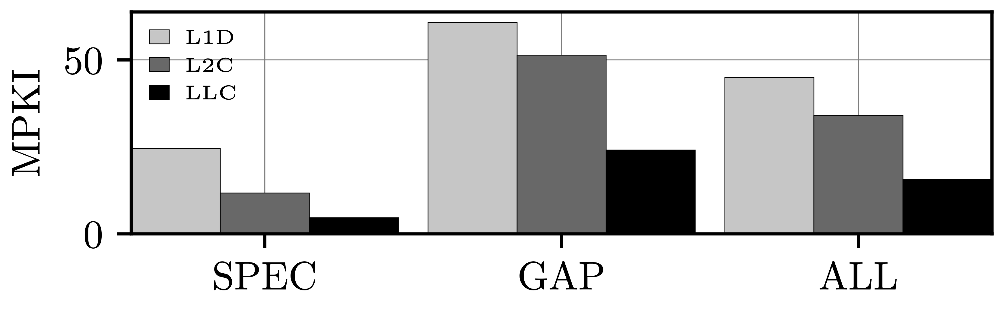
Cache Behaviour of Modern Workloads
For SPEC and GAP workloads, we analyse the load in the cache hierarchy
On average, 34.7% of L1D misses eventually require a DRAM access
Graph workloads exhibit irregular access pattern that caches can hardly capture
Most demand load requests triggered by applications with large working set sizes miss in all cache levels.
Notes:
Here, we mention that modern workloads (and particularly GAP) put large load on the cache hierarchy.

Slide 5
Off-Chip Prediction
Throw a speculative request to DRAM?
CORE
L1D
L2C
LLC
DRAM
Assess whether a load demand access will be served from the caches or the DRAM
Promising technique. No yet implemented by leading vendors
A state-of-the-art design is Hermes (MICRO’22)
Notes:
Here, we give a brief explanation on what is Off-Chip prediction
Basically, a predictor figures out whether or not a load demand access originating from the core would require a DRAM access or hit somewhere in the cache hierarchy?
If predicted off-chip, in addition to the regular memory access from the core, a prefetch request to the DRAM is issued. If not, the regular memory access process is followed.

Slide 6
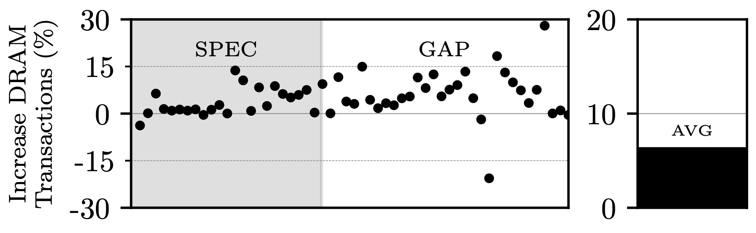
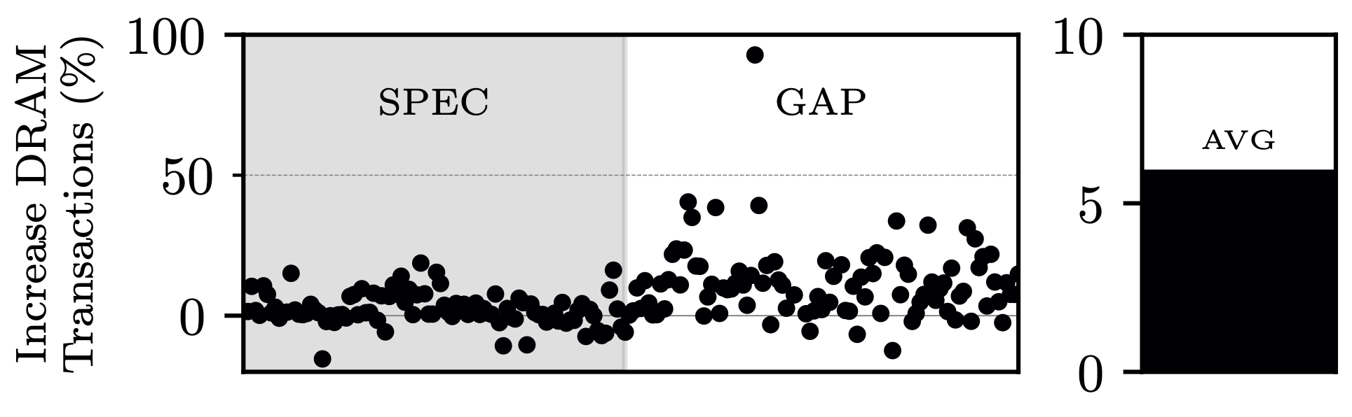
Limitations of Off-Chip Prediction
Hermes provides performance benefits
Single-core —> 5.2% geomean speed-up
Multi-core —> 11.5% geomean speed-up
Hermes significantly increases the # of DRAM transactions
Single-core —> 6.4% on average
Multi-core —> 6.0% on average
Hermes significantly increases DRAM accesses (both single-core and multi-core contexts).
Notes:
Here, we show the limitations of Hermes (i.e., while Hermes provides speed-up, it also increases the # of DRAM transactions).
Fine if we are dealing with a system with large resources but in practice completely impractical.

Slide 7
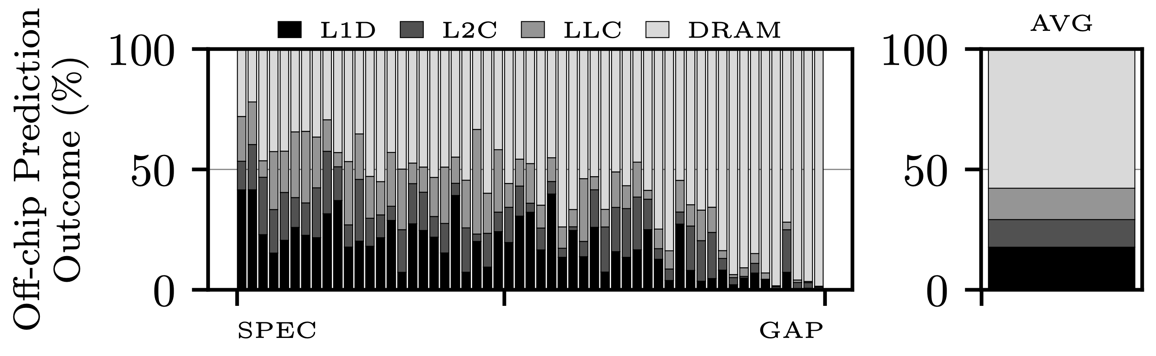
Limitations of Off-Chip Prediction
Measuring Hermes’ inaccurate off-chip predictions:
42.2% of off-chip predictions are inaccurate —> hit in cache hierarchy
17.7% of total off-chip predictions are found in the L1D.
Selectively delaying Hermes off-chip predictions until the L1D lookup is resolved has the potential to significantly reduce the number of useless DRAM transactions and deliver performance.
Notes:
Here, we demonstrate that 42.2% of Hermes’ off-chip predictions are inaccurate (i.e., while predicted off-chip, the requests are satisfied somewhere in the cache hierarchy).
Take way: It might pay off to wait to consume the prediction when we lack confidence at the core level. The idea being that with L1D misses we leverage an additional information that skews towards off-chip.

Slide 8
Hardware Prefetching & Prefetch Filtering
CORE
L1D
L2C
LLC
DRAM
Is PFR useful?
PF
PF
PF
Prefetchers proactively fetch blocks into caches before they are demanded by the core
Not all prefetch requests are useful —> Need to filter useless prefetch requests
Notes:
Here we present the concept of hardware prefetching combined with adaptive prefetching.

Slide 9
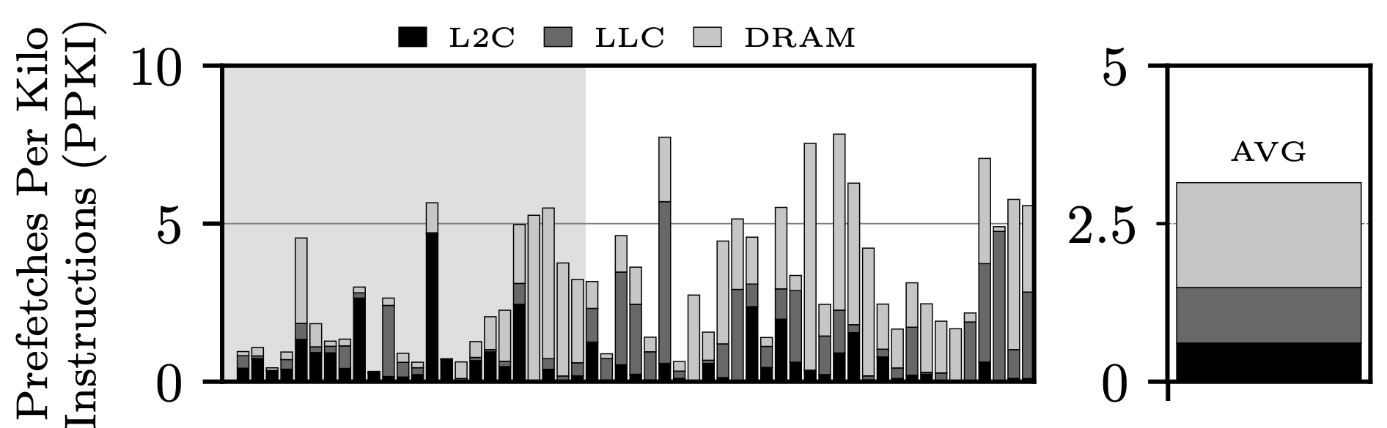
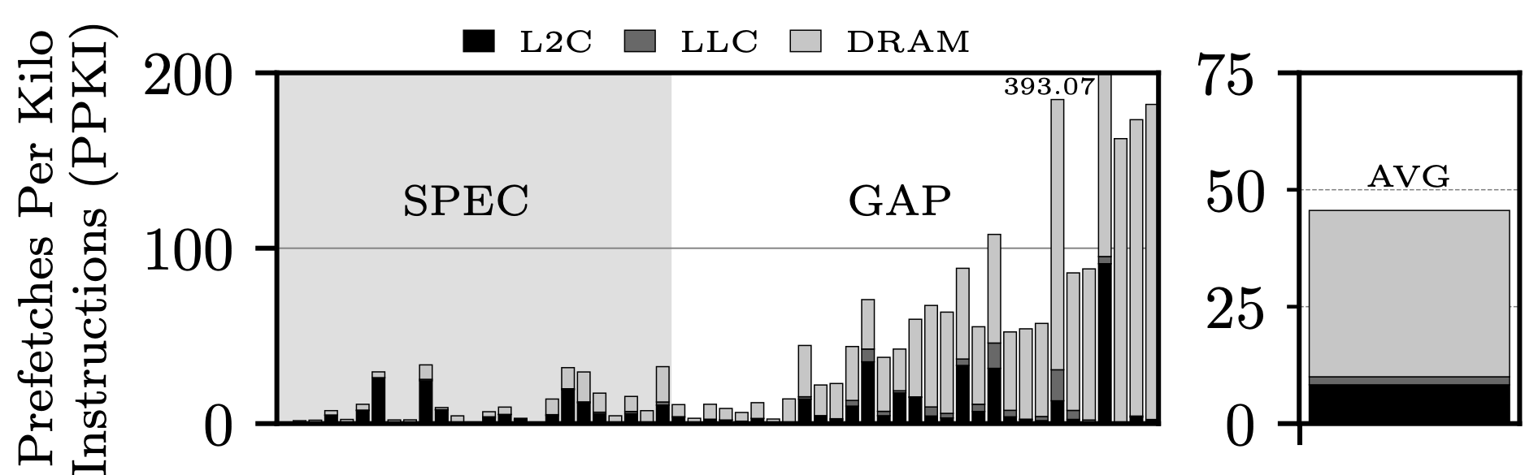
Hardware Prefetching & Prefetch Filtering
Where are useless (not touched during their lifetime) prefetches fetched from?
L2C —> 18.2%
LLC —> 3.8%
DRAM —> 78%
On average 95.2% of prefetch requests served by the DRAM are inaccurate
Off-chip prediction can be leveraged to design an effective prefetch filtering scheme for L1D.
Notes:
Here, we demonstrate that most of the useless prefetch request are served from DRAM, establishing a link between Adaptive Filtering for Hardware Prefetching and Off-Chip Prediction.

Slide 10
TLP: A Solution to address useless DRAM Transactions
Selectively delaying Off-Chip predictions can reduce the # of DRAM transactions
Improve Hermes to selectively delay speculative DRAM accesses after L1D misses
We propose the First Level Perceptron (FLP)
Useless L1D prefetch requests are mostly fetched from DRAM
Off-Chip prediction can drive Prefetch Filtering
We propose the Second Level Perceptron (SLP)
Finally, we assemble FLP and SLP into the Two Level Perceptron (TLP)
We assemble FLP and SLP into the Two Level Perceptron (TLP).
Notes:
Here we summarise the findings to transition to the design proposal.

Slide 11
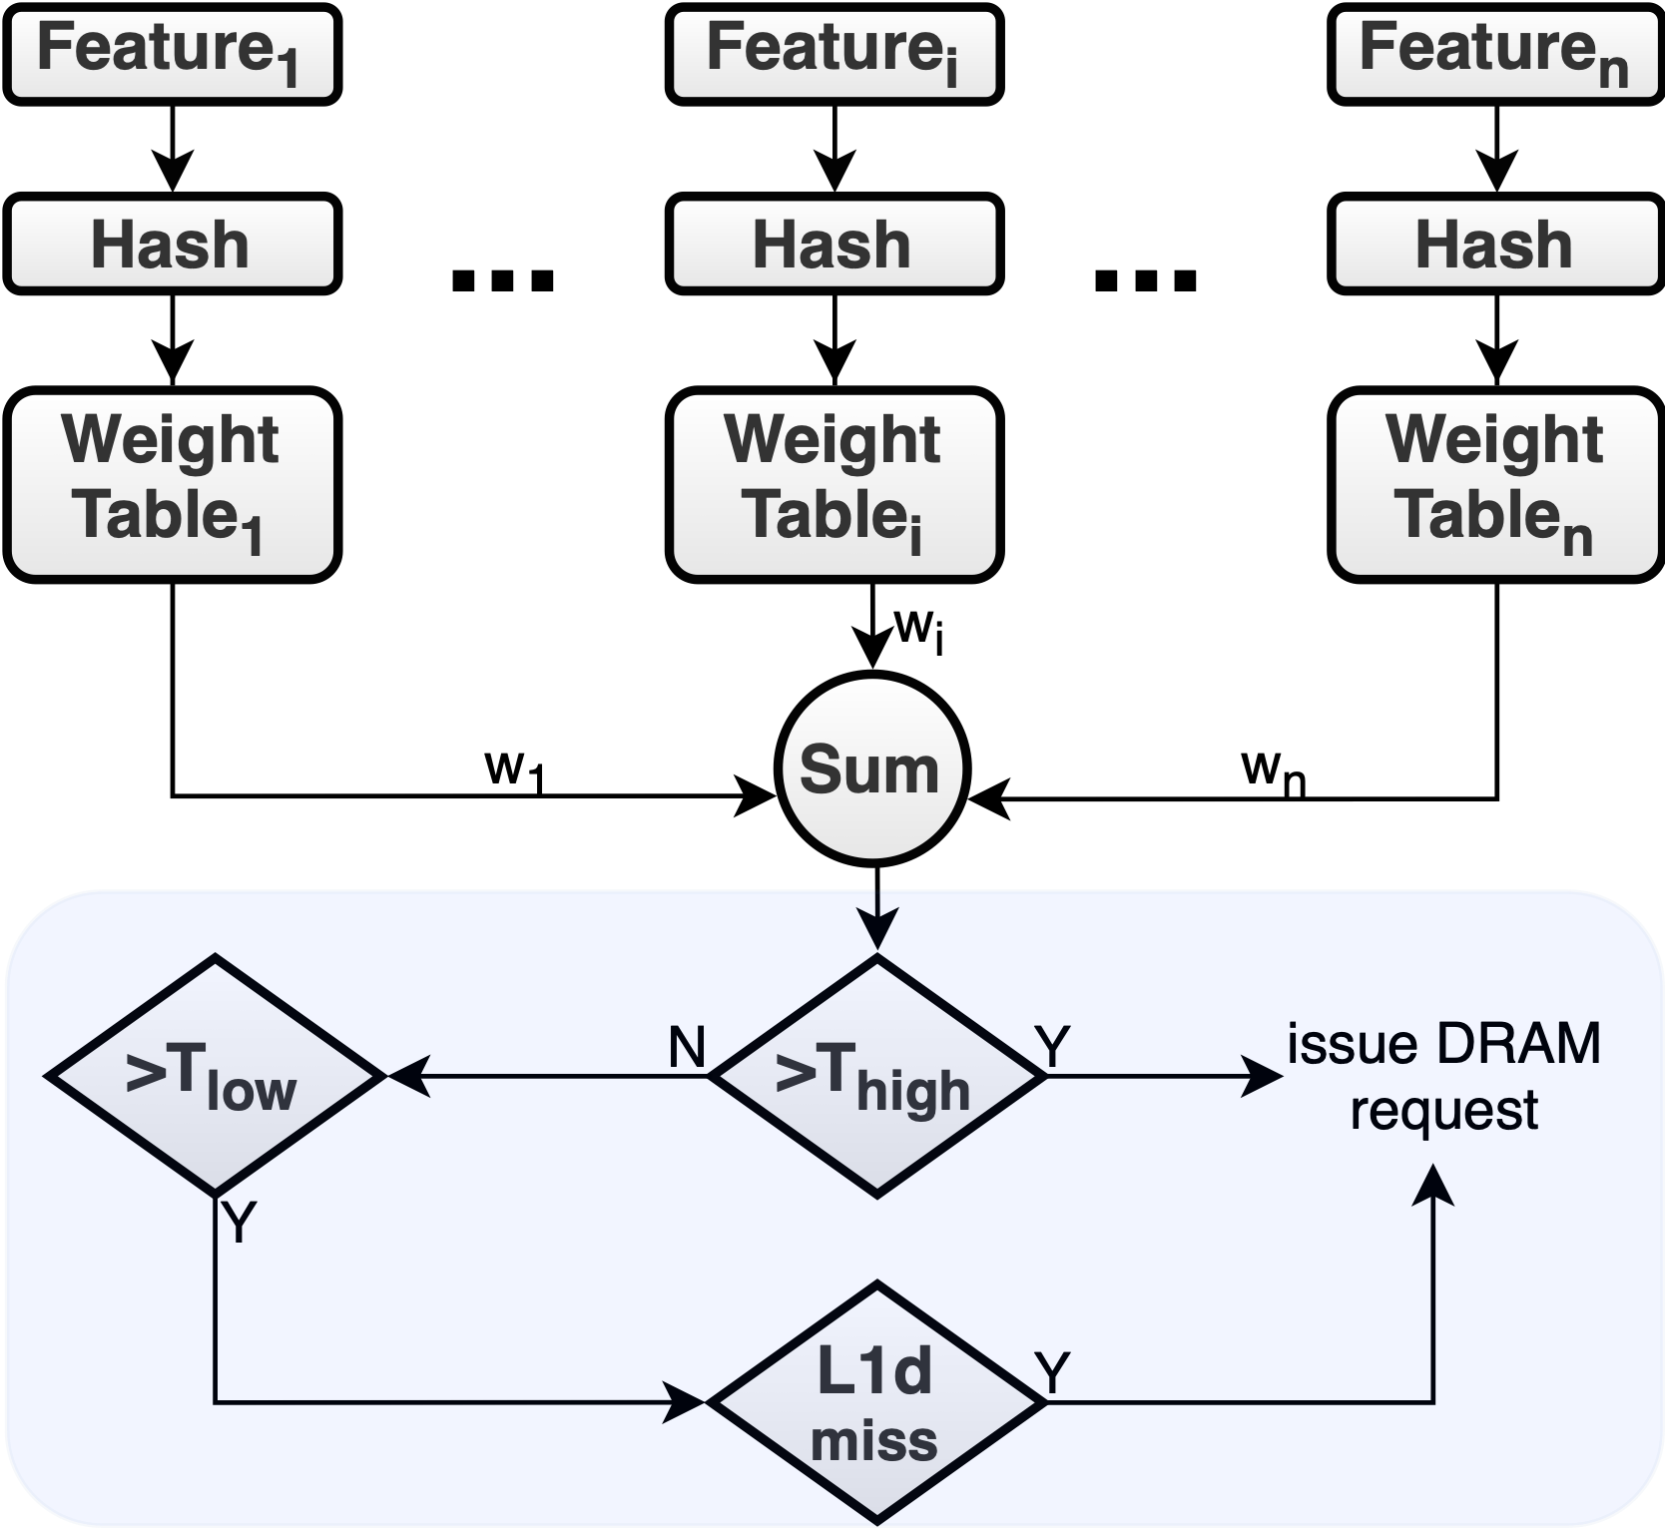
FLP: Leveraging Off-Chip Prediction for Prefetch Filtering
FLP is a hashed perceptron predictor
Utilizes several µ-arch features (history of load PCs, etc.)
Components (5 prediction tables, 128-1K entries, history of the last n-load PCs, virtual address bits, etc.)
FLP is consulted upon a load demand request
Prediction outcomes:
On-Chip —> No DRAM prefetch
Off-Chip —> DRAM prefetch from the core
Delayed Prediction —> Delays DRAM prefetch after L1D lookup
FLP is trained when a request returns to the core

Slide 12
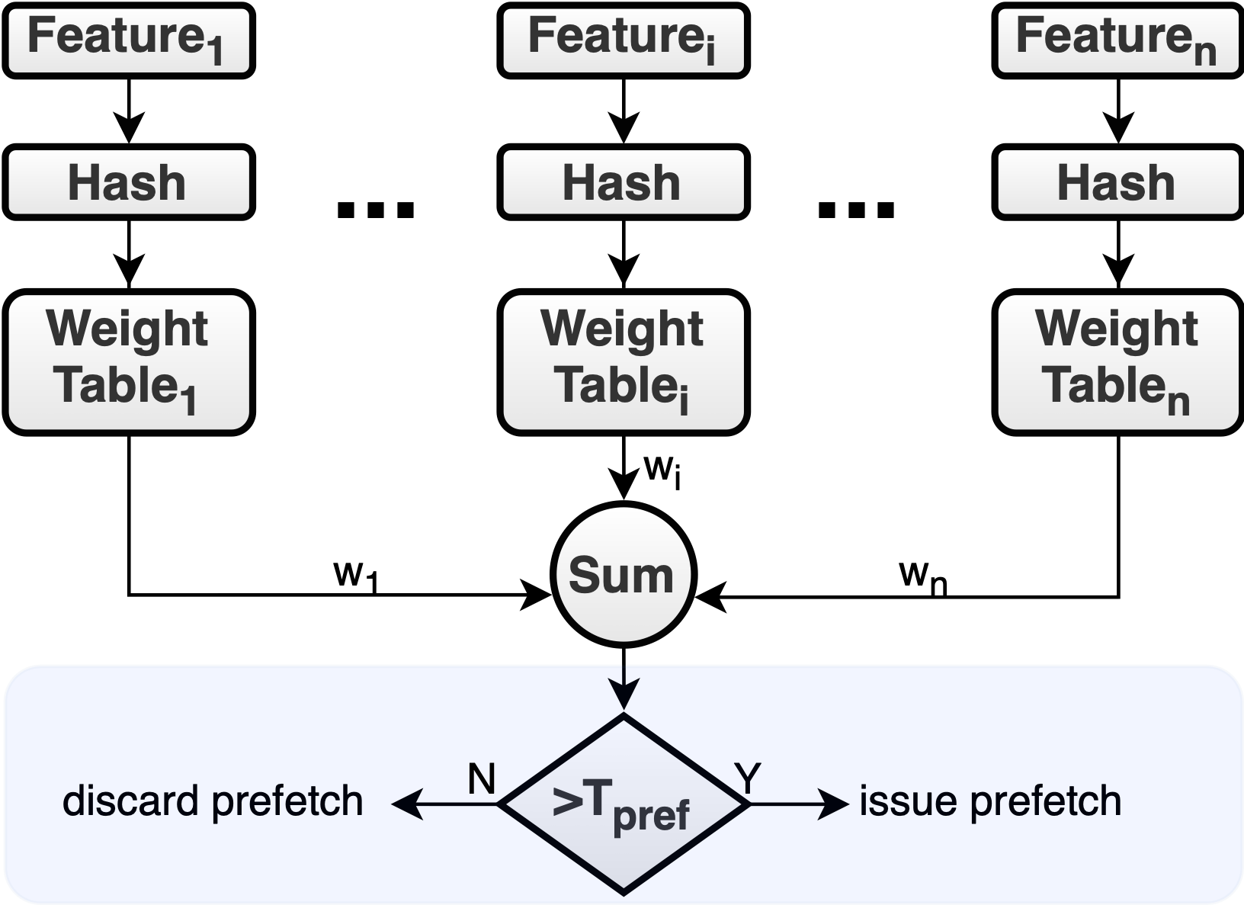
SLP: An Approach to Off-Chip Prediction-based Prefetch Filtering
SLP is a hashed perceptron predictor
Utilizes several µ-arch features (history of load PCs, etc.)
Components (6 prediction tables, 128-1K entries, history of the last n-load PCs, physical address bits, output of FLP, etc.)
SLP is consulted upon a L1D prefetch request emission
Prediction outcomes:
On-Chip —> the prefetch request is issued
Off-Chip —> the prefetch request is discarded
Similarly to FLP, SLP is trained upon the completion of an L1D prefetch request.

Slide 13
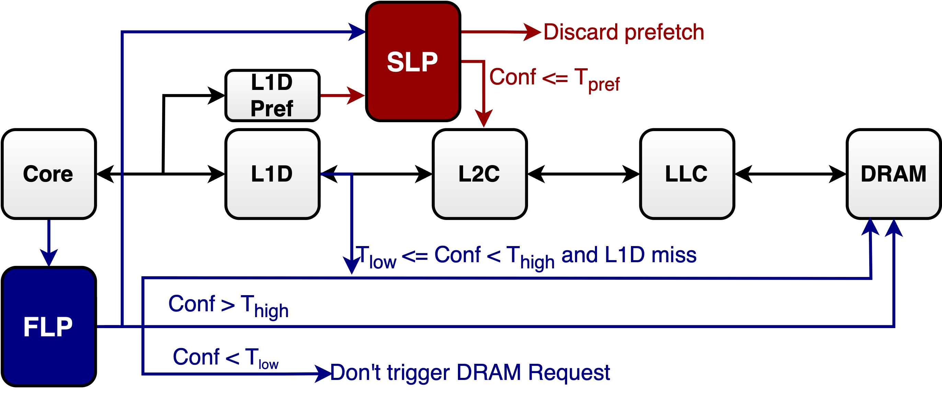
TLP: An Approach to Off-Chip Prediction-based Prefetch Filtering
❶ FLP provides confidence on a load going off-chip
High confidence triggers speculative DRAM request ❷
Low confidence delays DRAM request until L1D miss ❸
If predicted to be on-chip, no action taken ❹
The Two Level Perceptron (TLP) Predictor combines the FLP and the SLP
It allows a layered perceptron design
SLP uses the output of the FLP as an input

Slide 14
TLP: An Approach to Off-Chip Prediction-based Prefetch Filtering
SLP is consulted upon L1D prefetch requests ❺
If the request is predicted to be off-chip ❻, the request is discarded
If the request is predicted to be on-chip ❼, the request continues as usual
The Two Level Perceptron (TLP) Predictor combines the FLP and the SLP
It allows a layered perceptron design
SLP uses the output of the FLP as an input

Slide 15
Experimental Setup
ChampSim simulator (GitHub)
Cascade Lake micro-architecture (specs)
Workloads
SPEC CPU 2006 & 2017 (24 workloads)
GAP Benchmark Suite (31 workloads)
SimPoints methodology
Single-core evaluation
Multi-core evaluation
Component | Parameters | Latency
ITLB | 64-entry, 4-way | 1cc
DTLB | 64-entry, 4-way | 1cc
STLB | 1536-entry, 12-way | 8cc
L1 I-Cache | 32KB, 8-way | 4cc
L1 D-Cache | 32KB, 8-way, IPCP/Berti Prefetcher | 4cc
L2 Cache | 1MB, 16-way, SPP Prefetcher | 10cc
LLC | 1.375MB/core, 11-way | 20cc
DRAM | 16GB, tRP=tRCD=tCAS=24cc | variable
Notes:
Here, we simply describe the simulation set-up.

Slide 16
Alternative Techniques
Designs evaluated:
PPF (ISCA’19)
Hermes (MICRO’22)
Hermes+PPF
TLP (our design)
Considered L1D Prefetchers:
IPCP (ISCA’20)
Berti (MICRO’22)
Hermes+PPF, like TLP provides Off-Chip Prediction and Adaptive Prefetch Filtering.
Notes:
The alternative techniques we are considering.

Slide 17
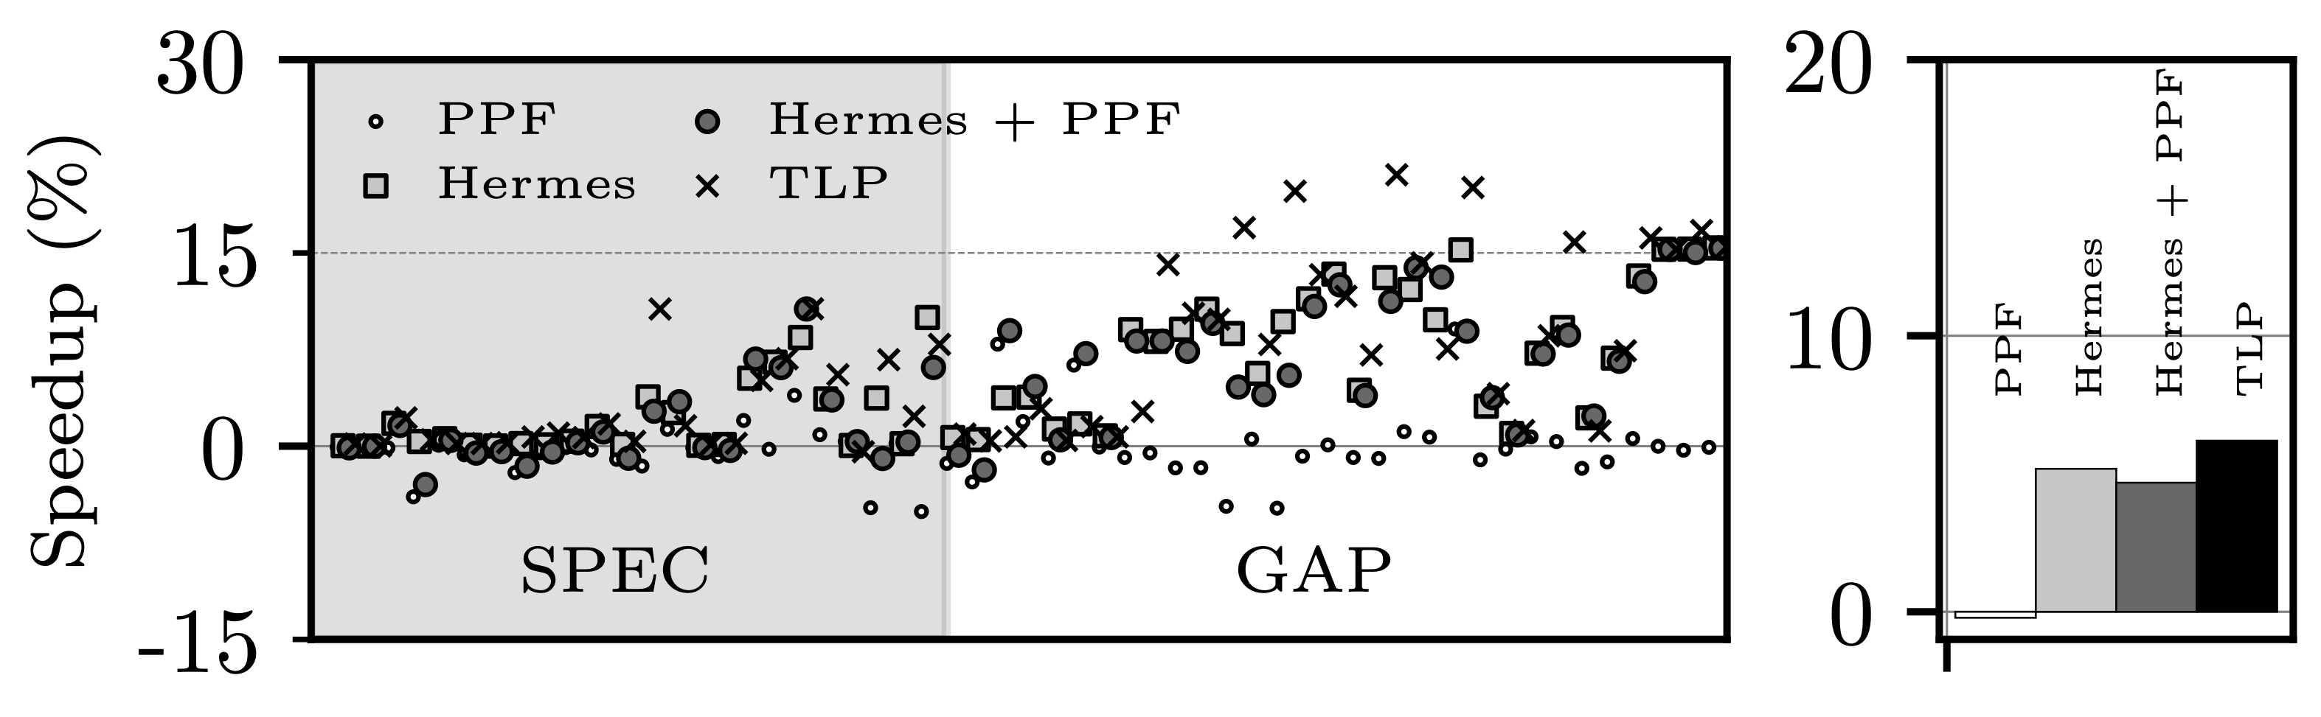
Single-Core Evaluation | Performance
Considering a single-core scenario, TLP outperforms all considered designs
n.b., The single-core scenario assumes 12.8 GB/s per core of DRAM bandwidth
n.b., We evaluated TLP over a range of DRAM bandwidth allocation. We observe that as bandwidth decreases, TLP’s potential grows higher
TLP leverages 6.2% geomean speed-up as compared to -0.2%, 5.2%, and 4.7% for PPF, Hermes, and Hermes+PPF, respectively

Slide 18
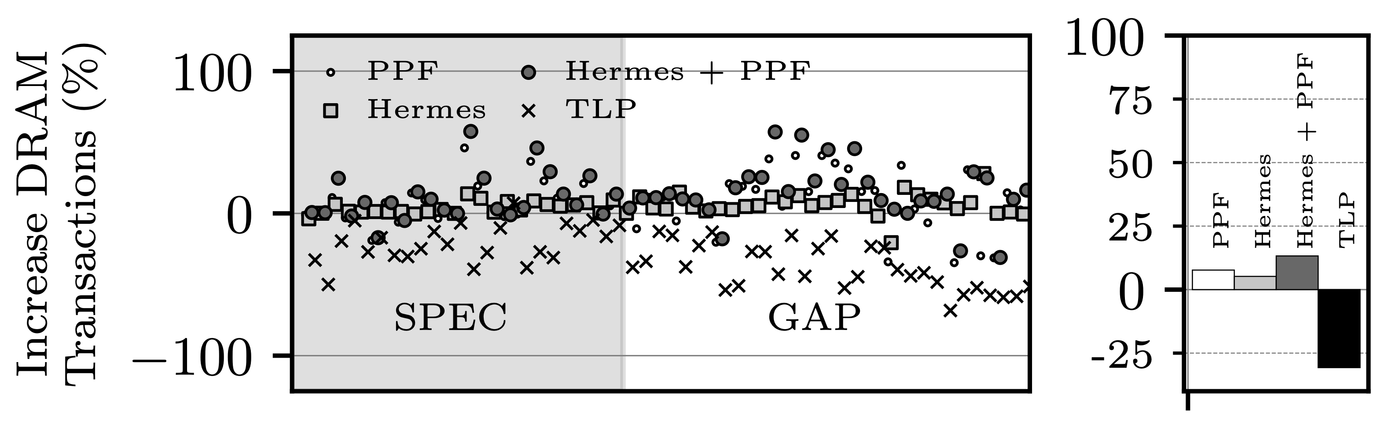
Single-Core Evaluation | DRAM Transactions
Considering a single-core scenario, TLP significantly reduces DRAM transactions as compared all considered designs
TLP reduces DRAM transactions by 30.7% on average, while DRAM transactions increase by 7.7%, 5.2%, and 13.3% for PPF, Hermes, and Hermes+PPF, respectively

Slide 19
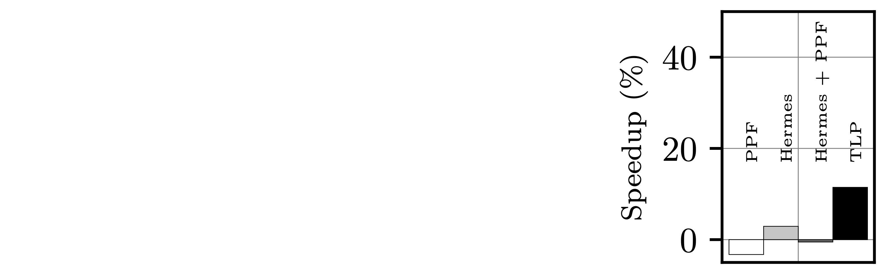
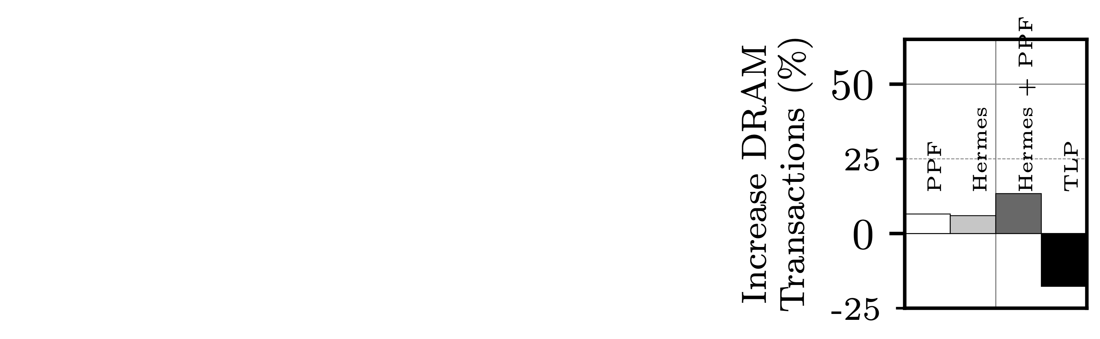
Multi-Core Evaluation | Performance & DRAM Transactions
Considering a multi-core scenario, TLP outperforms all considered designs
n.b., The multi-core scenario assumes 3.2 GB/s per core of DRAM bandwidth
TLP leverages 11.5% geomean speed-up as compared to -3.3%, 3.0%, and -0.5% for PPF, Hermes, and Hermes+PPF, respectively
TLP reduces DRAM transactions by 17.7% on average, while DRAM transactions increase by 6.5%, 6.0%, and 13.4% for PPF, Hermes, and Hermes+PPF, respectively

Slide 20
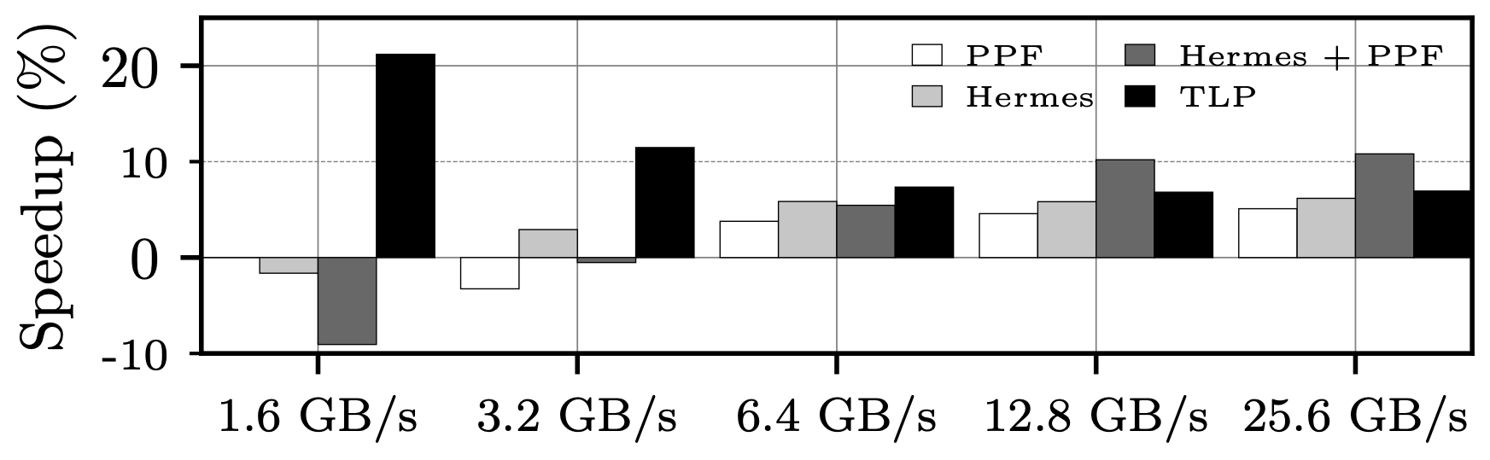
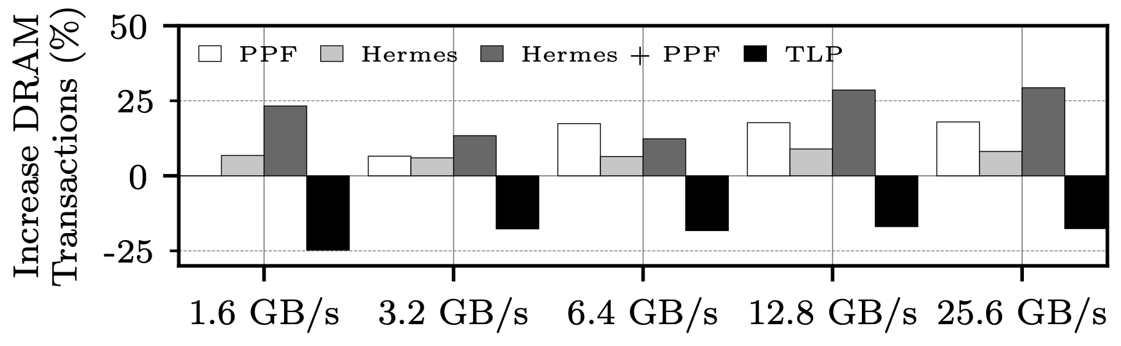
Multi-Core Evaluation | Impact of Bandwidth
Considering a multi-core scenario, TLP outperforms all considered designs
n.b., The x-axes measures bandwidth in GB/s per core.
n.b., Here, we vary DRAM bandwidth from 1.6 to 25.6 GB/s per core.
TLP outperforms all approaches in scenarios where bandwidth ranges between 1.6 to 6.4 GB/s per core
Even considering unrealistic scenarios (12.8 and 25.6 GB/s per core), TLP outperforms Hermes and PPF

Slide 21
Conclusions
We show that off-chip prediction can be used to drive prefetch filtering, reducing the # of DRAM transactions and ultimately improving performance.
This work generalises to any L1D prefetcher and/or workloads.
Off-chip prediction could be correlated to other µ-architectural problems (Dead-On-Arrival STLB entries, etc.).

Slide 22

Reproducing results — Public Artifact
An artifact is publicly available for you to reproduce the results and play around.
Main artifact on Zenodo.
We provide the traces used for the paper.
Volume 1 on Zenodo.
Volume 2 on Zenodo.
Volume 3 on Zenodo.

Slide 23
Thank you for your attention!
A Two Level Neural Approach Combining Off-Chip Prediction with Adaptive Prefetch Filtering — HPCA’24

Slide 24
Acknoledgments/ Fundings
The authors are grateful to the anonymous reviewers for their valuable comments and constructive feedback that significantly improved the quality of the paper.
This work has been partially supported by the European HiPEAC Network of Excellence, by the Spanish Ministry of Science and Innovation MCIN/AEI/10.13039/501100011033 (contracts PID2019-107255GB-C21 and PID2019-105660RB-C22) and by the Generalitat de Catalunya (contract 2021-SGR-00763).
This work is supported by the National Science Foundation through grant CCF-1912617 and generous gifts from Intel.
Marc Casas has been partially supported by the Grant RYC-2017-23269 funded by MCIN/AEI/10.13039/501100011033 and by ESF Investing in your future.
Els autors agraeixen el suport del Departament de Recerca i Universitats de la Generalitat de Catalunya al Grup de Recerca "Performance understanding, analysis, and simulation/emulation of novel architectures" (Codi: 2021 SGR 00865). This research has received funding from the European High Performance Computing Joint Undertaking (JU) under Framework Partnership Agreement No 800928 (European Processor Initiative) and Specific Grant Agreement No 101036168 (EPI SGA2). The JU receives support from the European Union’s Horizon 2020 research and innovation programme and from Croatia, France, Germany, Greece, Italy, Netherlands, Portugal, Spain, Sweden, and Switzerland. The EPI-SGA2 project, PCI2022-132935 is also co-funded by MCIN/AEI /10.13039/501100011033 and by the UE NextGenerationEU/PRTR.

Slide 25
BACKUP SLIDES

Slide 26
Details on Graph Workloads
 | BC | BFS | CC | PR | TC | SSP
irregData ElemSz | 8B + 4B | 4B | 4B | 4B | 4B | 4B
Execution style | Push-Mostly | Push & Pull | Push-Mostly | Pull-Only | Push-Only | Push-Only
Use Frontier | Yes | Yes | No | No | No | Yes
 | Web | Road | Twitter | Kron | Urand | Friendster
# Vertices (in M) | 50.6 | 23.9 | 61.6 | 134.2 | 134.2 | 65.2
# Edges (in M) | 1,949.4 | 58.3 | 1,468.4 | 2,111.6 | 2,147.4 | 3,612.1
Notes:
Here, we simply describe the simulation set-up.

Slide 27
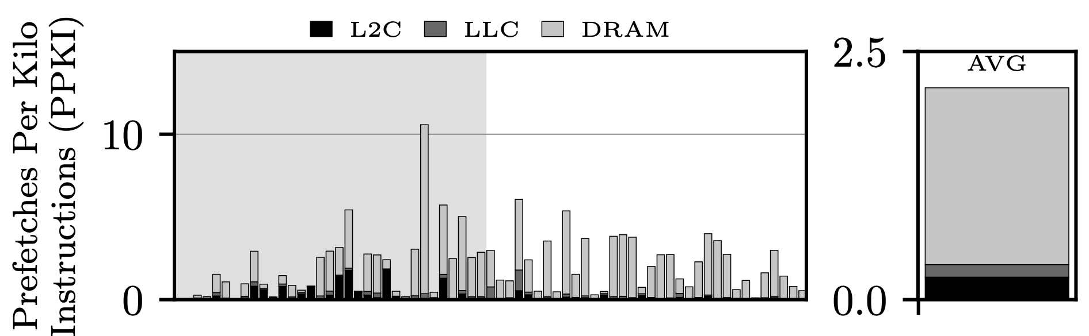
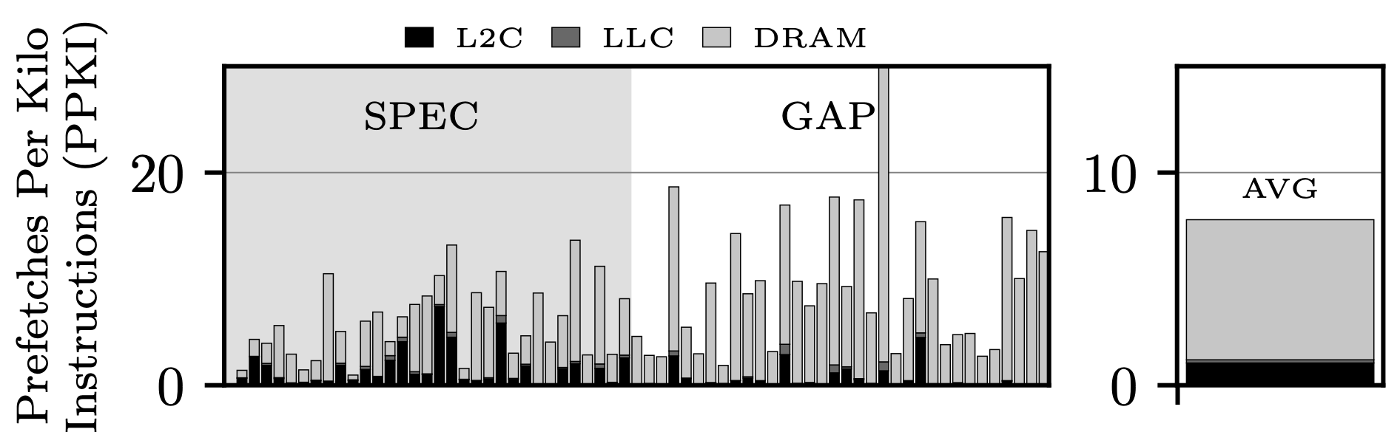
Hardware Prefetching & Prefetch Filtering (Berti)
Where are useless (not touched during their lifetime) prefetches fetched from?
L2C —> 18.2%
LLC —> 3.8%
DRAM —> 78%
On average 95.2% of prefetch requests served by the DRAM are inaccurate
Worse on GAP workloads (96.7%) as compared to SPEC (82%).

Slide 28
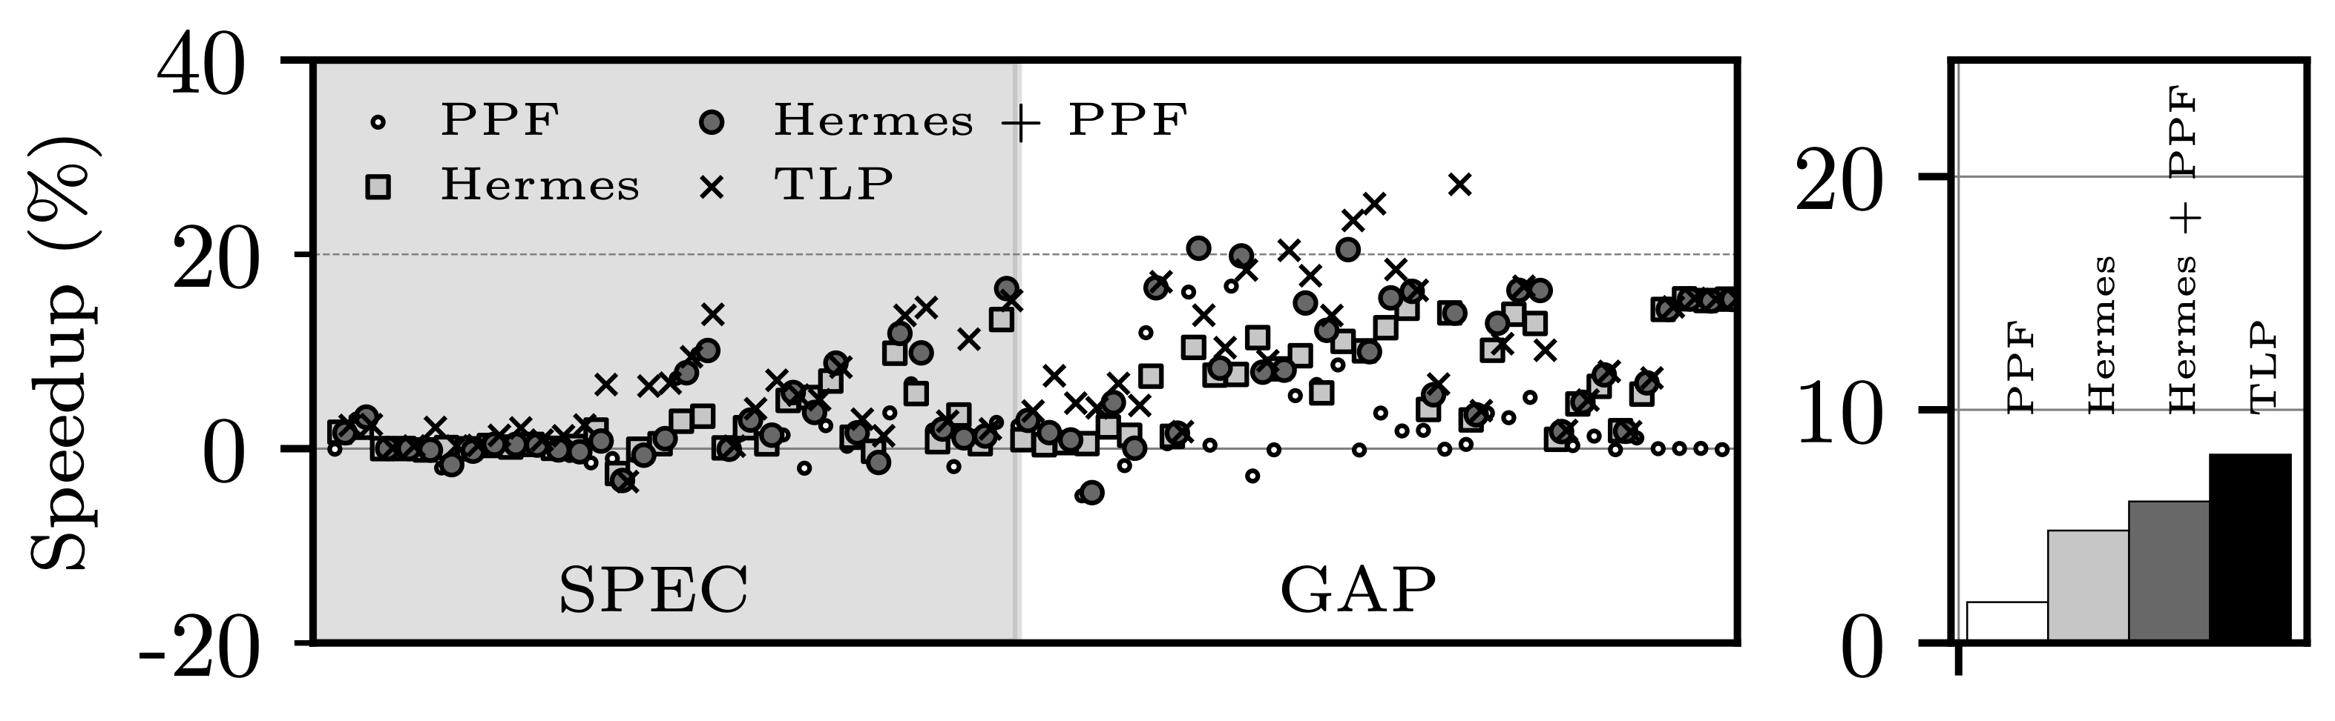
Single-Core Evaluation / Performance (Berti)
Considering a single-core scenario, TLP outperforms all considered designs.
n.b., The single-core scenario assumes 12.8 GB/s per core of DRAM bandwidth. This favours aggressive prefetching techniques.
TLP leverages 8.1% geomean speed-up as compared to 1.7%, 4.8%, and 6.1% for PPF, Hermes, and Hermes+PPF, respectively.

Slide 29
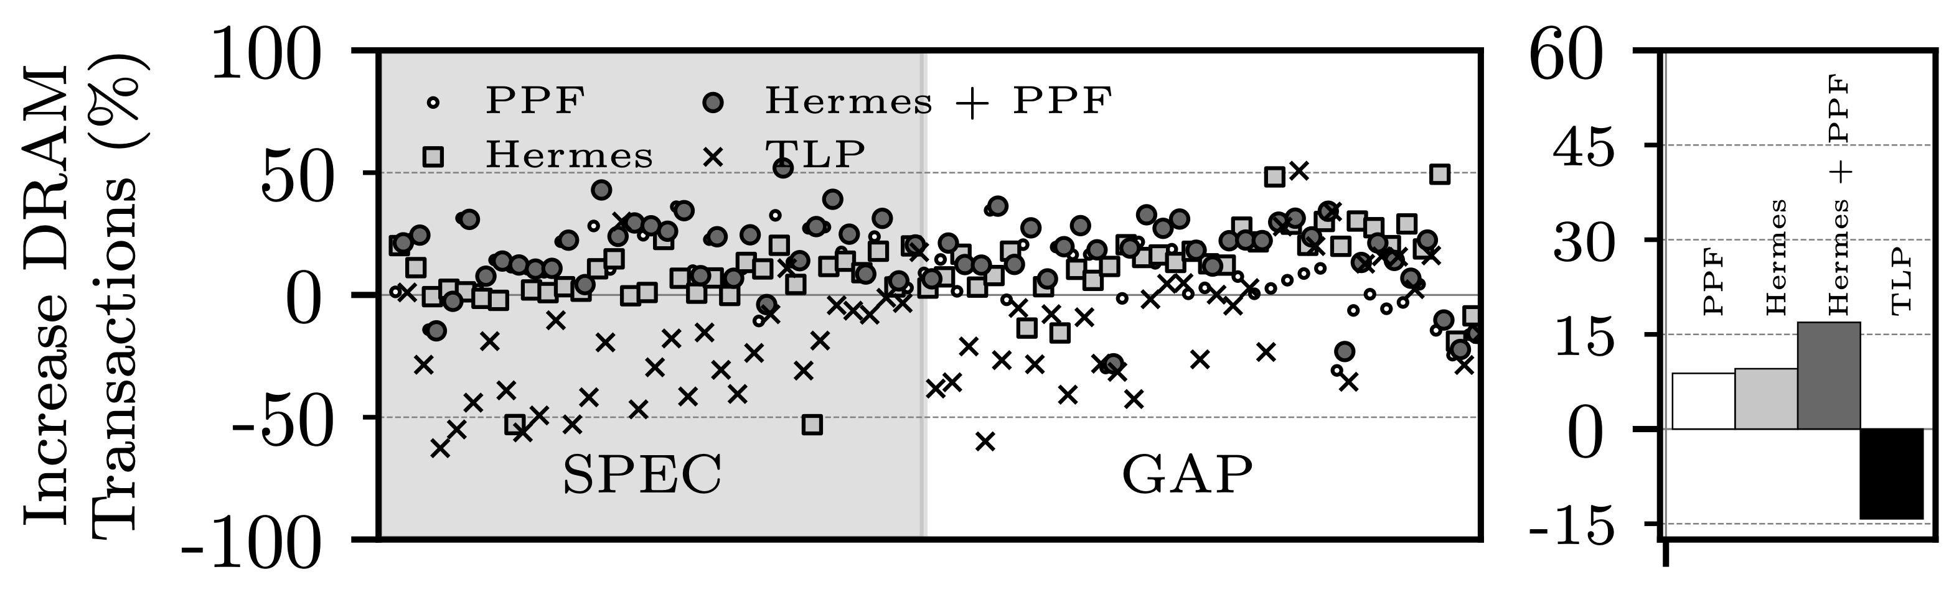
Single-Core Evaluation / DRAM Transactions (Berti)
Considering a single-core scenario, TLP significantly reduces DRAM transactions as compared all considered designs.
TLP reduces DRAM transactions by 14.2% on average, while DRAM transactions increase by 8.8%, 9.6%, and 16.9% for PPF, Hermes, and Hermes+PPF, respectively.

Slide 30
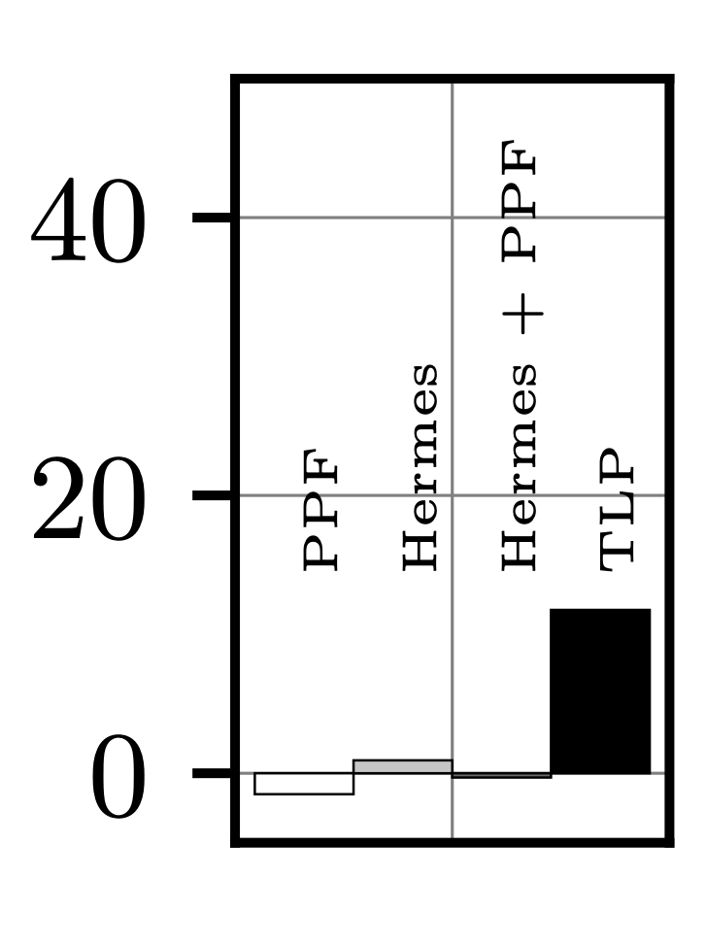
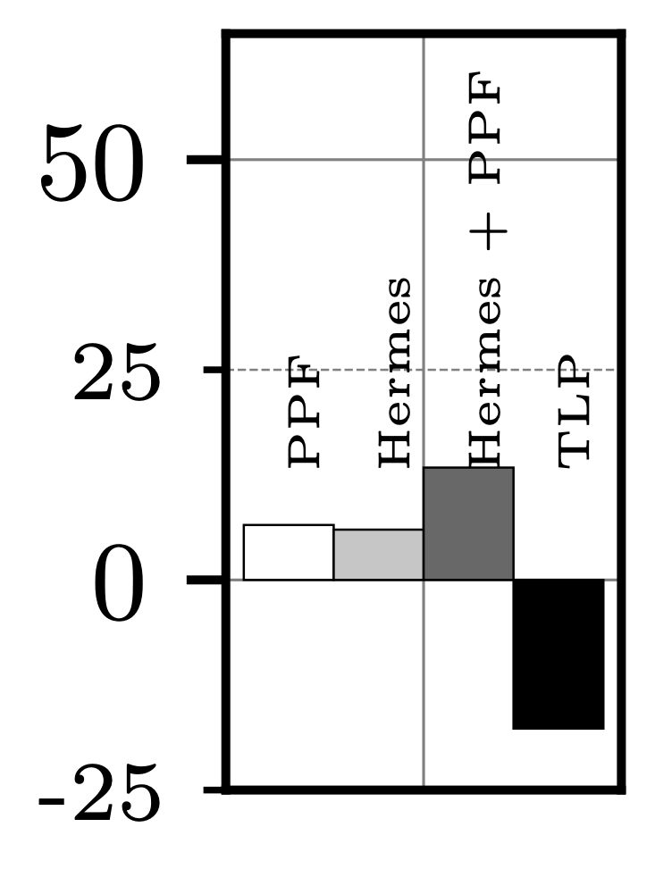
Multi-Core Evaluation / Performance & DRAM Transactions (Berti)
Considering a multi-core scenario, TLP outperforms all considered designs.
n.b., The multi-core scenario assumes 3.2 GB/s per core of DRAM bandwidth. The favours less aggressive prefetching techniques.
TLP leverages 11.8% geomean speed-up as compared to -1.5%, 1.0%, and 0.3% for PPF, Hermes, and Hermes+PPF, respectively.
TLP reduces DRAM transactions by 17.7% on average, while DRAM transactions increase by 6.5%, 6.0%, and 13.4% for PPF, Hermes, and Hermes+PPF, respectively.

Slide 31
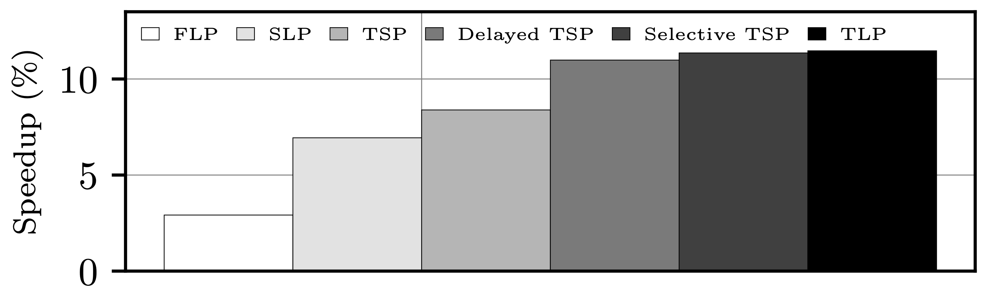
Performance contribution of each TLP component
We breakdown the the performance contribution of each building blocks of the final TLP proposal:
FLP —> 2.9%
SLP —> 6.9%
TSP —> 8.4%
Delayed TSP —> 10.2%
Selective TSP —> 11.4%
TLP —> 11.5%

Slide 32
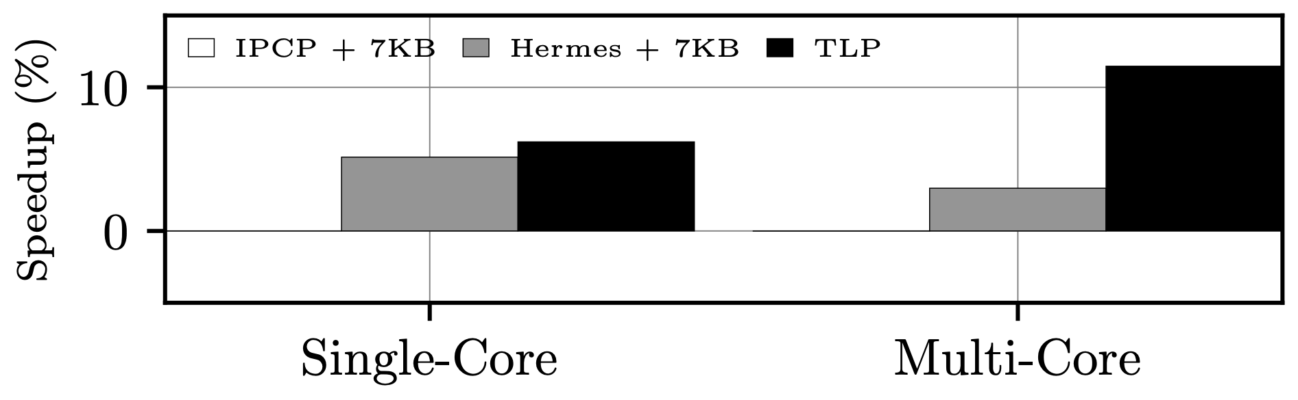
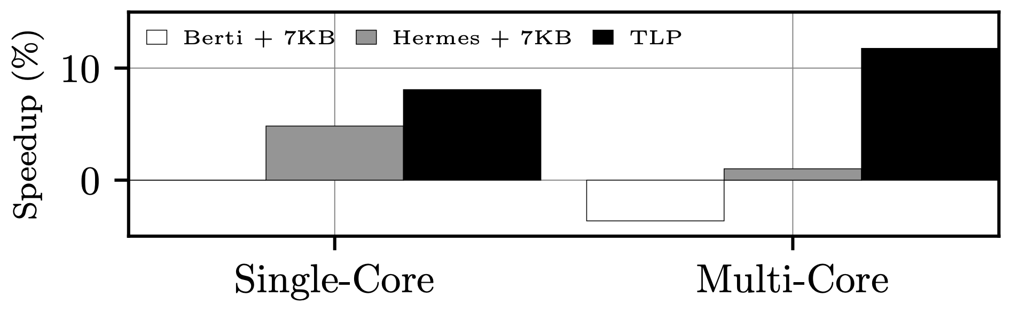
Enhanced designs with TLP’s budget
Comparing TLP do designs enhanced with TLP’s hardware budget (7KB)
IPCP + 7KB —> Enhancing IPCP does not provide any improvements.
Berti + 7KB —> Single-core: 0.0% | Multi-core: -3.6%
Hermes + 7KB —> Single-core: 5.2% | Multi-core: 4.8%

