Slide 1
Characterizing the impact of last-level cache replacement policies on big-data workloads
2020 IEEE International Symposium on Workload Characterization
Alexandre Valentin Jamet, Lluc Alvarez, Danial A. Jiménez, Marc Casas

Slide 2

Introduction

Slide 3
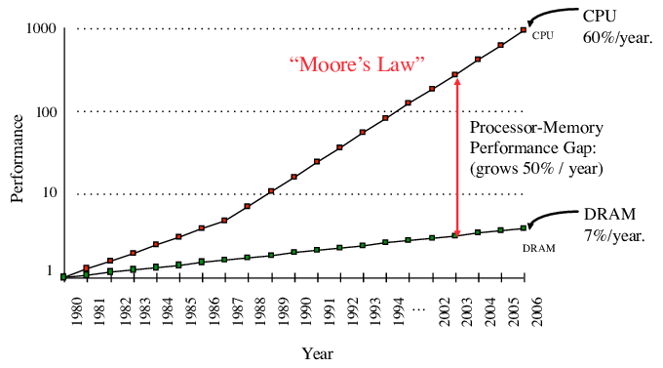
Hitting the memory wall
The CPU/memory performance gap has been increasing for decades
The addition of caches partially hid the long access times to memory systems retaining valuable data
Replacement policies are responsible of eviction choice:
How long in the future will that block be useful?

Slide 4
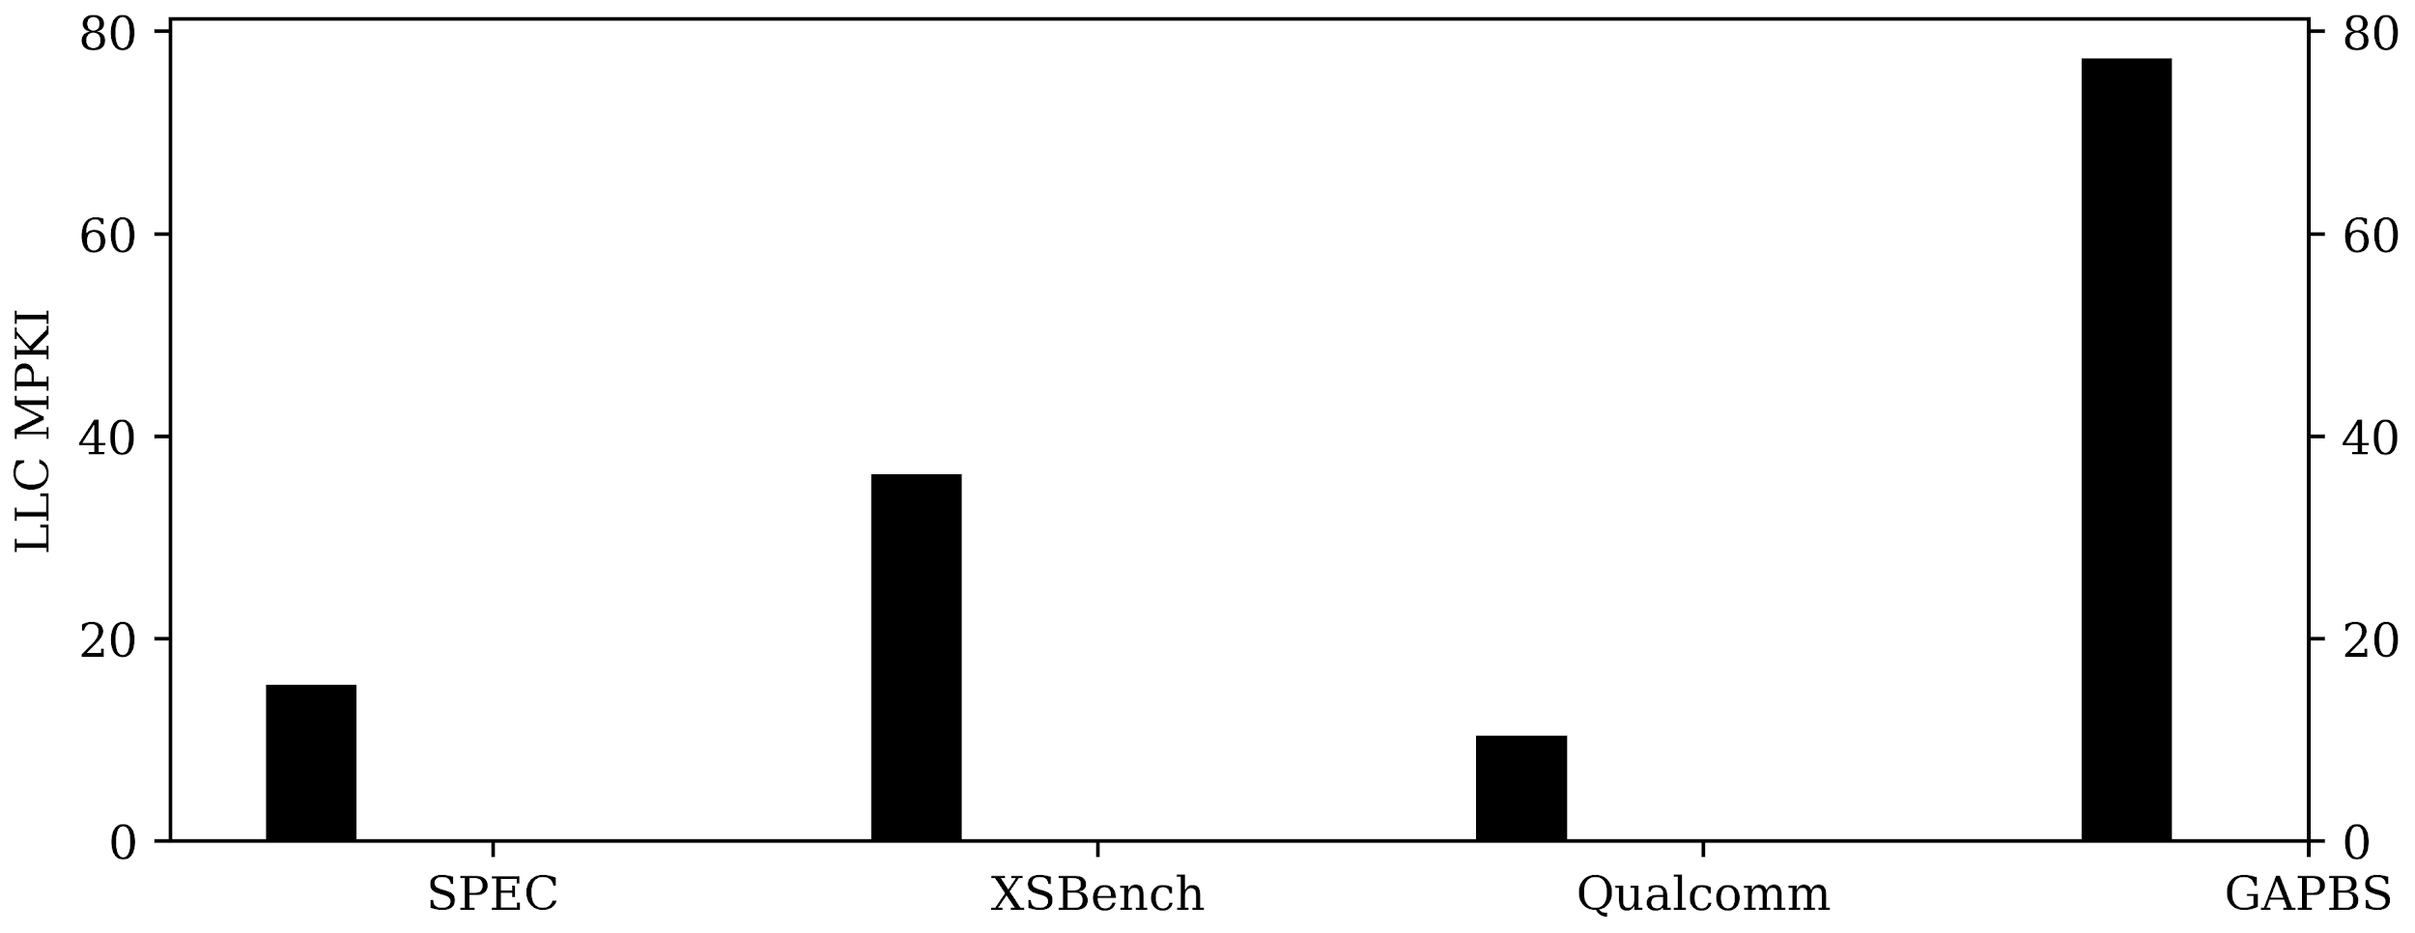
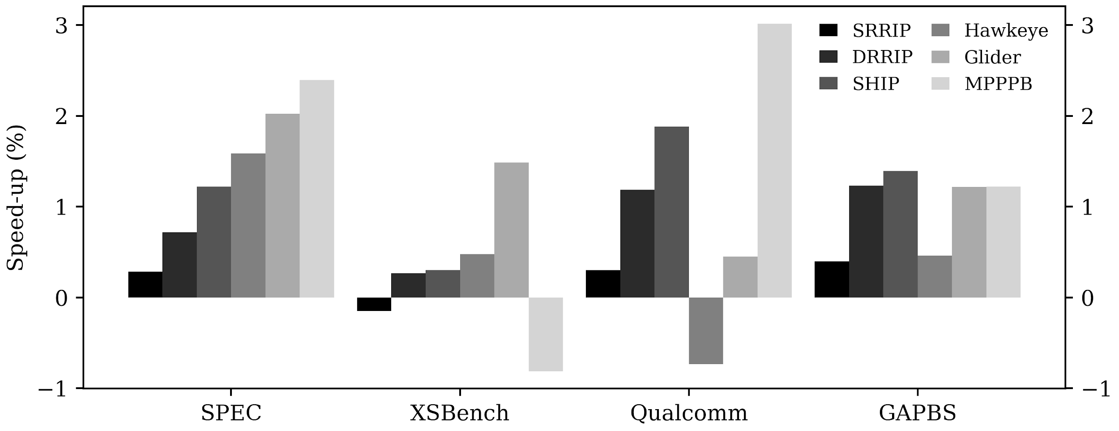
LLC Replacement policies facing new workloads
Cache replacement are responsible of the eviction candidate on cache misses:
How far in the future this block will be useful?
Literature contains advanced replacement policies delivering great performance improvements for well-known workloads (e.g. SPEC CPU 2006 & 2017)
New workloads, showing poor locality and high memory intensivity, leave LLC replacement policies helpless.
Results reported using methodology described in slide []

Slide 5
Workloads

Slide 6
SPEC & Qualcomm workloads
SPEC CPU 2006 & 2017 are standard workloads commonly used in Computer Architecture for evaluation purpose
Composed of a wide variety of commonly used
Compilers, data-compression, AI algorithms, physics, etc.
Qualcomm workloads are industrial workloads provided by Qualcomm
Used in the context of CVP1 (Value Prediction) contest
This benchmark suite is comprised of a mix of data-base & server workloads
Redis
MongoDB
etc.

Slide 7
GAP Benchmarks: Graph-Processing workloads
The GAP Benchmark Suite is shipped with both input graphs and kernels widely used in academia and industry.
Graph inputs:
BC, BFS, CC, PR, SSSP, TC
twitter, kron, urand, web, road
We run each possible combination of inputs / kernels
Graphs are organized using the CSR format
Stores the transition matrix of graph
Reduces memory footprint of a graph
This organization leads to indirect memory accesses:
A[B[i]]
Indirection depends on the graph topology
The property array of the graph is thus traversed with no specific pattern

Slide 8
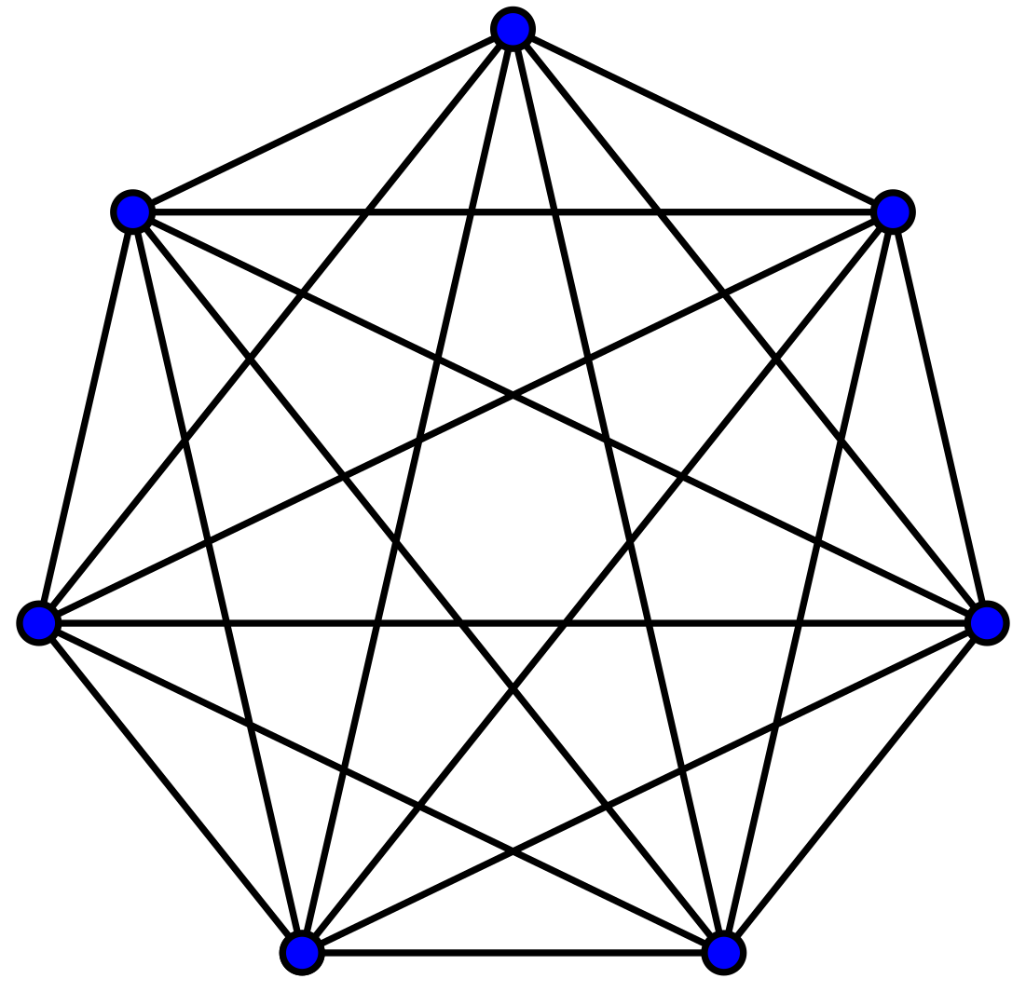
GAP Benchmarks: Graph-Processing workloads
Graph-processing is an emerging type of HPC workloads, with a wide variety of usage:
Social networks
Mobility (e.g. GPS)
Search engines,
etc.
By design, they exhibit corner cases for current computer architecture
Very large memory footprint
Highly irregular access patterns
etc.

Slide 9
GAP Benchmarks: Graph-Processing workloads
An example with PageRank
Graphs are organized using the CSR format
Stores the transition matrix of graph
Reduces memory footprint of a graph
This organization leads to indirect memory accesses:
A[B[i]]
Indirection depends on the graph topology
The property array of the graph is thus traversed with no specific pattern
PageRank is a rather simple graph kernel as it simply spans all edges of the graph
OA
0
2
2
4
5
7
8
CA
0
1
2
7
3
0
1
…
0
2
2
4
5
7
7
7
PA

Slide 10
GAP Benchmarks: Graph-Processing workloads
An example with PageRank
Graphs are organized using the CSR format
Stores the transition matrix of graph
Reduces memory footprint of a graph
This organization leads to indirect memory accesses:
A[B[i]]
Indirection depends on the graph topology
The property array of the graph is thus traversed with no specific pattern
PageRank is a rather simple graph kernel as it simply spans all edges of the graph
OA
0
2
2
4
5
7
8
CA
0
1
2
7
3
0
1
…
PA
0
2
2
4
5
7
7
7

Slide 11
GAP Benchmarks: Graph-Processing workloads
An example with PageRank
Graphs are organized using the CSR format
Stores the transition matrix of graph
Reduces memory footprint of a graph
This organization leads to indirect memory accesses:
A[B[i]]
Indirection depends on the graph topology
The property array of the graph is thus traversed with no specific pattern
PageRank is a rather simple graph kernel as it simply spans all edges of the graph
OA
0
2
2
4
5
7
8
CA
0
1
2
7
3
0
1
…
PA
0
2
2
4
5
7
7
7

Slide 12
GAP Benchmarks: Graph-Processing workloads
An example with PageRank
Graphs are organized using the CSR format
Stores the transition matrix of graph
Reduces memory footprint of a graph
This organization leads to indirect memory accesses:
A[B[i]]
Indirection depends on the graph topology
The property array of the graph is thus traversed with no specific pattern
PageRank is a rather simple graph kernel as it simply spans all edges of the graph
OA
0
2
2
4
5
7
8
CA
0
1
2
7
3
0
1
…
PA
0
2
2
4
5
7
7
7

Slide 13
GAP Benchmarks: Graph-Processing workloads
An example with PageRank
Graphs are organized using the CSR format
Stores the transition matrix of graph
Reduces memory footprint of a graph
This organization leads to indirect memory accesses:
A[B[i]]
Indirection depends on the graph topology
The property array of the graph is thus traversed with no specific pattern
PageRank is a rather simple graph kernel as it simply spans all edges of the graph
OA
0
2
2
4
5
7
8
CA
0
1
2
7
3
0
1
…
PA
0
2
2
4
5
7
7
7

Slide 14
GAP Benchmarks: Graph-Processing workloads
An example with PageRank
Graphs are organized using the CSR format
Stores the transition matrix of graph
Reduces memory footprint of a graph
This organization leads to indirect memory accesses:
A[B[i]]
Indirection depends on the graph topology
The property array of the graph is thus traversed with no specific pattern
PageRank is a rather simple graph kernel as it simply spans all edges of the graph
OA
0
2
2
4
5
7
8
CA
0
1
2
7
3
0
1
…
PA
0
2
2
4
5
7
7
7

Slide 15
GAP Benchmarks: Graph-Processing workloads
An example with PageRank
Graphs are organized using the CSR format
Stores the transition matrix of graph
Reduces memory footprint of a graph
This organization leads to indirect memory accesses:
A[B[i]]
Indirection depends on the graph topology
The property array of the graph is thus traversed with no specific pattern
PageRank is a rather simple graph kernel as it simply spans all edges of the graph
OA
0
2
2
4
5
7
8
CA
0
1
2
7
3
0
1
…
PA
0
2
2
4
5
7
7
7

Slide 16
GAP Benchmarks: Graph-Processing workloads
An example with PageRank
Graphs are organized using the CSR format
Stores the transition matrix of graph
Reduces memory footprint of a graph
This organization leads to indirect memory accesses:
A[B[i]]
Indirection depends on the graph topology
The property array of the graph is thus traversed with no specific pattern
PageRank is a rather simple graph kernel as it simply spans all edges of the graph
OA
0
2
2
4
5
7
8
CA
0
1
2
7
3
0
1
…
PA
0
2
2
4
5
7
7
7

Slide 17
GAP Benchmarks: Graph-Processing workloads
An example with PageRank
Graphs are organized using the CSR format
Stores the transition matrix of graph
Reduces memory footprint of a graph
This organization leads to indirect memory accesses:
A[B[i]]
Indirection depends on the graph topology
The property array of the graph is thus traversed with no specific pattern
PageRank is a rather simple graph kernel as it simply spans all edges of the graph
OA
0
2
2
4
5
7
8
CA
0
1
2
7
3
0
1
…
PA
0
2
2
4
5
7
7
7

Slide 18
GAP Benchmarks: Graph-Processing workloads
An example with PageRank
Graphs are organized using the CSR format
Stores the transition matrix of graph
Reduces memory footprint of a graph
This organization leads to indirect memory accesses:
A[B[i]]
Indirection depends on the graph topology
The property array of the graph is thus traversed with no specific pattern
PageRank is a rather simple graph kernel as it simply spans all edges of the graph
Pattern looks random, right? Imagine with real size graphs…
OA
0
2
2
4
5
7
8
CA
0
1
2
7
3
0
1
…
PA
0
2
2
4
5
7
7
7

Slide 19
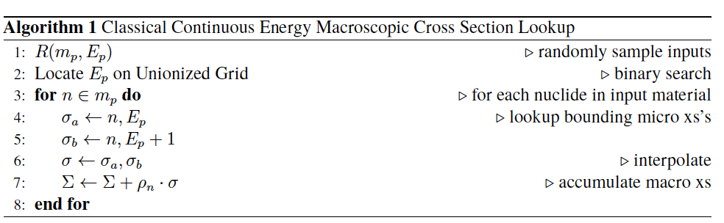
XSBench: Scientific workloads
XSBench is an initiative of Tramm and Siegel to build an approximation of OpenMC (a simulation used in Nuclear Physics) by exposing only the core code.
In an effort to approximate the real behavior of such a simulation, the events triggering cross-section lookups are randomly generated
Authors argue that it is a very good approx.
Lead to hard-to-predict access patterns & poor cache utilization

Slide 20
Replacement Policies

Slide 21
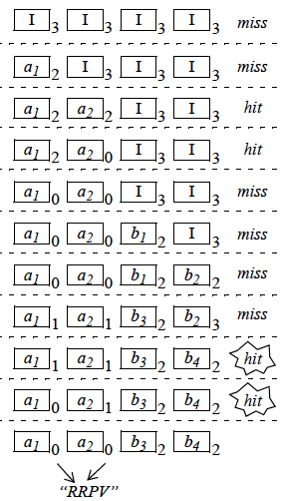
Reuse-Distance Prediction
SRRIP & DRRIP are based on the idea of Re-Reference Prediction
They try to classify blocks in groups from immediate-reuse to distant-reuse
Blocks classified as distant-reuse will be favored for eviction

Slide 22
Signature-based Hit Prediction
SHiP is a dead-block predictor based on SRRIP
It learns the likelihood of blocks with similar signatures to experience hits
On a hit the counter associated to a signature is incremented
The SRRIP insertion policy is modified
Low confidence blocks are inserted in the distant-reuse position

Slide 23
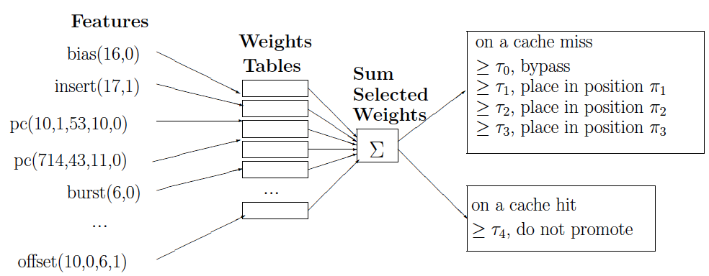
Multiperspective Reuse Prediction
Multiperspective Reuse Prediction is a dead-block prediction & bypass mechanism
A sampler triggers learning signals based on whether a block hits or gets evicted
A hashed-perceptron is used to learn correlation between the access patterns and features
Features are obtained through a « gradient-descent » algorithm
On an access, the hashed-perceptron is indexed to build a prediction value
Actions are triggered depending on the prediction value

Slide 24
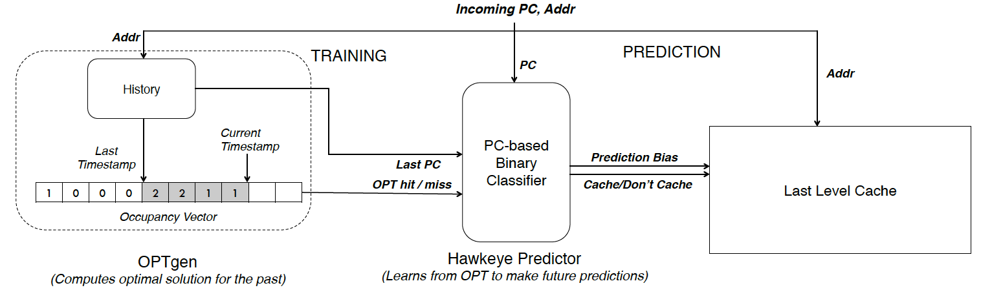
Optimal Replacement Approximation
Techniques such as Glider & Hawkeye intend to approximate Belady’s MIN replacement.
Jain’s OPTgen component is used generate binary learning signals on whether a block should be kept in the cache.
A predictor is then used to learn correlations and to produce prediction

Slide 25
Methodology

Slide 26
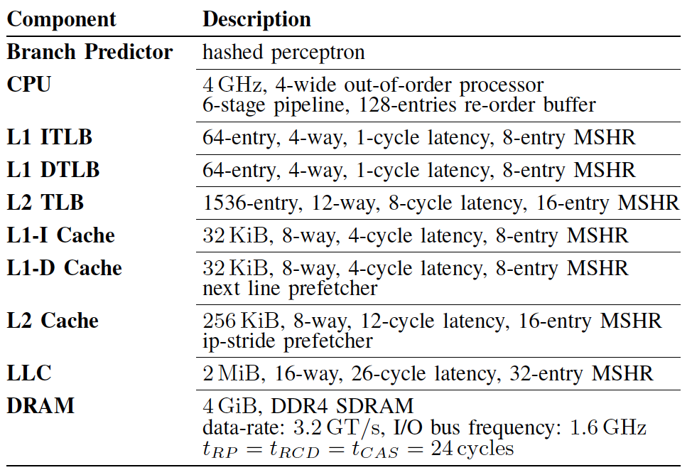
Methodology & tools
Using ChampSim, a detailed trace-based simulator
Out-of-Order CPU
Memory hierarchy
Knobs are shown in the table
Traces are obtained with the SimPoints methodology
each trace is 1B instructions long
Up to 10 traces/workload representative $≥$ 5%
Graph-processing traces cover all the possible combination of kernel/input-graph

Slide 27
Proposed designs

Slide 28
Extensions to MPPPB
To cope with the different nature of the newly introduced workloads, we introduce two extensions to the Multiperspective Reuse Prediction
Designed to adapt the predictor to phase changes & correlation with different features

Slide 29
Extensions to MPPPB (MS-MPPPB)
PC, Addr &
other features
To cope with the different nature of the newly introduced workloads, we introduce two extensions to the Multiperspective Reuse Prediction
Designed to adapt the predictor to phase changes & correlation with different features
MS-MPPPB: makes use of multiple samplers
MS-MPPPB extends the original Multiperspecitve by using 4 samplers & 4 hashed-perceptrons
Each samplers are accessed in parallel on an access
The associated hashed-perceptrons are trained
When the cache needs a prediction, the best hashed-perceptron is selected using a set-dueling mechanism
LLC
Sampler #1
Sampler #2
training signals
Perceptron #1
Perceptron #2
set-dueling
prediction

Slide 30
Extensions to MPPPB (DS-MPPPB)
To cope with the different nature of the newly introduced workloads, we introduce two extensions to the Multiperspective Reuse Prediction
Designed to adapt the predictor to phase changes & correlation with different features
DS-MPPPB: allows to dynamically select the best behaving features in a phase-wise manner
The « quality » of a feature is measured through a « coefficient »
DS-MPPPB extends the original Multiperspective by training a large set of 64 features while predicting with only a subset of the 16 features
On a prediction, only the 16 best behaving features are used
…
$$τ_{0}$$
…
$$τ_{0}$$
…
$$τ_{0}$$
…
$$τ_{0}$$
…
$$τ_{0}$$
…
$$τ_{0}$$
…
$$τ_{0}$$
…
$$τ_{0}$$

Slide 31
Extensions to MPPPB (DS-MPPPB)
To cope with the different nature of the newly introduced workloads, we introduce two extensions to the Multiperspective Reuse Prediction
Designed to adapt the predictor to phase changes & correlation with different features
DS-MPPPB: allows to dynamically select the best behaving features in a phase-wise manner
The « quality » of a feature is measured through a « coefficient »
DS-MPPPB extends the original Multiperspective by training a large set of 64 features while predicting with only a subset of the 16 features
On a prediction, only the 16 best behaving features are used
…
$$τ_{0}$$
…
$$τ_{1}$$
…
$$τ_{2}$$
Adder
…
$$τ_{3}$$
…
$$τ_{4}$$
…
$$τ_{5}$$
…
$$τ_{6}$$
…
$$τ_{7}$$

Slide 32
Results & Discussion

Slide 33
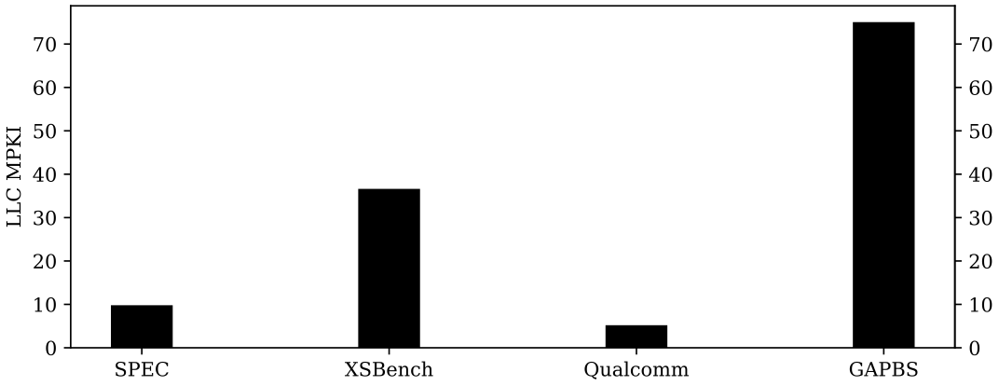

Motivation
Comparing SPEC CPU 2006 & 2017 to other domains workloads
LLC MPKI with baseline LRU policy
Speed-up over LRU for state-of-the-art replacement policies
Compared to the newly introduced benchmark, SPEC workloads do not stress the LLC in terms of misses
SPEC workloads show speed-up incremental improvement with the introduction of new replacement techniques
Such techniques do not benefit the newly introduced benchmark suites

Slide 34
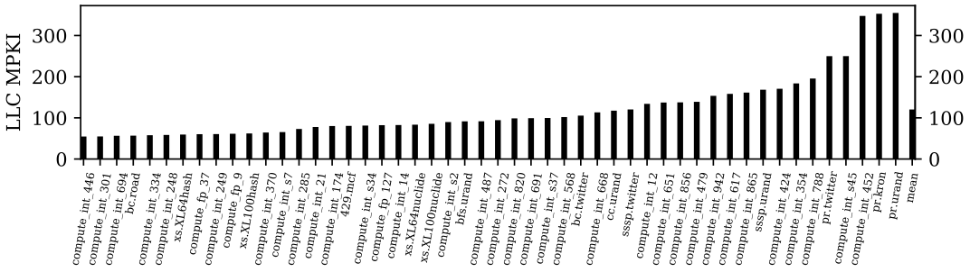
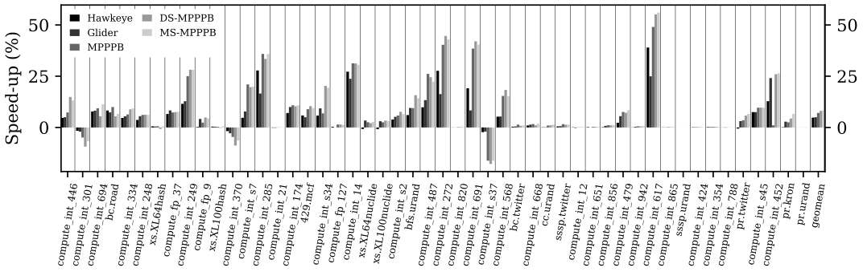
Misses & Performance (1/2)
N.B.: Showing the 50 most intensive workloads among the available ones
Average LLC MPKI is very high due the new workloads (XSBench, Qualcomm, GAP)
The 50 most intensive workloads being dominated by a mix of XSBench, Qualcomm and GAP shows the clear necessity to introduce them in further evaluation of replacement policies

Slide 35
Misses & Performance (2/2)
Simulating state-of-the-art replacement policies (Hawkeye, Glider, Multiperspective)
Adding two custom designs derived from Multiperspetive
Glider & Multiperspective, techniques based on AI, are failing at generalizing to not explored yet workloads
Hence the need to include these workloads in further work
Multiperspective derived techniques generalize better by dynamically adapting the correlating features and deliver better performance
8.0 % for DS-MPPPB
8.3 % for MS-MPPPB

Slide 36
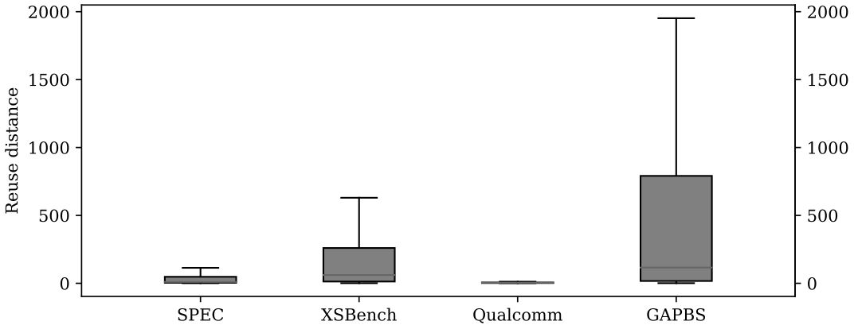
Reuse-distance (1/2)
Reuse-distance is the number of accesses separating two consecutive usages of a block
$D≥16$ means that block was dead
$D<16$ means that the block was useful
SPEC & Qualcomm are mostly cache-friendly
Distributions’ properties show that some Qualcomms show a very cache-averse behavior
XSBench & GAP workloads are more biased towards a cache-averse behavior
Median reuse-distance is rather high
Parameters | SPEC | XSBench | Qualcomm | GAP
Maximum | 21 076 | 12 677 | 59 934 | 34 836
Median | 10 | 61 | 4 | 116
Mean | 126.23 | 343.23 | 93.76 | 907.89
Std. | 572.94 | 875.68 | 541.80 | 2106.41
Avg. dead block | 48.03% | 37.32% | 28.01% | 55.84%

Slide 37
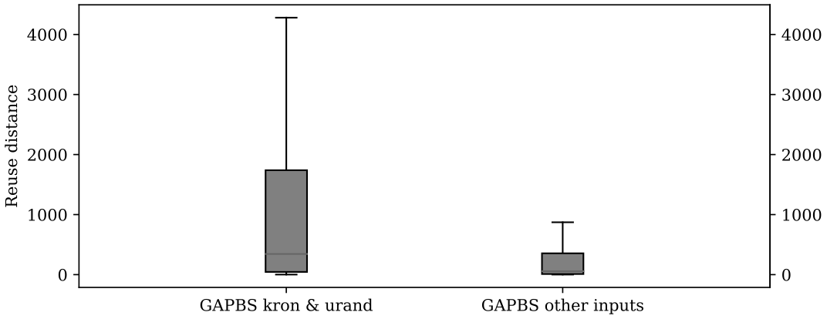
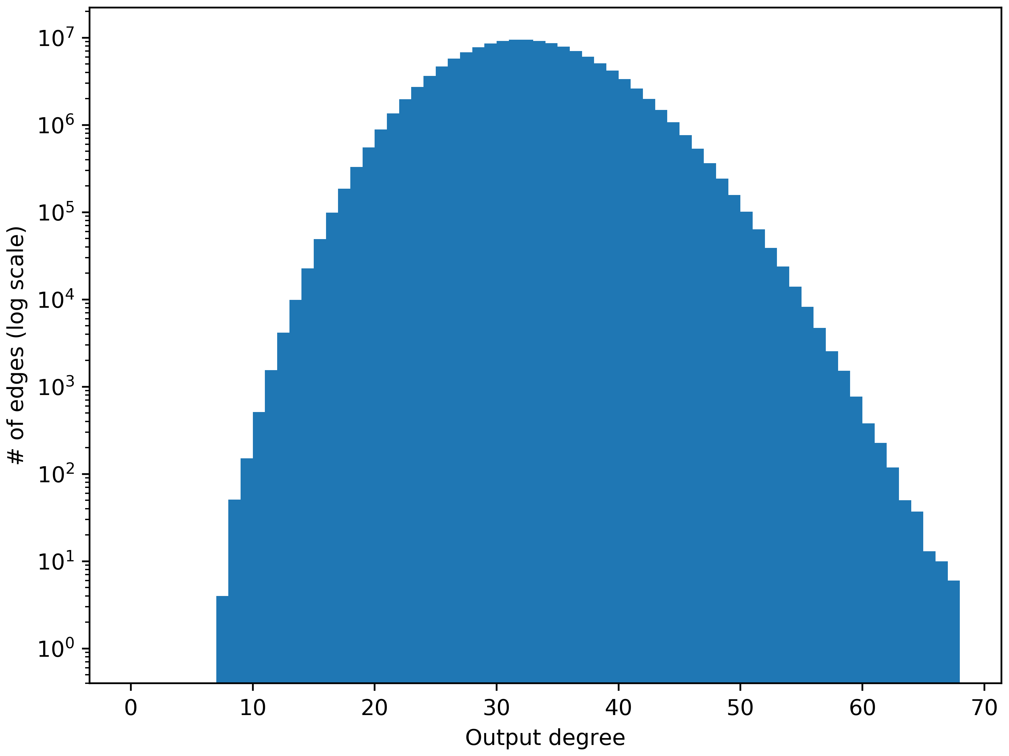
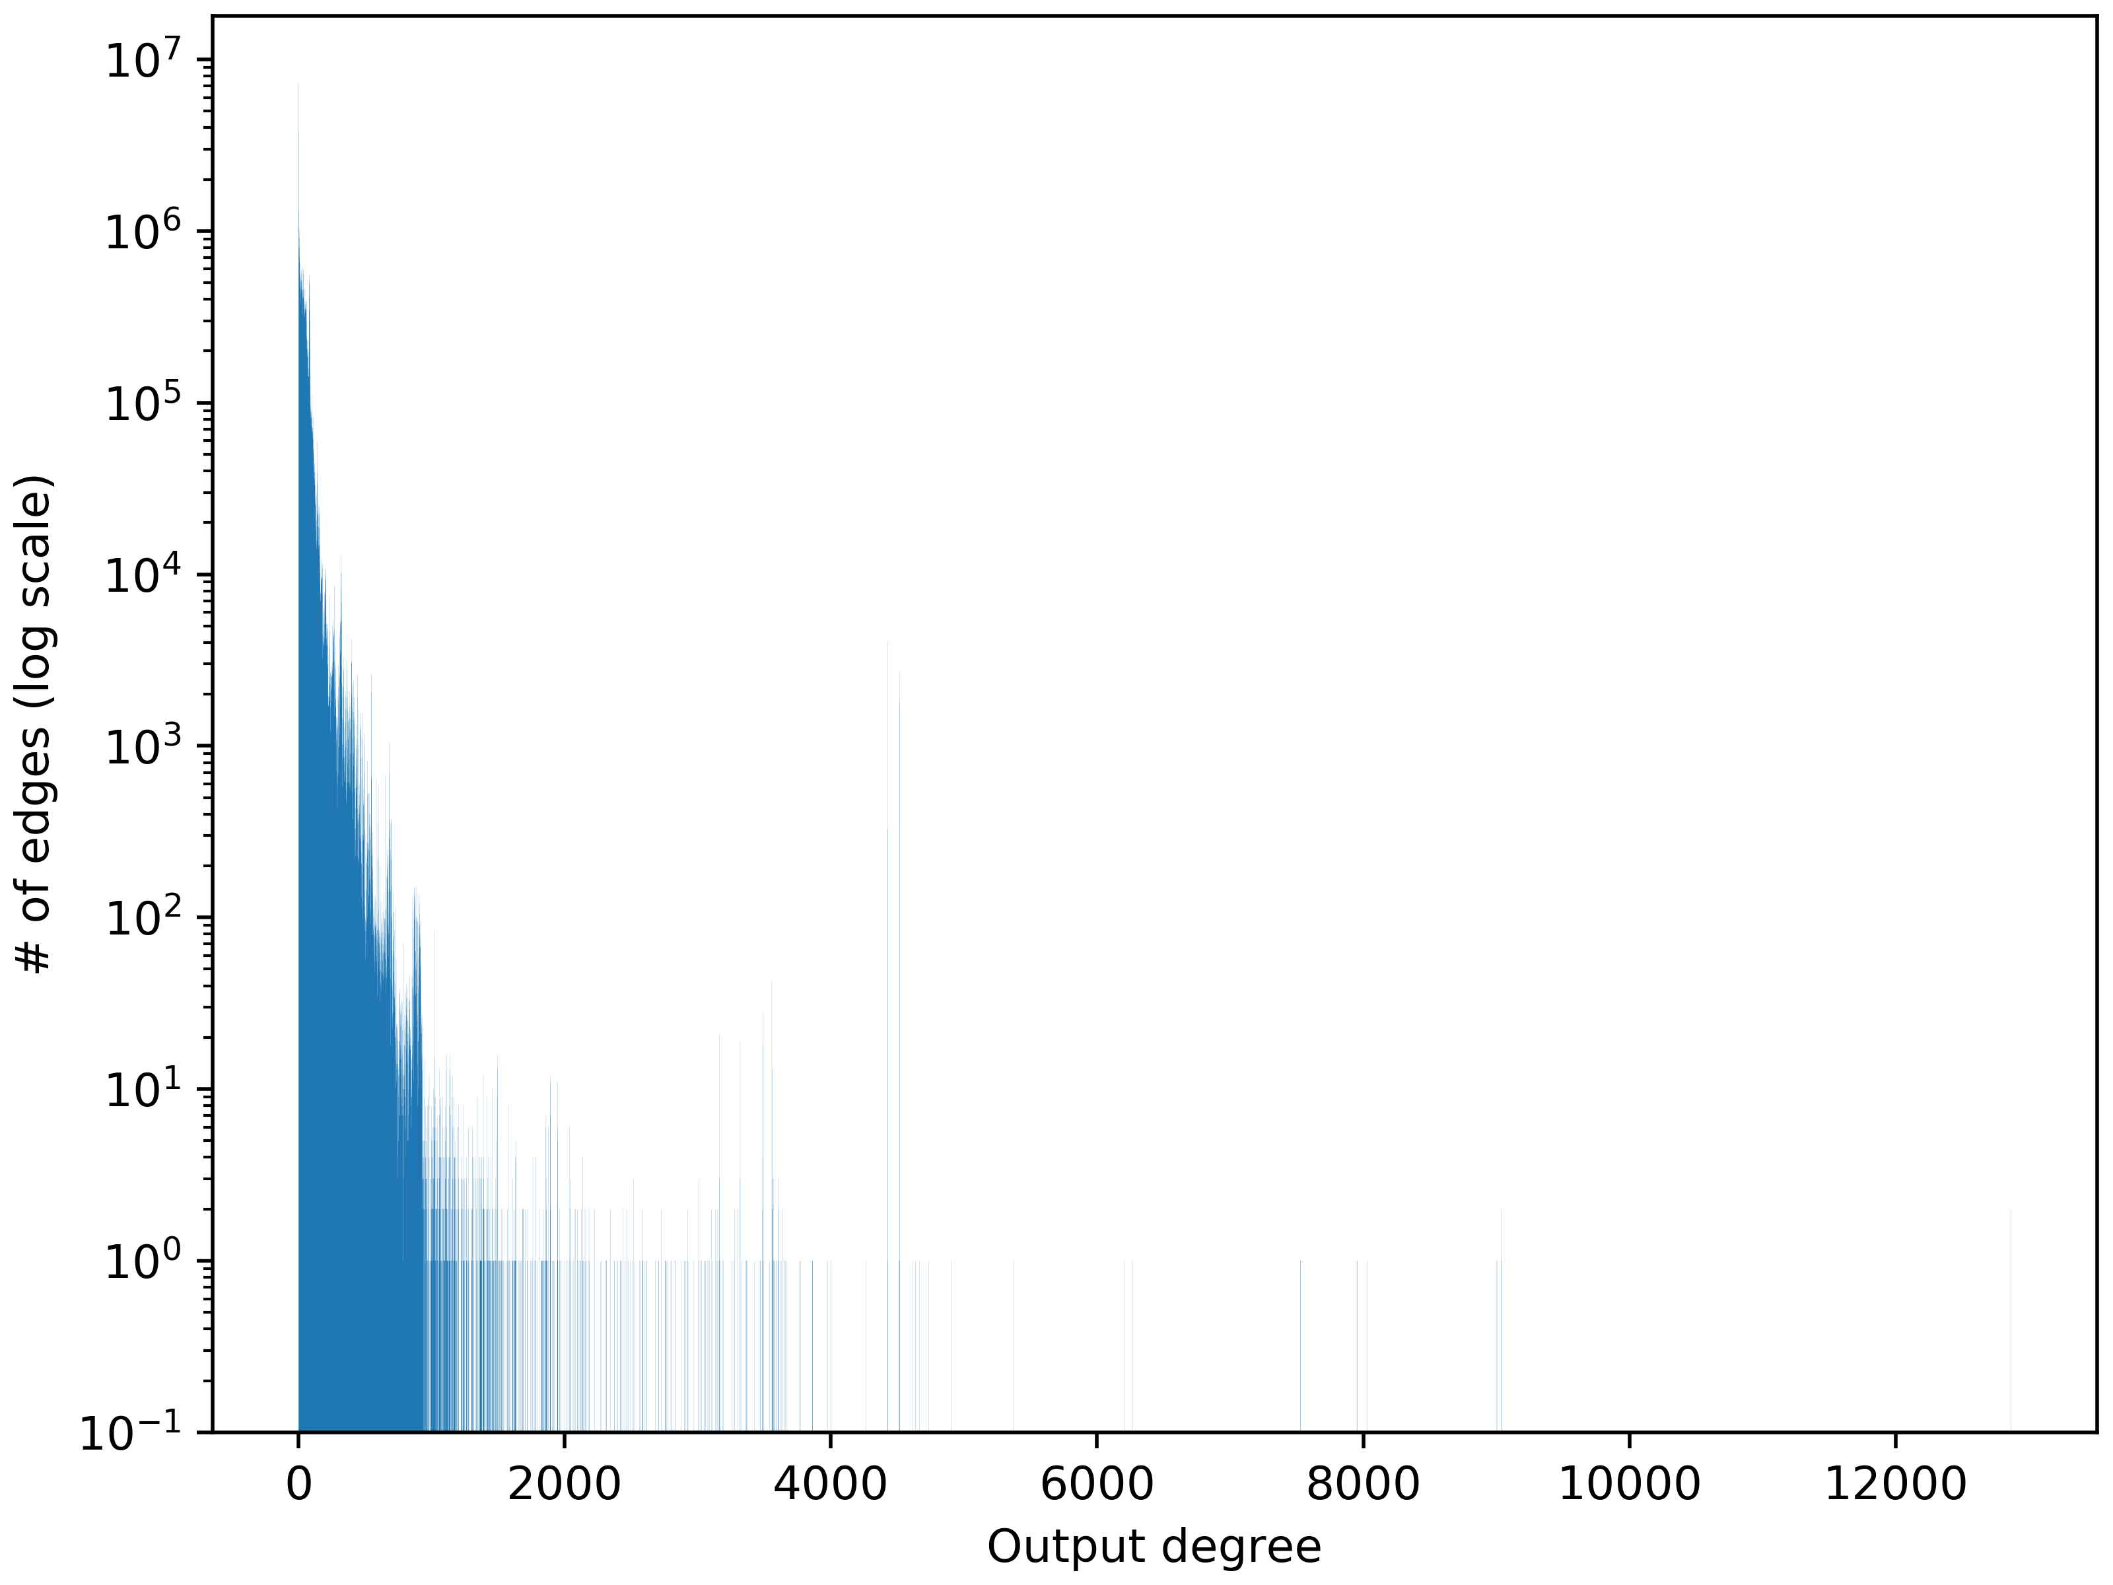
Reuse-distance (2/2)
The reuse-distance figure clearly shows a high correlation between the input-graph & the workloads’ behavior
kron & urand produce the most cache-averse workloads
High LLC MPKI (c.f. slide 29)
Relatively poor improvement over LRU of the state-of-the-art replacement policies
The behavior of this graphs can be correlated to theirs degree distributions
Avg. degree
Shape of the distribution
$|V||E|$, # of vertices & edges
etc.

Slide 38
Conclusion

Slide 39
Thank you for your attention!

