Slide 1






Practically Tackling Memory Bottlenecks of Graph-Processing Workloads
alexandre.jamet@bsc.es
Alexandre Valentin Jamet^{1,2}, Georgios Vavouliotis³, Lluc Alvarez^{1,2}, Daniel A. Jiménez⁴, Marc Casas^{1,2}
¹Barcelona Supercomputing Center
²Universitat Politècnica de Catalunya
³Huawei Zurich Research Center
⁴Texas A&M University
Notes:
Simply introducing the paper’s title and the authors. Quick.

Slide 2

Executive Summary
Emerging workloads (e.g., graph processing) have massive data footprints
Significant pressure on the caches
Latency Tolerance Techniques:
Domain-specialised Cache Management (e.g., T-OPT (HPCA’21))
Irregular Memory Prefetching (e.g., IMP (MICRO’15))
Graph pre-processing schemes (e.g., Goder (SIGMOD’17))
Notes:
Quickly span through the problem of modern workloads (i.e., large data footprint).
Then, go on to explaining the different techniques available to workaround these problems:
Off-Chip Prediction (Predicting load demand accesses for cache hits)
Data Prefetching coupled with Adaptive Filtering (Improving prefetching for adaptive workload handling)
Cache bypassing (Selective bypass strategies for system performance)
Disruptive cache designs (Innovative architectures for efficiency and performance)

Slide 3
Executive Summary
Emerging workloads (e.g., graph processing) have massive data footprints
Significant pressure on the caches
Latency Tolerance Techniques:
Domain-specialised Cache Management (e.g., T-OPT (HPCA’21))
Irregular Memory Prefetching (e.g., IMP (MICRO’15))
Graph pre-processing schemes (e.g., Goder (SIGMOD’17))
Limitations in Domain-specialised Cache Management mechanisms:
Require extensive disruption to the memory sub-system and/or ISA.
Our approach:
Predicting irregular access patterns in graph-processing workloads.
Leverage a split approach to managing access patterns.
Notes:
Quickly span through the problem of modern workloads (i.e., large data footprint).
Then, go on to explaining the different techniques available to workaround these problems:
Off-Chip Prediction (Predicting load demand accesses for cache hits)
Data Prefetching coupled with Adaptive Filtering (Improving prefetching for adaptive workload handling)
Cache bypassing (Selective bypass strategies for system performance)
Disruptive cache designs (Innovative architectures for efficiency and performance)

Slide 4
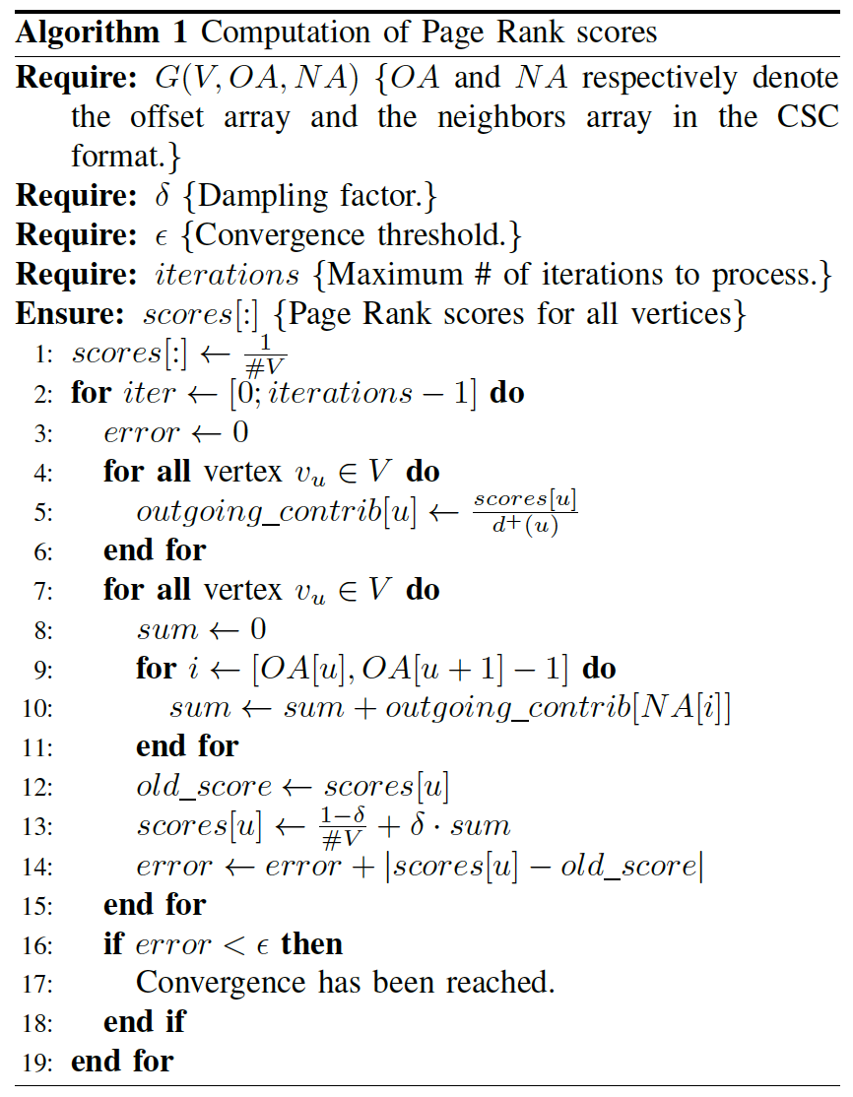
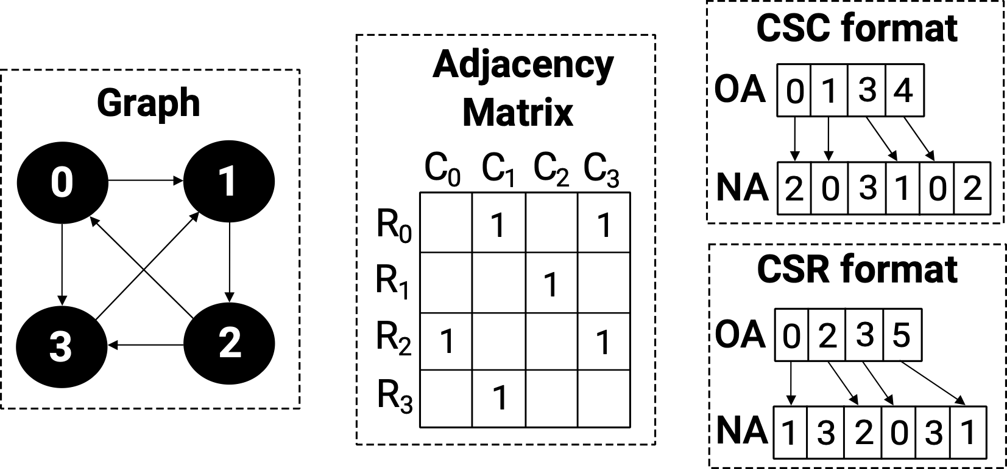
Graph Representation and its Implications
Graphs are usually represented as sparse matrices (e.g., CSR/CSC formats)
The adjacency matrix of the graphs are usually sparse and benefit from such formats
Graph traversal cause very irregular access patterns similar to Sparse Algebra workloads
Notes:
Here, we mention that modern workloads (and particularly GAP) put large load on the cache hierarchy.

Slide 5
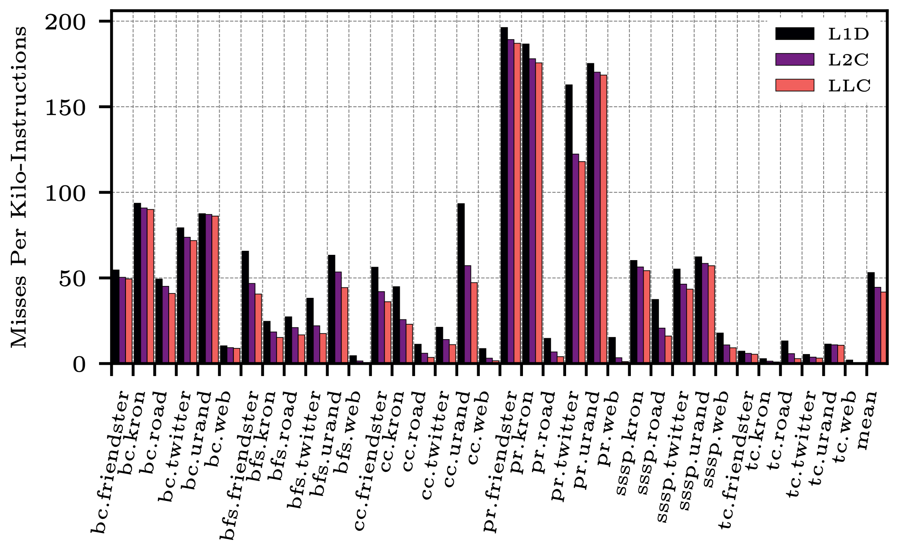
Cache Behaviour of Modern Workloads
For GAP workloads, we analyse the load in the cache hierarchy
On average, 78.6% of L1D misses eventually require a DRAM access
Graph workloads exhibit irregular access pattern that caches can hardly capture
Graph-processing workloads exhibit very high MPKI rates in all cache levels.
Notes:
Here, we mention that modern workloads (and particularly GAP) put large load on the cache hierarchy.

Slide 6
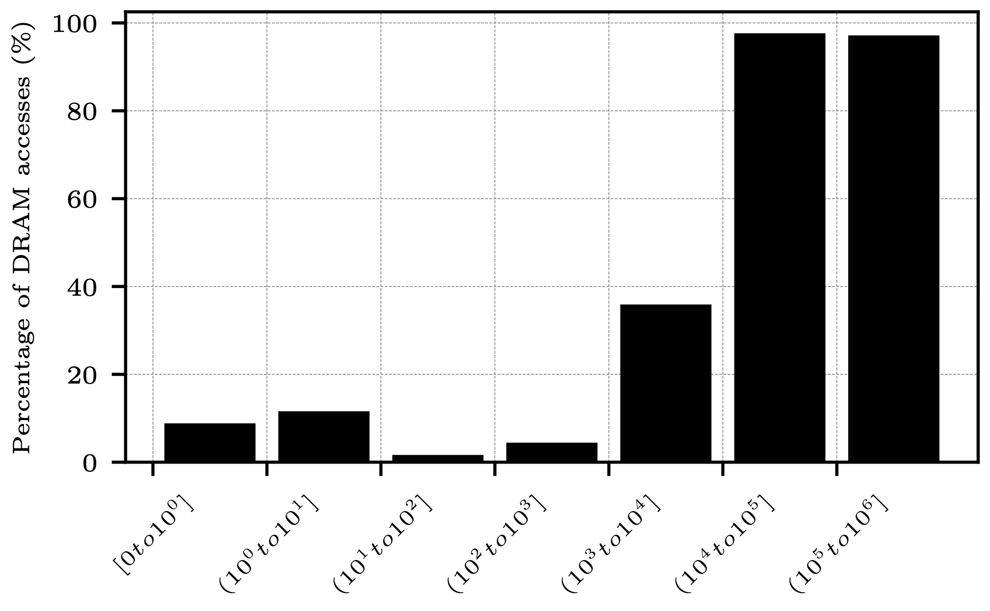
Characteristics of Memory Access
For instructions showing large strides, accessing DRAM is more likely
For strides between 2 and 10, accessing DRAM has an 11.6% probability
For strides between 10⁵+1 and 10⁶, accessing DRAM has an 97.6% probability
Memory accesses featuring large strides have a very high probability of accessing DRAM.
Notes:
Here, we mention that modern workloads (and particularly GAP) put large load on the cache hierarchy.

Slide 7
SDC+LP: An Approach to Manage Memory Accesses of Graph Workloads
Graph-Processing workloads are intrinsically irregular (i.e., caused by the memory representation and code structure)
Caches are ineffective on such irregular access patterns
Causes a large amount of DRAM accesses
Load instructions hitting the DRAM can be identified through the strides they generate
We propose the Large Predictor (LP) to identify such load instructions
These accesses cause tremendous cache pollution
We propose the Side Data Cache (SDC) to isolate accesses relative to irregular load instructions
We assemble LP and the SDC into the SDC+LP design proposal.
Notes:
Here we summarise the findings to transition to the design proposal.

Slide 8
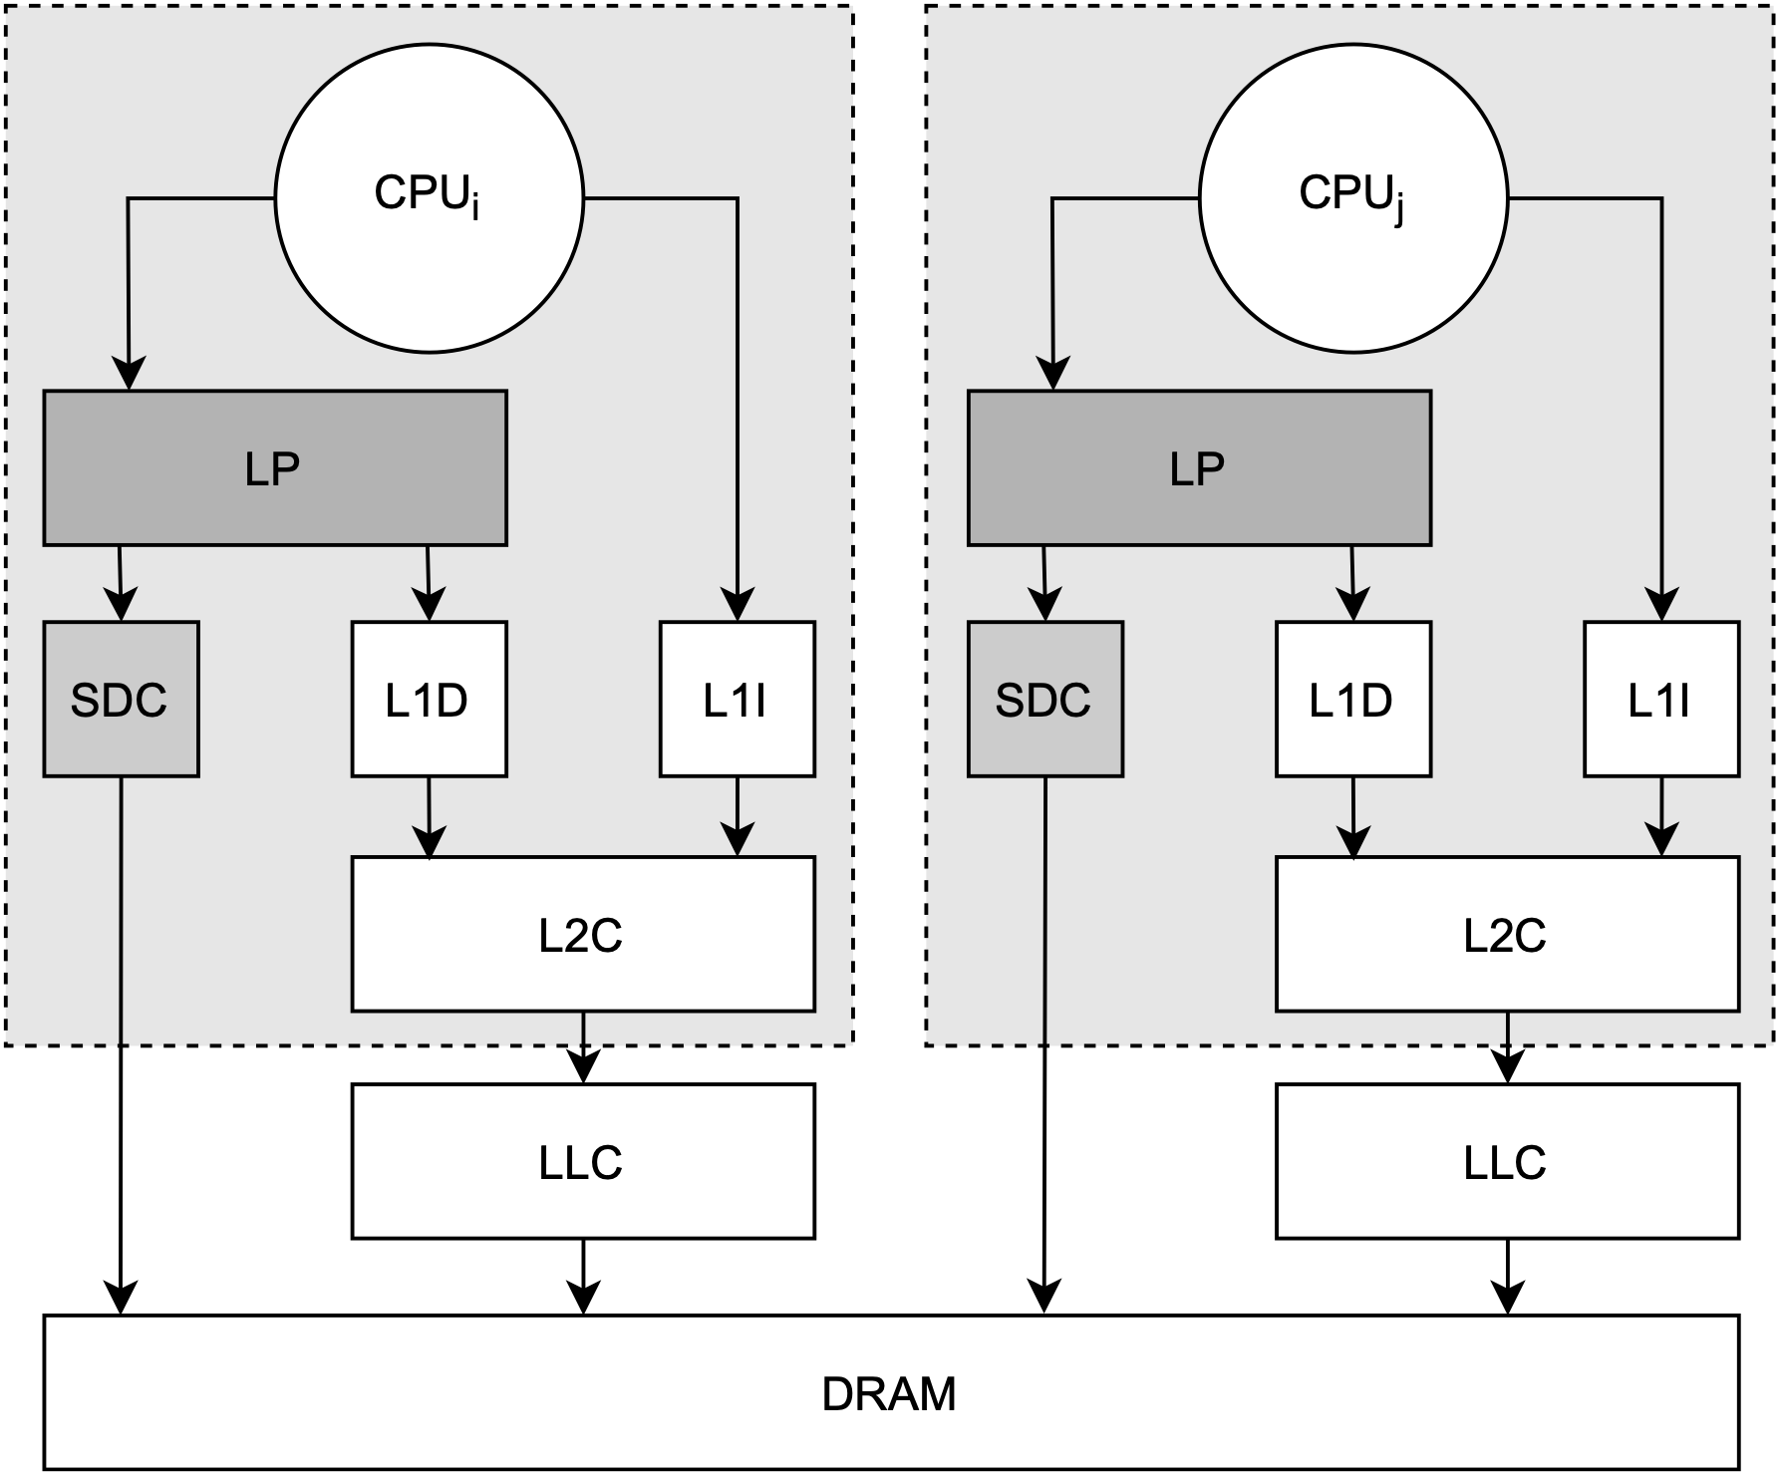
The Side Data Cache (SDC)
The Side Data Cache (SDC) is a small cache sitting alongside the L1D
A large fraction of accesses missing in the L1D, miss in lower levels
Such accesses are directed to the SDC
Prevents cache pollution
Notes:
Here we summarise the findings to transition to the design proposal.

Slide 9
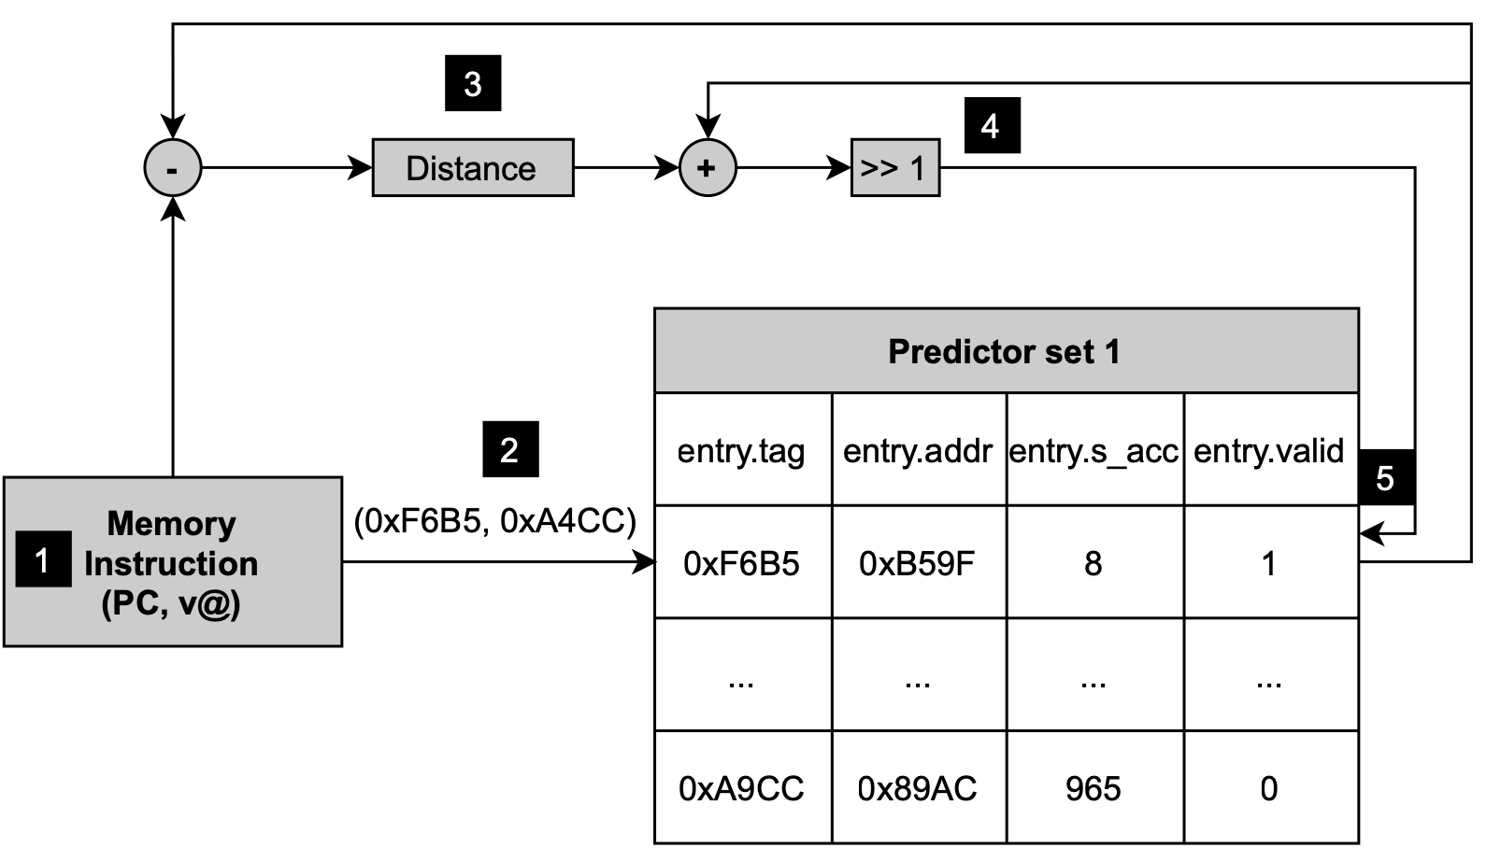
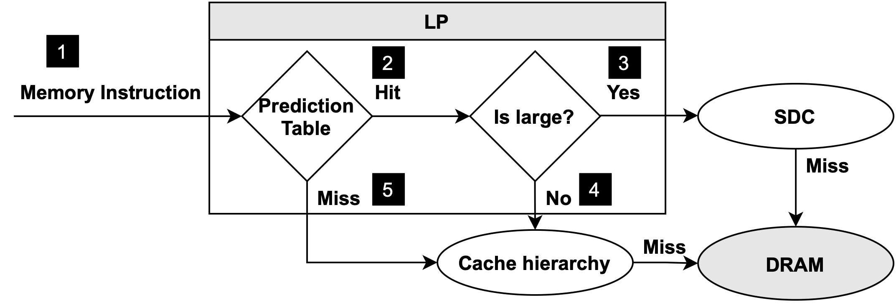
The Large Predictor (LP)
LP is stride-based predictor
LP’s prediction table is indexed by the PC
Each entry contains information relative to the observed strides (avg. distance, virtual address, etc.)
LP is consulted before triggering a memory access:
Prediction outcome:
Regular —> forwarded to the L1D
Irregular —> forwarded to the SDC
LP is trained upon a load demand request
Notes:
Here we summarise the findings to transition to the design proposal.

Slide 10
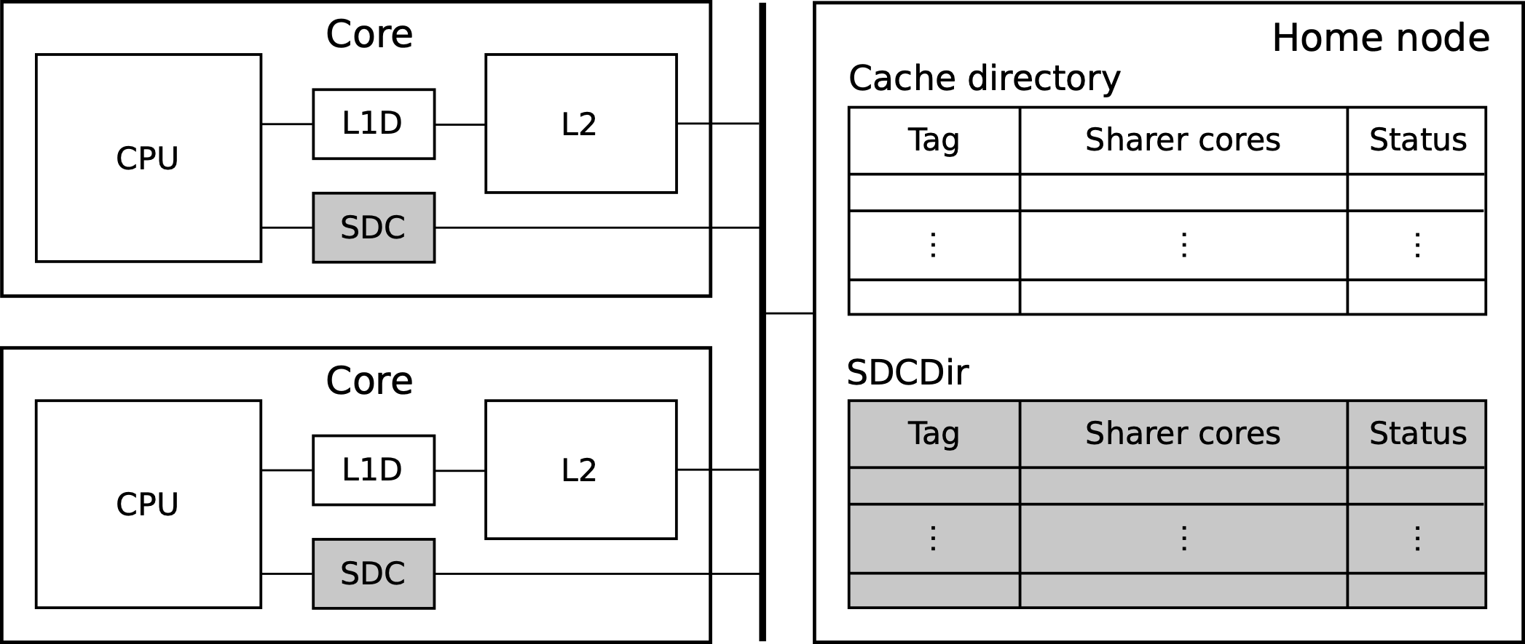
SDC+LP: Managing Coherence
To maintain coherency between the SDC and the caches, we introduce the SDCdir
SDCdir is an extension of the cache directory
Requests from SDCs and L2s simultaneously access both the directory and the SDCdir
Likewise, stores access both the SDCdir and the directory.
Invalidates cache lines in remote cores
Write-back to DRAM if line is dirty
Notes:
Here we summarise the findings to transition to the design proposal.

Slide 11
Experimental Setup
ChampSim simulator (GitHub)
Cascade Lake micro-architecture (specs)
Workloads
GAP Benchmark Suite (36 workloads)
SimPoints methodology
Single-core evaluation
Multi-core evaluation
Component | Parameters | Latency
ITLB | 64-entry, 4-way | 1cc
DTLB | 64-entry, 4-way | 1cc
STLB | 1536-entry, 12-way | 8cc
L1 I-Cache | 32KB, 8-way | 4cc
L1 D-Cache | 32KB, 8-way, Next-Line Prefetcher | 4cc
L2 Cache | 1MB, 16-way, SPP Prefetcher | 10cc
LLC | 1.375MB/core, 11-way | 36/56cc
DRAM | 16GB, tRP=tRCD=tCAS=24cc | variable
Notes:
Here, we simply describe the simulation set-up.

Slide 12
Alternative Techniques
Designs evaluated:
T-OPT
Distill Cache
L1D 40KB ISO
2xLLC
The budget allocated to the SDC is dedicated to the L1D.
Notes:
The alternative techniques we are considering.

Slide 13
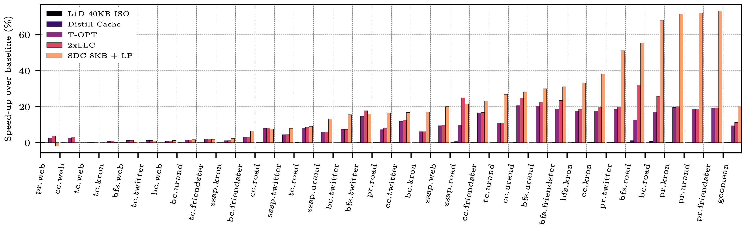
Single-Core Evaluation | Performance
Considering a single-core scenario, SDC+LP outperforms all considered designs
SDC+LP leverages 20.3% speed-up over the baseline as compared to 0.0%, 0.1%, 9.4%, and 11.2% for L1D 40KB ISO, Distill Cache, T-OPT, and 2xLLC, respectively

Slide 14
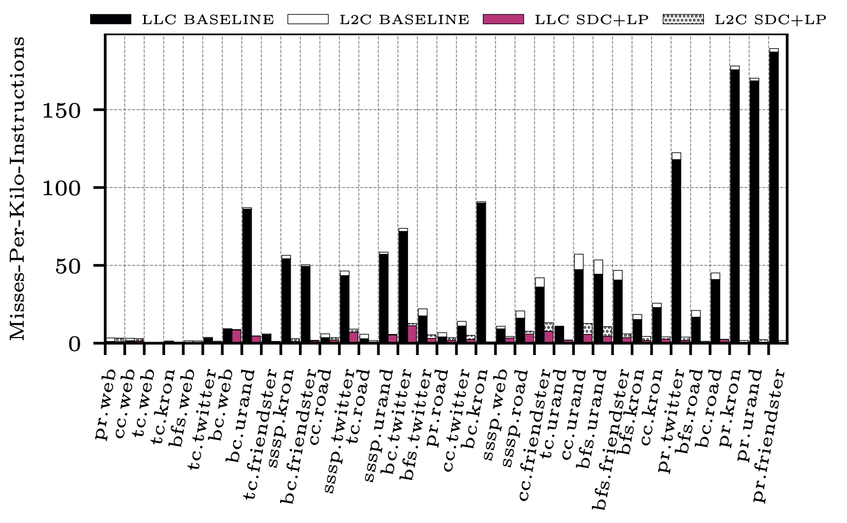
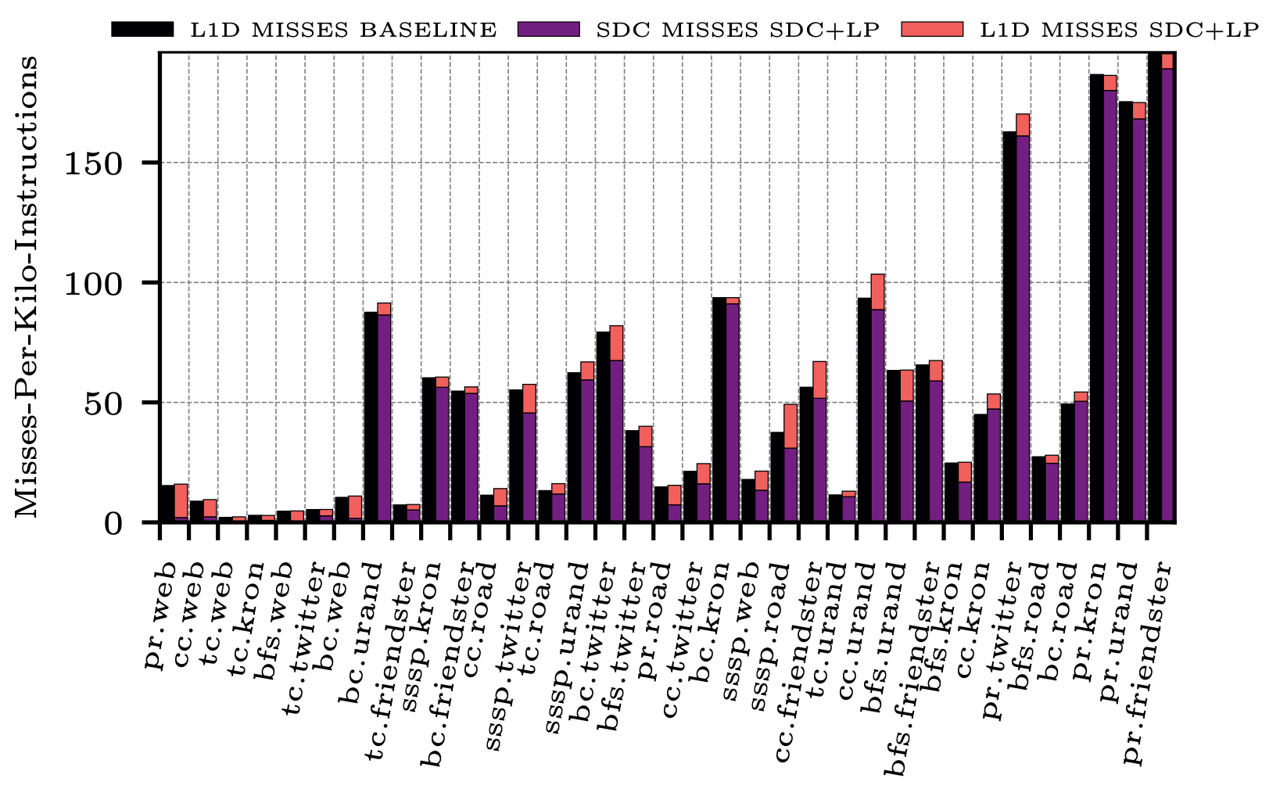
Single-Core Evaluation | MPKI
Analysis on caches’ MPKI on L2C and LLC:
Considering the Baseline and the SDC+LP designs
Difference refers to accessing missing in the L2C but hitting in the LLC
L2C MPKI —> 44.5 to 4.4
LLC MPKI —> 41.8 to 2.8
Analysis on caches’ MPKI on L1D and SDC:
Considering the Baseline and the SDC+LP designs
L1D MPKI —> 53.2 to 7.4
SDC MPKI —> 48.3

Slide 15
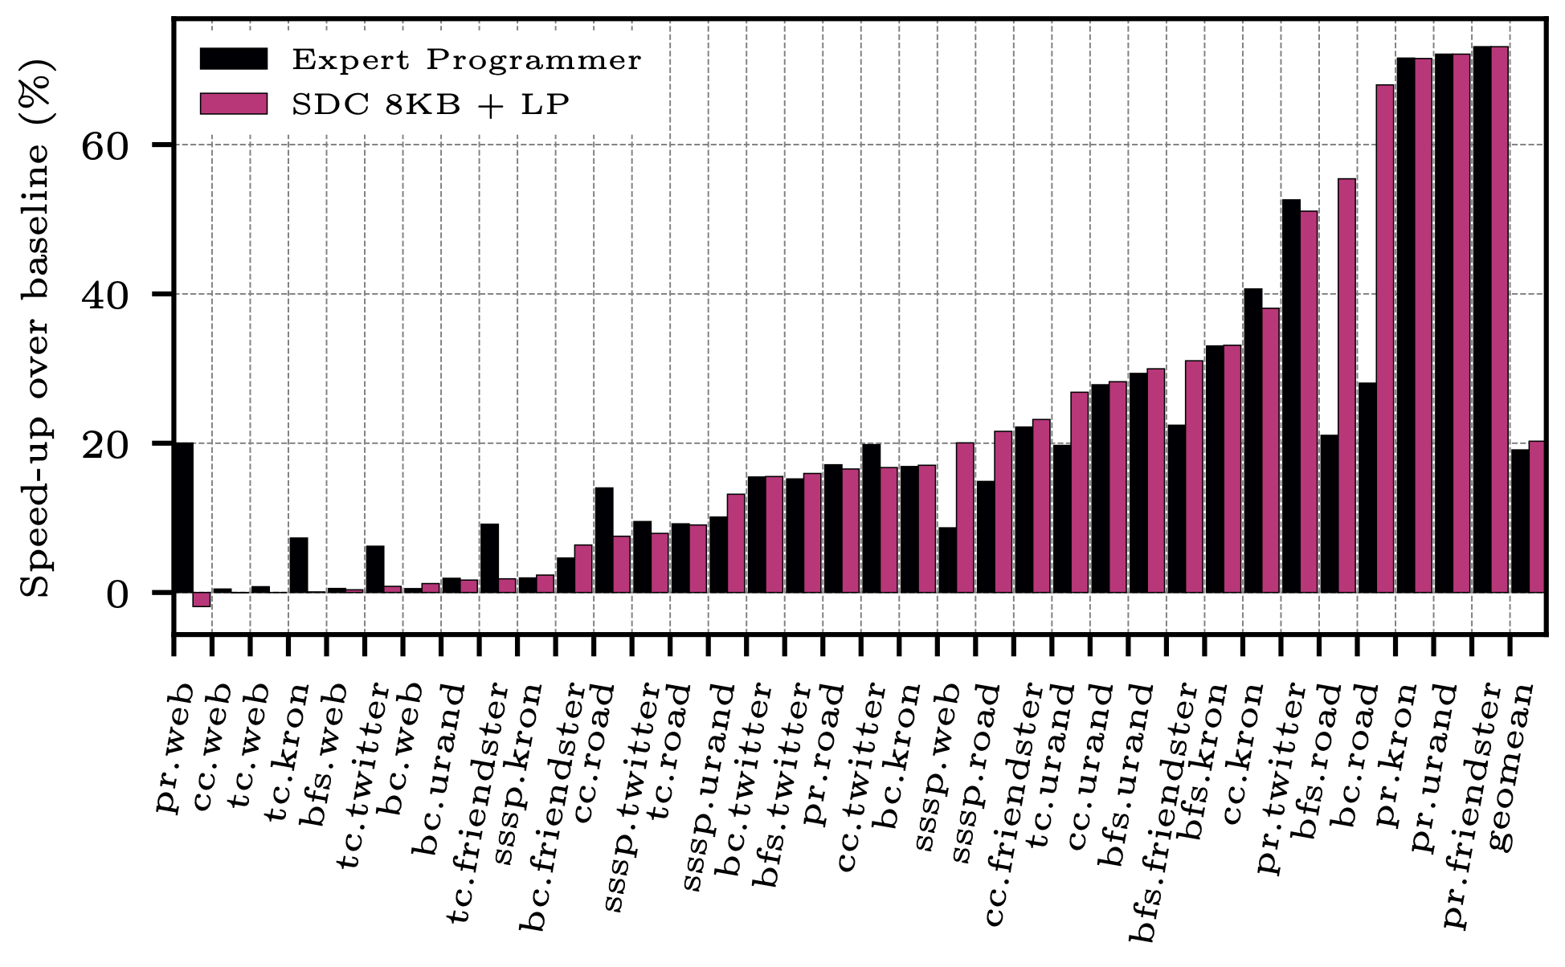
Single-Core Evaluation | Expert Programmer
We compare the SDC+LP design to an Expert Programmer
Expert Programmer is a design in which, after careful analysis an expert labels load instructions as either cache- friendly/averse.
n.b., Expert Programmer also uses an 8KB SDC.
Expert Programmer leverages 19.1% geomean speed-up over the baseline as compared to 20.3% for SDC+LP

Slide 16
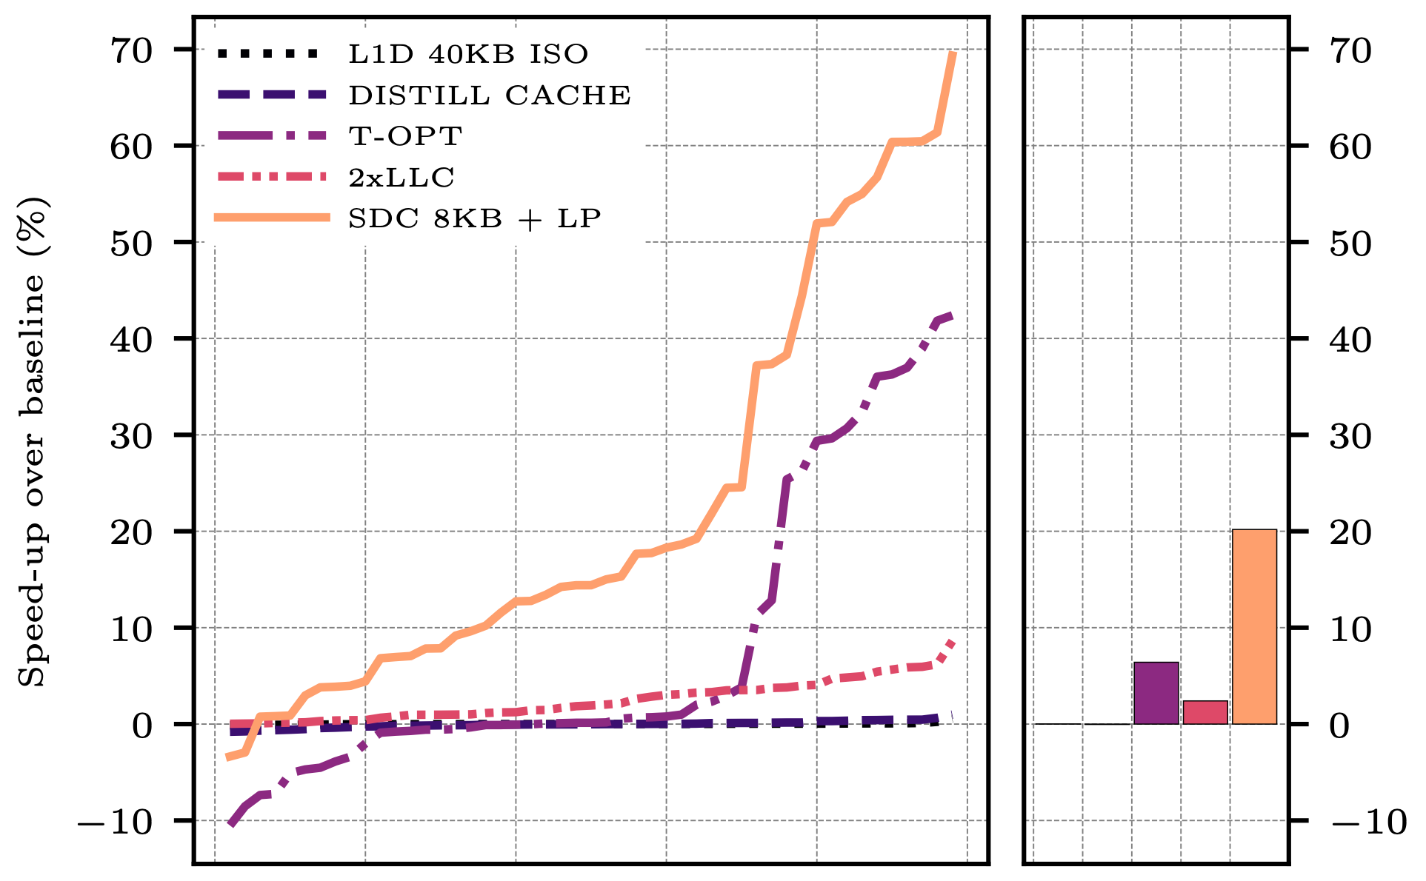
Multi-Core Evaluation | Performance
Considering a multi-core scenario, SDC+LP outperforms all considered designs
n.b., 50 distinct 4-thread workloads, randomly generated from the 36 single-thread workloads
SDC+LP leverages 20.2% geomean speed-up over the baseline as compared to 0.02%, -0.04%, 6.4%, and 2.4% for L1D 40KB ISO, Distill Cache, T-OPT, and 2xLLC, respectively

Slide 17
Conclusions
We show that a simple stride-based predictor can drive a latency-tolerance technique aimed at Graph Processing workloads.
Outperforms domain specific techniques without requiring heavy modifications to the memory sub-system or ISA.
Limited to a single use case.

Slide 18
Thank you for your attention!
Practically Tackling Memory Bottlenecks of Graph-Processing Workloads — IPDPS’24

Slide 19
Acknoledgments/ Fundings
The authors are grateful to the anonymous reviewers for their valuable comments and constructive feedback that significantly improved the quality of the paper.
This work has been partially supported by the European HiPEAC Network of Excellence, by the Spanish Ministry of Science and Innovation MCIN/AEI/10.13039/501100011033 (contracts PID2019-107255GB-C21 and PID2019-105660RB-C22) and by the Generalitat de Catalunya (contract 2021-SGR-00763).
This work is supported by the National Science Foundation through grant CCF-1912617 and generous gifts from Intel.
Marc Casas has been partially supported by the Grant RYC-2017-23269 funded by MCIN/AEI/10.13039/501100011033 and by ESF Investing in your future.
Els autors agraeixen el suport del Departament de Recerca i Universitats de la Generalitat de Catalunya al Grup de Recerca "Performance understanding, analysis, and simulation/emulation of novel architectures" (Codi: 2021 SGR 00865). This research has received funding from the European High Performance Computing Joint Undertaking (JU) under Framework Partnership Agreement No 800928 (European Processor Initiative) and Specific Grant Agreement No 101036168 (EPI SGA2). The JU receives support from the European Union’s Horizon 2020 research and innovation programme and from Croatia, France, Germany, Greece, Italy, Netherlands, Portugal, Spain, Sweden, and Switzerland. The EPI-SGA2 project, PCI2022-132935 is also co-funded by MCIN/AEI /10.13039/501100011033 and by the UE NextGenerationEU/PRTR.

