Slide 1


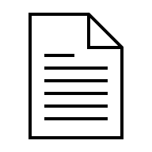
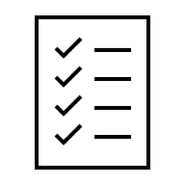


2. Dataset is randomly sampled
Feedback
3. Plan is generated
Planner
Validator
Improved plan
4. Plan is validated for correctness
6. Pre-transformation data quality report is generated
1. User provides dataset and task description
Data Quality Reporter
5. Validated plan is applied to the whole dataset
6. Post-transformation data quality report is generated
7. Artifacts are returned to User, ready for analysis or download

