Slide 1
presentación
HERNANDEZ LUIS JOSE DE JESUS
ALONSO SALINAS DAVID
GARCIA LEON ANGEL DANIEL
ARGUELLO CHAVEZ DAVID DANIEL

Slide 2
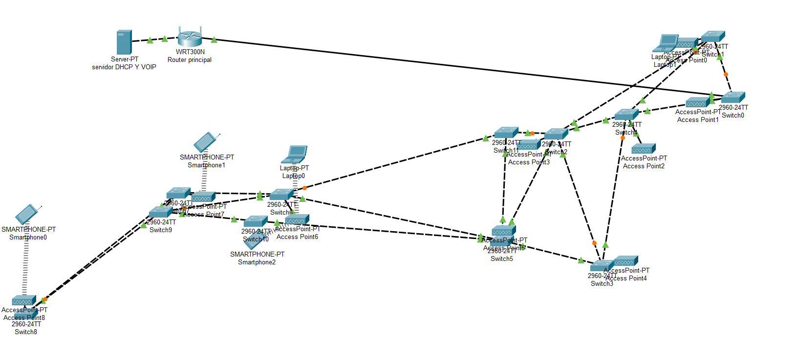
.

Slide 3
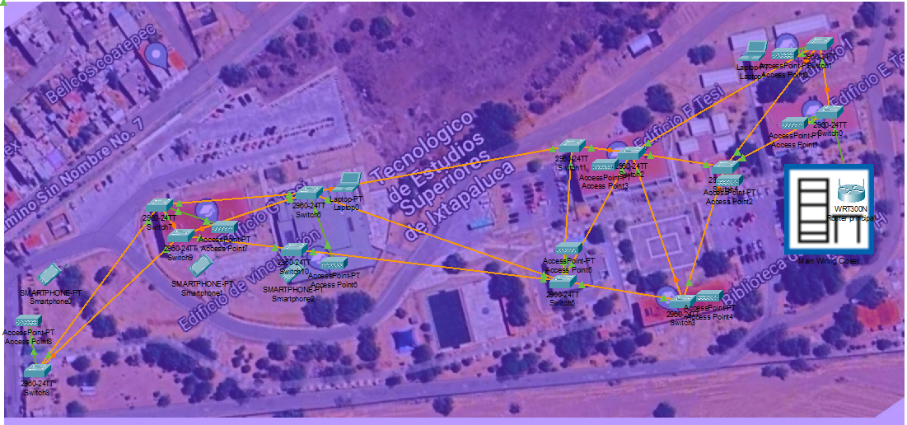
.

Slide 4
topology
Network topology incorporates elements of star topology (where each node is connected to a central hub) and mesh topology (where nodes are interconnected with many redundant connections). This was done thinking about the various failures that may occur.

Slide 5
.
Material and tools
Previously, in order to save costs, it had been considered using the bus topology, but this was discarded due to its unsafety. In its place it was replaced by the "mesh" topology. This in order to reduce possible failures in the network
What are the advantages of a mesh network?
Greater stability. Single points of failure do not harm the entire network.Greater reach. Mesh networks can transmit signals over greater distances. They have fewer dead spots where Wi-Fi signals don't reach.
Direct communication. Nodes can send messages to each other directly. The intervention of a central access point is not necessary.

Slide 6
.
Regarding materials, it is intended to use UTP category 5e cable, since it has more range than UTP category 6. That is why this type of material is being chosen.
In order to protect the cables from human or natural factors, it was thought to use PVC conduit tube, this given that said material is highly resistant to said factors, and is used in installations of some networks, also, it is the most viable and reliable option, in addition to being one of the most economical.
RJ45 connectors will be used for category 5e UTP cable.
Trunking to protect cables indoors, in this case in buildings.
Necessary tool, such as drills, screwdrivers, pliers, puncher, connectivity testers, among others

Slide 7
Wiring Implementation
Horizontal Wiring Cables: Category 5e (Cat 5e), which supports speeds up to 1 Gbps (1000 Mbps) and frequencies up to 100 MHz.
Connectors: RJ45 connectors on each end of the cable.
Network Outlets (Wall Plates): Wall plates with RJ45 ports at each workstation.
On the outside, the arrangement of the tubes to be used to protect the cables
Inside the buildings, gutters will be installed to facilitate cable management.

