Slide 1

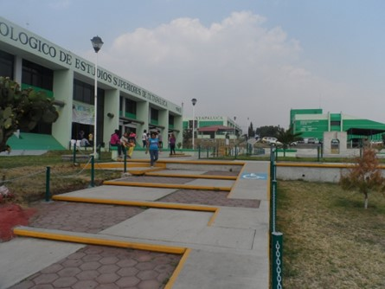
VoIP PROJECT
ARGUELLO CHAVEZ DAVID DANIEL – 202119013
HERNANDEZ LUIS JOSE DE JESUS – 202118425
ALONSO SALINAS DAVID – 202118372
GARCIA LEON ANGEL DANIEL -

Slide 2
INTRODUCTION
The analysis of requirements and needs for the implementation of the VoIP service in the technological college of higher education of Ixtapaluca is described, in order to make it functional for the institution.
User management, type of network cabling necessary, devices to be used were analyzed.

Slide 3
CONTEXT
Telephone service management is required, covering communication needs, establishing an efficient infrastructure, having control over its quality and performance.

Slide 4
NEEDS
-Ease of system maintenance management (security and monitoring tools.
-Reliable access to the service on a temporary basis.

Slide 5
REQUIREMENTS
FUNCTIONAL
>User registration and management: the user registers on the page and is registered in the database along with a temporary extension.
>User deletion and availability: Upon expiration of the concession time, the user is deleted from the database and the extension is released to be used again.
NON-FUNCTIONAL
>Performance: support 50 simultaneous users without service degradation.
>Security: authentication for user registration (registration and name).
>Usability: intuitive and easy-to-understand web interface for the user.
>Compatibility: compatible with standard devices and software.
>Scalability: only if it is possible to increase the number of maximum simultaneous users and increase coverage.

Slide 6
TOOLS
TECHNICAL REQUIREMENTS
PLATFORMS
>Server in Issabel: CentOS.
>Database: Mysql/Maria DB.
>Network cabling: UTP cat 5/6.
>Signal repeaters: compatible with Wi-Fi 802.11ac.
TOOLS
>Asterisk for call management.
>Issabel web interface for system administration.
>Mysql for database administration.

Slide 7
RESTRICTIONS AND ASSUMPTIONS
RESTRICTIONS
>LIMITED BUDGET FOR HARDWARE
>IMPLEMENTATION TIME AVAILABLE
ASSUMPTIONS
>The Isabel system adapts to all the needs of the project.
>The network infrastructure supports the traffic load.

Slide 8
Material budget:
9 access Point wifi
• Unit price: $108 Mexican pesos
• Total: $972 Mexican pesos
• Characteristics:
Network: 2.4 GHz
PoE (Power over Ethernet)
Transmission frequency: 100 bps
Connection types: wired and wireless
9 switches
• Unit price: $130 Mexican pesos
• Total: $1170 Mexican pesos
• Characteristics:
Number of ports: 5 RJ45 ports
Telecommunication type: Store and forward (this for emails)
Auto-MDI/MDIX
10/100 Mbps speeds per port

Slide 9
RJ45 Cat 5e Connectors
• Price per package (100 pieces): $83.72 Mexican pesos
Outdoor cat 5e UTP cable:
• Price per roll (305 m): $1131 Mexican pesos
Software to use:
Issabel pbx (server for voip and emails)
• License cost: None, since it is Open Source
Softphone:
Zoiper
• License cost per year: $3,968.09 Mexican pesos, this price may vary and is subject to change due to the conversion of dollars to Mexican pesos (239 dollars)
• Note: For what is required, the license is not necessary, the free version is enough.
Total, approximate: The approximate total to spend on the material described is $3356.72 Mexican pesos. (not counting the zoiper pro license)

Slide 10
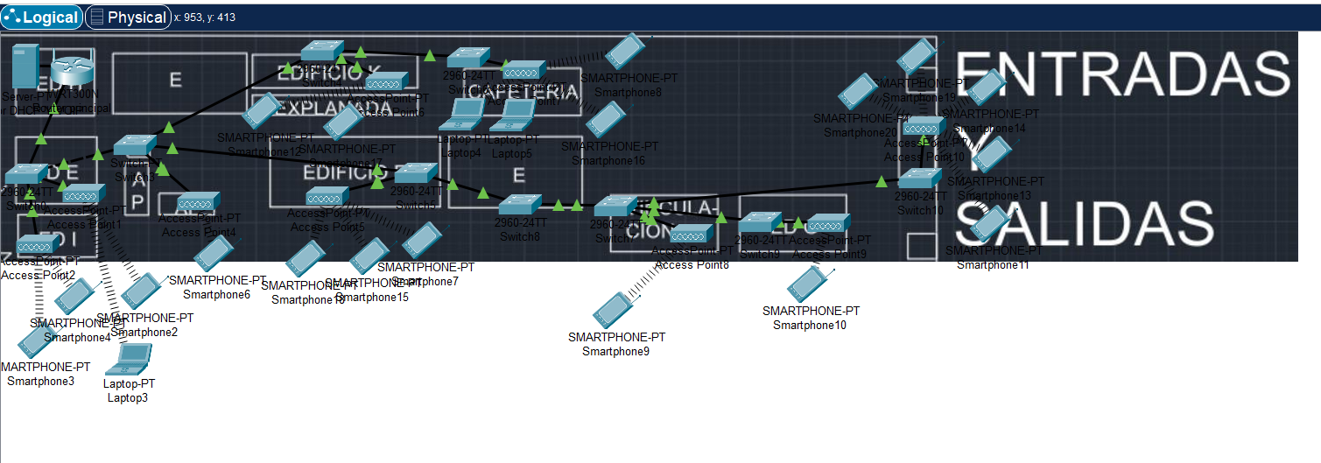
LOGICAL DESIGN

Slide 11
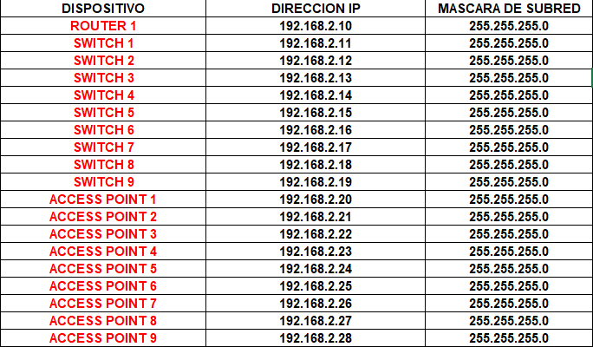
IP ADDRESSING TABLE

Slide 12
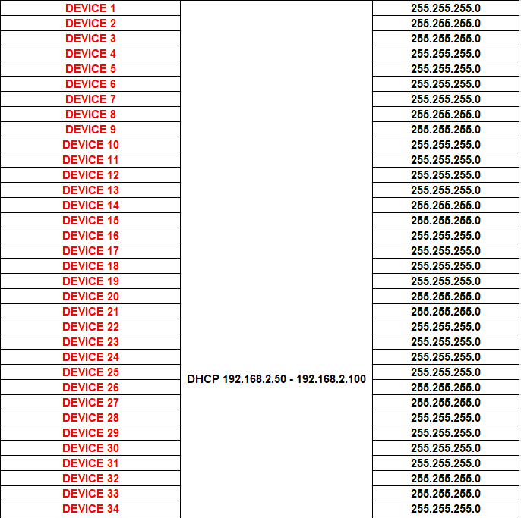

Slide 13
