Slide 1

Biodiversity at National Parks
Role: Developer
Name: Jesus Alfredo Vazquez Cervin

Slide 2
List of visualizations
Status Conservation Status.
Prevalent Species

Slide 3
Species information
This section describe de data contained in the file species_info.csv.
The file has the following layout:
Column: category
Column: scientific_name
Column: common_names
Column: conservation_status
Findings
There were no duplicated records.
There were some records with the same scientific name but different common names. These were removed.
Were created categorical codes for the category column.

Slide 4
Species and conservation status is significant?
# run Chi-Square test and print p-value
chi2, pval, dof, expected = chi2_contingency(table)
print('-------')
print("The pval is ->", pval)
# determine significance
The pval is -> 0.45527924478334036
print("The differences between species and their conservation estatus are not significant!")

Slide 5
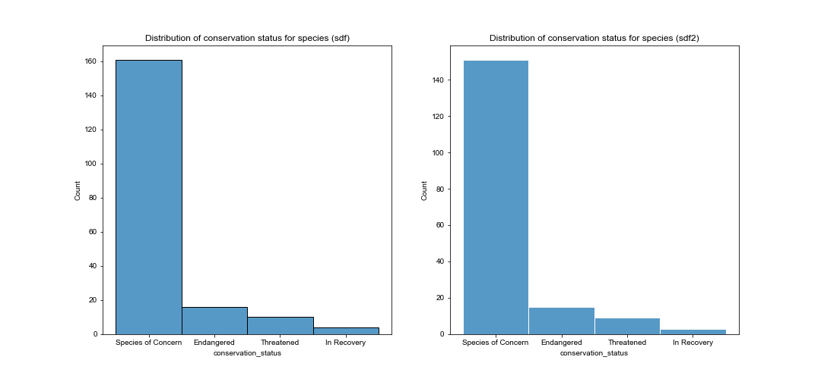
Status conservation estatus

Slide 6
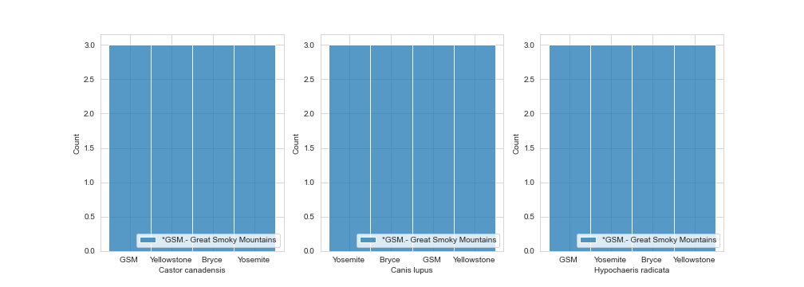
Prevalent Species 1/3

Slide 7
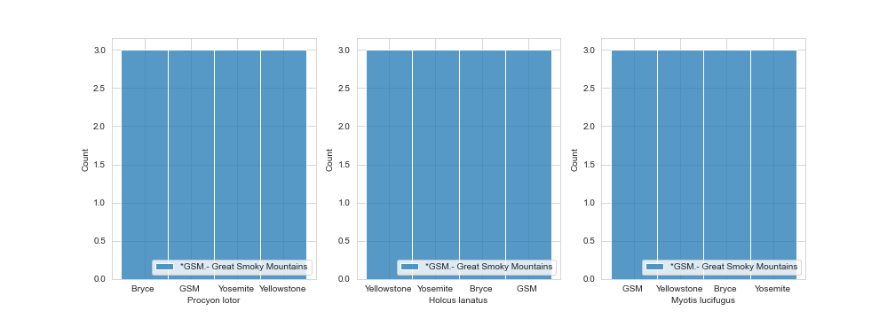
Prevalent Species 2/3

Slide 8
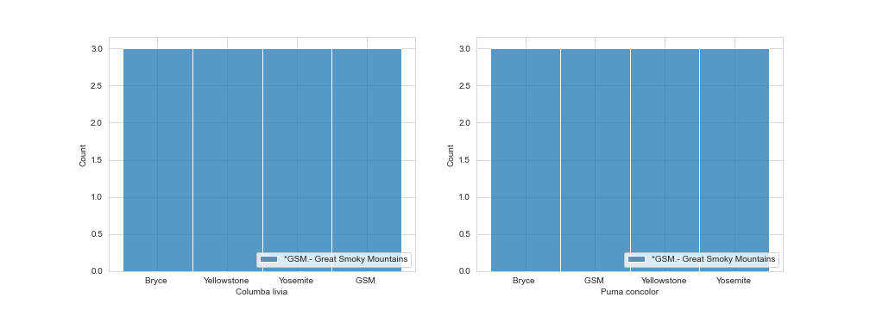
Prevalent Species 3/3

