Slide 1
Financial Risk Detection
Introduction:
This project aims to leverage Exploratory Data Analysis (EDA) and machine learning to conduct risk analysis for loan default prediction in the context of a consumer finance company. By analyzing historical loan application data, we will identify patterns and factors that indicate whether a client is likely to default on their loan payments. This analysis will assist the company in minimizing financial losses while ensuring that creditworthy applicants are not unfairly rejected.

Slide 2
Identify patterns indicating clients' difficulty in repaying loans through
detailed analysis of application data.
Determine the key demographic, financial, and credit-related factors
that influence loan default using machine learning models.
Utilize insights gained from the analysis to inform portfolio
management, risk assessment, and lending practices.
Develop strategies to minimize financial losses due to loan defaults
and optimize lending decisions.
Business Objectives:

Slide 3
Feature Importance Analysis:
Which factors have the strongest predictive power for loan
default?
Are there any unexpected or surprising relationships between
features and default risk?

Slide 4
Steps Involved
Importing a dataset using pandas and analysing the features.
Data Cleaning
Feature Engineering
Categorical values Encoding
EDA (Exploratory Data Analysis)
Feature Selection
Model Selection
Evaluation of Model

Slide 5
Data Cleaning
Data Cleaning involves Checking for duplicate columns or duplicate rows.
Identifying the null values.
Checking for any misaligned formats

Slide 6
Feature Engineering
Feature Engineering include modification in the existing columns based on the problem statement.
In this, project feature engineering has been done to some columns to convert days to years and some features with negative values instead of positive values. So, we used abs()
function.

Slide 7
Feature Encoding
Feature Encoding is the process to convert the categorical columns to numerical columns.
So, in this project I have encoded only 2 columns using Binary encoding, Since there are only 2 categories
EX:Gender- M/F

Slide 8
Feature Selection
Feature selection is a process to identify the importance of the feature that highly correlate with the target so the model can avoid complexity and perform well.

Slide 9
EDA(Exploratory Data Analysis)
EDA is the process of data exploration and understanding of data across various features and categories.
It is used to find the insights from data and also the relationship between the independent features and the target variable.

Slide 10
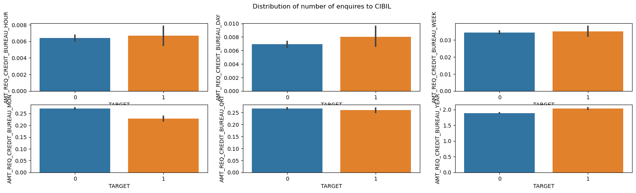
Cibil Investigations for clients
INFERENCE:-
*From the Above plots we can find there is less correlation with the target variable and has a considerable null values as well in the data.

Slide 11
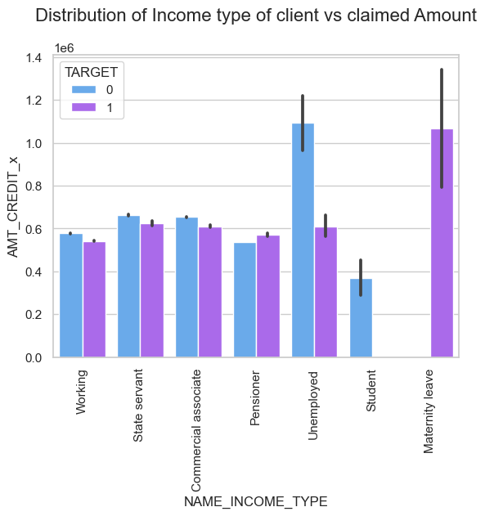
Distribution of Income type of client vs claimed Amount
INFERENCE:-
1.From the above plot the persons(Females) are in maternity leave are most likely defaulting on
loan.
2.And Students were excellent in repaying their loans than the other types.

Slide 12
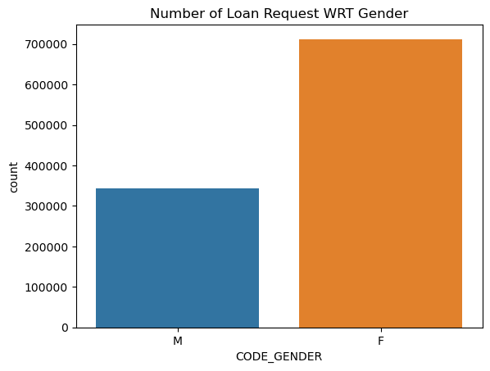
Number of Loan Request WRT Gender
Inference
#The above plot says Females are getting more Loans than Males.
In [56]:

Slide 13
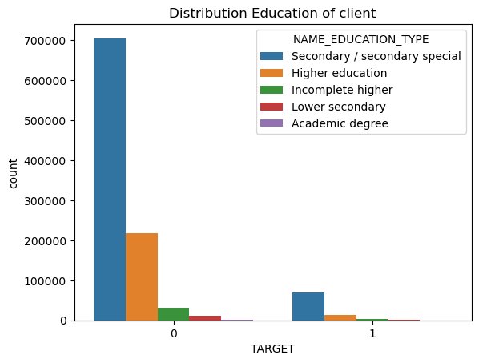
Distribution Education of client
INSIGHTS:
From the above plot the people who are done secondary/secondary special are taking higher amount of loan and they were not defaulting.
So, Most of the people who were not educated are mostly not taking loans. And default ratio also low.

Slide 14
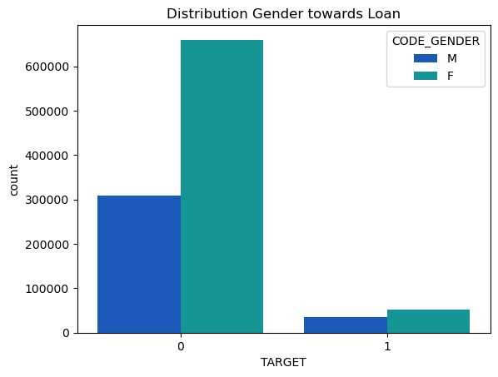
Distribution Gender towards Loan
INSIGHTS:
Here the more Females are getting loans than Males.
And the default ratio between Male and Females are nearly same.

Slide 15
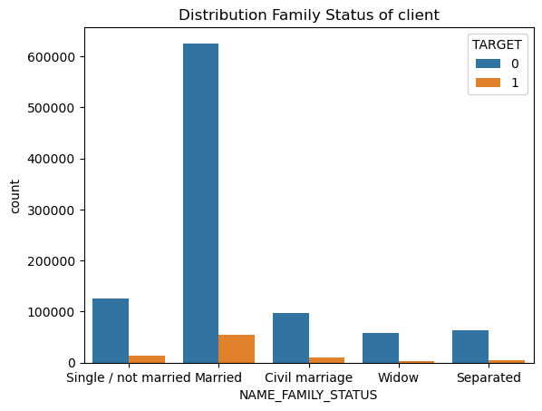
Distribution Family Status of client
INFERENCE
From the above distribution Married persons are paying loans correctly and parallely their default also bit higher than other groups.

Slide 16
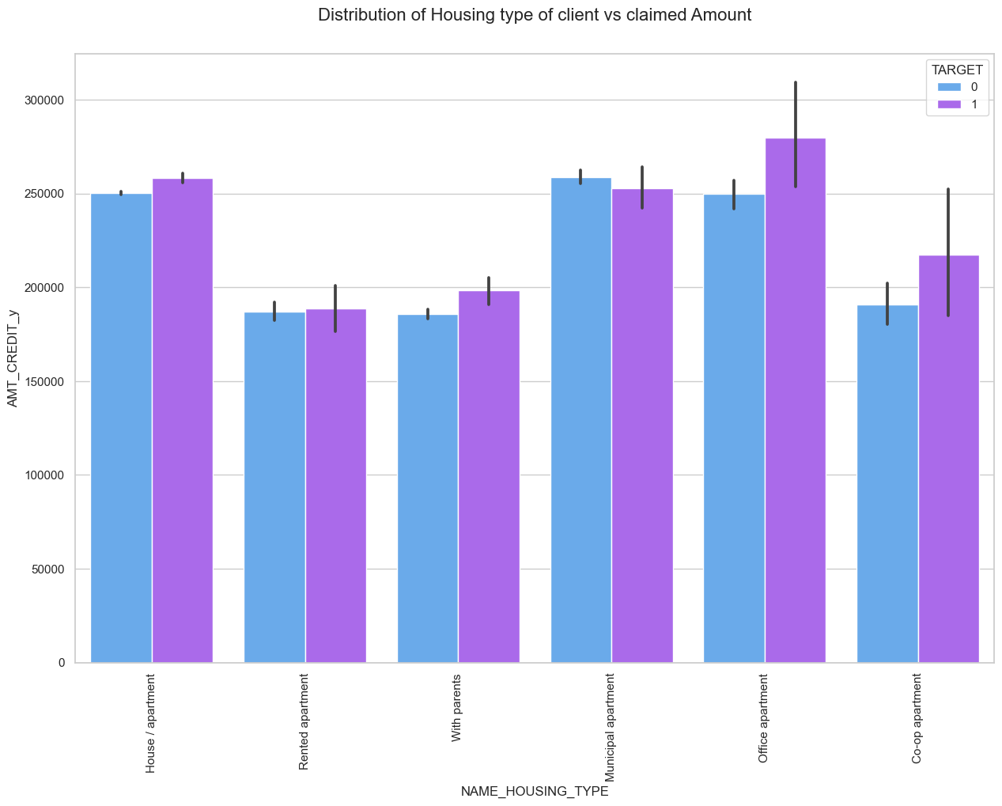
Distribution of Housing type of client vs claimed Amount
INSIGHTS
1.The clients from House/Apartment, Office apartment and Co-operative apartment are highly Defaulting on loans.
2.The clients from Rented Apartment and Municipal apartment are less in default compared to other groups.

Slide 17
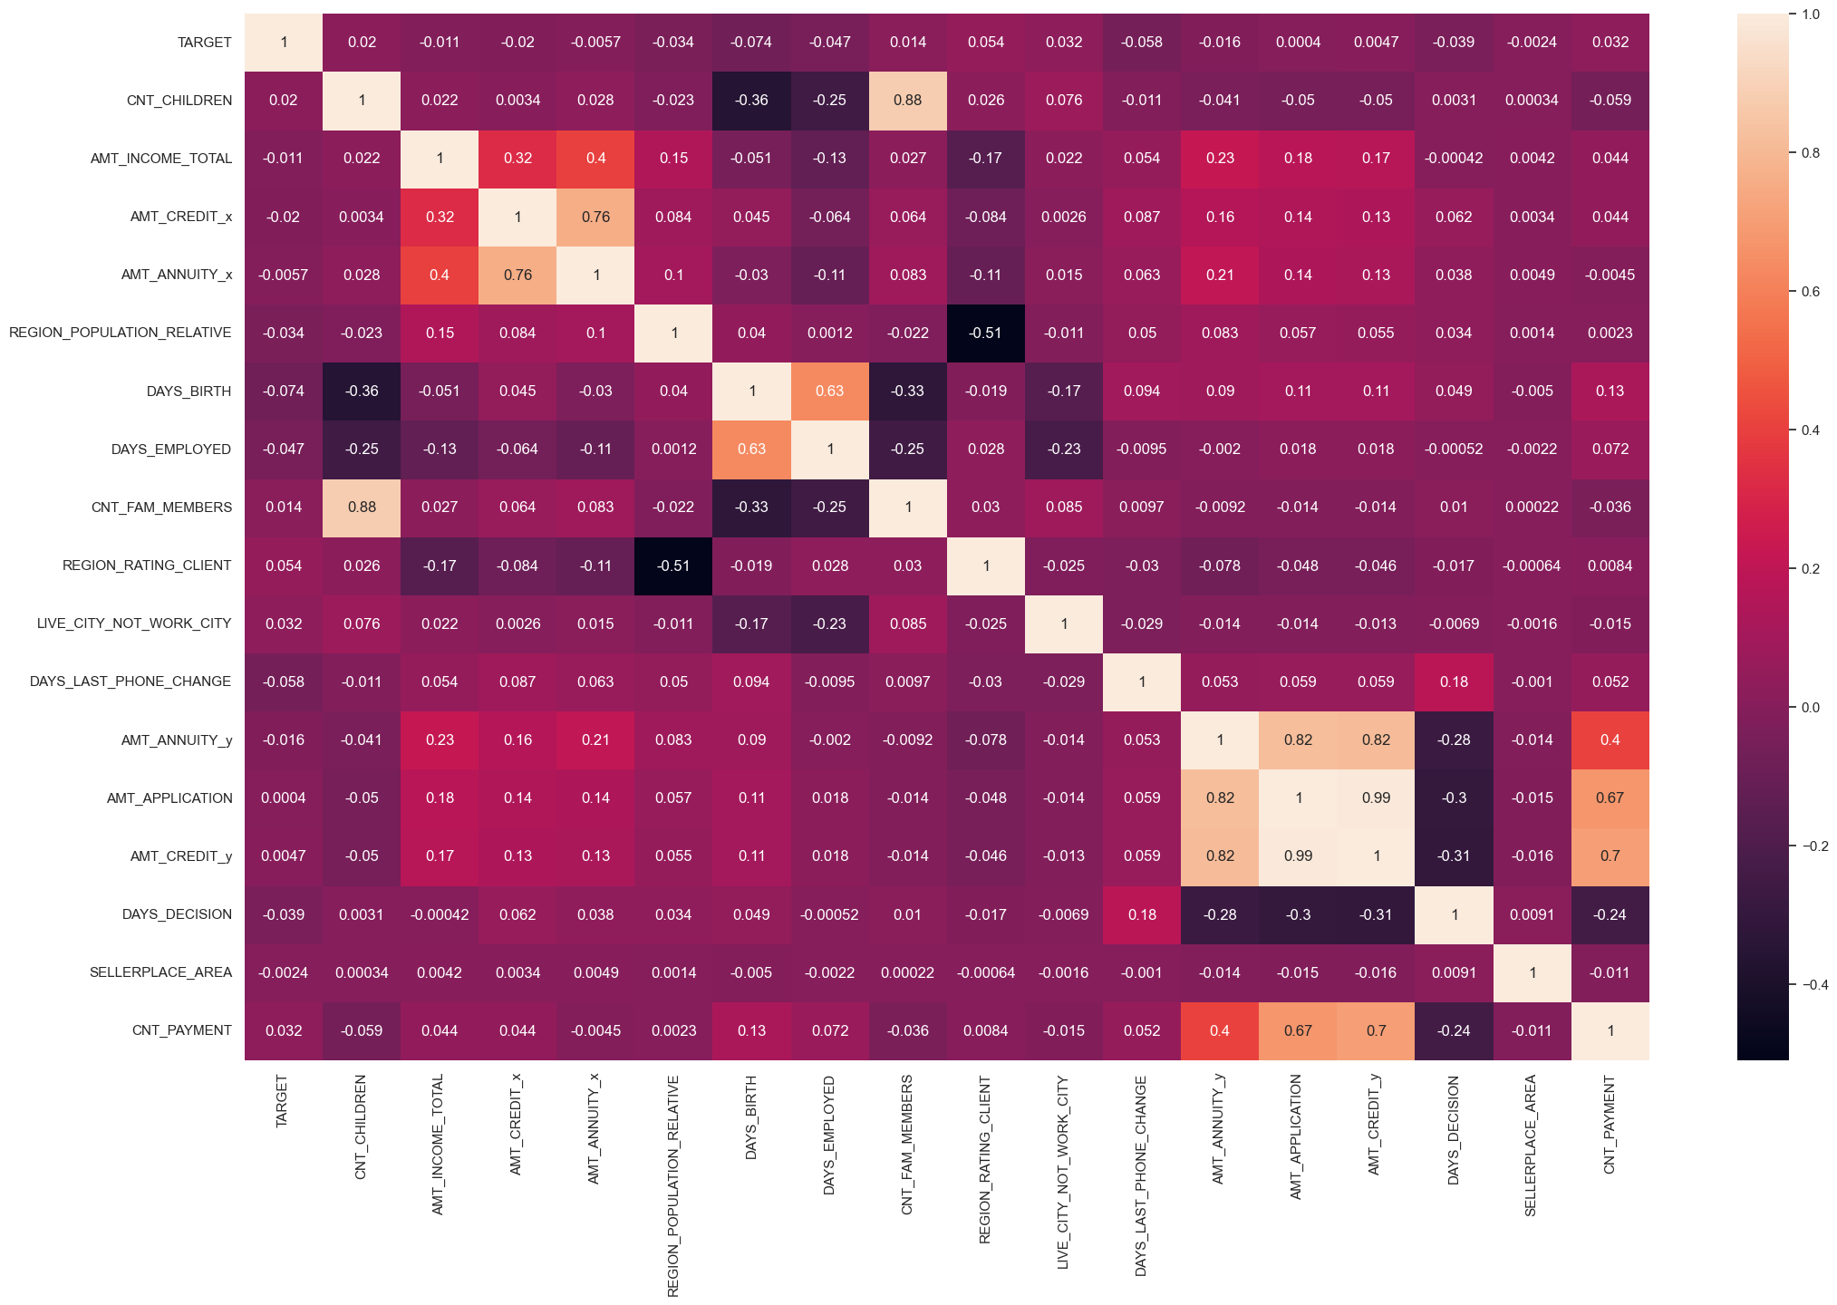
Checking for correlation of data using Heatmap
There is very less correlation of features with target.

Slide 18
Feature Selection
Feature selection is the process of identifying features which are important for prediction and selecting those features to built a better model.
We have Extracted the relevant feature to predict the financial risk and dropped all the other features not necessary.

Slide 19
Model Building
Model building involves the process of selecting, training, and evaluating machine learning models to make predictions or decisions based on input data.
Since, the problem is a classification problem we have chosen different classifiers for predicting the better result.
Among the classifiers the ensemble technique XGBClassifier performs well, providing high precision and accuracy.

Slide 20
CONCLUSION
Hence the problem solution was provided with the accuracy and Precision of 92%.
So, we can analyse the loan defaulters and can able to avoid financial risk

