Slide 1
Introduction to ATL
Part I

Slide 2
ATL Language
ATL: ATLAS Transformation Language
Mature transformation infrastructure (>10 years)
Widely used language
https://eclipse.org/atl/
ATL characteristics
Designed for model-to-model transformations
Source models are read-only
Target models are write-only
Rule-based + implicit reference resolution
Model navigation in OCL
Limited imperative constructs
Notes:
Read-only: they can only be navigated, not modified
Write-only: they cannot be navigated

Slide 3
Transformation example
UML class diagram to GUI
Client
Pet
ID : String
name : String
birth : Date
*
name : String
birth : Date
type : String
Clients
Pets
ID :
Name:
Name:
Birth:
_ _ / _ _ / _ _
Birth:
_ _ / _ _ / _ _
Type:
Add Pet

Slide 4
Transformation example
Mapping at the high-level
Model would be a GUI
Class would be Frame or a Window
Each property a UI element
String properties would be text widgets
Date properties would be a date picker
References can be converted to buttons, etc.

Slide 5
UML class diagram meta-model
Model
ownedType *
Type
Everything inherits
from NamedElement
1 type
Classifier
ownedAttribute*
DataType
Class
Property
isAbstract : Boolean
memberEnd 2..*
Primitive
Type
Enumeration
association 0..1
Association

Slide 6
GUI meta-model
Container
Widget
widgets *
name : String
GUI
Window
windows *
title: String
Frame
Label
Text
DatePicker
value: String
Container
layout 0..1
Layout
FlowLayout
GridLayout
GridInfo
cols : int
row: int
column: int
Widget
widget 1
gridInfo *

Slide 7
ATL transformation
uml2gui_intro_01.atl
module “uml2gui";
create OUT: GUI from IN: CD;
helper context CD!Property def : isText() : Boolean =
self.type.name = ‘String’;
rule class2frame {
from c : CD!Class ( not c.isAbstract )
to f : GUI!Frame (
title <- c.name,
widgets <- c.ownedAttribute
)
}
rule property2text {
from p : CD!Property ( p.isText() )
to t : GUI!Text
}
Module declaration
Helper
In pattern
Matched rule
Bindings
Out pattern

Slide 8
ATL Transformation
This transformation:
Creates a Frame widget for each class
Creates a Text widget for each attribute whose type is String
Links Text widgets to the frame (via the widget reference)
This is the basic schema of any ATL transformation

Slide 9
Introduction to ATL
Basic constructs

Slide 10
Module definition
Name
No need to coincide with the file name
(need to be the same for EMFTVM)
Dots not allowed. Several words, with “ “
-- @atlcompiler atl2006
-- @nsURI CD=http://www.eclipse.org/uml2/5.0.0/UML
-- @path GUI=/models17.tutorial.uml2gui/metamodels/gui.ecore
module “uml2gui”;
create OUT : GUI from IN : CD;

Slide 11
Module definition
Meta-model references
Not compulsory, but recommended
Enables auto-completion (+ anATLyzer)
@nsURI for registered meta-models
@path for workspace files
-- @atlcompiler atl2006
-- @nsURI CD=http://www.eclipse.org/uml2/5.0.0/UML
-- @path GUI=/models17.tutorial.uml2gui/metamodels/gui.ecore
module “uml2gui”;
create OUT : GUI from IN : CD;

Slide 12
Module definition
Compiler directive
-- @atlcompiler atl2004
-- @atlcompiler atl2006
-- @atlcompiler atl2010
-- @atlcompiler emftvm
-- @atlcompiler atl2006
-- @nsURI CD=http://www.eclipse.org/uml2/5.0.0/UML
-- @path GUI=/models17.tutorial.uml2gui/metamodels/gui.ecore
module “uml2gui”;
create OUT : GUI from IN : CD;
Notes:
The architecture is extensible. New compilers can be created using: org.eclipse.m2m.atl.engine.atlcompiler

Slide 13
Rules
Matched rule
Lazy rule
Unique lazy rule
Called rule
Entry point rule
Endpoint rule
In this part
Not covered

Slide 14
Matched rules
Structure
Input pattern (from)
Optional filter/guard
Output pattern (to)
Contains bindings (<-)
Imperative block (do)
Optional. Discouraged.
Behaviour
Executed implicitly, at the top level
Target elements created automatically
Target features initialized with bindings
rule class2frame {
from c : CD!Class ( not c.isAbstract )
to f : GUI!Frame (
title <- c.name,
widgets <- c.ownedAttribute
)
do { ... }
}

Slide 15
Bindings
Structure
Left part
Target feature
Right part
OCL expression
Behaviour
Right part is flattened
Primitive bindings
Left is primitive type
Right is primitive value
Direct assignment
Object bindings
Left type is meta-class
Right value is object
Primitive binding
title <- c.name,
widgets <- c.ownedAttribute
Object binding

Slide 16
Binding resolution
rule class2frame {
from c : CD!Class
to f : GUI!Frame (
widgets <- c.ownedAttribute
)
}
:DataType
p1:Property
type
name = ‘String’
p2:Property
:DataType
type
name = ‘Date’
p1 matched by the input pattern?
rule property2text {
from p : CD!Property ( p.isText() )
to t : GUI!Text
}
Object instantiated
Assigned to feature

Slide 17
Binding resolution
rule class2frame {
from c : CD!Class
to f : GUI!Frame (
widgets <- c.ownedAttribute
)
}
:DataType
p1:Property
type
name = ‘String’
p2:Property
:DataType
type
name = ‘Date’
p2 matched by the input pattern?
rule property2int {
from p : CD!Property ( p.isDate() )
to t : GUI!DatePicker
}
Object instantiated
Assigned to feature

Slide 18
Resolving elements explicitly
uml2gui_intro_02.atl
Problem: We want to attach a label to each widget.
Solution: add an additional out pattern element
rule property2text {
from p : CD!Property ( p.isText() )
to t : GUI!Text ( ... ),
l : GUI!Label ( ... )
}

Slide 19
Resolving elements explicitly
Next problem, we need to link the label to its container
Remember, ATL only resolves the first element
Solution: resolveTemp
thisModule.resolveTemp(obj, ‘varName’)
Performs the trace lookup for obj explicitly
Retrieves the element created with the output pattern element whose variable name is ‘varName’

Slide 20
Resolving elements explicitly
rule class2frame {
from c : CD!Class ( not c.isAbstract )
to f : GUI!Frame (
title <- c.name,
widgets <- c.ownedAttribute,
widgets <- c.ownedAttribute->collect(a | thisModule.resolveTemp(a, ‘l’))
)
}
: Attribute
name= “name”
rule property2text {
from p : CD!Property ( p.isText() )
to t : GUI!Text ( ... ),
l : GUI!Label ( ... )
}
p
: TraceLink
at runtime
t
l
: Text
: Label

Slide 21
Resolving elements explicitly
rule class2frame {
from c : CD!Class ( not c.isAbstract )
to f : GUI!Frame (
title <- c.name,
widgets <- c.ownedAttribute,
widgets <- c.ownedAttribute->collect(a | thisModule.resolveTemp(a, ‘l’))
)
}
look up
: Attribute
name= “name”
rule property2text {
from p : CD!Property ( p.isText() )
to t : GUI!Text ( ... ),
l : GUI!Label ( ... )
}
p
: TraceLink
at runtime
t
l
: Text
: Label

Slide 22
Resolving elements explicitly
What if the source element cannot be resolved?
It returns OclUndefined
What if the output pattern element name (e.g., ‘l’) does not exist?
It returns OclUndefined

Slide 23
Model navigation – OCL
ATL implements its own variant
Somewhat out of date with respect to newer versions
e.g., lack of closure operation
OCL is statically typed, ATL/OCL is not!
Model elements named with syntax MM!Type

Slide 24
OCL
Example: get all attributes of type String in a class diagram
aModel.classifiers->
select(c | c.oclIsKindOf(CD!Class))->
collect(c | c.features->select(f | f.oclIsKindOf(CD!Attribute) )->
flatten()->
select(a | if a.type.oclIsUndefined() then
a.type.name = ‘String’
else
false
endif)

Slide 25
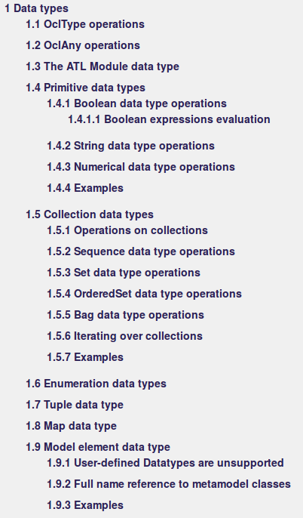
OCL
Details about the supported operations in the ATL guide
https://wiki.eclipse.org/ATL/User_Guide_-_The_ATL_Language

Slide 26
Helpers
“Methods” attached to (meta-model) types at runtime
Two types
Module helpers
Context helpers
Two modes
Operation
Attribute
Notes:
Disclaimer: in the ATL guide helpers are “operations”, an attributes are not classified as helpers. This is different from the abstract syntax.

Slide 27
Helpers
Module helpers
Global helpers
Methods attached to “this transformation module”
Context helpers
Methods attached at runtime to a meta-class
thisModule.propsByName(‘age’)
helper def: propsByName(name : String) : Set(CD!Property) =
CD!Attribute.allInstances()->select(p | p.name = name);
aClass.hasProperty(‘age’)
helper context CD!Class def: hasProperty(name : String): Boolean =
self.ownedAttribute->exists(p | p.name = name);

Slide 28
Lazy rules
Rules which are explicitly invoked
Same structure as matched rules
No trace links are generated
Can be invoked many times over the same source element
thisModule.createText(obj1, obj2)
Input pattern elements are passed as parameters
rule createText {
from c : CD!Class, p : CD!Property
to t : GUI!Text ( ... )
}
Object instantiated
Assigned to feature
Basic constructs – 28

Slide 29
Lazy rules
rule class2frame {
from c : CD!Class ( not c.isAbstract )
to f : GUI!Frame (
title <- c.name,
widgets <- c.ownedAttributes->collect(f |
if f.isText() then thisModule.property2text(f)
else if f.isDate() then thisModule. property2date(f)
else OclUndefined endif endif
)
)
}
You need to “pattern match” explicitly unless you use rule inheritance
lazy rule property2text {
from p : CD!Property
to t : GUI!Text
}
lazy rule property2date {
from p : CD!Property
to t : GUI!DatePicker
}
Notes:
Be aware that you don’t need the input pattern filters any more

Slide 30
Unique lazy rules
Similar to lazy rules, but they keep trace links
Useful if a matched rule is subordinated to the execution of others
Required if the target element of a lazy rule must be reused
For example, the previous modification did not considered the layout...

Slide 31
Introduction to ATL
Tooling

Slide 32
ATL Plug-in
Features
ATL perspective
Register meta-model button
Editor with syntax highlighting
Automatic compilation
Autocompletion + Code templates
CTRL + SPACE
Outline view
ATL Console
Launching transformations

Slide 33
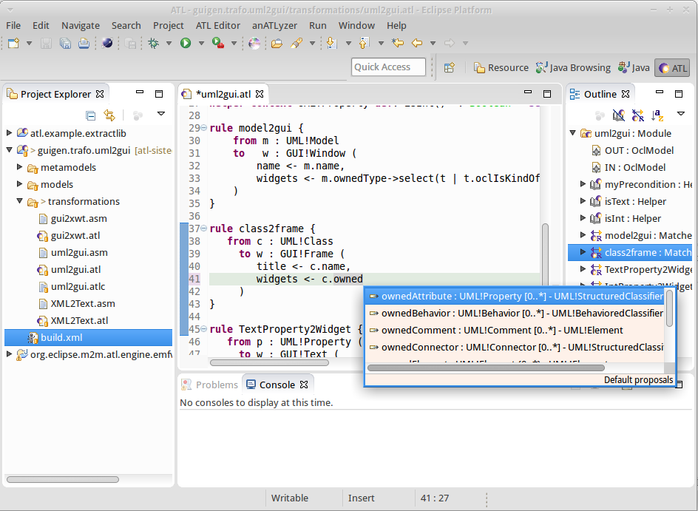
ATL Editor
Automated
compilation
Content
assist
Syntax error highlighting
Dedicated
launcher

Slide 34

Compilation & Execution
Source
MM(s)
Source
Model(s)
<push>
<load>
<pop>
<invoke>
ATL Compiler
.atl
ATL Module
ASM File
Target
Model(s)
ATL Engine
(VM)
<push>
<load>
<pop>
<invoke>
ATL Compiler
.atl
Target
MM(s)
ATL Library
ASM File
Notes:
Important thing to notice: there is no meta-model involved in the compilation process.

Slide 35
Project structure
File -> Project .. -> ATL Project
The projects are created with no structure
Possible structure
myProject
+ launching
+ metamodels
+ models
+ output
+ transformations

Slide 36
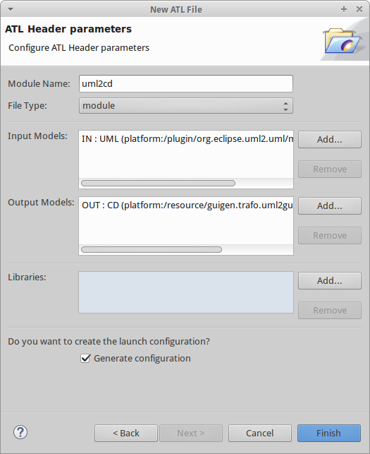
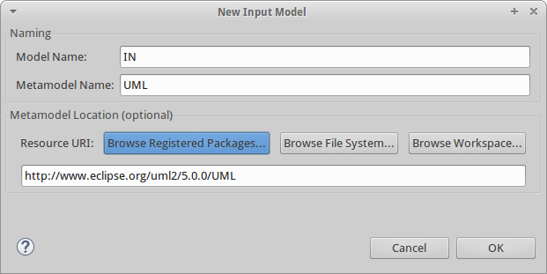
New ATL transformation
File -> New … -> ATL File

Slide 37
Launching
Dedicated launcher
ANT Tasks
http://wiki.eclipse.org/ATL/User_Guide_-_The_ATL_Tools#ATL_ant_tasks
Programatically
ATL Plug-in project
We will see this later

Slide 38
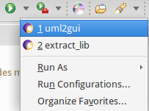
Launching
Dedicated launcher
Based on Eclipse infrastructure
Accessible via the “play button”
Right-click on the ATL file
Run as… -> ATL Transformation
Meta-model information is automatically filled in if you have the proper annotations

Slide 39
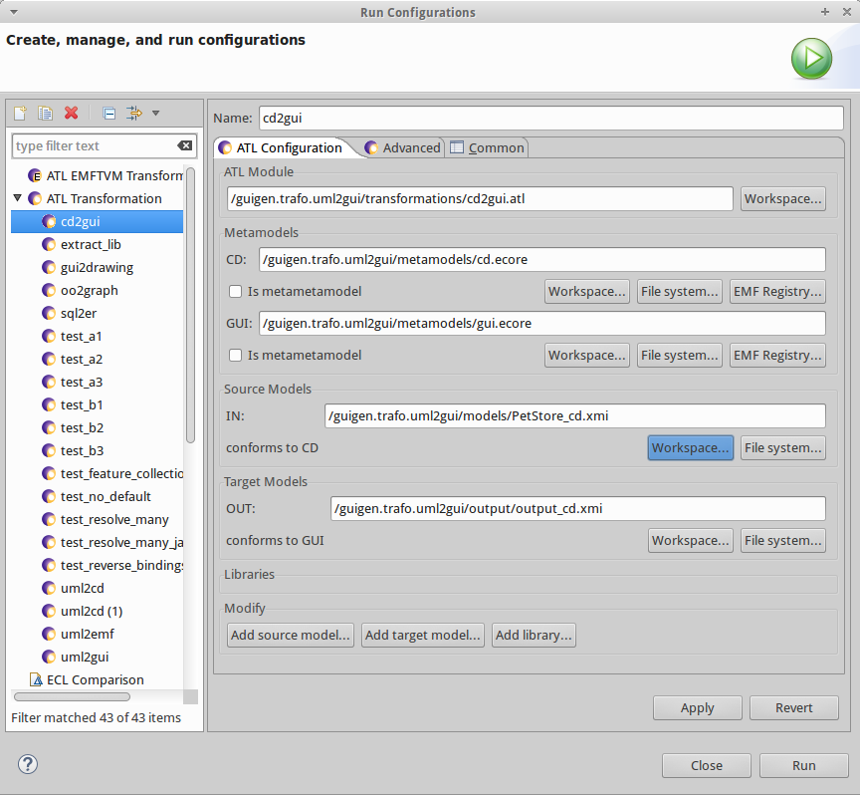
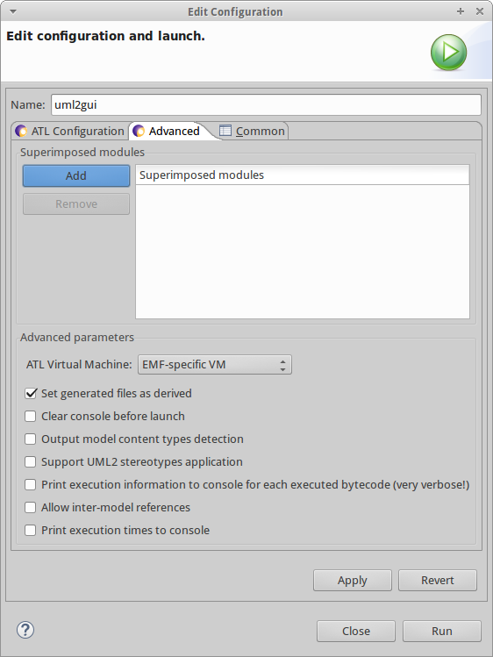
Launching
Tooling – 39

Slide 40
Launching
Opening the output model
Not that easy…
XMI files does not include schemaLocation information
Registering meta-models is a must
The ATL perspective must be active to have access to the register meta-model button
Right-click on the target meta-model file
Register meta-model

