Slide 1
AnATLyzer
Part II

Slide 2
AnATLyzer
A static analyser for ATL model transformations
Static analysis
Detect problems before executing the transformation
Goal:
Be precise: few false positives
Be complete: few false negatives

Slide 3
Precision and completeness
There is a trade-off between precision and completeness (recall).
Static analysis typically is over-restrictive
You can improve precision by sacrificing completeness and vice-versa
Our approach is to detect “possible problems” and let the constraint solver find a witness model that confirms, or discard it otherwise.

Slide 4





AnATLyzer
meta-
models
1: type
checking
annot.
ATL
model
2: create
dep. graph
3: trafo. analysis
TDG
ATL
trafo.
errors,
warnings
potential problems
Yes!
Confirm error
4: constraint solving
No! Discard error
witness model
found?

Slide 5
Motivation
Writing a model(-to-model) transformation is a complex task
You must handle every possible input configuration
You must ensure the target model is syntactically correct (and satisfies the target constraints)
There are many (sometimes implicit) relationships between the rules
The mapping itself must be semantically correct

Slide 6
Motivation
There are also accidental details due to the transformation language.
In ATL:
It is dynamically typed
Hidden features not well documented
Design decisions may not be optimal

Slide 7
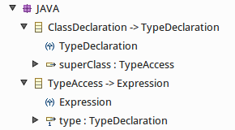
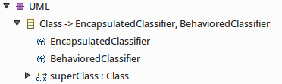

Is rule class2class correct?
-- Transforms Java classes (e.g., obtained with MoDISCO)
-- into UML classes and sets the inheritance links
module java2uml;
create CD : UML from CODE: JAVA;
helper context JAVA!ClassDeclaration
def : getSuperClass : JAVA!ClassDeclaration = ... ;
rule class2class {
from s1 : JAVA!ClassDeclaration
to t1 : UML!Class (
name <- s1.name,
superClass <- s1.getSuperClass
)
}
The typing looks correct. Let’s deploy!
This is what the developer sees

Slide 8
Is rule2class correct?
Problem difficult to detect
Seasoned developers make mistakes like this
A test may uncover a problem, but
The developer would need to know UML very well to identify the problem location
It is a derived feature:
self.generalization->
collect(g | g.general)->
select(c | c.oclIsKindOf(Class))

Slide 9
Questions
What makes a high-quality transformation?
Q1: is the transformation correctly typed w.r.t. to the source meta-models?
Q2: do the generated models conform to the target meta-model?
Q3: do the transformation rules cover all cases?
Q4: is the transformation semantically correct?

Slide 10
Questions
AnATLyzer helps you ask
Q1: typing
Q2: target conformance
Q3: rule coverage
For Q4 (semantic correctness)
Testing is typically used
Code reviews, etc.

Slide 11
What AnATLyzer do for you?
AnATLyzer detects more that 50 types of problems
Additional features
IDE Integration (+ quick fixes, quick assist, explanations)
Source and target constraint handling
Visualizations
Support for UML profiles
Utilities around AnATLyzer
Meta-model slicing
Constraint satisfaction for OCL
Programmatic API

Slide 12
What AnATLyzer do for you?
Useful for developing from scratch
Improved ATL editor
Quick fixes
Useful during maintenance
A transformation has may implicit relationships among the rules
The static analysis may spot problems in a given change
Visualizations to understand rule relationships

Slide 13
Technical information
Installation
Requirements:
Java 8
ATL 3.x
UML support (optional)
Visualization support (optional) – Eclipse Zest, Graphviz
Tested on Eclipse Luna, Mars and Neon
Web site and source code:
https://github.com/jesusc/anatlyzer
Update site:
http://sanchezcuadrado.es/projects/anatlyzer/sites/anatlyzer.updatesite/

Slide 14




Credits
Built in the Miso team
Juan de Lara
Esther Guerra
Jesús Sánchez Cuadrado
Special thanks to the team behind USE/USE Validator
Martin Gogolla
Frank Hinkel ...
http://miso.es

Slide 15
Research papers
Static analysis of model transformations. Jesús Sánchez Cuadrado, Esther Guerra and Juan de Lara. IEEE Transactions on Software Engineering (2016).
Quick fixing ATL transformations with speculative analysis. Jesús Sánchez Cuadrado, Esther Guerra and Juan de Lara. Software and Systems Modeling, 2016.
Translating Target to Source Constraints in Model-to-Model Transformations. Jesús Sánchez Cuadrado, Esther Guerra, Juan de Lara, Robert Clarisó, Jordi Cabot. MoDELS’17, 2017.
* Papers available at: http://miso.es and http://sanchezcuadrado.es

Slide 16
AnATLyzer
Using AnATLyzer

Slide 17
Installing the example projects
Download from the tutorial Github page
http://github.com/jesusc/anatlyzer-models17
File → Import …
Existing projects into workspace
Select archive file (example-projects.zip)

Slide 18
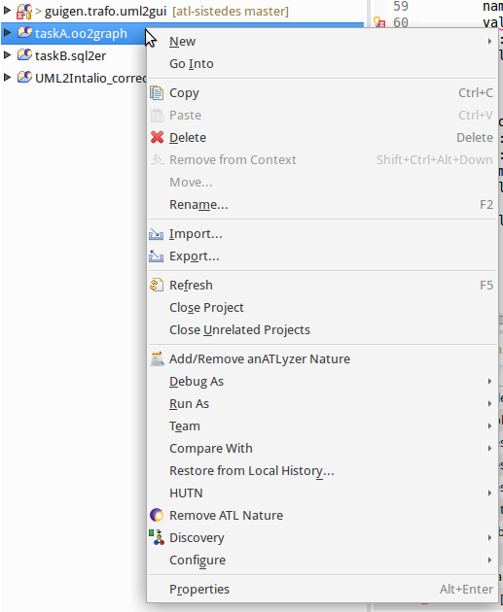
Setting up the project
uml2gui_errors.atl
Right-click on an ATL project
Select “Add/Remove” AnATLyzer feature
Transformations in the project will automatically be analysed (when opened in the editor)

Slide 19
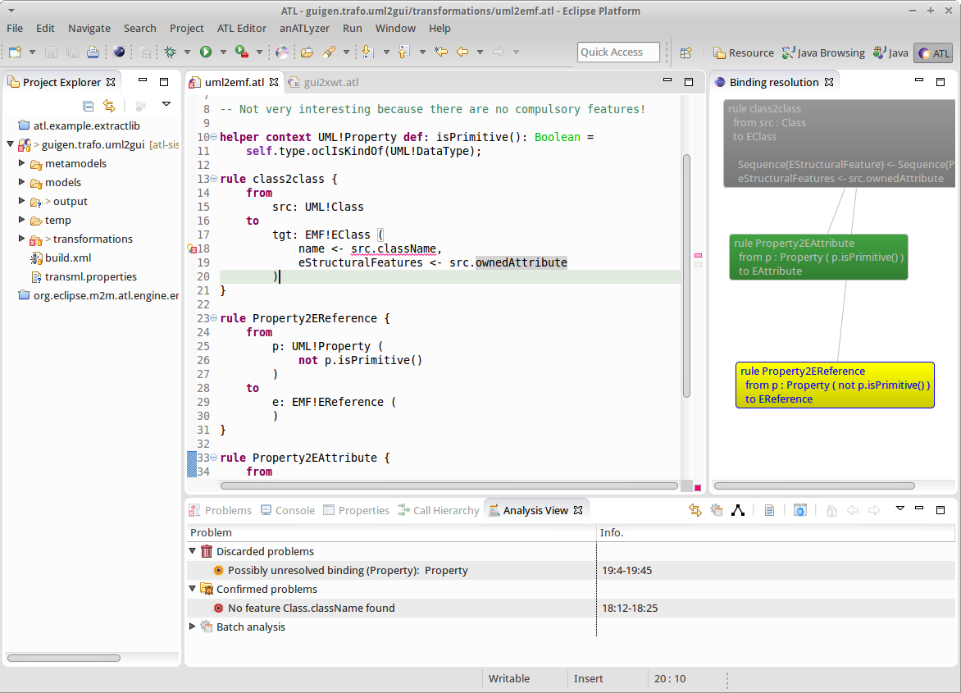
User interface
Errors
Visualization
Analysis
view
Using AnATLyzer – 19

Slide 20
The Analysis View
Show list of detected problems
Provide access to batch analysis
Regular problems scheduled for batch mode
Rule conflict
Target invariants analysis
Child stealing (experimental!)
Unconnected components (experimental!)
Show the view
Window -> Show view -> Other ...
AnATLyzer -> Analysis View

Slide 21
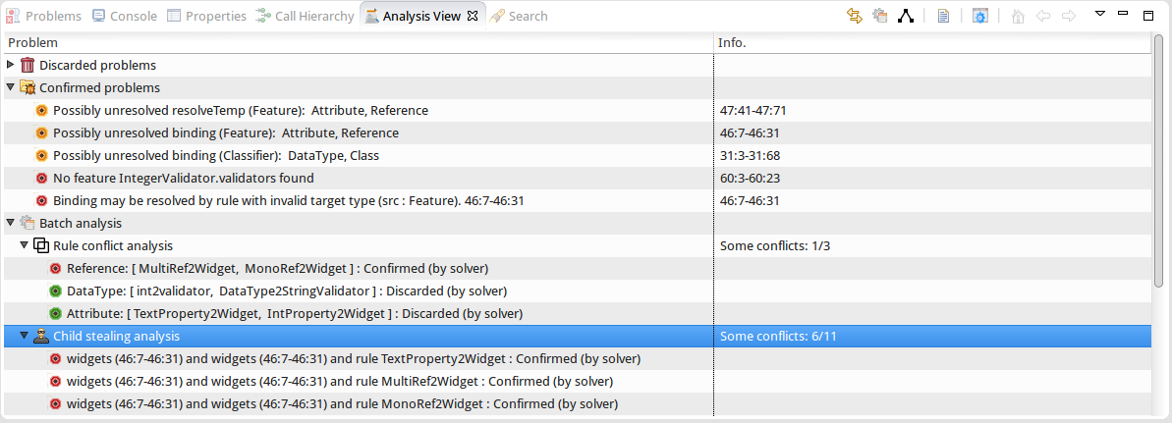
The Analysis View
Reload analysis
Warning
Error
Double-click on “Rule conflict analysis” or “Child stealing” to execute

Slide 22
The Analysis View
Confirmed
It is a true error. Should be fixed somehow.
Try some quick fix! CTRL + 1
Discarded
We used model finding to ensure it is not an error
Can be ignored
Unknown
It is a smell but we cannot check if it is an error.
Running
Errors which are currently being processed
Most of the time the user does not see this.
Time out
If it takes to long to confirm the problem
Basic constructs – 22

Slide 23
Keyboard shortcuts
CTRL + 1
Over an error, show quick fix
Over a normal statement, show quick assists
Be ready to use CTRL-Z to undo...
CTRL + S to save and re-analyse
The analysis is mostly incremental
Notes:
CTRL + SHIFT + V
Show analysis view
CTRL+R
Reload analysis

Slide 24
Keyboard shortcuts (Inherited from ATL Editor)
Auto-complete / Template proposals
CTRL+SPACE
Not completely precise
Go to definition (e.g., helper, definition)
CTRL + Click
F3 with the keyboard
Comment / Uncomment
CTRL+SHIFT+C

Slide 25
Quick fixes
Boosting transformation development

Slide 26
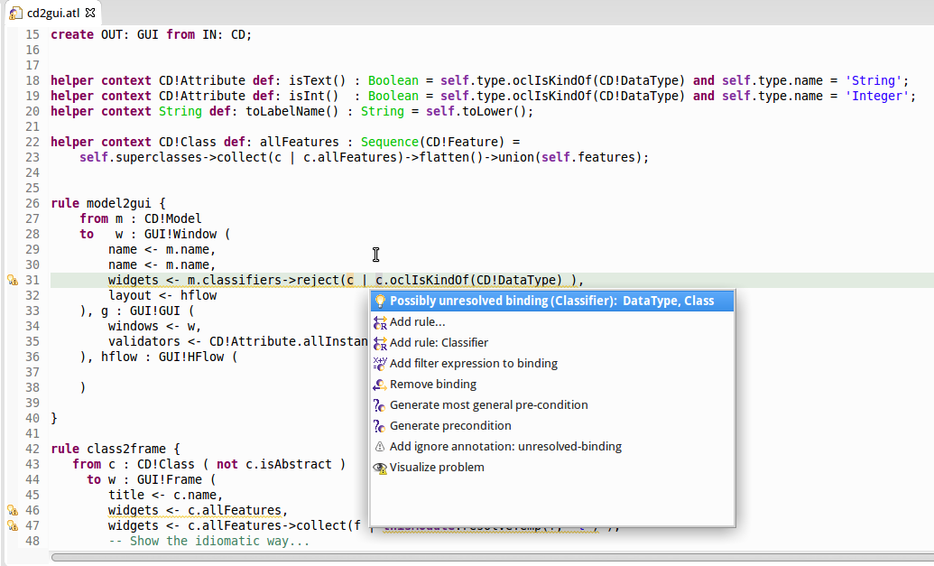
Quick fixes
Access to detailed
Information about
the problem
Quick fixes
Visualization quick access

Slide 27
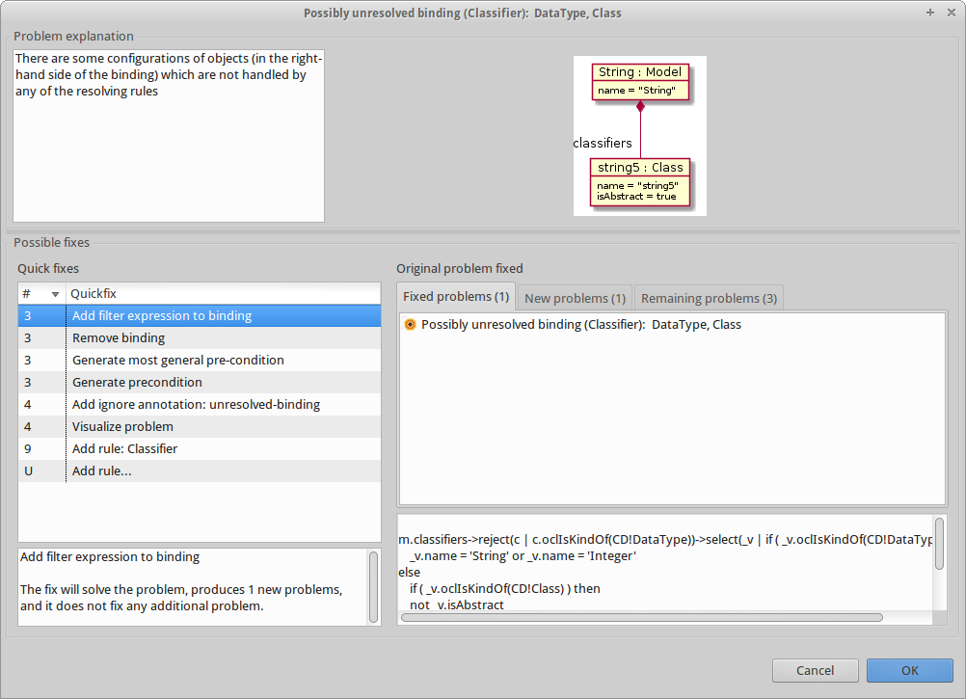
Problem information
Witness
Speculative quick fixes

Slide 28
Types of quick fixes
Modify the transformation
E.g., add a rule filter
Modify the meta-model
E.g., Add a new class
Generate pre-condition
E.g., To document that certain configurations are not allowed
Ignore the problem

Slide 29
Developing from scratch
Make errors on purpose
Save the file to re-execute the analysis
Should be fast
CTRL + 1
Know the quick fix to apply on advance

Slide 30
Developing from scratch
Typical scenarios
Create the helper signature automatically
Create rules
Create new meta-model classes/features
As a an auto-completion mechanism
E.g., the variable name in a resolveTemp

Slide 31
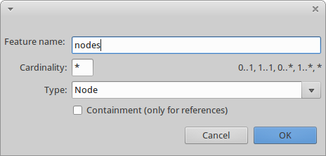
Create new feature
Type:
* Name of a datatype: EString, EInt, EBoolean, EDouble
* Name of an existing class to use it
* Name of a unexisting class to create it.

Slide 32
Static analysis with AnATLyzer
Types of problems

Slide 33
Types of problems
AnATLyzer detects more than 50 types of problems
Classification:
Typing and navigation
Typing w.r.t. meta-models and use of OCL
Transformation integrity
Checks related to the transformation structure
Target meta-model conformance
Does the output model conforms to the target meta-model?
Transformation rules
Issues related to (matched) rule usage
Notes:
Understanding the problems that anATLyzer detects helps understanding how ATL works at runtime
Typing and navigation typically runtime errors or warnings
Transformation integrity typically load-errors
Target meta-model conformance do not have visible effect. They are the hardest to debug.
Transformation rules may lead to runtime errors or just warnings.

Slide 34
Typing and navigation
OCL expressions should be well typed w.r.t. the source meta-model
AnATLyzer detects problems like:
Invalid references to classes and features
Invalid iteration expressions
Invalid variable declarations / return types
“Null pointer exceptions”
Invalid downcasting (“Feature found in subtype”)

Slide 35
Typing and navigation
uml2gui_errors_01.atl
Invalid class name and invalid feature
Clasifier : is a typo
ownedTypes : does not exist, it is ownedType
helper context CD!Model
def: classifiers : Sequence(CD!Clasifier) =
self.ownedTypes->select(c | c.oclIsKindOf(CD!Classifier));

Slide 36
Typing and navigation
uml2gui_errors_02.atl
Incoherent return type
helper context CD!Class
def: superclasses : Sequence(CD!Generalization) =
self.generalization->
collect(g | g.general)->
select(c | c.oclIsKindOf(CD!Class));

Slide 37
Typing and navigation
uml2gui_errors_03.atl
Access to undefined value
This is the “Null pointer exception” of OCL
Possible quick fixes:
Surround with “if”
Generate pre-condition
helper context CD!Property def: isText(): Boolean =
self.type.oclIsKindOf(CD!DataType) and
self.type.name = 'String';
The type checker uses the condition to rule out the problem
Constraint solving is then used to discard the problem

Slide 38
Typing and navigation
Implicit downcasting
In ATL there is no oclAsType
An attribute/operation must defined for all possibles dynamic types of an expression
Duck typing

Slide 39
Typing and navigation
uml2gui_errors_04.atl
Implicit downcasting
helper context CD!Model def: notEmptyClasses: Sequence(CD!Class) =
self.ownedType->select(t | t.ownedAttribute->notEmpty());
Model
Type
ownedType*
UseCase
Structured
Classifier
ownedAttribute *
Property
Class

Slide 40
Typing and navigation
uml2gui_errors_04.atl
Implicit downcasting
Possible fixes
helper context CD!Model def: notEmptyClasses: Sequence(CD!Class) =
self.ownedType->select(t | t.ownedAttribute->notEmpty());
helper context CD!Model def: notEmptyClasses: Sequence(CD!Class) =
self.ownedType->select(t | t.oclIsKindOf(CD!Class))->
select(t | t.ownedAttribute->notEmpty());
AnATLyzer uses this to infer the proper typing
self.ownedType->
select(t | t.oclIsKindOf(CD!Class))->
select(t | t.ownedAttribute->notEmpty());

Slide 41
Special operations
oclAsType
ATL does not have a downcasting operation
If you implement this dummy operation:
AnATLyzer recognizes it to avoid so many nested ifs.
fail_(str : message)
OclUndefined.fail_(“Pattern match error”)
To indicate an impossible path in your code
helper context OclAny def: oclAsType(t : OclType) : OclAny = self;

Slide 42

Target conformance problems
uml2gui_errors_05.atl
No binding for compulsory feature
Feature title is compulsory, but the rule is not setting it.
It will cause problems in other transformations relying on the existence of a value for title.
rule class2frame {
from c : CD!Class ( not c.isAbstract )
to f : GUI!Frame (
widgets <- c.ownedAttribute,
...
)
}

Slide 43
Target conformance problems
uml2gui_errors_06.atl
Binding resolved by rule with invalid target
A binding gets assigned a target object whose type is incompatible with the feature type
Model
Classifier
windows *
Window
Widget
classifiers *
GUI
Frame
Class
DataType
rule model2gui {
from m : CD!Model
to g : GUI!GUI (
windows <- m.nonEmptyClasses()
)
}
rule class2frame {
from c : CD!Class ( not c.isAbstract )
to w : GUI!Frame ( … )
}
Frame is not compatible with Window!

Slide 44
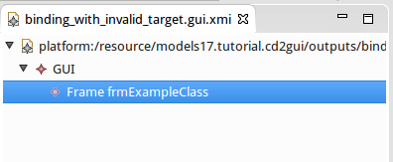
Target conformance problems
uml2gui_errors_06.atl
Binding resolved by rule with invalid target
<guigen:GUI
xmi:version="2.0"
xmlns:xmi="http://www.omg.org/XMI"
xmlns:xsi="http://www.w3.org/2001/XMLSchema-instance"
xmlns:guigen="http://guigen/gui">
<!-- There is a Frame object where
only Window is permitted -->
<windows xsi:type="guigen:Frame"
name="frmExampleClass"/>
</guigen:GUI>

Slide 45
Target conformance problems
Binding resolved by rule with invalid target
Difficult to detect
It is not a runtime error
It is only observable inspecting the target models
Typically occur when the source and target meta-models have different shapes and inheritance is involved
Also, one needs to be careful when a rule has several target patterns
Only the first one is assigned

Slide 46
Transformation integrity
ATL code which is syntactically correct but leads to unexpected behaviour.
Example
Are filters in lazy rules allowed?
The lazy rule will be executed regardless of the filter.
Filters in lazy rules only work with rule inheritance
lazy rule property2text {
from p : CD!Property ( p.isText() )
to t : GUI!Text
}
Notes:
This is a common misunderstanding. There is no pattern match for lazy rules.

Slide 47
Transformation rules problems
uml2gui_errors_07.atl
Unresolved binding
What happens when there is no rule to resolve an element appearing in the right part of a binding?
Example:
Rules property2text and property2date only handles a subset of the possible Property objects
rule class2frame {
from c: CD!Class ( not c.isAbstract )
to f: GUI!Frame (
widgets <- c.ownedAttribute, ...
Cannot set feature widgets to value [org.eclipse.emf.ecore.impl.DynamicEObjectImpl@4a12c7a0 (eClass: org.eclipse.emf.ecore.impl.EClassImpl@54087d0d (name: Frame) (instanceClassName: null) (abstract: false, interface: false)), org.eclipse.emf.ecore.impl.DynamicEObjectImpl@632e536 (eClass: org.eclipse.emf.ecore.impl.EClassImpl@789537ef (name: Class) (instanceClassName: null) (abstract: false, interface: false)), org.eclipse.emf.ecore.impl.DynamicEObjectImpl@f99ae63 (eClass: org.eclipse.emf.ecore.impl.EClassImpl@54087d0d (name: Frame) (instanceClassName: null) (abstract: false, interface: false)), org.eclipse.emf.ecore.impl.DynamicEObjectImpl@6704dd1e (eClass: org.eclipse.emf.ecore.impl.EClassImpl@54087d0d (name: Frame) (instanceClassName: null) (abstract: false, interface: false))], inter-model references are forbidden. Configure launching options to allow them.

Slide 48
Transformation rules
Unresolved binding
Should be treated appropriately
It is a smell of incompleteness in the transformation
Not all cases are covered
If the cases don’t need to be considered:
Filter the right-hand side of the binding
Write a pre-condition
Ignore (but documenting)

Slide 49
Transformation rules
uml2gui_errors_08.atl
resolveTemp with invalid output pattern
rule class2frame {
from c: CD!Class
to f: GUI!Frame (
...
), grid: GUI!GridLayout (
numColumns <- 2,
info <- c.ownedAttribute->
collect(a | thisModule.resolveTemp(a, 'grid1')),
info <- c.ownedAttribute->
collect(a | thisModule.resolveTemp(a, 'g2'))
)
}
It should be ‘g1’

Slide 50
Pre-conditions
Useful to document the conditions under which the transformation actually works
Used by anATLyzer to filter out problems
Need to be written formally in OCL
Written as:
Module annotations ( --@pre )
Helpers annotated with -- @precondition

Slide 51
Pre-conditions
Module annotations
Helpers
-- @pre CD!Property.allInstances()->forAll(v |
-- not v.type.oclIsUndefined())
module “uml2gui”;
create OUT : GUI from IN : CD;
-- @precondition
helper def: supportedDataTypes() : Boolean =
CD!Property.allInstances()->forAll(p |
p.isText() or p.isInt() );

Slide 52
Annotations
Ignore annotations
They are used to remove problems of a certain type in a rule or helper
Easy access via a quick fix
Examples:
-- @ignore unresolved-binding
-- @ignore no-binding-compulsory-feature

Slide 53
Annotations
uml2gui_errors_09.atl
Force return type
To prefer declared type over inferred
Type inference is typically precise, but false positives may arise
-- @force-declared-return-type
-- @force-declared-return-type
helper context UML!Element def: getContainingModel() : UML!Model =
if self.refImmediateComposite().oclIsTypeOf(UML!Model) then
self.refImmediateComposite()
else
self.refImmediateComposite().getContainingModel()
endif;

Slide 54
Libraries
Library support via @lib annotation
-- @nsURI CD=http://www.eclipse.org/uml2/5.0.0/UML
-- @path GUI=/models17.tutorial.cd2gui/metamodels/gui.ecore
--
-- @lib GUILIB=/models17.tutorial.cd2gui/transformations/guilib.atl
module “uml2gui”;
create OUT : GUI from IN : CD;
uses GUILIB
All helpers are inlined in the current module

Slide 55
Batch analysis

Slide 56
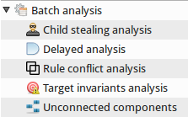
Batch analysis
Analysis that may take too long to do them while editing
Delayed analysis
Rule conflict analysis
Child stealing analysis
Target invariant analysis
Unconnected component analysis

Slide 57
Delayed analysis
Regular checks removed from the live analysis and scheduled to be executed in batch mode
See configuration options
Global AnATLyzer configuration
Window -> Preferences -> AnATLyzer
Default batch configuration
ATL file configuration
Right-click on the file -> AnATLyzer -> Configure AnATLyzer
Fine grained control over the checked problems

Slide 58
Rule conflicts
Two matched rules should not match the same source element
rule model2window {
from m1: CD!Model
to w: GUI!Window
}
rule package2window {
from p: CD!Package
to w: GUI!Window
}
Package
Classifier
ownedType *
Model
Class
DataType
Solution #1. Make model2window inherit package2window
Solution #2. Add filter p.oclIsType(UML!Package)

Slide 59
Rule conflicts
uml2gui_rule_conflict.atl
rule property2text {
from p : CD!Property ( p.isText() )
to t : GUI!Text
}
rule property2largeText {
from p : CD!Property (
p.type.name = ‘LString' or p.type.name = 'Text'
)
to t : GUI!TextArea
}
Is p.isText() in conflict with the other filter?

Slide 60

Rule conflicts
uml2gui_rule_conflict.atl
Double click on “Rule conflict analysis”
Green means “that’s ok”
Red means “there’s a rule conflict!”

Slide 61
Child stealing
uml2gui_child_stealing.atl
Example. Consider both owned and inherited features of a class.
Dog
Pet
Name:
name : String
birth : Date
Birth:
_ _ / _ _ / _ _
Breed:
expected
Dog
Rabbit
Rabbit
breed: String
size: Integer
Name:
Birth:
_ _ / _ _ / _ _
Size:

Slide 62
Child stealing
uml2gui_child_stealing.atl
Change is straightforward:
helper context CD!Class def: allAttributes : Sequence(CD!Feature) =
self.superclasses->collect(c | c.allFeatures)->flatten()
->union(self.ownedAttribute);
rule class2frame {
from c: CD!Class ( not c.isAbstract )
to f: GUI!Frame (
title <- c.name,
widgets <- c.ownedAttribute,
widgets <- c.allAttributes,
...
), ...
}

Slide 63
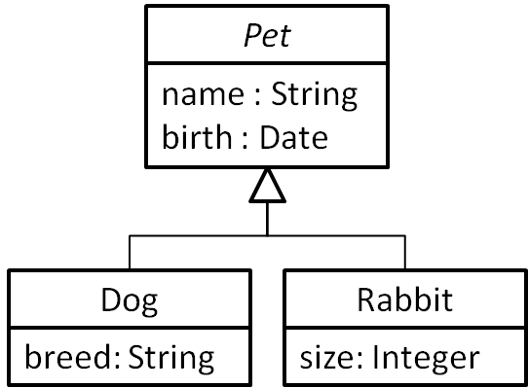
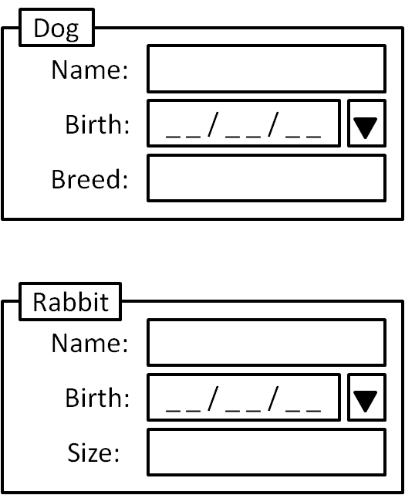
Child stealing
uml2gui_child_stealing.atl
rule class2frame {
from c : CD!Class ( not c.isAbstract )
to f : GUI!Frame (
title <- c.name,
widgets <- c.allAttributes
)
}
rule property2text {
from p : CD!Property ( p.isText() )
to t : GUI!Text
}
?
rule property2date {
from p : CD!Property ( p.isDatePicker() )
to t : GUI!DatePicker
}

Slide 64

Child stealing
uml2gui_child_stealing.atl
Double click on “Child stealing”
It checks pair of binding which may “steal” objects to each other
It may not work with the default configuration because “Class.allAttributes” is recursive
Activate “unfold recursion” option

Slide 65
Child stealing
uml2gui_child_stealing.atl
Dog
Pet
name : String
birth : Date
Breed:
you get
Dog
Rabbit
Rabbit
breed: String
size: Integer
Name:
Birth:
_ _ / _ _ / _ _
Size:
Why?

Slide 66
Child stealing
Explanation
Each instance of a Property generates one Widget instance.
Several activations of the class2frame rule put the same Property in the right part of the binding
The last binding wins
We need one instance per concrete subclass
Solutions
Use lazy rules
Use rule with two input elements (Class + Property)
Forbid the scenario (e.g., forbid inheritance)

Slide 67
Target constraint analysis
uml2gui.atl
Analyse if the transformation will satisfy a given constraint of the target meta-model
-- @target_constraint
helper def : rightColumn() : Boolean =
GUI!GridInfo.allInstances()->forAll(info | info.column >= 1);
More details about this in our talk
“Translating source to target constraints in model-to-model transformations”
Wednesday 20th - 11:30

Slide 68
Unconnected components
Attempts to check the number of (sub-)graphs generated by the transformation
E.g., if you forget to add a binding you will have an “unconnected element”
Still in development
Do not trust it yet

Slide 69
Visualizations

Slide 70
Rule relationships
We make use of the TDG to provide visualizations about rule relationships
In ATL,
Rules are connected via bindings
Relationships between rules are implicit
Visualization to make them explicit

Slide 71
Visualization
Available as quick assist for bindings and also as quick fix for binding errors
Currently visualization does not use constraint solving to prune, you get all “possible” resolutions

Slide 72
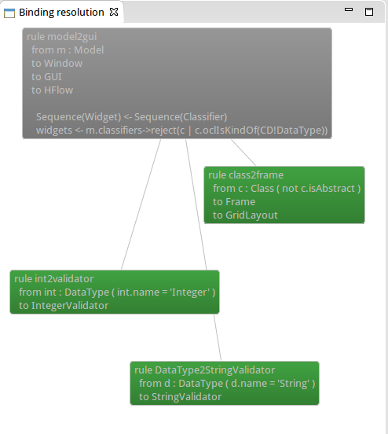
Visualization

Slide 73
UML Support

Slide 74
Enabling UML support
Additional analysis for UML meta-models
Proof of concept
Support for UML profiles
-- @nsURI CD=http://www.eclipse.org/uml2/5.0.0/UML
-- @path GUI=/models17.tutorial.uml2gui/metamodels/gui.ecore
--
-- @profile CD=/models17.tutorial.uml2gui/profiles/GUI.profile.uml
module “uml2gui”;
create OUT : GUI from IN : CD;

Slide 75
Enabling UML support
Additional analysis for UML meta-models
Check stereotypes
Main drawback: model finder will not work
rule class2window {
from c : CD!Class (
c.getAppliedStereotype(‘GUI::isUI’) <> OclUndefined
)
to f : GUI!Window (
title <- c.name,
widgets <- c.ownedAttribute
)
}

Slide 76
Configuration options

Slide 77
Configuration
Eclipse-wide configuration
Window -> Preferences -> AnATLyzer
Transformation-specific configuration
Right-click on the ATL file
AnATLyzer -> Configure anATLyzer

Slide 78
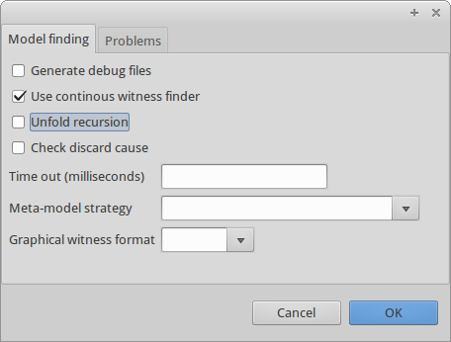
Configuration
Continous mode
Recommended
Untick to execute model finder on demand
Unfold recursion
Experimental support for recursive helpers
Check discard cause
Errors can be discarded due to meta-model issues
Time out

Slide 79
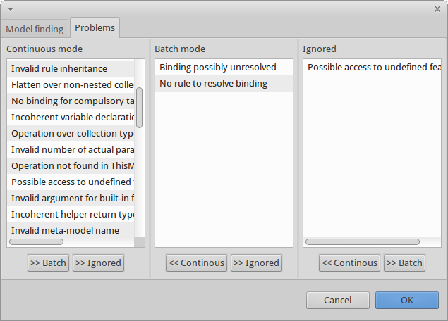
Configuration

Slide 80
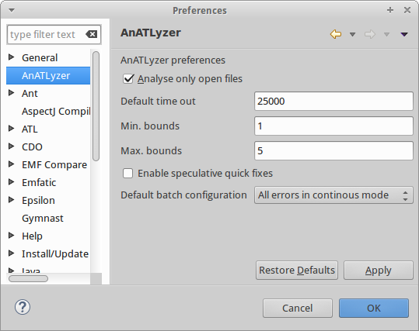
Configuration
Analyse only open files
Recommended to avoid the Eclipse builder to force too many unneeded analysis
Default time out
2.5 seconds – 5 seconds
Min./Max. bounds
1..5 is typically enough but you can play according to your computing power
Enable speculative qfx.
Needs too much memory

Slide 81
Configuration
Default batch configuration
Which problems to check if there is no specific .atlc file
All errors in continuous mode
All errors are checked as the user is editing
Model finding on errors
Selects for continuous mode only severe errors that require model finding
No model finding
Delay to batch mode any analysis that requires model finding.

Slide 82
Troubleshooting

Slide 83
Troubleshooting
The solver does not work (too many unknowns)
If there are errors in the error path the solver is likely to fail
There are features which are not supported by USE Validator
Bugs and limitations in the translation

Slide 84
Troubleshooting
The solver takes too much memory
It is likely that there are some memory leaks
We will work harder, sorry!
Move some of the solver-based problems to batch mode. This is the recommended order:
Unresolved binding
Feature defined in subtype
Access to undefined value
Binding resolved by invalid target
Do not move this if you can afford the solver time

Slide 85
Troubleshooting
Suddenly, all error markers are vanished and the Analysis View is empty
Probably there is an internal error in AnATLyzer
Please, send us the bug

Slide 86
Troubleshooting
Typing
Type inference for (mutually) recursive helpers may lead to false positives sometimes
Try with @force-declared-return-type

Slide 87
Limitations
Many!
Including fixing bugs
Technical issues:
After undo we need to reload…
Mapping to USE Validator
We have good coverage but we have to work on e.g., Map and Tuple support
Cannot re-analyse dependent transformations or changes in the meta-model
Lack of standard mega-model

Slide 88
More information
Available at Github
https://github.com/jesusc/anatlyzer
Send me an e-mail if:
You want to use it and have some problem
You have found a bug
You want to collaborate
jesus.sanchez.cuadrado@gmail.com

