Slide 1
ANATLYZER API & Extensions
Part III

Slide 2
AnATLyzer usage scenarios
IDE to develop ATL transformations
End-user perspective
Develop other tools for ATL
ATL tooling developer
Run experiments on ATL transformations
Useful for researchers in MT
Learn how to use
AnATLyzer programmatically

Slide 3
Architecture

Slide 4
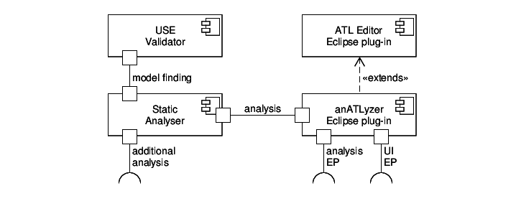
Architecture

Slide 5








static analysis
annotated
ATL
model
analysis
TDG
ATL
code
parsing
ATL
model
type
checking
errors,
warnings
potential problems
input
meta-
model
for each
potential
problem
generation of witnesses
error
meta-model
path
effective
meta-model
error
path
model finder
witness
model
OCL
path
condition
generation of
transformation
pre-conditions
OCL
transformation
pre-condition

Slide 6
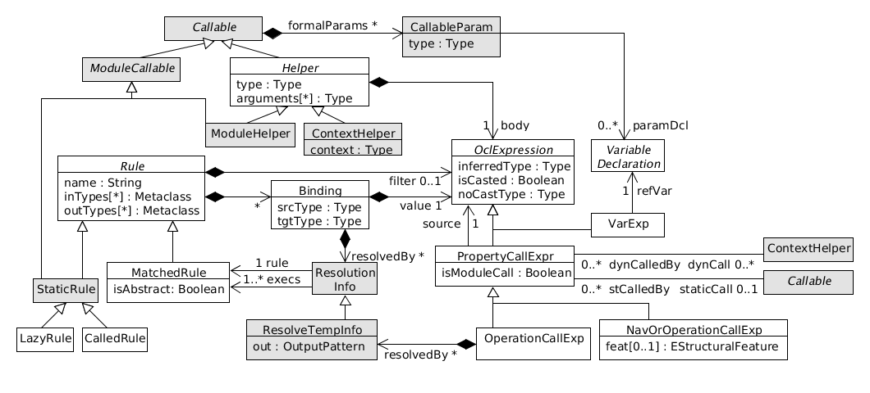
Extended ATL meta-model
Available in: anatlyzer.atl.typing/model/generated/merged.ecore

Slide 7
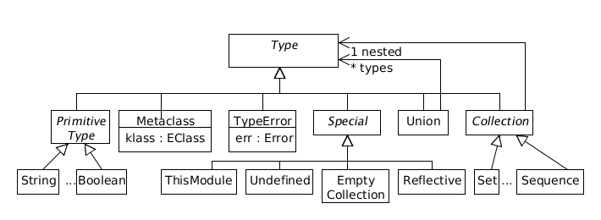
Types meta-model
Available in: anatlyzer.atl.typing/model/types.ecore

Slide 8
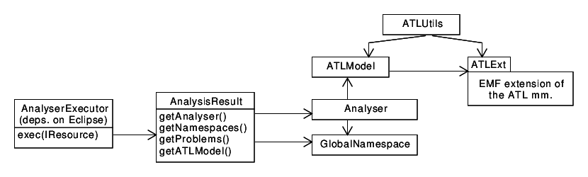
Main classes

Slide 9
Eclipse extension points
Plug-in anatlyzer.atl.editor
anatlyzer.atl.editor.additionalanalysis
anatlyzer.atl.editor.quickfix
anatlyzer.atl.editor.quickassist
anatlyzer.atl.editor.problemexplanation
anatlyzer.atl.editor.views.additionalactions
anatlyzer.atl.editor.witnessvisualizer
anatlyzer.atl.editor.witnessfinder

Slide 10
Executing AnATLyzer programmatically

Slide 11
Executing the analyser
Make use of the AnATLyzer infrastructure
Profit from the TDG
E.g., to implement optimized access to model repository for a specific transformation
Build generators from ATL to other technologies
E.g., a new ATL compiler for another platform
E.g., compile a some verifier backend
Run experiments over transformations in batch mode
E.g., compare how many errors are made by students

Slide 12
AnATLyzer in standalone mode
Project: models17.tutorial.standalone
ExampleAnalysis.java
final File atlTrafoFile = new File("examples/families2persons.atl");
final String[] names = new String[] { "Persons", "Family" };
final String[] metamodels = new String[] { "examples/Persons.ecore",
"examples/Families.ecore" };
// Configure the ATL resource
Resource atlTrafo = AtlLoader.load(atlTrafoFile.getAbsolutePath());
AnalysisLoader loader = AnalysisLoader.fromResource(atlTrafo, metamodels, names);
// Launch the type checking and the static analysis
AnalysisResult result = loader.analyse();
// For each detected problem, check if the constraint solver needs to be run
// to confirm the problem
for (Problem problem : result.getProblems()) {
if ( AnalyserUtils.isWitnessRequred(problem) ) {
StandaloneUSEWitnessFinder.confirmOrDiscard(problem, result);
}
if ( AnalyserUtils.isConfirmed(problem) ) {
String desc = AnalyserUtils.getProblemDescription(problem);
String pdesc = problem.getDescription().replaceAll("\n", " ");
String location = (problem instanceof LocalProblem) ?
((LocalProblem) problem).getLocation() : "no-location";
System.out.println(des+ " "+atlTrafoFile.getName() + " " + location + " " + pdesc);
}
}

Slide 13
Using the extended ATL model Example: Using the TDG
ExampleMetrics.java
// Launch the type checking and the static analysis
AnalysisResult result = loader.analyse();
// Access the extended ATL model
ATLModel extATLModel = result.getATLModel();
// Query model declarations
List<ModelInfo> modelDeclarations = ATLUtils.getModelInfo(extATLModel);
for (ModelInfo declaration : modelDeclarations) {
System.out.println("Signature: " + declaration.getModelName() + " : " +
declaration.getMetamodelName());
System.out.println("Is input: " + declaration.isInput());
if ( declaration.hasMetamodelInfo() ) {
System.out.println(declaration.getURIorPath());
System.out.println("isURI: " + declaration.isURI());
}
}
// Compute metrics
computeMetrics(extATLModel);

Slide 14
Using the extended ATL model Example: Using TDG
ExampleMetrics.java
public void computeMetrics(ATLModel model) {
int numMatchedRules = 0;
int numHelpers = 0;
int numRuleLinks = 0;
Module module = model.getModule();
for (ModuleElement elem : module.getElements()) {
if ( elem instanceof MatchedRule ) {
numMatchedRules++;
MatchedRule r = (MatchedRule) elem;
for (OutPatternElement ope : r.getOutPattern().getElements()) {
for (Binding binding : ope.getBindings()) {
numRuleLinks += binding.getResolvedBy().size();
}
}
} else if ( elem instanceof Helper ) {
numHelpers++;
}
}
System.out.println("Num. matched rules: " + numMatchedRules);
System.out.println("Num. rule links: " + numRuleLinks);
System.out.println("Num. helpers: " + numHelpers);
}
}

Slide 15
Using the extended ATL model Example: The TDG and the visitor
ExampleMetricsWithVisitor.java
public class MetricsWithVisitor extends AbstractVisitor {
int numMatchedRules = 0;
int numHelpers = 0;
int numRuleLinks = 0;
public void computeMetrics(ATLModel model) {
// Start the depth-first traversal
startVisiting(model.getRoot());
System.out.println("Num. matched rules: " + numMatchedRules);
System.out.println("Num. rule links: " + numRuleLinks);
System.out.println("Num. helpers: " + numHelpers);
}
@Override
public void inMatchedRule(MatchedRule self) { numMatchedRules++; }
@Override
public void inStaticHelper(StaticHelper self) { numHelpers++; }
@Override
public void inContextHelper(ContextHelper self) { numHelpers++; }
@Override
public void inBinding(Binding self) { numRuleLinks += self.getResolvedBy().size(); }
}

Slide 16
AnATLyzer within Eclipse
public class ExecuteAnalysisHandler extends AbstractHandler {
public Object execute(ExecutionEvent event) throws ExecutionException {
IEditorPart editor = HandlerUtil.getActiveEditor(event);
if ( editor instanceof AtlEditorExt ) {
IFile file = (IFile) ((AtlEditorExt) editor).getUnderlyingResource();
// Query the index in case the file has already been analysed
AnalysisResult r = AnalysisIndex.getInstance().getAnalysis(file);
if( r == null ) {
try {
// Otherwise, execute the analysis
// This is not executing the model finder for "witness-required" problems
r = new AnalyserExecutor().exec(file);
} catch (Exception e) { e.printStackTrace(); }
}
// Do something with the analysis
MessageDialog.openInformation(null, "Analysis available!",
"Problems: " + r.getLocalProblems().size());
}
return null;
}
}

Slide 17
Implementing new analysis

Slide 18
AnATLyzer extensions
AnATLyzer analysis are structured in a set of phases
An extension may add a new phase
Before the regular analysis
After the regular analysis
In this stage the TDG is already filled with the results of the analysis

Slide 19
AnATLyzer extensions
e.g. inline helpers
ATL
file
Build
the ATL model
Pre-processing
phases
Analysis
phases
TDG
Error model
Analysis
extensions
The filled TDG is available
Pre-processing
extensions

Slide 20
Example
UML-specific analysis
Feature “type” has cardinality “optional”
If UML is used as target model, it is likely that we want to make sure that “type” is initialized
Build an analysis that mark a problem if a rule is not setting a type feature

Slide 21
Example
Project: models17.tutorial.extensions
Use an extension point to install the analysis:
anatlyzer.atl.editor.additionalanalysis
The AnalysisProvider checks the applicability conditions and instantiate the new analysis
public class UmlAnalysis implements AnalysisProvider {
@Override
public List<AnalyserExtension> getExtensions(ATLModel m, GlobalNamespace ns) {
List<ModelInfo> declarations = ATLUtils.getModelInfo(m);
boolean isUmlMetamodel = declarations.stream().anyMatch(d ->
d.getURIorPath().startsWith("http://www.eclipse.org/uml2/"));
if ( isUmlMetamodel ) {
return Collections.singletonList( new UmlAnalysisExtension() );
}
return Collections.emptyList();
}
}

Slide 22
public class UmlAnalysisExtension extends AbstractVisitor implements AnalyserExtension {
private ATLModel model;
@Override
public boolean isPreparationTask() { return false; }
@Override
public void perform(ATLModel model, GlobalNamespace ns, Unit root) {
this.model = model;
startVisiting(root);
}
@Override
public void inSimpleOutPatternElement(SimpleOutPatternElement self) {
Metaclass m = (Metaclass) self.getInferredType();
EClass c = m.getKlass();
if ( c != null && UMLPackage.Literals.TYPED_ELEMENT.isSuperTypeOf(c) ) {
// Check if there is a bindings setting the "type" property
if ( self.getBindings().stream().noneMatch(b ->
b.getWrittenFeature() == UMLPackage.Literals.TYPED_ELEMENT__TYPE ) ) {
model.getErrors().signalGenericProblem("Property 'type' is not set",
"type-not-set", self);
}
}
}
}

Slide 23
Implementing quick fixes

Slide 24
Example
Project: models17.tutorial.extensions
UML-specific quick fix
Solution to the problem of assigning “superClass”
We will learn a bit about how to query the extended ATL model
It requires extensive creation of ATL model elements
We will change an ATL abstract syntax in-place

Slide 25
Example
models17.tutorial.java2uml
-- Transforms Java classes (e.g., obtained with MoDISCO)
-- into UML classes and sets the inheritance links
module java2uml;
create CD : UML from CODE: JAVA;
helper context JAVA!ClassDeclaration
def : getSuperClass : JAVA!ClassDeclaration = ... ;
rule class2class {
from s1 : JAVA!ClassDeclaration
to t1 : UML!Class (
name <- s1.name,
superClass <- s1.getSuperClass
)
}

Slide 26
Example
models17.tutorial.java2uml
rule class2class {
from s1 : JAVA!ClassDeclaration
to t1 : UML!Class (
name <- s1.name,
-- Binding changed to create a Generalization object
generalization <-
thisModule.createGeneralization(s1, s1.getSuperClass)
)
}
-- Lazy rule automatically generated
lazy rule createGeneralization {
from c : JAVA!ClassDeclaration, c1 : JAVA!ClassDeclaration
to g : UML!Generalization (
specific <- c,
general <- c1
)
}

Slide 27
Implementing a quick fix
An extension point is provided
anatlyzer.atl.editor.quickfix
Two options:
quickfix: single quick fix
quickfix set: a group of related quick fixes
Many examples are available in the anATLyzer source code, under project found in: plugins/anatlyzer.atl.editor.quickfix

Slide 28
Implementing a quick fix
Project: models17.tutorial.extensions
Example:
Quick fix for “assignment to readonly feature”
Create new plug-in project
Open MANIFEST.MF
Add anatlyzer.atl.editor.quickfix to “Dependencies”
Go to “Extensions” tab
Click on “Add”
Find and select “anatlyzer.atl.editor.quickfix”
It implicitly imports other required plugins like “anatlyzer.atl.editor” and “anatlyzer.atl.typing”

Slide 29
Implementing a quick fix
Example:
Add the extension
Right-click on “New” -> “Quick fix”
In the “Apply” field specify the class that will handle the quick fix life cycle.
E.g., anatlyzer.uml.quickfix. AssignmentToReadonlyFeature_CreateLazyRule
The class must implement AtlProblemQuickfix
Alternatively, extend AbstractAtlQuickfix which already does much of the work.

Slide 30
Important methods
AbstractAtlQuickfix
It has two phases: isApplicable and apply/getQuickfixApplication
Main query methods (require a marker if invoked from isApplicable!)
getProblem
getProblematicElement
getATLModel
getAnalysisResult

Slide 31
Example
public class AssignmentToReadonlyFeature_CreateLazyRule
extends AbstractAtlQuickfix {
@Override
public boolean isApplicable(IMarker marker) throws CoreException {
if ( getProblem(marker) instanceof AssignmentToReadonlyFeature ) {
Binding b = (Binding) getProblematicElement(marker);
return b.getWrittenFeature() ==
UMLPackage.Literals.CLASS__SUPER_CLASS &&
b.getPropertyName().equals("superClass");
}
return false;
}
@Override
public void apply(IDocument document) {
try {
QuickfixApplication qfa = getQuickfixApplication();
new InDocumentSerializer(qfa, document).serialize();
} catch (CoreException e) { }
}
@Override
public String getDisplayString() {
return "Replace 'superClass' by 'generalization' and lazy rule call";
}

Slide 32
Example
The rest of the code is too large, let’s use the editor

Slide 33
Implementing a quick fix
Why?
Contribute new quick fixes to anATLyzer
Create quick fixes specific to your meta-models
Take advantage of domain information
Useful if you write transformations for the same meta-model many times
Main difficulty:
You need to be familiar with anATLyzer problems
Described with a meta-model (errors.ecore)
See also ErrorModel, its elements
Or observe what is highlighted in the IDE to know which would be the abstract syntax element pointed by the problem
Available in: anatlyzer.atl.typing/model/errors.ecore

