Slide 1
Introduction to ATL
Tutorial of the ATL transformation language
http://github.com/jesusc/atl-tutorial
Creative commons (attribution, share alike)
Part I
jesus.sanchez.cuadrado@gmail.com
@sanchezcuadrado
http://sanchezcuadrado.es

Slide 2
Motivation
Some documentation, but not much and a bit disperse
http://www.eclipse.org/atl/documentation/
You have to learn by:
Trial and error
Code excerpts in papers
Looking up the forums
Browsing the source code
Notes:
This is the available documentation:
ATL Concepts wiki page: An introduction to ATL concepts.
ATL Tutorials: Tutorials on how to use ATL.
ATL User Guide: The complete ATL User Guide.
ATL Developer Guide: A description of ATL implementation for developers.
Specification of the ATL Virtual Machine: Working draft of the specification of the ATL Virtual Machine.
ATL Transformation Description Template: Working draft of the transformation description template.
Presentation of the ATL Virtual Machine

Slide 3
Motivation
Java-like meta-model
class Person {
public void setName(String name) {...}
public String getName() { ... }
public void setAge(int v) { ... }
public int getAge() { ... }
}
JavaClass
Operation
operations *
name : String
name : String
Each pair of “get” / “set”
methods is transformed
into a property
UML-like meta-model
Class
Property
Person
properties *
name : String
name : String
name : String
age : int

Slide 4
Motivation
rule JavaClass2Classifier {
from j : JAVA!JavaClass
to c : CD!Class (
name <- j.name,
features <- j.operations ¿?
)
}
rule get_set2attribute {
from get : JAVA!Operation, set : JAVA!Operation (
get.name.startsWith('get') and set.name.startsWith('set') and
get.name.substring(3, get.name.size()) =
set.name.substring(3, get.name.size())
)
to feature : CD!Property (
name <- get.name,
type <- get.type
)
}
How can we resolve
the properties created with
get_set2attribute?

Slide 5
Motivation
If you know the answer probably you can come and help me with the talk ☺
We need to understand how ATL works to make the most of it.
This is what this course is about
To understand how ATL works
To learn how to use ATL effectively
Notes:
We will see the basics of ATL, but also
This kind of “hidden” stuff

Slide 6
Introduction to ATL
A grasp of the language

Slide 7
ATL Language
ATL characteristics
Designed for model-to-model transformations
Source models are read-only
Target models are write-only *
Implicit reference resolution
Model navigation in OCL
Helpers
Limited imperative constructs
* This is not actually true
A grasp of the language – 7
Notes:
Read-only: they can only be navigated, not modified
Write-only: they cannot be navigated

Slide 8
Transformation example
Class Diagram to UI
Client
Pet
ID : String
name : String
birth : Date
*
name : String
birth : Date
type : String
ID :
Pet #1
Pet #2
Name:
Name:
Birth:
_ _ / _ _ / _ _
Birth:
_ _ / _ _ / _ _
Add Pet
Type:

Slide 9
Transformation example
PUT THE META-MODELS
Mapping at the high-level
Model would be a Window
Class would be Frame
Each property a UI element
String properties would be text widgets
Date properties would be a date picker
References can be converted to buttons, etc.
A grasp of the language – 9

Slide 10
Class diagram meta-model
classifiers *
1 type
Model
Classifier
features*
DataType
Class
Feature
isAbstract : Boolean
lowerBound : int
upperBound : int
Reference
Attribute
Everything inherits
from NamedElement
isContainment: bool
A grasp of the language – 10

Slide 11
GUI meta-model
GUI
windows *
widgets *
Window
Container
Widget
title: String
name : String
widget 1
1 layout
Layout
Frame
Label
Text
DatePicker
FlowLayout
GridLayout
value: String
cols : int
GridInfo
column: int
gridInfo *
A grasp of the language – 11

Slide 12
ATL transformation
module “cd2gui";
create OUT: GUI from IN: CD;
helper context CD!Attribute def: isText() : Boolean =
self.type.name = ‘String’;
rule class2frame {
from c : CD!Class ( not c.isAbstract )
to f : GUI!Frame (
title <- c.name,
widgets <- c.features
)
}
Module declaration
Helper
In pattern
Matched rule
Bindings
Out pattern
A grasp of the language – 12

Slide 13
ATL transformation
cd2gui_01.atl
module “cd2gui";
create OUT: GUI from IN: CD;
helper context CD!Attribute def : isText() : Boolean =
self.type.name = ‘String’;
rule class2frame {
from c : CD!Class ( not c.isAbstract )
to f : GUI!Frame (
title <- c.name,
widgets <- c.features
)
}
rule attribute2text {
from p : CD!Attribute ( p.isText() )
to t : GUI!Text
}
Module declaration
Helper
In pattern
Matched rule
Bindings
Out pattern
A grasp of the language – 13

Slide 14
ATL Transformation
This transformation:
Creates a Frame widget for each class
Creates a Text widget for each attribute whose type is String
Links Text widgets to the frame (via the widget reference)
This is the basic schema of any ATL transformation
A grasp of the language – 14

Slide 15
What else?
Tooling
The compiler
The development environment
Language
Different kinds of rules
OCL navigation
Helpers
A grasp of the language – 15

Slide 16
Introduction to ATL
Tooling

Slide 17
ATL Plug-in
Features
ATL perspective
Register meta-model button
Editor with syntax highlighting
Automatic compilation
Autocompletion + Code templates
CTRL + SPACE
Outline view
ATL Console
Launching transformations
Tooling – 17

Slide 18
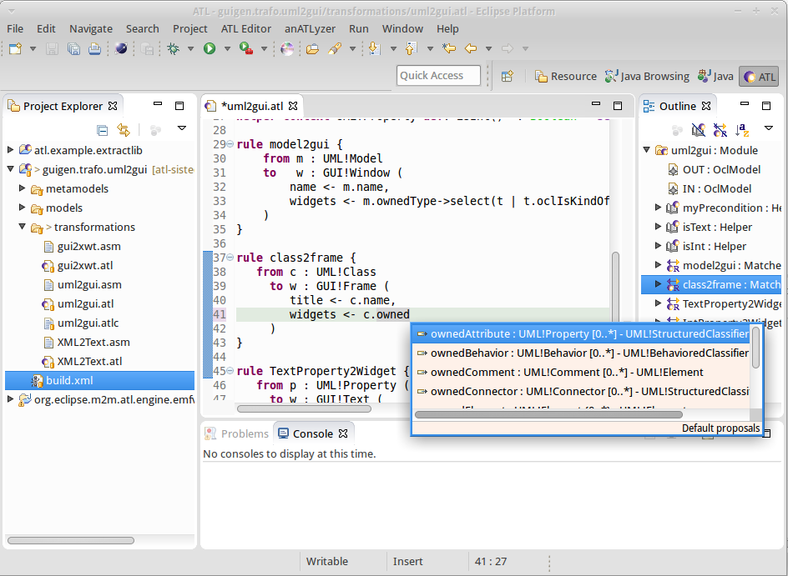
ATL Editor
Automated
compilation
Content
assist
Syntax error highlighting
Dedicated
launcher
Tooling – 18

Slide 19

Compilation & Execution
Source
MM(s)
Source
Model(s)
<push>
<load>
<pop>
<invoke>
ATL Compiler
.atl
ATL Module
ASM File
Target
Model(s)
ATL Engine
(VM)
<push>
<load>
<pop>
<invoke>
ATL Compiler
.atl
Target
MM(s)
ATL Library
ASM File
Tooling – 19
Notes:
Important thing to notice: there is no meta-model involved in the compilation process.

Slide 20
Project structure
File -> Project .. -> ATL Project
The projects are created with no structure
Possible structure
myProject
+ launching
+ metamodels
+ models
+ output
+ transformations
Tooling – 20

Slide 21
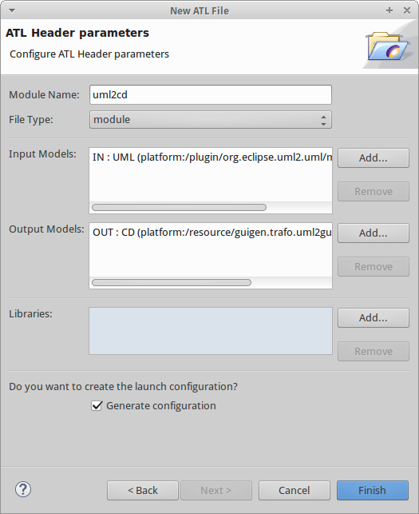
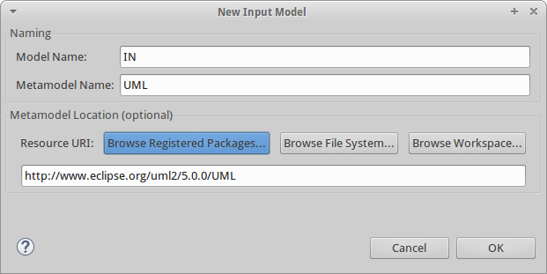
New ATL transformation
File -> New … -> ATL File
Tooling – 21

Slide 22
Launching
Dedicated launcher
ANT Tasks
http://wiki.eclipse.org/ATL/User_Guide_-_The_ATL_Tools#ATL_ant_tasks
Programatically
ATL Plug-in project
We will see this later
Tooling – 22

Slide 23
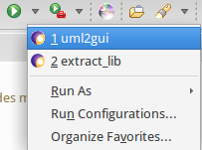
Launching
Dedicated launcher
Based on Eclipse infrastructure
Accessible via the “play button”
Right-click on the ATL file
Run as… -> ATL Transformation
Meta-model information is automatically filled in if you have the proper annotations
Tooling – 23

Slide 24
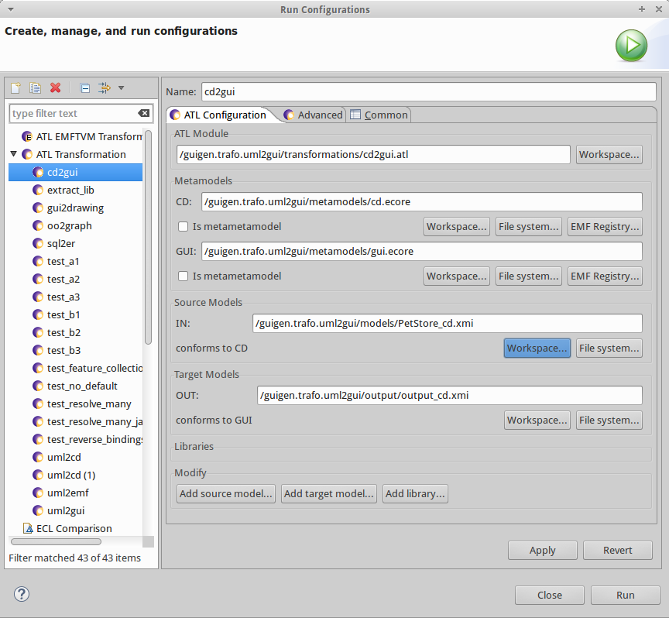
Launching
Tooling – 24
Tooling – 24

Slide 25
Launching
Opening the output model
Not that easy…
XMI files does not include schemaLocation information
Registering meta-models is a must
The ATL perspective must be active to have access to the register meta-model button
Right-click on the target meta-model file
Register meta-model
Tooling – 25

Slide 26
Introduction to ATL
Basic constructs

Slide 27
ATL
Module
*
ModuleElement
Rule
Helper
1 body
bindings
guard
var. dcls.
OCL Expression
action block
Basic constructs – 27

Slide 28
Module definition
Name
No need to coincide with the file name
(need to be the same for EMFTVM)
Dots not allowed. Several words, with “ “
-- @atlcompiler atl2006
-- @nsURI UML=http://www.eclipse.org/uml2/5.0.0/UML
-- @path CD=/guigen.trafo.uml2gui/metamodels/cd.ecore
module “uml to class diagram”;
create OUT : CD from IN : UML;
Basic constructs – 28

Slide 29
Module definition
Meta-model references
Not compulsory, but recommended
Enables auto-completion (+ anATLyzer)
@nsURI for registered meta-models
@path for workspace files
-- @atlcompiler atl2006
-- @nsURI UML=http://www.eclipse.org/uml2/5.0.0/UML
-- @path CD=/guigen.trafo.uml2gui/metamodels/cd.ecore
module “uml to class diagram”;
create OUT : CD from IN : UML;
Basic constructs – 29

Slide 30
Module definition
Compiler directive
-- @atlcompiler atl2004
-- @atlcompiler atl2006
-- @atlcompiler atl2010
-- @atlcompiler emftvm
-- @atlcompiler atl2006
-- @nsURI UML=http://www.eclipse.org/uml2/5.0.0/UML
-- @path CD=/guigen.trafo.uml2gui/metamodels/cd.ecore
module “uml to class diagram”;
create OUT : CD from IN : UML;
Basic constructs – 30
Notes:
The architecture is extensible. New compilers can be created using: org.eclipse.m2m.atl.engine.atlcompiler

Slide 31
Rules
Matched rule
Lazy rule
Unique lazy rule
Called rule
Entry point rule
Endpoint rule
Basic constructs – 31

Slide 32
Rules
Matched rule
Lazy rule
Unique lazy rule
Called rule
Entry point rule
Endpoint rule
In this part
Later
Basic constructs – 32

Slide 33
Rules – Conceptual model
According to the invocation mode *
Rule
Implicit
Explicit
Matched
End/Entry point
Lazy
Called
Unique
Lazy
* This classification has nothing to do with the abstract syntax of the language
Basic constructs – 33

Slide 34
Matched rules
Structure
Input pattern (from)
Optional filter/guard
Output pattern (to)
Contains bindings (<-)
Imperative block (do)
Optional. Discouraged.
Behaviour
Executed implicitly, at the top level
Target elements created automatically
Target features initialized with bindings
rule class2frame {
from c : CD!Class ( not c.isAbstract )
to f : GUI!Frame (
title <- c.name,
widgets <- c.features
)
do { ... }
}
Basic constructs – 34

Slide 35
Matched rules
Multiple input elements
Cartesian product of instances of the input pattern types
Intuitively:
for x in T1.allInstances()
for y in T2.allInstances()
check guard(x, y)
rule model_class2frame {
from m : CD!Model,
c : CD!Class ( m.classifiers->includes(c) )
to f : GUI!Frame (
title <- m.name + ‘_’ + c.name,
widgets <- c.features
)
}
* This is not a very efficient way of doing this...
Basic constructs – 35

Slide 36
Matched rules
cd2gui_02.atl
Multiple output pattern elements
Comma-separated
Can be linked to any of the other output elements
rule model2gui {
from m : CD!Model
to w : GUI!Window (
title <- m.name,
layout <- vflow,
widgets <- m.classifiers
), g : GUI!GUI (
windows <- w
), vflow : GUI!FlowLayout (
direction <- #vertical
)
}
Basic constructs – 36

Slide 37
Bindings
Structure
Left part
Target feature
Right part
OCL expression
Behaviour
Right part is flattened
Primitive bindings
Left is primitive type
Right is primitive value
Direct assignment
Object bindings
Left type is meta-class
Right value is object
Primitive binding
title <- c.name,
widgets <- c.features
Object binding
Basic constructs – 37

Slide 38
Binding resolution
:DataType
a1:Attribute
widgets <- c.features
type
name = ‘String’
a2:Attribute
:DataType
type
name = ‘Integer’
a1 matched by the input pattern?
rule attribute2text {
from p : CD!Attribute ( p.isText() )
to t : GUI!Text
}
Object instantiated
Assigned to feature
Basic constructs – 38

Slide 39
Binding resolution
:DataType
a1:Attribute
widgets <- c.features
type
name = ‘String’
a2:Attribute
:DataType
type
name = ‘Integer’
a2 matched by the input pattern?
rule attribute2int {
from p : CD!Attribute ( p.isInt() )
to t : GUI!Text
}
Object instantiated
Assigned to feature
Basic constructs – 39

Slide 40
Binding assignment
Semantics
Multi-valued
Addition of elements
widgets <- xxx,
widgets <- yyy
Mono-valued
The second assignment wins
I assume bindings are executed in order, but all ATL papers claim that the order is not guaranteed (i.e., because ATL is a declarative language...)
Assign both elements
Basic constructs – 40

Slide 41
Binding assignment
Given that the semantics is a bit confusing...
Idiomatic way of dealing with multi-valued bindings and multiple-resolutions
You could also use including for single elements
Take into account that union and including may be expensive operations...
feature <- expr1->union(expr2)
feature <- expr1->including(expr2)
Basic constructs – 41

Slide 42
Resolving elements explicitly
cd2gui_03.atl
Problem: We want to attach a label each widget.
Solution: add an additional out pattern element
rule attribute2text {
from p : CD!Attribute ( p.isText() )
to t : GUI!Text ( ... ),
l : GUI!Label ( ... )
}
Basic constructs – 42

Slide 43
Resolving elements explicitly
Next problem, we need to link the label to its container
Remember, ATL only resolves the first element
Solution: resolveTemp
thisModule.resolveTemp(obj, ‘varName’)
Performs the trace lookup for obj explicitly
Retrieves the element created with the output pattern element whose variable name is ‘varName’
Basic constructs – 43

Slide 44
Resolving elements explicitly
rule class2frame {
from c : CD!Class ( not c.isAbstract )
to f : GUI!Frame (
title <- c.name,
widgets <- c.features,
widgets <- c.features->collect(a | thisModule.resolveTemp(a, ‘l’))
)
}
: Attribute
name= “name”
rule attribute2text {
from p : CD!Attribute ( p.isText() )
to t : GUI!Text ( ... ),
l : GUI!Label ( ... )
}
p
: TraceLink
at runtime
t
l
: Text
: Label
Basic constructs – 44

Slide 45
Resolving elements explicitly
rule class2frame {
from c : CD!Class ( not c.isAbstract )
to f : GUI!Frame (
title <- c.name,
widgets <- c.features,
widgets <- c.features->collect(a | thisModule.resolveTemp(a, ‘l’))
)
}
look up
: Attribute
name= “name”
rule attribute2text {
from p : CD!Attribute ( p.isText() )
to t : GUI!Text ( ... ),
l : GUI!Label ( ... )
}
p
: TraceLink
at runtime
t
l
: Text
: Label
Basic constructs – 45

Slide 46
Resolving elements explicitly
What if the source element cannot be resolved?
It returns OclUndefined
What if the output pattern element name (e.g., ‘l’) does not exist?
It returns OclUndefined
Basic constructs – 46

Slide 47
OCL
Object constraint language
OMG Specification. Current version 2.4 *
Initially defined to write constraints on UML models
Invariants (well-formedness rules)
Operation pre/post conditions
Scope extended for e.g.,:
Model navigation in model transformation languages
Well-formedness rules in DSLs (i.e., validation rules)
Transformation contracts
* http://www.omg.org/spec/OCL/2.4/
* Object Constraint Language (OCL): A Definitive Guide. Jordi Cabot, Martin Gogolla
Basic constructs – 47

Slide 48
OCL
Characteristics
Side-effect free (i.e., there are no assignments)
No statements, only expressions
Collection navigation operators
Collection navigation in a “functional style”
An OCL expression is typed w.r.t. a meta-model
Basic constructs – 48

Slide 49
OCL
ATL implements its own variant
Somewhat out of date with respect to newer versions
e.g., lack of closure operation
OCL is statically typed, ATL/OCL is not!
Model elements named with syntax MM!Type
Basic constructs – 49

Slide 50
OCL
Example: get all attributes of type String in a class diagram
aModel.classifiers->
select(c | c.oclIsKindOf(CD!Class))->
collect(c | c.features->select(f | f.oclIsKindOf(CD!Attribute) )->
flatten()->
select(a | if a.type.oclIsUndefined() then
a.type.name = ‘String’
else
false
endif)
This example assumes that Attribute.type
is an optional property
Basic constructs – 50

Slide 51
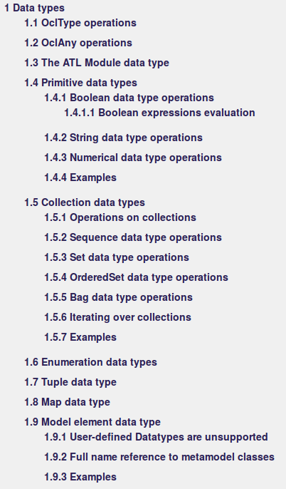
OCL
Details about the supported operations available in the ATL guide
https://wiki.eclipse.org/ATL/User_Guide_-_The_ATL_Language
Basic constructs – 51

Slide 52
OCL
Type hierarchy
OclAny
Primitive Type
Collection(T)
Tuple
Class
Integer
String
Boolean
Set(T)
Bag(T)
Sequence(T)
OrderedSet(T)
Real
Basic constructs – 52

Slide 53
OCL
Literal values
let i : Integer = 1024 in ...
let r : Real = 3.1415 in ...
let s : String = ‘a string’ in ...
let b : Boolean = true in ...
let s : Set(Integer) = Set {1, 2, 3} in ...
let s : Sequence(Integer) = Sequence {1, 2, 3, 3} in ...
let s : Bag(Integer) = Sequence {1, 2, 3, 3, 3} in ...
let s : OrderedSet(Integer) = Sequence {3, 2, 1} in ...
Basic constructs – 53

Slide 54
Collection operations
Should be written using “->”
collectionExp->operation()
Query operations:
size()
includes(o : oclAny)
excludes(o : oclAny)
count(o : oclAny)
includesAll(c : Collection)
excludesAll(c : Collection)
isEmpty()
notEmpty()
sum()
Basic constructs – 54

Slide 55
Collection operations
Modification operations available for all collection types:
union(c : Collection)
flatten()
including(o : OclAny)
excluding(o : OclAny)
* ATL and OCL collections are immutable
Basic constructs – 55

Slide 56
Collection operations
There are other operations depending on the collection type
Sequence: append, prepend, insertAt, subSequence, at, indexOf, first, last
Set: intersection, - (operator, for difference), symmetricDifference
OrderedSet: mix Sequence and Set
Basic constructs – 56

Slide 57
Collection operations
Should be written using “->”
collectionExp->operation()
Operations:
size() returns the number of elements in the collection
includes(o : oclAny) is o part of the collection?
excludes(o : oclAny) is o not part of the collection?
count(o : oclAny) number of occurrences of o in the collection
includesAll(c : Collection) is c completely contained?
excludesAll(c : Collection) opposite of includesAll
isEmpty() is the collection empty?
notEmpty() is the collection not empty?
sum() uses the ‘+’ operator to compute the sum
Basic constructs – 57

Slide 58
Iterators
Syntax:
<source_exp>->iteratorName(itVar | <body>)
Available:
exists(itVar | <boolean-body>)
forAll(itVar | <boolean-body>)
isUnique(itVar | <boolean-body>)
any(itVar | <boolean-body>)
If body never evaluates to true, the operation returns OclUndefined;
one(itVar | <boolean-body>)
collect(itVar | <any-body>)
Implement OCL’s collectNested
select(itVar | <boolean-body>)
reject(itVar | <boolean-body>)
sortedBy(itVar | <any-body>)
The body must evaluate to a data type with “<“ operator
Basic constructs – 58

Slide 59
Iterator
Example: organize widgets by alphabetical order
Example: obtain a searchable attribute
rule class2frame {
from c : CD!Class ( not c.isAbstract )
to f : GUI!Frame (
title <- c.name,
widgets <- c.features->sortedBy(f | f.name)
)
}
helper context CD!Class def: searchableAtt() : CD!Atribute =
self.features->reject(f | not f.oclIsKindOf(CD!Attribute))->
->any(f | f.isId);
Basic constructs – 59

Slide 60
Checking “instance of”
OCL provides two operations to check if an object is instance of a given class
obj.oclIsKindOf(Type)
Is the runtime type of obj the same as Type or a subtype?
obj.oclIsTypeOf(Type)
Is the runtime type of obj exactly the same as Type?
aClassifier.oclIsKindOf(CD!Class)
aNamedElement.oclIsTypeOf(CD!Property)
Basic constructs – 60

Slide 61
OclAny
refImmediateComposite
Returns the container of an object
Equivalent to eContainer in EMF
OclUndefined if none
from c : CD!Class
using m : CD!Model = c.refImmediateComposite();
to f : GUI!Frame (
title <- m.name + ‘_’ + c.name,
widgets <- c.features
)
}
Basic constructs – 61

Slide 62
OclAny
asSet, asBag, asSequence
For collections: type conversion
Sequence {1, 2, 2}->asSet() => Set{1, 2}
For single elements: wrap an object into a collection
aClass->asSequence => Sequence { aClass }
Try not to abuse
They have a cost, particularly for large collections
Basic constructs – 62

Slide 63
OclAny
debug
Prints the value of an object, prefixed by a message and returns the same object
Syntax: obj.debug(message : String)
ATL tries to pretty print...
aClass.debug(‘class: ‘) => class: IN!Person
aClass.debug(aClass) =>
org.eclipse.emf.ecore.impl.DynamicEObjectImpl@14e987ac (eClass: org.eclipse.emf.ecore.impl.EClassImpl@11851c1d (name: Class)
Often you want the identify
Basic constructs – 63

Slide 64
Model elements
allInstances, allInstancesFrom(model : String)
Retrieve all instances of a given OclModelElement
If the same meta-model is used for two input models:
CD!Class.allInstances()
CD!Class.allInstances()
=
CD!Class.allInstancesFrom(‘IN1’)->union(
CD!Class.allInstancesFrom(‘IN2’) )
Basic constructs – 64

Slide 65
Helpers
“Methods” attached to (meta-model) types at runtime
Two types
Module helpers
Context helpers
Two modes
Operation
Attribute
Basic constructs – 65
Notes:
Disclaimer: in the ATL guide helpers are “operations”, an attributes are not classified as helpers. This is different from the abstract syntax.

Slide 66
Helpers
Module helpers
Context helpers
Global helpers
Or methods attached to “this transformation module”
Methods attached at runtime
thisModule.propsByName(‘age’)
helper def: propsByName(name : String) : Set(CD!Attribute) =
CD!Attribute.allInstances()->select(p | p.name = name);
aClass.hasProperty(‘age’)
helper context CD!Class def: hasFeature(name : String): Boolean =
self.features->exists(p | p.name = name);
Basic constructs – 66
Notes:
Disclaimer: in the ATL guide helpers are “operations”, an attributes are not classified as helpers. This is different from the abstract syntax.

Slide 67
Helpers
Module helpers
Global helpers
Methods attached to “this transformation module”
Context helpers
Methods attached at runtime to a meta-class
thisModule.propsByName(‘age’)
helper def: propsByName(name : String) : Set(CD!Attribute) =
CD!Attribute.allInstances()->select(p | p.name = name);
aClass.hasProperty(‘age’)
helper context CD!Class def: hasFeature(name : String): Boolean =
self.features->exists(p | p.name = name);
Basic constructs – 67

Slide 68
Helpers
Context helpers
Methods attached at runtime
Polymorphic calls
self variable refers to the current object
aFeature.isContainment()
helper context CD!Attribute def: isContainment(): Boolean = false;
helper context CD!Reference def: isContainment(): Boolean =
self.containment;
Basic constructs – 68

Slide 69
Helpers
Attribute
No parameters. Syntactically there are no ()
Overrides meta-model features
Memoized
Operation
Regular method
Basic constructs – 69

Slide 70
Helpers
When to use Attribute or Operation?
Think if caching makes sense. Is it going to be reused the called value?
Example:
Which one is faster?
helper context CD!Class def: allFeatures() : Sequence(CD!Feature) =
self.superclasses->collect(c | c.allFeatures())->flatten()->
union(self.features);
helper context CD!Class def: allFeatures : Sequence(CD!Feature) =
self.superclasses->collect(c | c.allFeatures)->flatten()->
union(self.features);
Basic constructs – 70

Slide 71
Helpers
 | Operation | Attribute
Module | function | static final field
Context | method | final field (lazily initialized)
Basic constructs – 71

Slide 72
Lazy rules
Rules which are explicitly invoked
Same structure as matched rules
No trace links are generated
Can be invoked many times over the same source element
thisModule.aLazyRule(obj1, obj2)
Input pattern elements are passed as parameters
rule aLazyRule {
from c : CD!Class, p : CD!Property
to t : GUI!Text ( ... )
}
Object instantiated
Assigned to feature
Basic constructs – 72

Slide 73
Lazy rules
Lazy rules vs. Matched rules
Use matched rules
Start the design with matched rules
They are a good fit for relative direct mappings
Use lazy rules
If you need to create a target element from a source element many times
If you need dynamic mappings
Basic constructs – 73

Slide 74
Lazy rules
cd2gui_04.atl
Example. Consider generating a layout for each frame.
Approach #1: Fixed layout.
Grid layout with two columns
Person
Person
Name:
name : String
surname : String
address : String
Surname:
Address:
Basic constructs – 74

Slide 75
cd2gui_04.atl
rule class2frame {
from c: CD!Class ( not c.isAbstract )
to f: GUI!Frame (
...,
layout <- grid
), grid: GUI!GridLayout (
numColumns <- 2,
info <- c.features -> collect(a | thisModule.resolveTemp(a, 'g1')),
info <- c.features -> collect(a | thisModule.resolveTemp(a, 'g2'))
)
}
rule attribute2text {
from a: CD!Attribute ( a.isText() )
to t: GUI!Text,
l: GUI!Label,
g1: GUI!GridInfo (
column <- 1,
widget <- t
),
g2: GUI!GridInfo (
column <- 2,
widget <- l
)
}
The layout is hardcoded in the output patterns
Basic constructs – 75

Slide 76
Lazy rules
Approach #2: “Dynamic selection” of layout.
Decide based on the elements of the model the best layout or with some parameter flag
For example, we want a vertical flow for a mobile device
Person
Name:
Person
name : String
surname : String
address : String
Surname:
Address:

Slide 77
cd2gui_05.atl
helper def : isMobile : Boolean = true;
rule class2frame {
from c: CD!Class ( not c.isAbstract )
to f: GUI!Frame (
...,
layout <- if thisModule.isMobile then
thisModule.createVFlow(c)
else
thisModule.createGrid(c)
endif ) }
lazy rule createVFlow {
from c : CD!Class
to layout : GUI!FlowLayout (
direction <- #vertical
) }
lazy rule createGrid {
from c : CD!Class
to grid: GUI!GridLayout (
numColumns <- 2,
info <- c.features -> collect(a | thisModule.resolveTemp(a, 'g1')),
info <- c.features -> collect(a | thisModule.resolveTemp(a, 'g2'))
)
}
Approach #1 was not enough because the layout was fixed in the target pattern.
Nevertheless, you can always code all possibilities in the filters of the matched rules...
Basic constructs – 77

Slide 78
Lazy rules
Example. Consider both owned and inherited features of a class.
Dog
Pet
Name:
name : String
birth : Date
Birth:
_ _ / _ _ / _ _
Breed:
expected
Dog
Rabbit
Rabbit
breed: String
size: Integer
Name:
Birth:
_ _ / _ _ / _ _
Size:

Slide 79
Lazy rules
cd2gui_06.atl
CD_PetStore_inh.xmi
Change is straightforward:
helper context CD!Class def: allFeatures : Sequence(CD!Feature) =
self.superclasses->collect(c | c.allFeatures)->flatten()
->union(self.features);
rule class2frame {
from c: CD!Class ( not c.isAbstract )
to f: GUI!Frame (
title <- c.name,
widgets <- c.features,
widgets <- c.allFeatures,
...
), ...
}
Basic constructs – 79

Slide 80
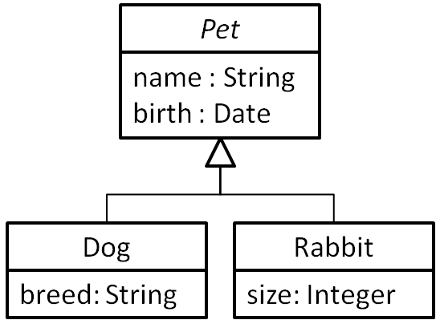
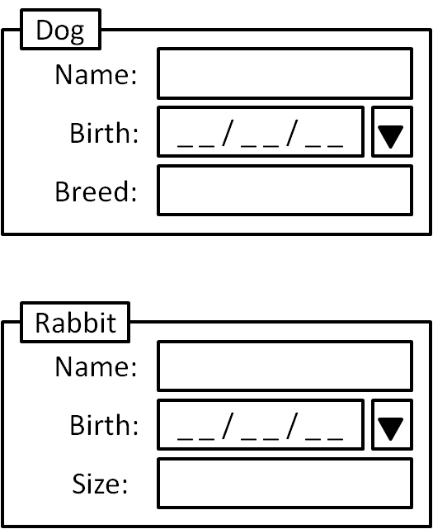
Lazy rules
rule class2frame {
from c : CD!Class ( not c.isAbstract )
to f : GUI!Frame (
title <- c.name,
widgets <- c.allFeatures
)
}
rule attribute2text {
from p : CD!Attribute
( p.isText() )
to t : GUI!Text
}
?
rule attribute2date {
from p : CD!Attribute ( p.isDate() )
to t : GUI!DatePicker
}

Slide 81
Lazy rules
Dog
Pet
name : String
birth : Date
Breed:
you get
Dog
Rabbit
Rabbit
breed: String
size: Integer
Name:
Birth:
_ _ / _ _ / _ _
Size:
Why?
Basic constructs – 81

Slide 82
Lazy rules
Child stealing
Each instance of an Atttribute generates one Widget instance
The last binding wins
We need one instance per concrete subclass
Basic constructs – 82

Slide 83
Lazy rules
cd2gui_07.atl
CD_PetStore_inh.xmi
rule class2frame {
from c : CD!Class ( not c.isAbstract )
to f : GUI!Frame (
title <- c.name,
widgets <- c.allAttributes->collect(f |
if f.isText() then thisModule.attribute2text(f)
else if f.isInt() then thisModule.attribute2int(f)
else if f.isDate() then thisModule.attribute2date(f)
else OclUndefined endif endif endif
)
)
}
You need to “pattern match” explicitly. We will use abstract rules later to solve this.
lazy rule attribute2text {
from p : CD!Attribute
to t : GUI!Text
}
lazy rule attribute2date {
from p : CD!Attribute
to t : GUI!DatePicker
}
What about labels? We need another lazy rule attribute2label
Notes:
Be aware that you don’t need the input pattern filters any more

Slide 84
Unique lazy rules
Similar to lazy rules, but they keep trace links
Useful if a matched rule is subordinated to the execution of others
Required if the target element of a lazy rule must be reused
For example, the previous modification did not considered the layout.
We need to create GridInfo elements (with called rules) and make them point to the wiget they are layout out.
Basic constructs – 84

Slide 85
Called rules
Rules invoked explicitly (like lazy rules) but with parameters (like a function)
A called rule has a return value, which is the last value of the do section
This is important if the result of a called rule is going to be assigned
Basic constructs – 85

Slide 86
Unique lazy rules and called rules
Revisiting the example...
rule class2frame {
from c: CD!Class ( not c.isAbstract )
to frm: GUI!Frame (
widgets <- ...
),
grid: GUI!GridLayout (
numColumns <- 2,
info <- c.allAttributes->collect(a |
Sequence { thisModule.widget2gridInfo(a, 1),
thisModule.label2gridInfo(a, 2) }
)
}
Called rule invocation
Basic constructs – 86

Slide 87
Unique lazy rules and called rules
cd2gui_07.atl
CD_PetStore_inh.xmi
rule widget2gridInfo(f : CD!Attribute, i : Integer) {
to tgt : GUI!GridInfo (
column <- i,
widget <- if f.isText() then thisModule.attribute2text(f)
else if f.isInt() then thisModule.attribute2int(f)
else if f.isDate() then thisModule.attribute2date(f)
else OclUndefined.fail_() endif endif endif
) do {
tgt; -- This is the return value!
}
}
Can use lazy rules here?
Basic constructs – 87

Slide 88
Unique lazy rules and called rules
cd2gui_08.atl
CD_PetStore_inh.xmi
In this case, the lazy rules (attribute2text, attribute2int and attribute2date) needs to be converted into unique lazy rules
This is so because GridInfo.widget is not containment
We have to assign the reference contained in Frame.widgets
Basic constructs – 88

Slide 89
To finish this part
The last example is just wrong again :-S
By using unique lazy rules we went back to the original problem of child stealing...
This is difficult to solve
We will use some imperative constructs later to deal with it.
Basic constructs – 89

