Slide 1
AnATLyzer
Tutorial of the ATL transformation language
http://github.com/jesusc/atl-tutorial
Creative commons (attribution, share alike)
Part II
jesus.sanchez.cuadrado@gmail.com
@sanchezcuadrado
http://sanchezcuadrado.es

Slide 2
Motivation
Writing a model(-to-model) transformation is a complex task
You must handle every possible input configuration
You must ensure the target model is syntactically correct
The mapping itself must be semantically correct

Slide 3
Motivation
Moreover:
The reliability of any MDE process depends on the correctness of its transformations
The same transformation will be used many times to generate many models, even in different projects (errors percolate every project!)

Slide 4
Motivation
There are also accidental details due to the transformation language.
In ATL:
It is dynamically typed
There is no formal semantics
Design decisions may not be optimal

Slide 5
Motivation
Consider this copy rule
Is it right?
rule class2class {
from s : UML!Class
to t : UML!Class (
-- Is there anything missing here?
)
}
Notes:
It depends... For instance, UML!Class has an obligatory property called model.

Slide 6
AnATLyzer
A static analyser for ATL model transformations
Static analysis
Detect problems before executing the transformation
Goal:
Be precise: few false positives
Be complete: few false negatives

Slide 7
What can anATLyzer do for you?
AnATLyzer detects more that 50 types of problems
Navigation & typing problems
Rule problems
Transformation integrity problems
Style problems

Slide 8
AnATLyzer
Using AnATLyzer

Slide 9
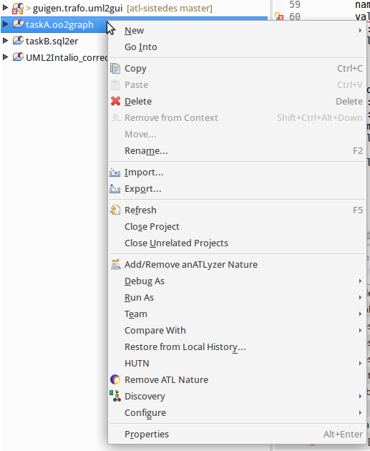
Setting up the project
cd2gui_errors.atl
Right-click on an ATL project
Select “Add/Remove” anATLyzer feature
All transformations in the project will automatically be analysed
Using AnATLyzer – 9

Slide 10
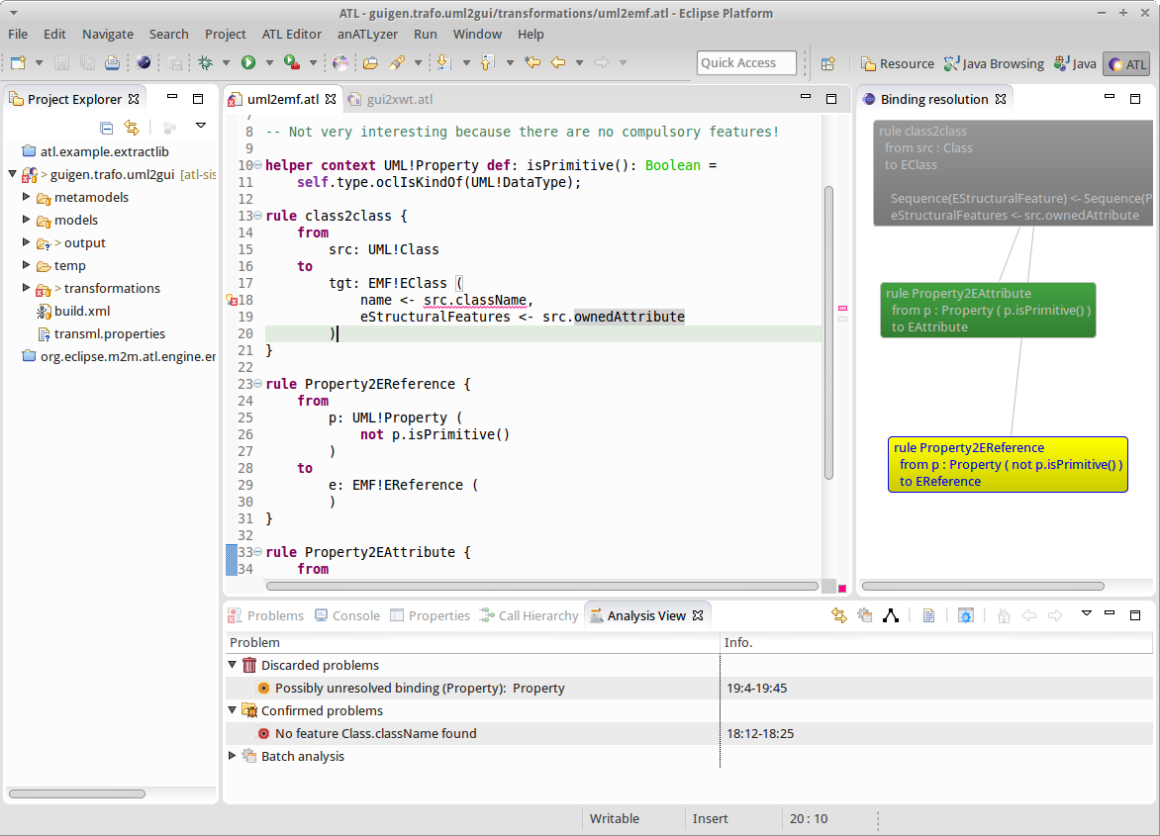
User interface
Errors
Visualization
Analysis
view
Using AnATLyzer – 10

Slide 11
The analysis view
Show list of detected problems
Provide access to batch analysis
Rule conflict
Child stealing (experimental!)
Show the view
Window -> Show view -> Other ...
AnATLyzer -> Analysis View
Using AnATLyzer – 11

Slide 12
The analysis View
Confirmed
It is a true error. Should be fixed somehow.
Try some quick fix! CTRL + 1
Discarded
We used model finding to ensure it is not an error
Can be ignored
Unknown
It is a smell but we cannot check if it is an error.
Running
Errors which are currently being processed
Most of the time you could not see this.
Time out
If it takes to long to confirm the problem
Using AnATLyzer – 12

Slide 13
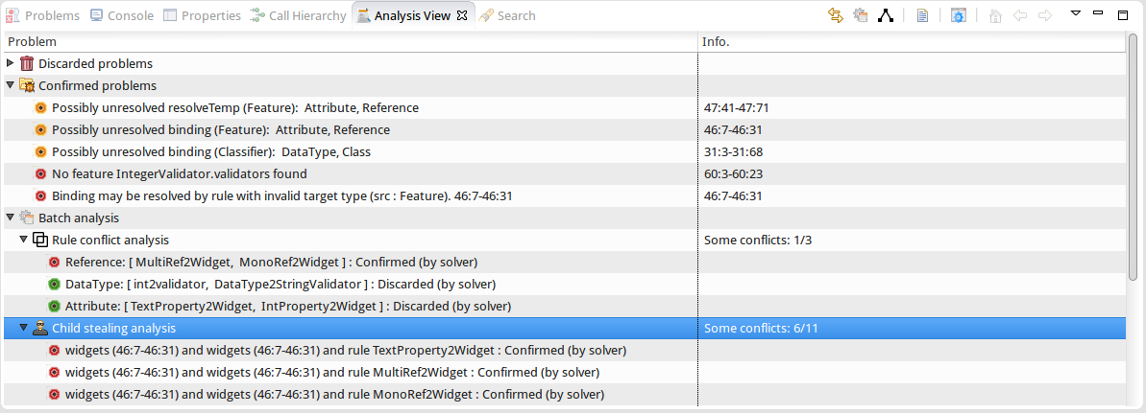
The analysis view
Reload analysis
Warning
Error
Double-click on “Rule conflict analysis” or “Child stealing” to execute
Using AnATLyzer – 13

Slide 14
Keyboard shortcuts
CTRL + 1
Over an error, show quick fix
Over a normal statement, show quick assist
Be ready to use CTRL-Z to undo...
CTRL + S to save and re-analyse
The analysis is mostly incremental
Using AnATLyzer – 14
Notes:
CTRL + SHIFT + V
Show analysis view
CTRL+R
Reload analysis

Slide 15
Keyboard shortcuts (Inherited from ATL Editor)
Auto-complete
CTRL+SPACE
Not completely precise
Go to definition (e.g., helper, definition)
CTRL + Click
F3 with the keyboard
Comment / Uncomment
CTRL+SHIFT+C
Using AnATLyzer – 15

Slide 16
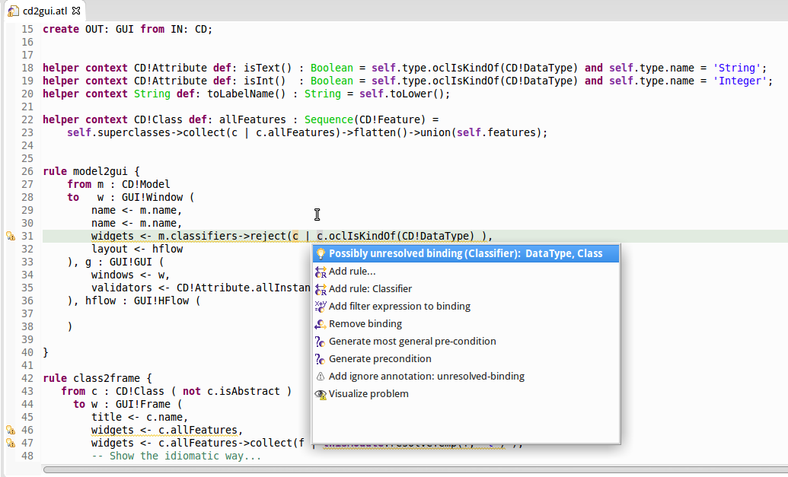
Quick fixes
Access to detailed
Information about
the problem
Quick fixes
Visualization quick access

Slide 17
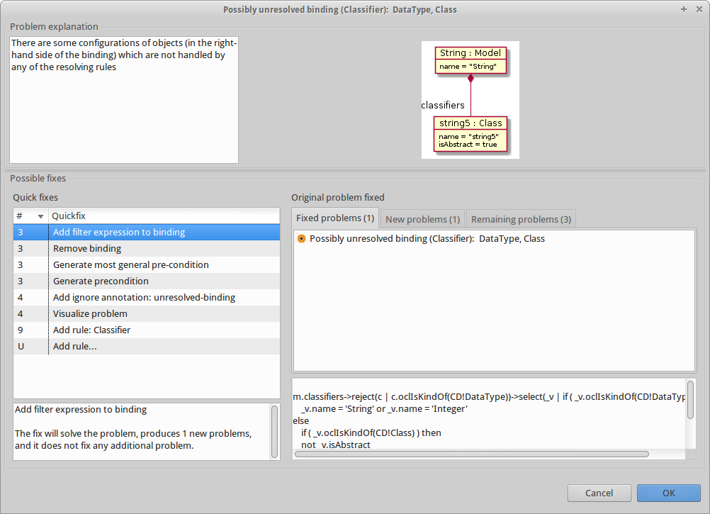
Problem information
Witness
Speculative quick fixes

Slide 18
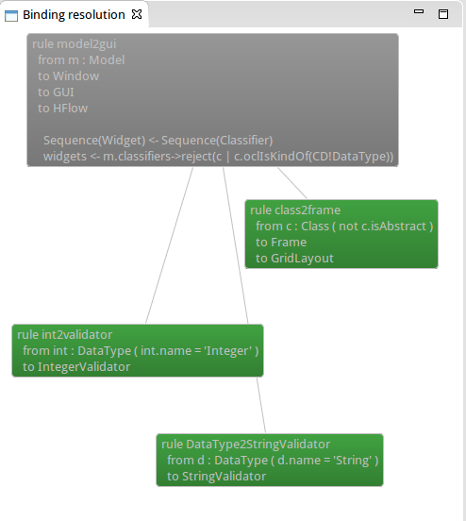
Visualization
Using AnATLyzer – 18

Slide 19
Visualization
Available as quick assist for bindings and also as quick fix for binding errors
Currently visualization does not use constraint solving to prune, you get all “possible” resolutions
In the previous example: int2validator and DataType2StringValidator could be pruned from the visualization
Using AnATLyzer – 19

Slide 20
Configuration
Right-click on the ATL file
anATLyzer -> Configure anATLyzer
Using AnATLyzer – 20

Slide 21
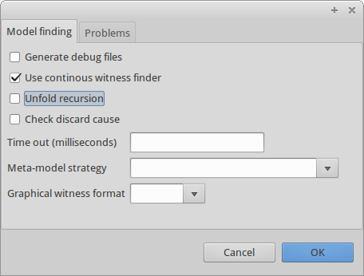
Configuration
Continous mode
Recommended
Untick to execute model finder on demand
Unfold recursion
Experimental support for recursive helpers
Check discard cause
Errors can be discarded due to meta-model issues
Time out
Using AnATLyzer – 21

Slide 22
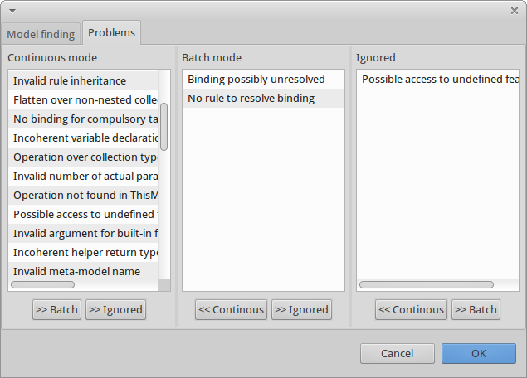
Configuration
Using AnATLyzer – 22

Slide 23
Technical information
Installation
Requirements:
Java 8
ATL 3.x
UML2 plug-in, for UML support (optional)
Zest 1.5 , for visualization support (optional)
Tested on Eclipse Luna and Mars
Web site:
http://miso.es/tools/anATLyzer.html
Update site:
http://sanchezcuadrado.es/projects/anatlyzer/sites/anatlyzer.updatesite/
Source code available at Github:
https://github.com/jesusc/anatlyzer
Using AnATLyzer – 23

Slide 24
AnATLyzer
Types of problems

Slide 25
Types of problems
AnATLyzer detects more than 50 types of problems
Classification:
Typing and navigation
Typing w.r.t. meta-models and use of OCL
Transformation integrity
Checks related to the transformation structure
Target meta-model conformance
Does the output model conforms to the target meta-model?
Transformation rules
Issues related to (matched) rule usage
Types of problems – 25
Notes:
Understanding the problems that anATLyzer detects helps understanding how ATL works at runtime
Typing and navigation typically runtime errors or warnings
Transformation integrity typically load-errors
Target meta-model conformance do not have visible effect. They are the hardest to debug.
Transformation rules may lead to runtime errors or just warnings.

Slide 26
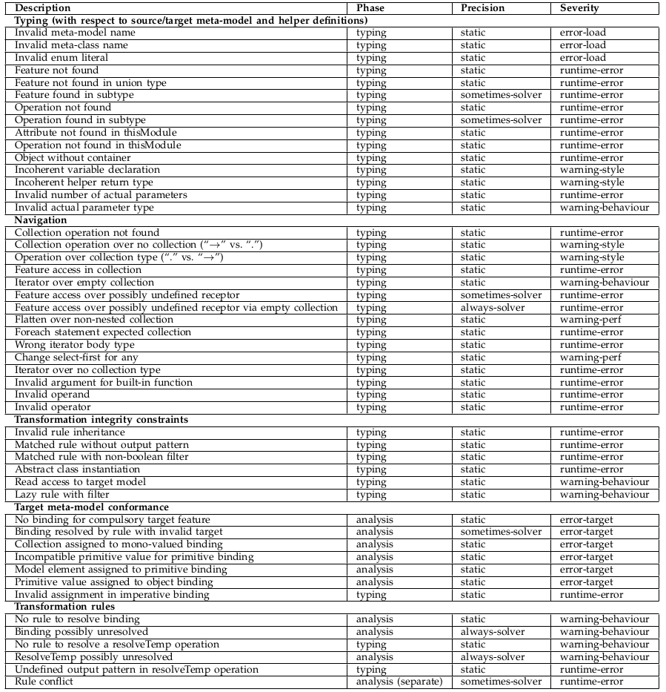

Slide 27
Typing and navigation
OCL expressions should be typed against the source meta-model
AnATLyzer detects problems like:
Invalid references to classes and features
Invalid iteration expressions
Invalid variable declarations
“Null pointer exceptions”
“Feature found in subtype”
Types of problems – 27

Slide 28

Target conformance problems
No binding for compulsory feature
Feature title is compulsory, but the rule is not setting it.
Will cause problems in other transformations relying on the existence of a value for title.
rule class2frame {
from c : CD!Class ( not c.isAbstract )
to f : GUI!Frame (
widgets <- c.features
)
}
Types of problems – 28

Slide 29
Target conformance problems
Binding resolved by rule with invalid target
Difficult to detect
Typically occur when there are different structures and inheritance is involved
Also, one needs to be careful when a rule has several target patterns
Only the first one is assigned
Types of problems – 29

Slide 30
Target conformance problems
Model
Classifier
classifiers *
widgets *
Widget
Frame
Window
Validator
IntValidator
Class
DataType
validators *
rule class2frame {
from c : CD!Class ( not c.isAbstract )
to w : GUI!Frame ( … )
}
rule model2gui {
from m : CD!Model
to w : GUI!Window (
name <- m.name,
widgets <- m.classifiers
)
}
rule int2validator {
from d : CD!DataType (d.name = ‘Integer’)
to w : GUI!Validator ( … )
}

Slide 31
Transformation integrity
ATL code which is syntactically correct but leads to unexpected behaviour.
Example
Are filters in lazy rules allowed?
The lazy rule will be executed regardless of the filter.
This does not apply it the lazy rule inherits from an abstract lazy rule.
lazy rule attribute2text {
from f : CD!Feature ( f.oclIsKindOf(CD!Attribute) )
to t : GUI!Text
}
Types of problems – 31
Notes:
This is a common misunderstanding. There is no pattern match for lazy rules.

Slide 32
Transformation rules problems
uml2cd_rule_conflict.atl
Rule conflict
Two matched rules should not match the same source element
rule model2model {
from m1: UML!Model
to m2: CD!Model
}
rule package2model {
from p: UML!Package
to m: CD!Model
}
Package
Classifier
classifiers *
Model
Class
DataType
Model
Classifier
classifiers *
Solution #1. Make model2model inherit package2model
Solution #2. Add filter p.oclIsType(UML!Package)
Class
DataType

Slide 33
Transformation rules problems
Unresolved binding
What happens when there is no rule to resolve an element appearing in the right part of a binding?
Example:
If you have a rule with a filter to discard abstract classes, you get
rule model2gui {
from m: CD!Model
to w: GUI!Window (
widgets <- m.classifiers->
select(c | c.oclIsKindOf(CD!Class))
Cannot set feature widgets to value [org.eclipse.emf.ecore.impl.DynamicEObjectImpl@4a12c7a0 (eClass: org.eclipse.emf.ecore.impl.EClassImpl@54087d0d (name: Frame) (instanceClassName: null) (abstract: false, interface: false)), org.eclipse.emf.ecore.impl.DynamicEObjectImpl@632e536 (eClass: org.eclipse.emf.ecore.impl.EClassImpl@789537ef (name: Class) (instanceClassName: null) (abstract: false, interface: false)), org.eclipse.emf.ecore.impl.DynamicEObjectImpl@f99ae63 (eClass: org.eclipse.emf.ecore.impl.EClassImpl@54087d0d (name: Frame) (instanceClassName: null) (abstract: false, interface: false)), org.eclipse.emf.ecore.impl.DynamicEObjectImpl@6704dd1e (eClass: org.eclipse.emf.ecore.impl.EClassImpl@54087d0d (name: Frame) (instanceClassName: null) (abstract: false, interface: false))], inter-model references are forbidden. Configure launching options to allow them.

Slide 34
Transformation rules problems
Unresolved binding
Should be treated appropriately
It is a smell of incompleteness in the transformation
Not all cases are covered
If the cases don’t need to be considered:
Filter the right-hand side of the binding
Write a pre-condition
Ignore (but documenting)
Types of problems – 34

Slide 35
Pre-conditions
Useful to document the conditions under which the transformation actually works
Used by anATLyzer to filter out problems
Need to be written formally
AnATLyzer:
Support as module annotations
Used to check problems
-- @pre CD!DataType.allInstances()->forAll(c |
-- c.name = 'Integer' or c.name = ‘String' or c.name = 'Date' )
--
Leave an empty line comment as separator
Types of problems – 35

Slide 36
Preconditions
uml2cd_preconditions.atl
-- @pre UML!Classifier.allInstances()->forAll(c |
-- c.oclIsTypeOf(UML!Class) or c.oclIsTypeOf(UML!DataType))
module "uml2cd preconditions";
create OUT: CD from IN: UML;
rule Model2Model {
from m : UML!Model
to w : CD!Model (
name <- m.name,
classifiers <- m.ownedType->select(c | c.oclIsKindOf(UML!Classifier))
)
}
rule Class2Class {
from m : UML!Class
to w : CD!Class ( name <- m.name )
}
rule DataType2DataType {
from m : UML!DataType
to w : CD!DataType ( name <- m.name )
}
Types of problems – 36

Slide 37
Annotations
Ignore annotations
They are used to remove problems of a certain type in a rule or helper
Easy access via a quick fix
Examples:
-- @ignore unresolved-binding
-- @ignore no-binding-compulsory-feature
Types of problems – 37

Slide 38
Annotations
Force return type
To prefer declared type over inferred
Type inference is typically precise, but false positives may arise
-- @force-declared-return-type
-- @force-declared-return-type
helper context UML!Element def: getContainingModel() : UML!Model =
if self.refImmediateComposite().oclIsTypeOf(UML!Model) then
self.refImmediateComposite()
else
self.refImmediateComposite().getContainingModel()
endif;
Types of problems – 38

Slide 39
Special operations
oclAsType
ATL does not have a downcasting operation
If you implement this dummy operation:
AnATLyzer recognizes to avoid so many nested ifs.
fail_(str : message)
OclUndefined.fail_(“Pattern match error”)
To indicate an impossible path in your code
helper context OclAny def: oclAsType(t : OclType) : OclAny = self;
Types of problems – 39

Slide 40
AnATLyzer
Implementation details

Slide 41
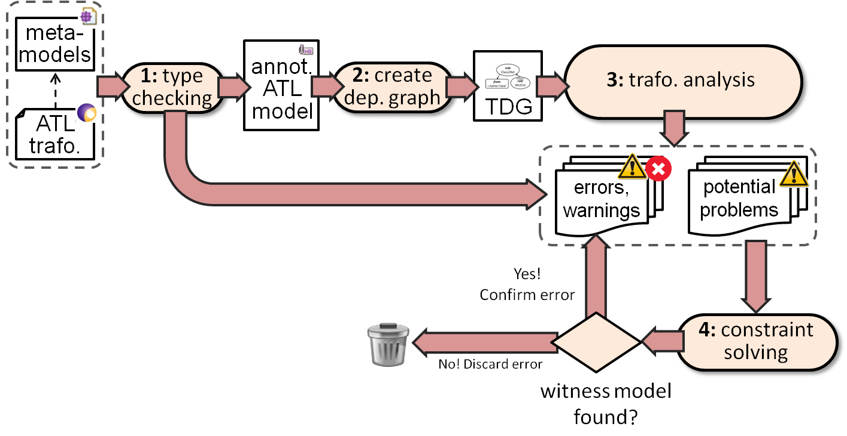
How does it works?
Implementation details– 41

Slide 42
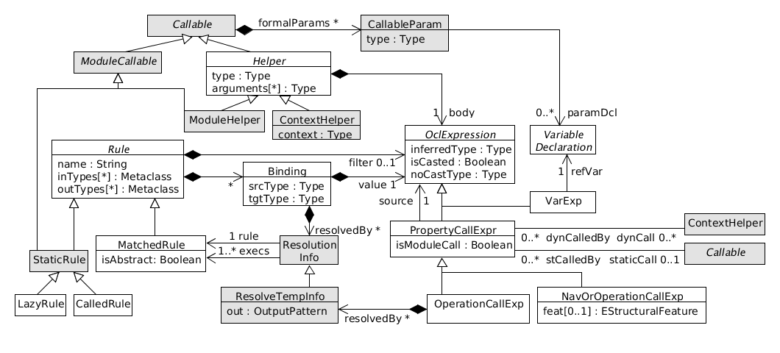
Transformation dependency graph
Implementation details– 42

Slide 43
API
Executing the analyser
Access to:
The anATLyzer ATL’s abstract syntax
Launching the model finder
Implementing new analysis
Implementing quick fixes
Contributing actions
Implementation details– 43

Slide 44
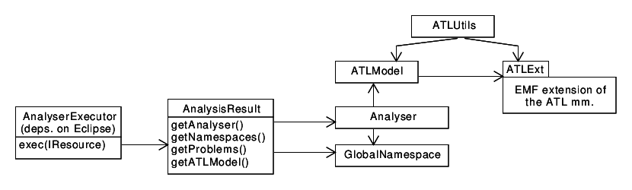
API
Implementation details– 44

Slide 45
Limitations
Many!
Including fixing bugs
Cannot re-analyse dependent transformations or changes in the meta-model
Lack of standard mega-model
Implementation details– 45

Slide 46
Limitations
Typing
Type inference for (mutually) recursive helpers may lead to false positives sometimes
Mapping to USE Validator
We have good coverage but we have to work on e.g., Map and Tuple support
Implementation details– 46

Slide 47
References
Uncovering Errors in ATL Model Transformations Using Static Analysis and Constraint Solving. Jesús Sánchez Cuadrado, Esther Guerra, Juan de Lara ISSRE 2014: 34-44
Quick fixing ATL transformations with speculative analysis. Jesús Sánchez Cuadrado, Esther Guerra, Juan de Lara. Software and Systems Modeling, 2016 (Springer), In press.
(Available at http://miso.es)

Slide 48
More information
If you need more information because:
You want to use it
You have found a bug
You want to collaborate
Send me an email: jesus.sanchez.cuadrado@gmail.com
Implementation details– 48

Slide 49
AnATLyzer
Quick fixes

Slide 50
Quick fix
Blah, blah
Popular in JDT

Slide 51
Quick fix
Captura de pantalla y el flujo
Error is detected
CTRL+1
Select quick fix
(or Esc to abort)
Text or meta-models
are modified

Slide 52
Speculative quick fixes

Slide 53
Example
Programming with quick fixes
rule Reference2Widget {
from r : CD!Reference ( not r.containment )
to w : GUI!ComboBox (
name <- r.name
), l : GUI!Label (
value <- r.name.toLower()
)
}
Prepare a piece of transformation
in which ComboBox does not exists
And containment is isContainment or must be created,
and see that you can create...
Copy-paste another rule and adapt

Slide 54
AnATLyzer
API usage & extension points

Slide 55
Implenting a quick fix
TODO: Draw the lifecycle, indicating the API methods that are called

Slide 56
Implementing a quick fix
Extension point is provided
anatlyzer.atl.editor.quickfix
Two options:
quickfix: single quick fix
quickfix set: a group of related quick fixes
Many examples are available in the anATLyzer source code, under project found in: plugins/natlyzer.atl.editor.quickfix

Slide 57
Implenting a quick fix
Example:
Quick fix for “Abstract class cannot be instantiated”
Create new plug-in project
Open plugin.xml
Add anatlyzer.atl.editor.quickfix to dependencies
Go to “Extensions” tab
Click on “Add”
Find and select “anatlyzer.atl.editor.quickfix”

Slide 58
Implenting a quick fix
Example:
Add the extension
Right-click on “New” -> “Quick fix”
In the “Apply” field specify the class that will handle the quick fix life cycle.
E.g., anatlyzer.atl.editor.quickfix.errors.AbstractClassCannotBeInstantiated_ChooseConcrete
The class must implement AtlProblemQuickfix
Alternatively, extend AbstractAtlQuickfix which already does much of the work.

Slide 59
private List<EClass> subclasses;
@Override
public boolean isApplicable(IMarker marker) throws CoreException {
return checkProblemType(marker, CannotInstantiateAbstractClass.class) &&
validConcreteClasses(marker).size() > 0 ;
}
private List<EClass> validConcreteClasses(IMarker marker) {
if ( subclasses != null ) return subclasses;
OutPatternElement elem = (OutPatternElement) getProblematicElement(marker);
Metaclass m = (Metaclass) elem.getInferredType();
List<EClass> classes = ASTUtils.getMetamodelClasses(m);
this.subclasses = classes.stream().
filter(c -> !c.isAbstract()).
filter(c -> m.getKlass().isSuperTypeOf(c)).collect(Collectors.toList());
return this.subclasses;
}
@Override
public void resetCache() { subclasses = null; }

Slide 60
@Override
public QuickfixApplication getQuickfixApplication() {
// Choose one, or ask the user. U
// Use canExpectUserInteraction to make sure you are in the UI thread
EClass selectedClass = selectedClass = subclasses.get(0);
OutPatternElement elem = (OutPatternElement) getProblematicElement(marker);
QuickfixApplication qfa = new QuickfixApplication(this);
final String className = selectedClass.getName();
qfa.replace((OclModelElement) elem.getType(), (original, trace) -> {
OclModelElement t = OCLFactory.eINSTANCE.createOclModelElement();
t.setName(className);
t.setModel(original.getModel());
return t;
});
return qfa;
}

Slide 61
@Override
public void apply(IDocument document) {
QuickfixApplication qfa = getQuickfixApplication();
new InDocumentSerializer(qfa, document).serialize();
}
@Override
public String getDisplayString() {
return "Change abstract class by concrete class";
}

Slide 62
Implementing a quick fix
Why?
Contribute new quick fixes to anATLyzer
Create quick fixes specific to your meta-models
Take advantage of domain information
Useful if you write transformations for the same meta-model many times
Main difficulty:
You need to be familiar with anATLyzer problems
Described with a meta-model (errors.ecore)
See also ErrorModel, its elements
Or observe what is highlighted in the IDE to know which would be the abstract syntax element pointed by the problem

