Slide 1
Integration of ATL transformations
Tutorial of the ATL transformation language
http://github.com/jesusc/atl-tutorial
Creative commons (attribution, share alike)
Part IV
jesus.sanchez.cuadrado@gmail.com
@sanchezcuadrado
http://sanchezcuadrado.es

Slide 2
Motivation
ATL transformations are created “at development time”
We need to integrate them in actual modelling tools, notably for Eclipse
We cannot use launch configurations
We need to develop our own launching code

Slide 3
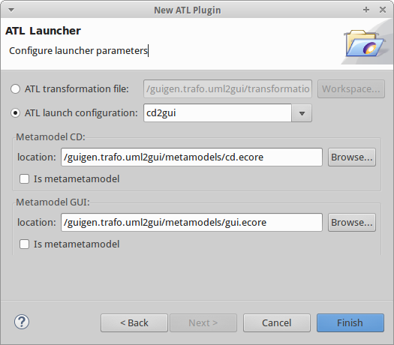
ATL Plug-in generator
File -> Project ... -> ATL -> ATL Plug-in

Slide 4
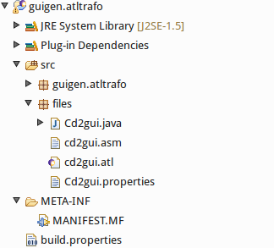
ATL Plug-in generator
Generates an Eclipse plug-in project
Cd2Gui
loadModels(in : String)
doCd2gui(monitor)
saveModels(out : String)
A copy of the original transformation.
Be careful!

Slide 5
ATL Plug-in generator
# ATL modules: if several, by order of superimposition (the latter ones overrides the former ones)
Cd2gui.modules = cd2gui.atl
# Metamodels paths or nsUris
Cd2gui.metamodels.CD = /guigen.trafo.uml2gui/metamodels/cd.ecore
Cd2gui.metamodels.GUI = /guigen.trafo.uml2gui/metamodels/gui.ecore
# Libraries paths
Cd2gui.libraries.GUIlib = /guigen.trafo.uml2gui/lib/GUILib.asm
# ATL Launching options
Cd2gui.options.supportUML2Stereotypes = false
Cd2gui.options.OPTION_CONTENT_TYPE = false
Cd2gui.options.step = false
Cd2gui.options.allowInterModelReferences = false
Cd2gui.options.printExecutionTime = true

Slide 6
ATL Plug-in generator
My advice…
Don’t use it as is, just as a reference to implement your own launching code.

Slide 7
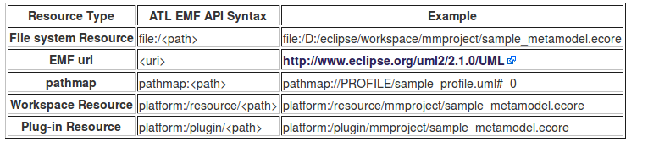
Resource references
Warning, in Eclipse:
IFile.getFullPath() -> Workspace-relative path
IFle.getLocation() -> Filesystem absolute path
* From: https://wiki.eclipse.org/ATL/Developer_Guide#EMF_interactions
* See also: http://lmap.blogspot.com.es/2008/03/platform-scheme-uri.html

Slide 8
Resource references
Pay particular attention to cross-model references
Either use workspace-relative paths
Or use absolute paths (IFile.getLocation())
getFullPath() is a false friend!

Slide 9
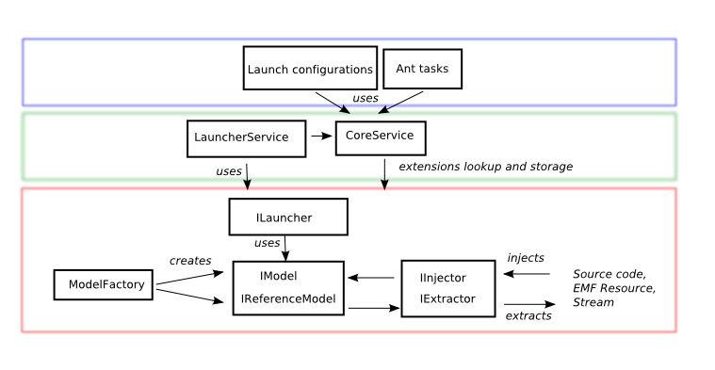
Launching architecture
In practice, one typically knows which subclass of IModel to use
* From: https://wiki.eclipse.org/ATL/Developer_Guide

Slide 10
Eclipse
Run using a
launch configuration
Main
Eclipse instance
Test
Eclipse instance
Your are developing your
transformations and the
integration code here
Your new plug-in is available here.
Paths to the original workspace does
not work. Always use references
relative to plug-ins, e.g.,
platform:/plugin/trafoprj/mytrafo.atl

Slide 11
Eclipse
Fighting Eclipse
SWT Spy
Alt+Shift+F1
Show information about the selected UI component
Alt+Shift+F2
Press this shortcut, and then select a menu to obtain information
* http://www.vogella.com/tutorials/EclipseCodeAccess/article.html#swt-spy

Slide 12
Eclipse
Typically required plug-ins
org.eclipse.ui,
org.eclipse.core.runtime,
org.eclipse.core.resources
org.eclipse.emf
org.eclipse.emf.ecore.xmi
org.eclipse.uml2
org.eclipse.uml2.uml
org.eclipse.m2m.atl.core,
org.eclipse.m2m.atl.core.emf
org.eclipse.m2m.atl.engine.emfvm.launch
org.eclipse.m2m.atl.emftvm

Slide 13
Demo
/guigen.integration/
Create a chain of transformations with Java
Integration in Eclipse
Pop-up menu over UML models
Eclipse Job to transform in background
Two different ATL VMs working together
Mini-exercise
Implement cancellation for the Eclipse job

