Slide 1
Higher-ORDER Transformations
Tutorial of the ATL transformation language
http://github.com/jesusc/atl-tutorial
Creative commons (attribution, share alike)
Part V
jesus.sanchez.cuadrado@gmail.com
@sanchezcuadrado
http://sanchezcuadrado.es

Slide 2
Definition
A higher-order transformation is a model transformation such that its input and/or output models are themselves transformation models
Pre-requisite
The transformation program must be expressed as a model, which means:
The ATL abstract syntax is defined as a meta-model
Tisi, M., Jouault, F., Fraternali, P., Ceri, S., & Bézivin, J. (2009, June). On the use of higher-order model transformations. ECMFA’09.

Slide 3
HOT and ATL
Many people have used HOTs
Perhaps the most relevant feature of ATL
Examples
Co-evolution
Genericity
Modularity
Model integration
Notes:
Model integration: Semi-automatic Model Integration using Matching
Transformations and Weaving Models

Slide 4
Categories
Synthesis
Input model: any model, but not a transformation
Output model: a transformation
Example: generate a copier
Analysis
Input model: a transformation
Output model: any model, but not a transformation
Example: metrics, type checking
Tisi, M., Jouault, F., Fraternali, P., Ceri, S., & Bézivin, J. (2009, June). On the use of higher-order model transformations. ECMFA’09.
Notes:
According to:
Tisi, M., Jouault, F., Fraternali, P., Ceri, S., & Bézivin, J. (2009, June). On the use of higher-order model transformations. In European Conference on Model Driven Architecture-Foundations and Applications (pp. 18-33). Springer Berlin Heidelberg.

Slide 5
Categories
De(composition)
Input model: at least one transformation
Output model: at least one transformation
Between input and output the #total of transformation is three or greater
Example: a superimposer
Modification
Input model: a transformation
Output model: a transformation (refactored, changed)
Example: add behaviour to record explicit trace links
Notes:
According to:
Tisi, M., Jouault, F., Fraternali, P., Ceri, S., & Bézivin, J. (2009, June). On the use of higher-order model transformations. In European Conference on Model Driven Architecture-Foundations and Applications (pp. 18-33). Springer Berlin Heidelberg.

Slide 6
ATL abstract syntax
To write a HOT :
You need to understand the ATL abstract syntax
Where is the meta-model?
Look for ATL.ecore
Plug-in org.eclipse.m2m.atl.dsls
Be aware that it does not pass Ecore validation
We provide (compatible) variants in anATLyzer
ATLStatic.ecore – Fully compatible, without validation errors
ATLModified.ecore – Almost compatible reorganization

Slide 7
ATL abstract syntax
ATL
Module
Rule structure, bindings
Imperative features
OCL
OCL Expression and subclasses
OCL Model
OCL Model Element
Primitive types

Slide 8
ATL abstract syntax
Best way to learn and understand
Serialize a transformation to XMI
Use AnATLyzer facility (Right-click -> anATLyzer -> Serialize)
Use Ant task:
Explore the model with the tree editor
<target name="run">
<atl.loadModel modelHandler="EMF" name="ATL" metamodel="MOF" path="ATL.ecore" />
<atl.loadModel name="ast" metamodel="ATL" path="simple_trafo.atl">
<injector name="ATL"/>
</atl.loadModel>
<atl.saveModel model="ast" path="simple_trafo.xmi" />
</target>

Slide 9
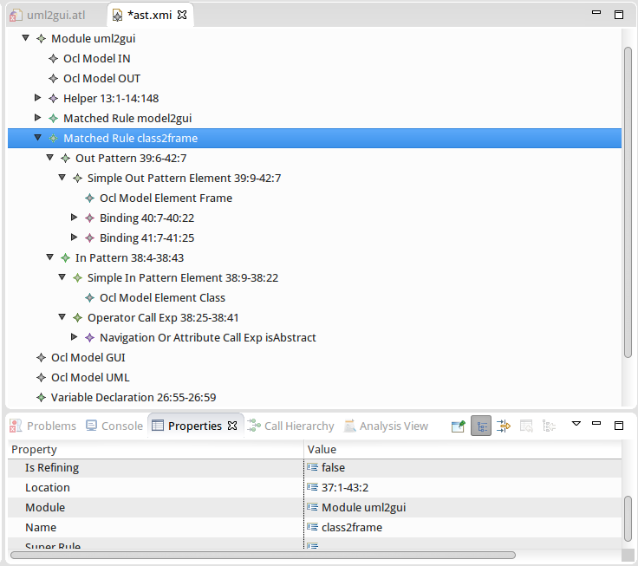
ATL abstract syntax
Models
rule class2frame {
from c : UML!Class ( not c.isAbstract )
to f : GUI!Frame (
title <- c.name,
widgets <- c.ownedProperties
)
}
Meta-models
self

Slide 10
ATL abstract syntax
1 metamodel
Unit
inModels *
OclModel
outModels *
elements
*
Library
Query
Module
ModuleElement
helpers
*
Helper
Rule
LocatedElement
location : String
comments Before: String[*]
commentsAfter: String[*]
* Everything inherits from LocatedElement

Slide 11
ATL abstract syntax
Considerations:
OclModel.metamodel cardinality is [1]
Meta-model is not strongly satisfiable (cannot be instantiated)
Location is a string with the format row:column
Library and Query do not declare models/meta-models

Slide 12
Module abstract syntax
-- @atlcompiler atl2006
-- @nsURI UML=http://www.eclipse.org/uml2/5.0.0/UML
-- @path CD=/guigen.trafo.uml2gui/metamodels/cd.ecore
module “uml2cd”;
create OUT : CD from IN : UML;
[0] @atlcompiler atl2006
[1] @nsURI UML=....
[2] @path CD=...
: Module
name = “uml2cd”
commentsAfter =
: OclModel
: OclModel
inModels
metamodel
name = “IN”
name = “UML”
outModels
: OclModel
: OclModel
metamodel
name = “OUT”
name = “CD”

Slide 13
Rule structure
outPattern 0..1
elements *
OutPattern
OutPattern
Element
Rule
ActionBlock
actionBlock 0..1
InPattern
Element
elements *
superRule 0..1
* children
CalledRule
MatchedRule
InPattern
inPattern 0..1
isEntryPoint: Boolean
isEndPoint : Boolean
LazyMatchedRule
filter 0..1
parameters *
OclExpression
isUnique : Boolean
Parameter
Abstract syntax – 13

Slide 14
ATL abstract syntax
Considerations:
Rule hierarchy is not natural
Input and output patterns are optional
OclExpression in filter must evaluate to Boolean
Abstract syntax – 14

Slide 15
Matched rule example
rule class2frame {
from c : UML!Class ( not c.isAbstract )
to f : GUI!Frame (
title <- c.name,
widgets <- c.ownedAttribute
) }
: MatchedRule
filter
: OperatorCallExp
: …
name = “class2frame”
operationName= “not”
: InPattern
elements
: SimpleInPatternElement
: OclModelElement
inPattern
varName = “c”
type
name= “Class”
model
: OutPattern
elements
: SimpleOutPatternElement
: OclModel
outPattern
varName = “f”
name= “UML”
: …

Slide 16
Variable declarations
initExpression 0..1
VariableDeclaration
OclExpression
varName : String
OclType
type 0..1
Iterator
Parameter
Pattern
Element
RuleVariable
Declaration
TuplePart
InPattern
Element
OutPattern
Element
Abstract syntax – 16

Slide 17
Variable declarations
Considerations
type is optional in VariableDeclaration. In practice it is compulsory in e.g., InPatternElement
type must be OclModelElement in InPatternElement
initExpression is used in IterateExp and LetExp
type is used in InPatternElement, OutPatternElement, Parameter and LetExp

Slide 18
Variable declarations
Parameter
helper context UML!Class
def: attrByName(n : String) : UML!Property =
let attrs : Sequence(UML!Property) = self.ownedAttribute
in attrs->any(a | a.name = n);
rule class2frame {
from c : UML!Class ( not c.isAbstract )
using {
attrs : Sequence(UML!Property) = c.ownedAttribute;
}
to f : GUI!Frame (
widgets <- attrs->
collect(a | Tuple {class=c, attr = a} )->...
)
}
Variable
Declaration
RuleVariable
Declaration
Iterator
TuplePart
Abstract syntax – 18

Slide 19
Property calls
source 1
* arguments
OclExpression
OclExpression
1 body
PropertyCallExp
NavigationOr
AttributeCallExp
OperationCallExp
LoopExp
operationName : String
name : String
IteratorExp
IteratorExp
CollectionOperationCallExp
OperatorCallExp
name : String
* iterators
Variable
Declaration
Iterator
result 1

Slide 20
Property calls
Considerations
Hierarchy is not natural
LoopExp syntatically supports many iterators, but in practice only the first one is used
Do not confuse IteratorExp with Iterator
Expressions are nested via the source reference

Slide 21
Property calls
aClass.allAtts()->select(c | c.name = ‘Person’)
referredVariable
: IteratorExp
: Iterator
: VariableExp
iterators
source
name = “select”
varName = “c”
: OperatorExp
source
: NavigationOrAttributeCallExp
operationName= “=“
name= “name”
body
: StringExp
:OperationCallExp
source
stringSymbol= “Person”
operationName =“allAtts”
arguments
: VariableExp
: VariableDeclaration
source
referredVariable
varName = “aClass”

Slide 22
Helpers
Helper
OclFeatureDefinition
OclContextDefinition
OclType
definition 1
context_ 0..1
context_ 1
OclFeature
feature 1
parameters *
Attribute
Operation
Parameter
name : String
name : String
initExpression 1
type 1
body 1
1 returnType
OclExpression
OclType
OclExpression
OclType
Abstract syntax – 22

Slide 23
Helpers
Considerations
The structure is sub-optimal
Requires many “if” to consider operation vs attribute
At the syntax level there is no link to the call sites

Slide 24
Helpers
Context helper
OclContextDefinition
Parameter
returnType
body
helper context UML!Class
def: attrByName(n : String) : UML!Property = ...;
helper def: dtString : UML!DataType = ...;
Operation
Module helper
type
initExpression
Attribute

Slide 25
Serialization
Using Ant Tasks
Programatically
AtlParser class
ATLSerialize from anATLyzer
<target name="run">
<atl.loadModel modelHandler="EMF" name="ATL" metamodel="MOF" path="ATL.ecore" />
<atl.loadModel name="ast" metamodel="ATL" path="simple_trafo.xmi" />
<atl.saveModel model="ast" path="simple_trafo.serialized.atl" />
<extractor name="ATL"/>
</atl.saveModel>
</target>

Slide 26
Exercise
Write a hot to inject debug expressions to visualize the execution flow of any transformation
Extend rule filters to output ‘matching <rule-name>’
Extend bindings to output ‘binding <feature-name>’
Remember that <expr>.debug(‘message’) returns
the original value of <expr>

Slide 27
Exercise
rule model2gui {
from m : CD!Model
to w : GUI!Window (
title <- m.name
)
}
rule model2gui {
from m : CD!Model
( true.debug(‘match model2gui’) )
to w : GUI!Window (
title <- m.name.debug(‘binding title’),
)
}

Slide 28
Exercise
/atl.example.autodebug/autodebug_emftvm.atl
Complete the code in:
Project: /atl.example.autodebug/
File: autodebug_emftvm.atl
To consider the generation of output messages for bindings

