Slide 1
The ATL Ecosystem
Tutorial of the ATL transformation language
http://github.com/jesusc/atl-tutorial
Creative commons (attribution, share alike)
Part VI

Slide 2
Some history
2003: Not yet ATL…
Jean Bézivin, et al. "The ATL transformation-based model management framework." Technical report (2003).

Slide 3
Some history
2003: First mention in the literature
Implemented by Frédéric Jouault
Jean Bézivin, et al. "First experiments with the ATL model transformation language: Transforming XSLT into XQuery." 2nd OOPSLA Workshop on Generative Techniques in the context of Model Driven Architecture. Vol. 37. 2003.
Description of the algorithm resembles current’s, with some (nice) considerations:
Mentions checking against source/target meta-models
Runtime errors if binding are not resolved
Specific construct for resolving non-default target elements

Slide 4
Some history
2005: “the paper” with > 1000 citations
Frédéric Jouault, and Ivan Kurtev. "Transforming models with ATL." International Conference on Model Driven Engineering Languages and Systems. Springer Berlin Heidelberg, 2005..
Beware, there is a short and a long version
Description of the ATL algorithm
Mostly matches current ATL
ATL available as Eclipse plug-in
(perhaps even in 2004)

Slide 5
Some history
2005: Rapid growth
AMMA, KM3, AM3, AMW
MoDISCO
See: An introduction to the ATLAS Model Management Architecture

Slide 6
Some history
2006: AMMA
Ivan Kurtev, et al. "Model-based DSL frameworks." Companion to the 21st ACM SIGPLAN symposium on Object-oriented programming systems, languages, and applications. ACM, 2006.

Slide 7
Some history
2009: Industrialisation
Obeo took control
The language became stable
* “ATL 3.1 – Industrialization improvements”, William Piers

Slide 8
Tools around ATL
EMFTVM
AnATLyzer
EMFMigrate
MoDISCO
AMW, AM3, KM3 seem to be dead
Wires
...

Slide 9
The ATL ecosystem
ATL architecture

Slide 10
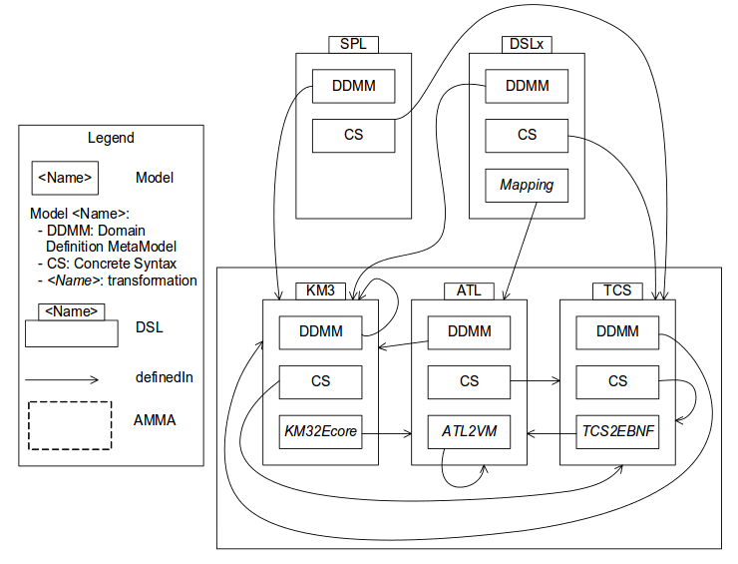
Architecture
* Taken from “Model-based DSL frameworks”

Slide 11
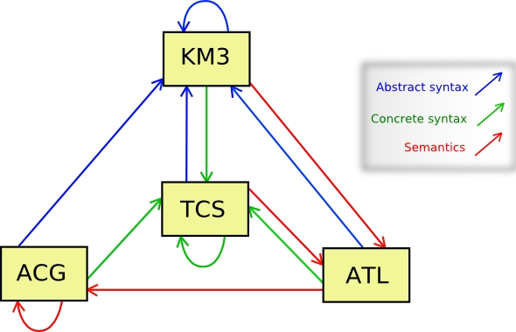
Architecture
* From: https://wiki.eclipse.org/ATL/Developer_Guide

Slide 12
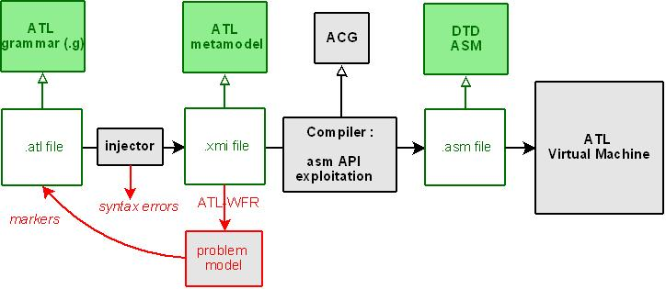
Architecture
* From: https://wiki.eclipse.org/ATL/Developer_Guide

Slide 13
Source code
git clone git://git.eclipse.org/gitroot/mmt/org.eclipse.atl.git

Slide 14
Compiler
Written in ACG
Documentation
https://wiki.eclipse.org/ACG
http://www.eclipse.org/atl/documentation/old/ATL_VM_Presentation_[1.0].pdf
http://www.eclipse.org/atl/documentation/old/ATL_VMSpecification[v00.01].pdf

Slide 15
Compiler
ATL.acg
This is the operational semantics of ATL
Complemented with some runtime libraries
Available in “dsls/” folder of the source code

Slide 16
Compiler
Semantics of bindings (excerpt)
code Binding {
dup
if(self.isAssignment) {
push self.propertyName
call 'J.refUnsetValue(S):J'
}
getasm
analyze self.value
call 'A.__resolve__(J):J'
set self.propertyName
}

Slide 17
Plug-ins
org.eclipse.m2m.atl.core
Generic interfaces for launching and model handling
org.eclipse.m2m.atl.core.emf:
EMF implementation of the Core API
org.eclipse.m2m.atl.dsls
Definition of ATL and ACG
org.eclipse.m2m.atl.engine
Provides ATL compiling and parsing utilities
org.eclipse.m2m.atl.engine.emfvm
Implementation of the EMFVM

Slide 18
Exploring Eclipse plug-ins
File -> Import -> Import Plug-ins and Fragments
Select “Import As” -> Projects with source folders
Filter your plug-in ID using wildcards (*name*)
Use your imagination to finally determine the plug-in(s) that you need
* See: www.vogella.com/tutorials/EclipseCodeAccess/article.html
(to learn how to browse Eclipse source code)

Slide 19
ATL plug-ins
org.eclipse.m2m.atl.engine.emfvm
Data type implementations
Package org.eclipse.m2m.atl.engine.emfvm.lib
Built-in operations
Class org.eclipse.m2m.atl.engine.emfvm.lib.ExecEnv
Bytecode processor
Class org.eclipse.m2m.atl.engine.emfvm.ASMOperation

Slide 20
ATL Compiler
New compilers can be created
Extension point org.eclipse.m2m.atl.engine.atlcompiler
See:
http://git.eclipse.org/c/mmt/org.eclipse.atl.git/tree/plugins/org.eclipse.m2m.atl.engine/plugin.xml
Useful to create new back-ends
Can you implement the extension point with an existing name to have two backends??
E.g. to create a new output e.g., for verification purposes

Slide 21
The ATL ecosystem
MoDisco & EMFTVM

Slide 22
MoDisco
URL
https://eclipse.org/MoDisco/
Paper:
Bruneliere, Hugo, et al. "Modisco: A model driven reverse engineering framework." Information and Software Technology 56.8 (2014): 1012-1032.

Slide 23
MoDisco
Provides facilities to extract models from Java code:
Abstract syntax of Java
UML models
KDM models
Extensible

Slide 24
MoDisco
Example: A transformation that extracts the ATL library from the source code

Slide 25
EMFTVM
Why?
Created by Dennis Wagelaar to solve limitations in ATL
Bytecode as an EMF model
Native notion of rule
Code blocks (i.e., closures)
Not only for ATL:
https://github.com/dwagelaar/simplegt
https://github.com/dwagelaar/simpleocl

Slide 26
EMFTVM
Papers:
Wagelaar, Dennis, et al. "Towards a general composition semantics for rule-based model transformation." International Conference on Model Driven Engineering Languages and Systems. Springer Berlin Heidelberg, 2011.
Documentation
https://wiki.eclipse.org/ATL/EMFTVM

Slide 27
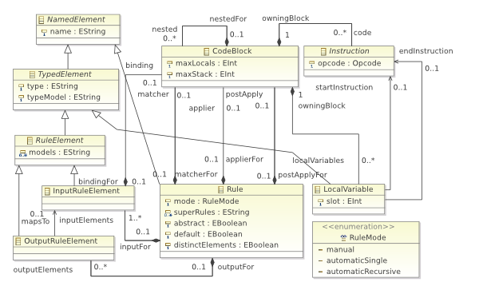
High-level structure

Slide 28
How to use EMFTVM
Annotation: -- @atlcompiler emftvm
Specific runner and a different programmatic API, and specific Ant tasks
emftvm.loadModel
emftvm.loadMetamodel
emftvm.run
emftvm.saveModel

Slide 29
Some differences
 | ATL | EMFTVM
Module | @atl2006, @atl2010 | @emftvm
Module name | Can be any | Same as the file
Helpers | No overloading, single dispatch | Overloading, multiple dispatch
Lazy rules with filter | Ignored | Pattern matched
Endpoint rules | Supported | Not supported
Refining mode | Deletion with drop | Deletion with no target pattern
Rule inheritance | Single | Multiple, Load time
Superimposition | Load time | Import, inheritance
Helper dispatch | Single | Multiple
VM | Custom | Optional JIT to JVM
Notes:
https://wiki.eclipse.org/ATL/EMFTVM#Multiple_dispatch

Slide 30
Exercise
Determine the meaning of <:= looking at the bytecode generated by EMFTVM

