Slide 1



Domain-Specific Languages (by example)
Jesús Sánchez Cuadrado
Universidad de Murcia
jesusc@um.es
@sanchezcuadrado
http://github.com/jesusc

Slide 2
Outline
Motivation
Computer languages
Domain-Specific Languages

Slide 3
Outline
Takeaway messages
What is a Domain-Specific Language and why they are useful
Main elements of a computer language
Pointers
Documentation
Tools

Slide 4
MOTIVATION
Part I

Slide 5
Motivation
General-purpose languages (GPL)
C/C++, Java, C#, Ruby, Python
Very expressive
Boilerplate code required many times
The important details are lost
Non-technical people do not understand them
Notes:
I am going to start talking about DSLs by going to the other side of the spectrum…
GPLs, very expressive, but you have to write boilerplate code

Slide 6
Motivation
Table people = Database.getTable(“people”);
int counter = 1;
for(Row row : people.getRows()) {
if (row.getStringField(“surname”).equals(“Hellín”)) {
counter++;
}
}
System.out.println(counter);
What is the intention of this piece of code?
Notes:
Can anyone of you tell me which is this piece of code doing? Please, don’t say that this is a loop…
So, which are the important details here?
- It is a database query
- The table is called people
- The filter condition is that the surname is Hellín
- We are counting
Can we do this better?

Slide 7
Motivation
We can do it better…
SELECT COUNT(*)
FROM People
WHERE surname = ‘Hellín’
* BTW, there is a bug in the previous slide
Notes:
This DSL is called is called SQL.
(in the previous slide counter should be = 0)

Slide 8
Domain-Specific Languages
DSLs are nothing new
Little languages
Examples
SQL
Make
Apache configuration files
LaTeX
Ruby on Rails
More examples?
Notes:
Ant, Maven, Linq
Yacc, Bison, ANTLR
CSS
Puppet
UML with profiles maybe…

Slide 9
Domain-Specific Languages
A DSL is a small language, tailored for a specific domain.
Why DSLs?
Increase productivity
A DSL embeds domain knowledge
Example: In SQL the “query loop” is hidden
Involve domain experts
Example: non-technical people is able to write SQL code
Optimization and analysis
Example: Optimize SQL queries
Notes:
For fun and (hopefully) profit

Slide 10
Domain-Specific Languages
The key issue is how to build DSLs effectively
Any programmer could build a DSL
The implementation cost should be small
You need:
Knowledge about “language engineering”
Including e.g., grammars, object-oriented programming
Knowledge about tools and strategies to build DSLs
(and pacience)
Notes:
The implementation cost should be small, but we want that our DSL has many features

Slide 11
COMPUTER Languages
Part II
Notes:
Now that I have conviced you that DSLs are useful, I would like to talk about computer languages in general because a DSL is similar to a GPL, but with a smaller scope

Slide 12
Languages
public class Person {
protected String name;
public String getName() {
return name;
}
}
Notes:
Which language is this?

Slide 13
Languages – Main elements
Abstract syntax
The concepts of the language
Concrete syntax
The notation
Semantics
The meaning

Slide 14
Languages – Abstract syntax
The concepts that make up the language
Two ways to represent the abstract syntax
Meta-model (i.e., an UML class diagram)
Grammar
In practice: set of Java classes
At runtime we get an Abstract Syntax Tree (AST)
For a textual language, a parser takes the text and generates the AST

Slide 15
Languages – Abstract syntax
JavaClass
JavaMethod
methods *
stmts *
name : String
name : String
Statement
JavaField
fields *
name : String
Return
Call
exp: Expr
obj: Expr
args : Expr
Excerpt of the Java abstract syntax as a
set of classes, using UML class diagram

Slide 16
Languages – Abstract syntax
public class Person {
protected String name;
public String getName() {
return name;
}
}
In-memory representation
of the text, used by the Java compiler
: JavaField
name = “name”
: JavaClass
: JavaMethod
name = “Person”
name = “getName”
: Return
: ReadField

Slide 17
Languages – Concrete syntax
The notation used by the user of the language
Textual
Graphical
Tabular
Projectional
GPLs typically use textual syntax
A parser takes text and produces the AST

Slide 18
Languages – Semantics
Complicated issue
Semantics for dummies: execute
Two main ways:
Compiler
Interpreter

Slide 19
Languages – Compilers
A program that takes another program and generates executable, typically low-level code
Example:
.c
gcc
x86 binary
Native
execution
Result
$ gcc my_program.c -o my_program
$ objdump --disassemble my_program
$ ./my_program

Slide 20
Languages – Interpreters
A program that takes an other program and executes it
Example:
.js
browser
Result
- Load a web page which includes some Javascript code
- The web browser interprets the Javascript code
- Produces the result directly in the web page

Slide 21
Languages – Execution
In Java:
Compiler
javac : generates bytecode
Interpreter
java : the virtual machine interprets the bytecode
So… what is Java?

Slide 22
Languages & DSLs
The construction of a DSL shares the same elements
Main requisite: affordable to the average programmer

Slide 23
Domain-Specific Languages
Part III

Slide 24
DSLs – Definition
A DSL is a language specially tailored to perform a particular kind task in some domain of interest
Parts of a DSL
Same as GPLs!
However, the implementation cost of a DSL needs to be small
We need strategies to build DSLs

Slide 25
DSLs – Implementation strategies
External
Standalone language, with a choosen concrete syntax (e.g., it has its own parser)
Language workbenches
Internal
The DSL is embedded into a GPL (the host)
Reuses the infrastructure of the host language

Slide 26
DSLs – Scope
Vertical domain
Business domain
Intended for non-technical people
Example:
A DSL to describe insurance products
Horizontal domain
Technical domain
Intended for developers
Example
CSS
Notes:
http://www.openmodeling.nl/dsl.html

Slide 27
DSLs – Execution
Compiler
Building a compiler is typically too costly
Poor’s man approach: code generation
Interpreter
If the DSL is small it may be easy

Slide 28
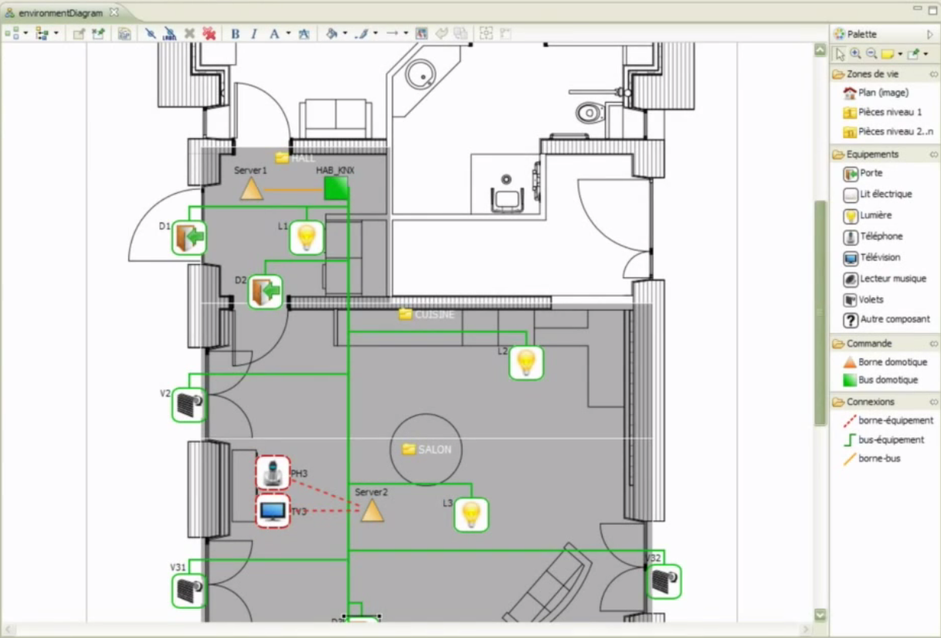
DSLs – Quick examples
Home automation
Business domain
External DSL
Graphical
Code generation
Built with Sirius
https://eclipse.org/sirius/gallery.html

Slide 29
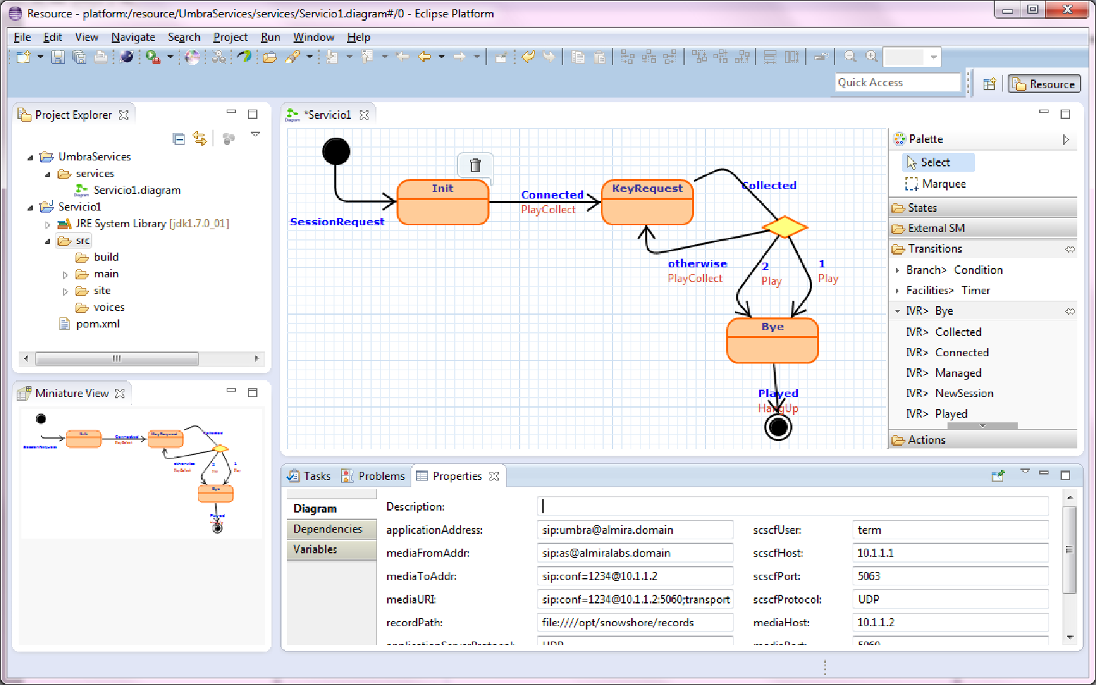
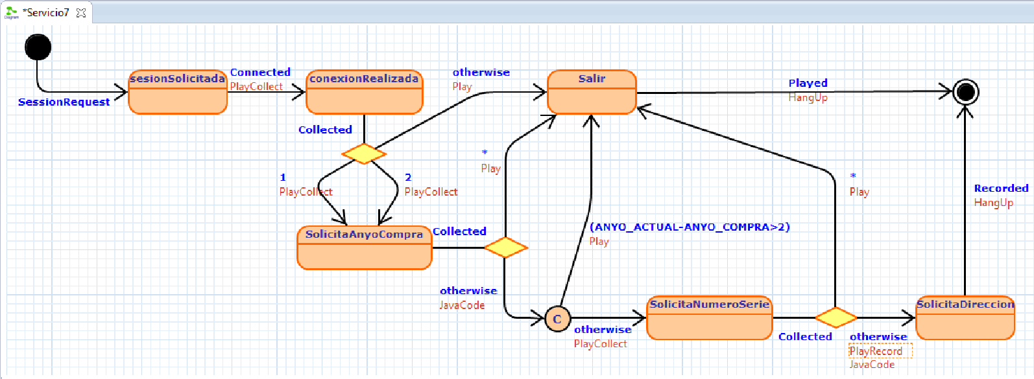
DSLs – Quick examples
Telephony
Business domain
External DSL
Graphical
Code gen.
Built with Graphitti
http://www.miso.es/pubs/ECMFA13.pdf

Slide 30
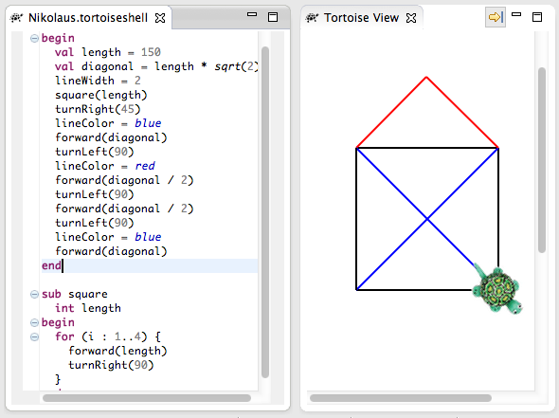
DSLs – Quick examples
Teaching
Business domain
External DSL
Textual
Interpreted
Built with Xtext
https://eclipse.org/Xtext/documentation/208_tortoise.html

Slide 31
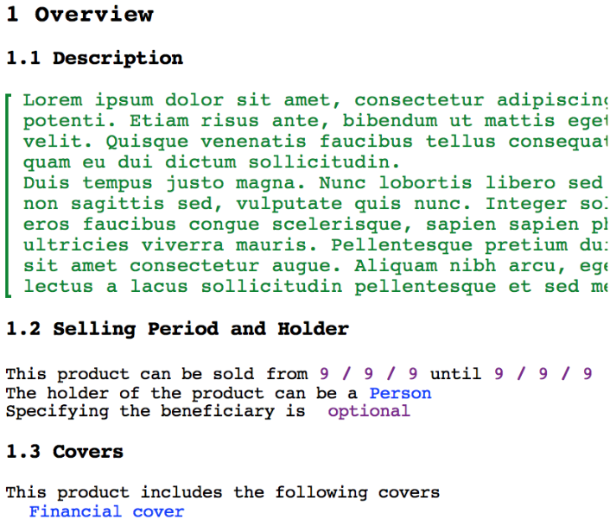
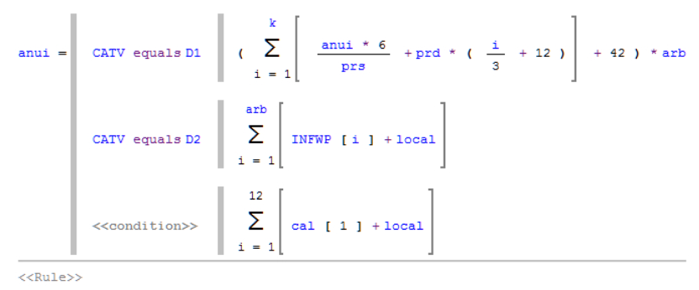
DSLs – Quick examples
Insurances
Projectional
Business domain
Interpreted
External DSL
Built with MPS

Slide 32
DSLs – CRUD applications
Purpose
Generate full applications from a data model automatically
CRUD applications
CREATE, READ, UPDATE, DELETE
App. building
Technical domain
External DSL
Textual
Code generation
Applying model-driven engineering in small software enterprises.
Jesús Sánchez Cuadrado, Javier Luis Cánovas Izquierdo and Jesús García Molina. SCP 2013
http://sanchezcuadrado.es/papers/scp_applying_mde_in_sme.pdf

Slide 33
DSLs – CRUD applications
package invoicedemo;
class Invoice {
ref customer[1] : Customer;
ref parts[*] container : Item;
attr invoiceDate[1] : Date;
}
class Item {
attr description[1] : String;
attr quantity[1] : Integer;
attr price[1] : Float;
}
class Customer {
attr name[1] : String;
}

Slide 34
package com.visualtis.invoicedemo.entities;
…
@Entity
@SequenceGenerator(name="invoice_seq", sequenceName="invoice_seq")
@Table(name = "invoice")
public class Invoice {
private Customer customer;
private java.util.List<Item> parts = new java.util.ArrayList<Item>(0);
private java.util.Date invoiceDate;
private float total;
private long id;
public Invoice() {}
public Invoice(Customer customer, java.util.List<Item> parts, java.util.Date invoiceDate, float total) {
this.customer = customer;
this.parts = parts;
this.invoiceDdate = invoiceDdate;
this.total = total;
}
@ManyToOne(fetch = FetchType.LAZY)
@JoinColumn(name = "customer_customer_id")
@Validate("required")
public Customer getCustomer() {
return customer;
}
@OneToMany(mappedBy="invoice", cascade = CascadeType.ALL)
public java.util.List<Item> getParts() {
return parts;
}
public float getTotal() {
return total;
}
// more methods ...
}

Slide 35
DSLs – CRUD applications
Screencast time!

Slide 36
DSLs – Web site testing
Purpose
Facilitate testing websites
Manually
Tedious
Error prone
Automation
Selenium allows us the interaction with the browser
Must be done programmatically
DSL to automate the test steps

Slide 37
DSLs – Web site testing
Let’s try with Sellenium (Ruby bindings)
require "selenium-webdriver"
driver = Selenium::WebDriver.for :firefox
driver.navigate.to "http://google.com"
element = driver.find_element(:name, 'q')
element.send_keys "Hello WebDriver!"
button = driver.find_element(:name, "btnK")
button.submit
driver.quit
https://github.com/SeleniumHQ/selenium/wiki/Ruby-Bindings
Probably also requires installing gecko driver

Slide 38
DSLs – Web site testing
Now, let’s check properties
require "selenium-webdriver"
driver = Selenium::WebDriver.for :firefox
driver.navigate.to "http://google.com"
element = driver.find_element(:name, 'q')
element.send_keys "Hello WebDriver!"
button = driver.find_element(:name, "btnK")
button.submit
if ! driver.title == "Google”
puts “Error”
end
driver.quit
Notes:
What if we have to add many of this?

Slide 39
DSLs – Web site testing
test 'google' do
go_to 'http://www.google.es'
fill 'q', 'Champions League'
press 'btnK' do
title_must_be 'Google‘
end
end
Testing
Technical domain
Internal DSL
Textual
Interpreted
Built with Ruby

Slide 40
DSLs – Web site testing
test ‘amazon' do
go_to ' http://www.amazon.es'
fill ‘field-keywords', ‘Ruby'
press ‘site-search' do
title_must_be ‘Amazon.es : Ruby‘
page_must_contain 'Ruby on Rails'
page_must_contain 'Programming'
end
end

Slide 41
DSLs – Web site testing
Coding time!

Slide 42
DSLs – Questionnaries
Purpose
Create web questionnaries easily
Useful to create web exams
Textual DSL to write the questionnaries
Code generator to generate .html files

Slide 43
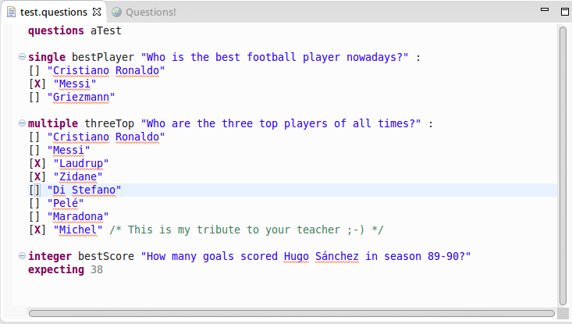
DSLs – Questionnaries
Teaching
Business domain
External DSL
Textual
Code gen.
Built with Xtext

Slide 44
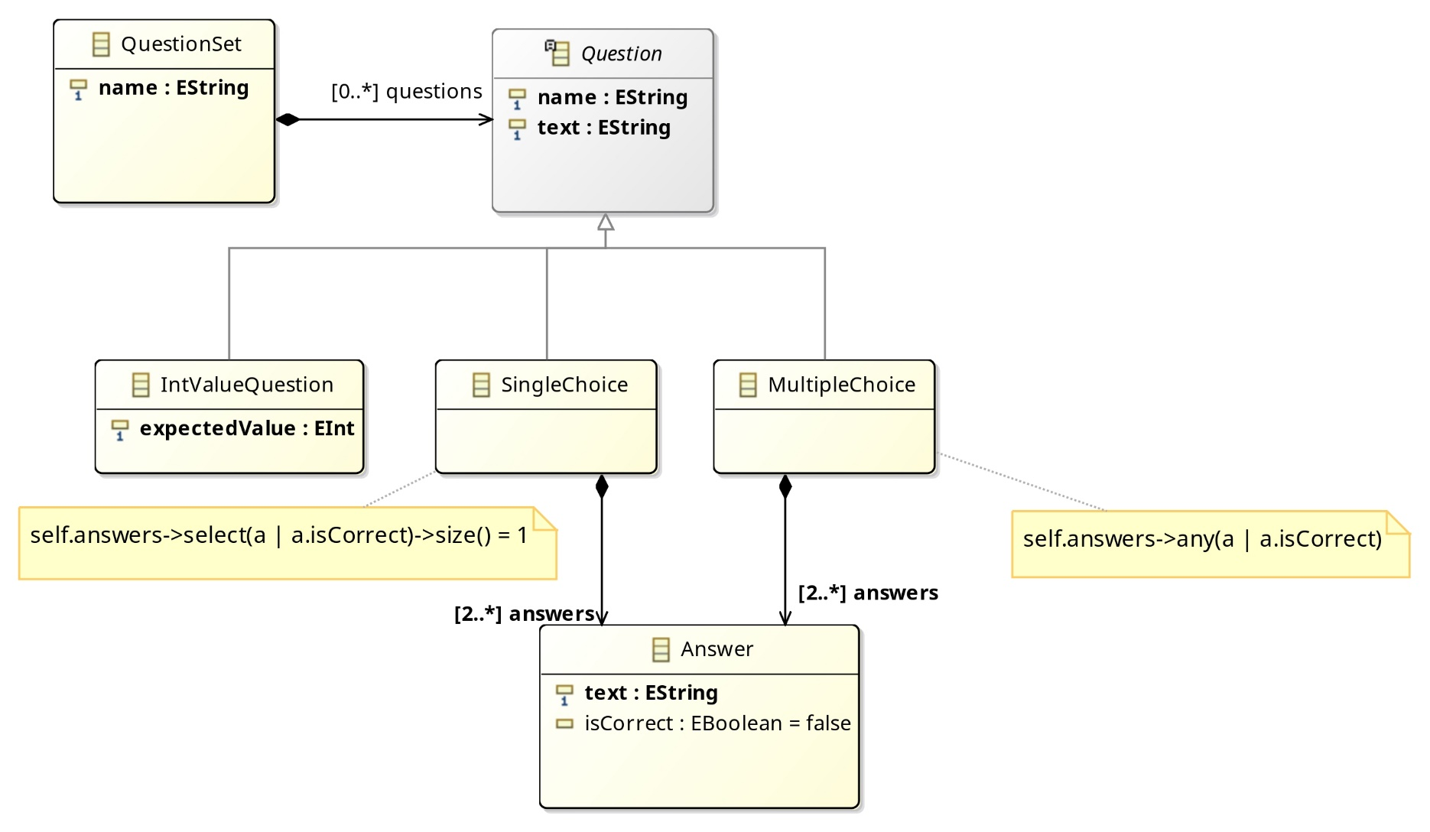
DSLs – Questionnaries

Slide 45
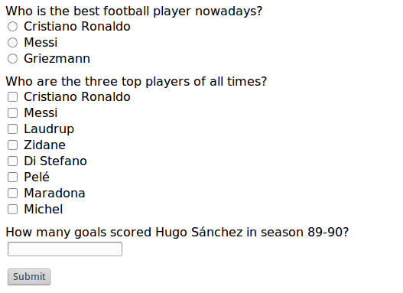
DSLs – Questionnaries

Slide 46
DSLs – Questionnaries
Coding time!

Slide 47
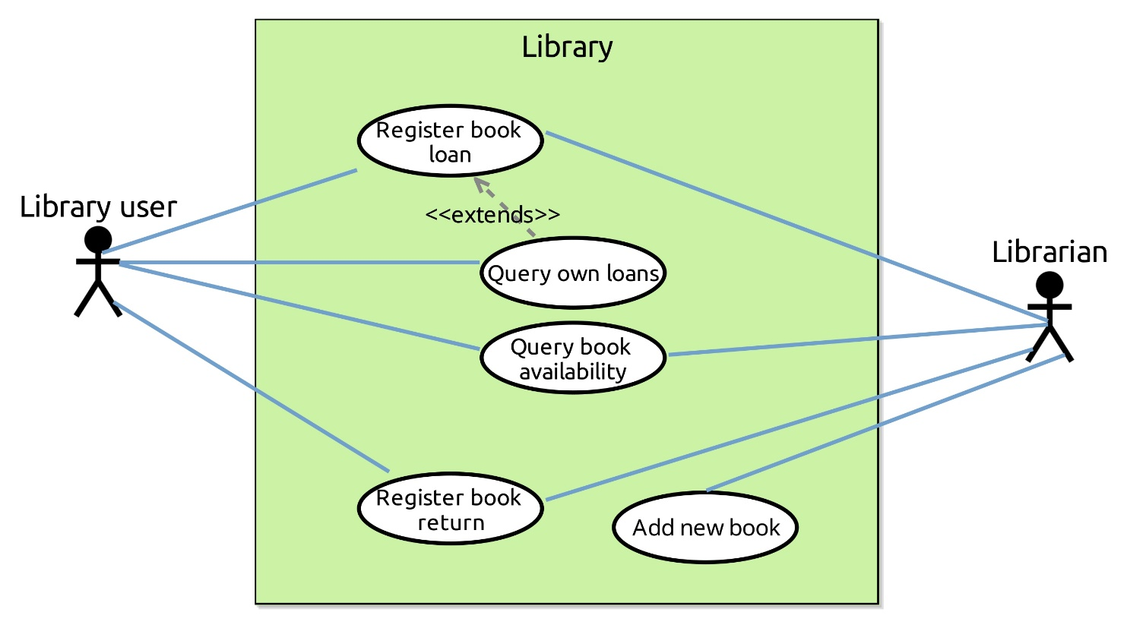
DSLs – Use cases
Graphical DSL
Systems
Business domain
External DSL
Graphical
Built with Sirius

Slide 48
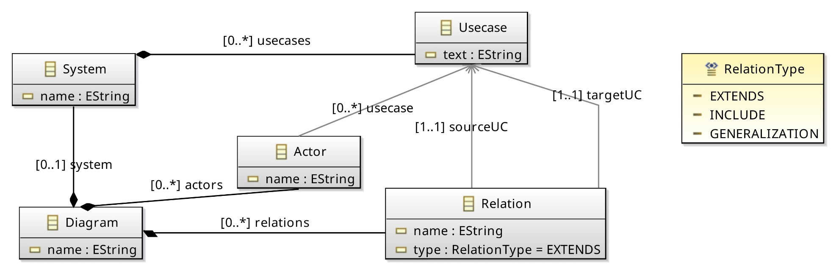
DSLs – Use cases

Slide 49
DSLs – Use cases
Coding time!

Slide 50
SOME POINTERS
Part IV

Slide 51
Buzzwords
Domain-Specific Languages
Model-Driven Engineering
Language workbenches
Internal DSL / External DSL / Fluent API
Graphical editor / Textual editor

Slide 52
Tools
Xtext
Language workbench for textual DSLs
Sirius
Building graphical editors
MPS
Language workbench for DSLs using projectional editing
Acceleo
Language to implement code generators

Slide 53
Documentation
Books
“DSL Engineering” by Markus Voelter
Donation-ware
http://voelter.de/data/books/markusvoelter-dslengineering-1.0.pdf
“Domain Specific Languages” by Martin Fowler
http://martinfowler.com/books/dsl.html
Podcast
Software engineering podcast
Many topics, sometimes DSLs

Slide 54
Thank you!
Any questions?
jesusc@um.es
@sanchezcuadrado
http://github.com/jesusc

Slide 55
Other examples
A few more examples in the following slides

Slide 56
DSLs – Menu generation
Purpose
Facilitate the creation of application menus
The same menu could be reused for several platforms: desktop, web, mobile
One code generator per platform
App. building
Technical domain
External DSL
Textual
Code generation
package invoicedemo;
class Invoice {
ref customer[1] : Customer;
ref parts[*] container : Item;
attr invoiceDate[1] : Date;
}
class Item {
attr description[1] : String;
attr quantity[1] : Integer;
attr price[1] : Float;
}
class Customer {
attr name[1] : String;
}
Code
generator #1
.html
Xtext
AST
Code
generator #2
Android

Slide 57
DSLs – Menu generation
tree menu File {
icon "/file.jpg"
shortcut "Alt+F"
mnemonic "F"
tooltip "File"
action menu New {
mnemonic "N"
}
action menu Close {
shortcut "Ctrl+W"
mnemonic "C"
tooltip "Close"
}
checkbox menu Synchronize default true {
shortcut "Ctrl+S"
mnemonic "S"
tooltip "Auto Synchronize"
}
}

Slide 58
DSLs – CV assembler
doc = Assembler.create_merits do
root_dir root
fullname 'Jesús Sánchez Cuadrado'
title 'Justificación de méritos'
subtitle 'Plaza de investigador en ACME'
category :research_project do
description 'Proyectos de I+D+i financiados en convocatorias competitivas de Administraciones o entidades públicas y privadas'
short_description 'Proyectos de I+D+i competitivos'
folder 'ParticipacionProyectos'
end
category :research_contract do
description 'Contratos, convenios o proyectos de I+D+i no competitivos con Administraciones o entidades públicas o privadas'
short_description 'Contratos de I+D+i'
folder 'ContratosInvestigacion'
end

Slide 59
DSLs – CV assembler
research_project :ip_proyectos do
name 'IP en proyectos de investigación'
# Estos ficheros deben estar en una carpeta que se llame ParticipacionProyectos/ip_proyectos
include 'proyecto-grande.pdf'
include 'proyecto-peq.pdf'
end
research_project :proyectos_no_ip do
name 'Participación en proyectos de investigación (No IP)'
# Este fichero estará en carpeta otros_proyectos/ directamente
include_external 'otros_proyectos/proyectos-de-otros.pdf'
end
research_project :mis_contratos do
name 'Participación en proyectos de investigación (No IP)'
# Este fichero estará en carpeta otros_proyectos/ directamente
include_external 'mis_contratos/lista_contratos.pdf', :pages => [1, 3]
end
end

Slide 60
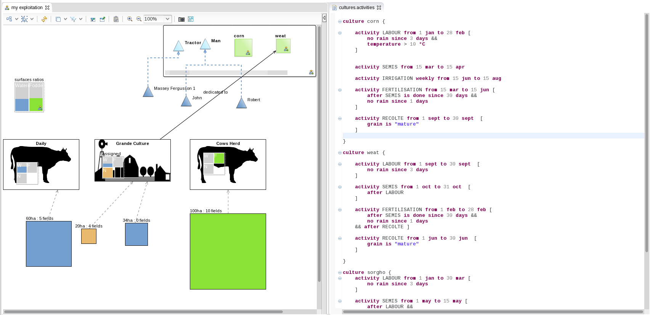
DSLs – Quick examples
Farming
Business domain
External DSL
Gr/Txt
Simulation
Built with Sirius
https://eclipse.org/sirius/gallery.html

