Slide 2

SASS

Slide 3
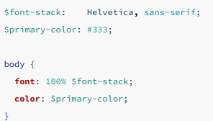
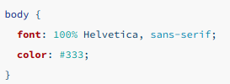
Variables

Slide 4
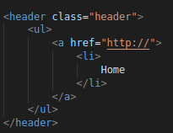
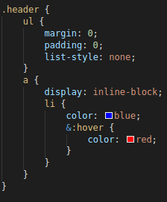
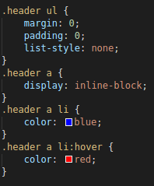
Anidación

Slide 5
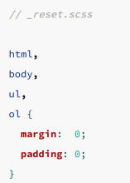
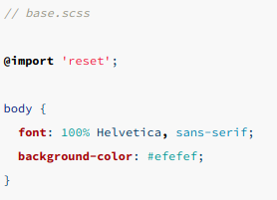
import

Slide 6
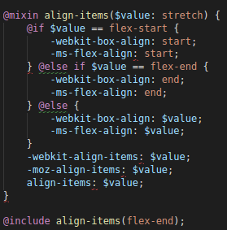
Mixins

Slide 7
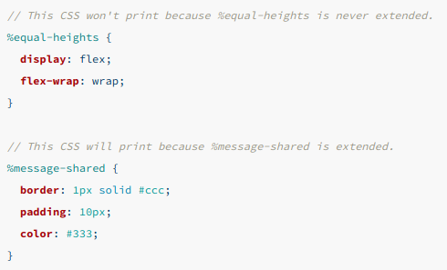
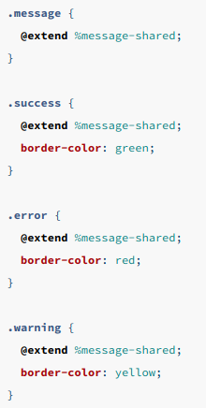
Extend/Herencia

Slide 8

Algunas funciones

Slide 9
Ember
Ember is a JavaScript front-end framework designed to help you build websites with rich and complex user interactions. It does so by providing developers both with many features that are essential to manage complexity in modern web applications, as well as an integrated development toolkit that enables rapid iteration.
SPA

Slide 10
Ember
Ember is a JavaScript front-end framework designed to help you build websites with rich and complex user interactions. It does so by providing developers both with many features that are essential to manage complexity in modern web applications, as well as an integrated development toolkit that enables rapid iteration.
SPA

Slide 11
Ember
Ember is a JavaScript front-end framework designed to help you build websites with rich and complex user interactions. It does so by providing developers both with many features that are essential to manage complexity in modern web applications, as well as an integrated development toolkit that enables rapid iteration.
SPA

Slide 12
Ember-cli
Ember CLI is the official command line utility used to create, build, serve, and test Ember.js apps and addons.
npm install -g ember-cli

Slide 13
Comandos basicos
ember new library-app
ember server
ember install addon
ember generate [component, model, route, controller, helper, adapter...]

Slide 14


Elementos principales
Components

Slide 15
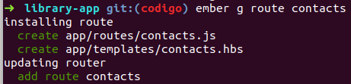

Elementos principales
Routes
The route handler then typically does two things:
It renders a template.
It loads a model that is then available to the template.

Slide 16

Router

Slide 17
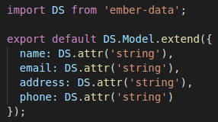
Model
Models represent persistent state.

Slide 18
Templates
Ember uses templates to organize the layout of HTML in an application.

Slide 19
Observers
Computed

Slide 20
Bootstrap
Ember cli sass
Emberfire

