Slide 1
WEBOTS-SIMULATION
JESÚS DAVIZON

Slide 2

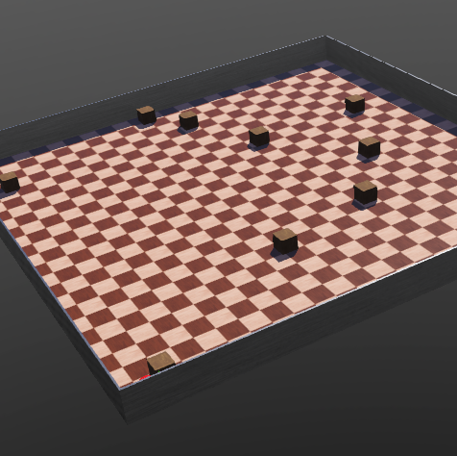


ENVIRONMENT
ARENA
WALLS
BOXES
ROBOT

Slide 3
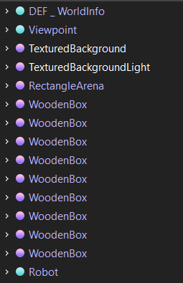
WORLD
FILE CONTAINING INFORMATION LIKE:
WHERE THE OBJECTS ARE
WHAT THEY LOOK LIKE
HOW THEY INTERACT WITH EACH OTHER
HOW ARE DEFNIED THE PHYSICAL CONDITIONS
WHAT IS THE COLOR OF THE OBJECTS
NODES
SCENE TREE

Slide 4

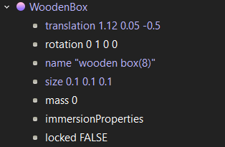
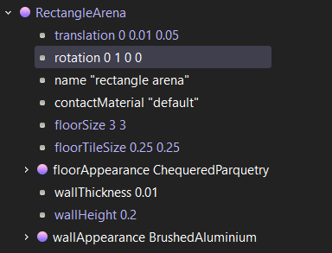
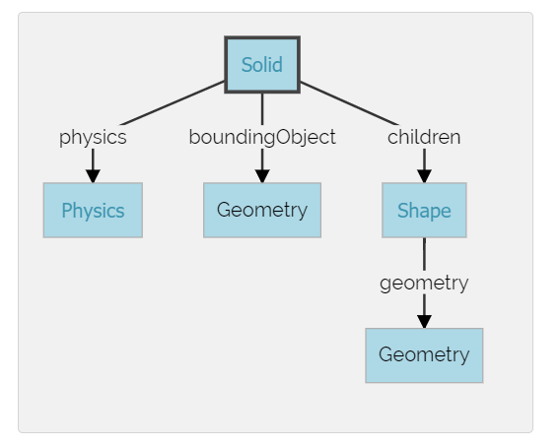
STRUCTURE

Slide 5
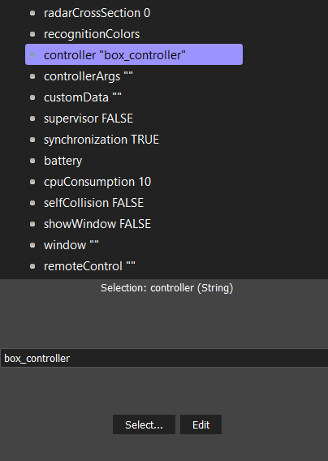
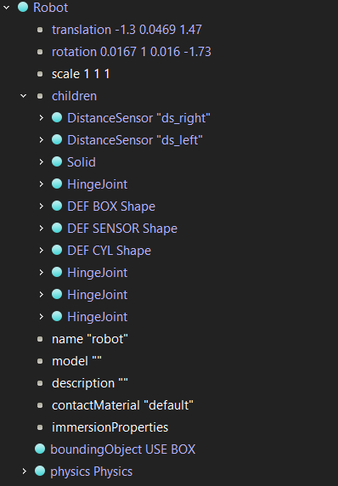
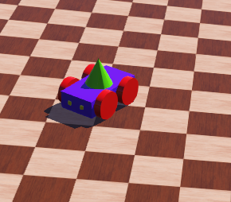
ROBOT
CONTROLLER
SOLID (OBJECT)

Slide 6
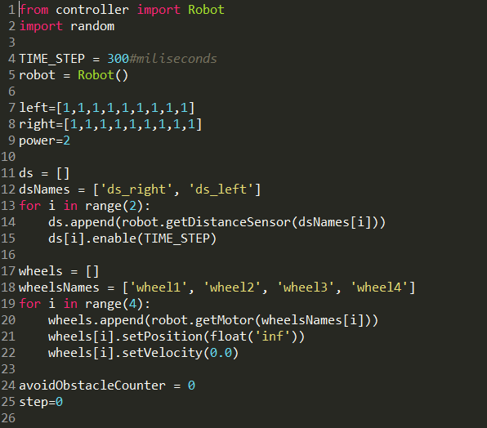
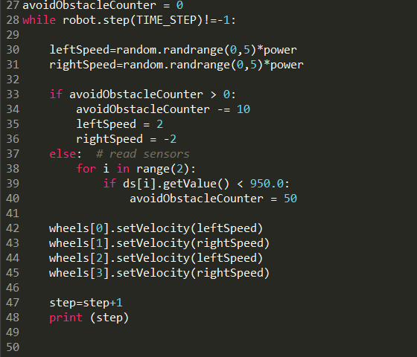
CODE –> BOX_CONTROLLER.PY

Slide 7
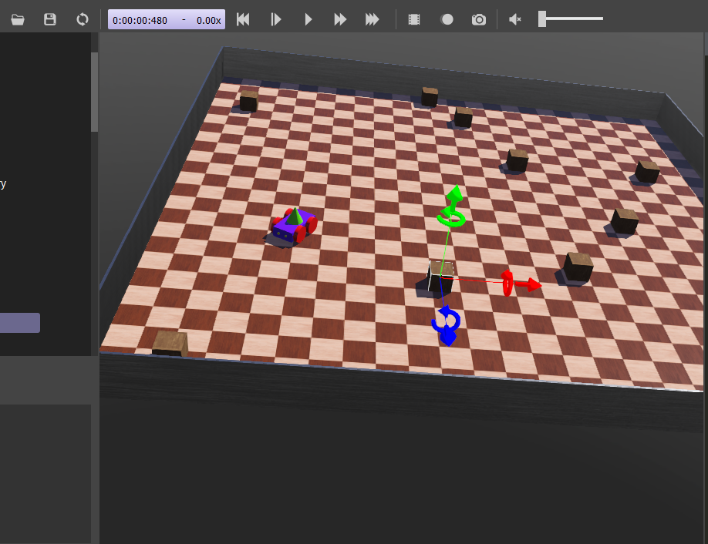
SIMULATION

Slide 8

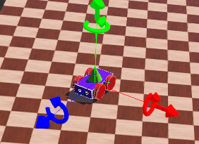
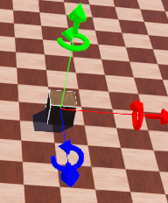
SIMULATION

