Slide 1

Bitcoin Price Prediction with Machine Learning
Jesús González Bonilla

Slide 2

ÍNDICE
Business Problem Presentation
Technical Problem Definition
Dataset Description and Exploratory Data Analysis (EDA)
Solution Architecture and Tested Models
Final Conclusions and Improvement Actions

Slide 3
1. Business Problem Presentation

Slide 4

Bitcoin is one of the most volatile cryptocurrencies in the market, generating uncertainty among investors and traders. Accurately predicting its closing price would enable more informed decision-making, reduce risk, and optimize investment strategies.

Slide 5
2. Technical Problem Definition

Slide 6
The technical problem addressed in this project is predicting Bitcoin's closing price using Machine Learning models. This is achieved by leveraging historical market data to identify patterns and improve prediction accuracy.

Slide 7
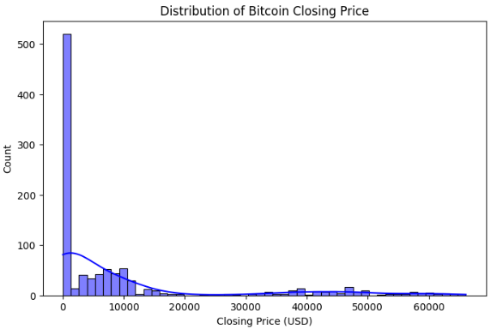
How does it help solve the business problem?
Anticipates price fluctuations based on historical data.
Enhances decision-making in investment and trading strategies.
Reduces uncertainty for both small and large investors.
Bitcoin closing price distribution. A high concentration of prices at low values ​​is observed, with a long tail indicating the presence of extreme values ​​in the higher price range. This suggests a skewed distribution, which can affect the performance of prediction models.

Slide 8
3. Dataset Description and Exploratory Data Analysis (EDA)

Slide 9
Source of the Data
The original dataset was obtained from Kaggle, containing historical Bitcoin data.
Source of the Data
Open Price (Open)
High and Low Prices (High, Low)
Transaction Volume (Volume)
Closing Price (Close)

Slide 10
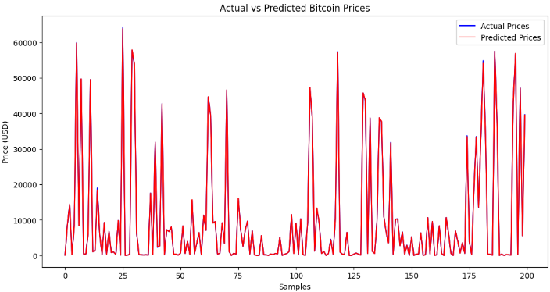
Data Preprocessing and Exploration
✔ A reduced sample of the original dataset was used to optimize processing.
✔ Data cleaning was performed, removing null values and duplicates.
✔ Correlations between key variables were analyzed to select the most relevant ones.
Comparison between actual and predicted Bitcoin prices. The model is observed to follow the general price trend, although it exhibits variability at certain peaks and valleys. This suggests that the model captures certain market patterns, but may need further adjustments to improve its accuracy.

Slide 11
Data Insights
The distribution of Bitcoin’s closing price shows a high concentration at lower values, with a long tail indicating extreme values in the higher price range. This suggests a skewed distribution, which can affect the performance of prediction models.
Comparing Actual vs. Predicted Prices
The model follows the general price trend but exhibits variability in certain peaks and troughs. This suggests that while the model captures some market patterns, further adjustments may be needed to improve accuracy.

Slide 12
4. Solution Architecture and Tested Models

Slide 13
Modeling Approach
Preprocessing
Data normalization using StandardScaler.
Splitting the dataset into 80% training and 20% testing.
Tested Models
Linear Regression: Baseline model for establishing a reference.
Random Forest Regressor: More advanced model to improve prediction accuracy.

Slide 14
Model Evaluation
Metrics Used:
MAE (Mean Absolute Error)
MSE (Mean Squared Error)
R² (Coefficient of Determination)
Comparison of Results
Linear Regression: High MAE, low generalization capability.
Random Forest: Better predictive ability and lower error.
Selected Model
Random Forest Regressor was chosen as it demonstrated better evaluation metrics. The model was saved in .joblib format for future predictions.

Slide 15
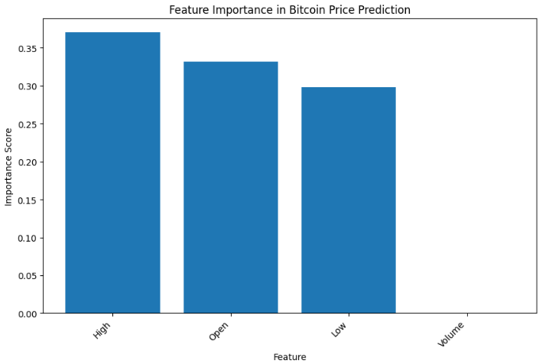
Importance of features in Bitcoin price prediction. It is observed that the variables 'High' (daily high), 'Open' (opening price), and 'Low' (daily low) have the greatest influence on the prediction, while transaction volume has a minor impact on the model.

Slide 16
5. Final Conclusions and Improvement Actions
Conclusions

Slide 17
Conclusions
A Machine Learning model capable of predicting Bitcoin’s price with acceptable accuracy was successfully trained.
Market volatility remains a challenge, limiting prediction accuracy.
Combining multiple factors and models could enhance future results.

Slide 18
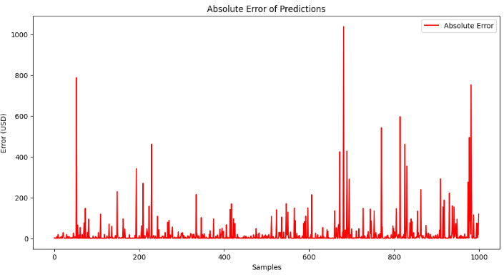
Analysis of the absolute error in the model's predictions. It is observed that in certain samples the error is significantly higher, indicating potential areas for improvement in the model's predictive ability. These spikes suggest that the model is struggling to capture sharp fluctuations in the Bitcoin price.

Slide 19
Improvement Actions
✔ Test advanced models, such as Neural Networks or LSTMs, for long-term predictions.
✔ Incorporate more relevant features, such as market news, technical indicators, and macroeconomic data.
✔ Optimize hyperparameters using techniques like GridSearchCV or Bayesian Optimization.
✔ Implement real-time predictions to dynamically apply the model to trading strategies.

