Slide 1
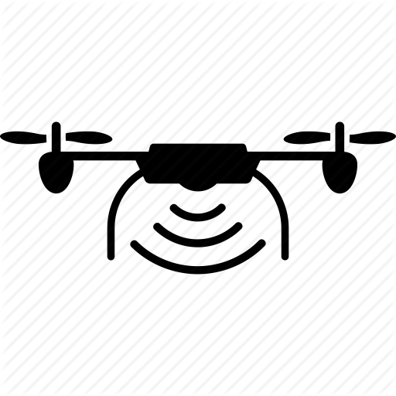

Contribution of RPAS in Research and Conservation in Protected Areas: present and future
Jesús Jiménez López

Slide 2
Background
A protected area
is a clearly defined geographical space, recognized, dedicated and managed, through legal or other effective means, to achieve the long term conservation of nature with associated ecosystem services and cultural values" (Dudley 2008)

Slide 3
Background
Current state of protected areas:
15.4% of the land area and 8.4% marine areas. (Juffe-Bignoli et al. 2014)
Size of wildlife populations has been estimated to have decreased by 52% in the period 1970 to 2012.
Habitat change and fragmentation, severe pollution particularly in freshwater ecosystems, overexploitation of resources, climate change and the impact of invasive species on indigenous populations have been identified as the main threats to biodiversity.

Slide 4
Background
Protected areas are reference sites for monitoring and managing biodiversity.
Technological advances supporting conservation:
Remote sensing.
Wildlife tracking devices.
Camera traps.
Computers, statistical tools and methods.
Sensors
Robots: Remotely Piloted Aerial Systems (RPAS)

Slide 5
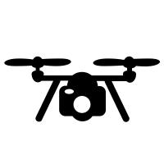



Background
Remotely Piloted Aerial Systems (RPAS) Drones Unmaned Aerial Vehicles (UAVs) Unmaned Aerial Systems (UAS) Multicopters Copters Helicopters
Rotor-wings
Fixed-wing

Slide 6
Applications
Wildlife Monitoring and Management
Infrastructure and risk assessment
Monitoring and mapping of terrestrial and aquatic ecosystems
Surveillance and support for compliance with laws in protected areas
Ecotourism
Environmental management and decision support
Considerations
Impact of RPAS on wildlife and ecosystems
Legal barriers

Slide 7
Applications: Wildlife Monitoring and Management
Wildlife Monitoring and Management
Population dynamics
Species Distribution
Density and abundance estimation
Target species
Terrestrial and aquatic mammals
Birds
Nesting sites
Research
Comparative studies: RPAS vs tracking devices (Mulero-Pázmány et al. 2015)
Novel methods: VHF tracking (Bayram et al. 2016) , biooacustic monitoring (Wilson, Barr, and Zagorski 2017), nesting status inspection, etc.
Software development: automatic detection and counts, statistical models (Lhoest et al. 2015; Abd-Elrahman, Pearlstine, and Percival 2005; Gemertet al. 2015, Chabot and Francis 2016, Christiansen et al. 2014).
Considerations
Cost-effective wildlife census campaigns. :)
Non-invasive and reliable monitoring technique ? Disturbance :(
Animal movement and remote sensing (follow-me, tagged species, mapping) :)

Slide 8
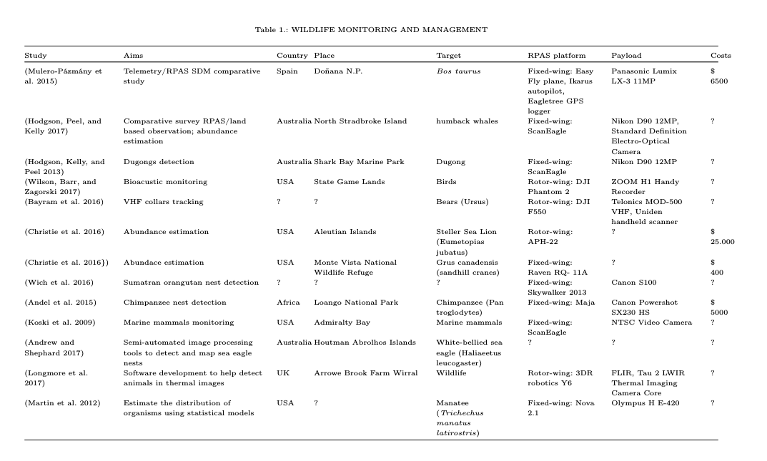

Slide 9
Applications: Monitoring and mapping of terrestrial and aquatic ecosystems
Wildlife Monitoring and Management
Mapping and habitat monitoring
Discrimination, classification, inventory
Ecosystem dynamics
Target ecosystems
Forests
Aquatic ecosystems
Wetlands
Research
Novel methods: vegetation cover (USGS, 2014), erosion dynamics (Casella et al. 2016, ), restoration (Zahawi et al. 2015)
Invasive species: spread (Zaman, Jensen, and McKee 2011), satellite, unmaned / manned aerial vehicles comparative studies (Müllerová et al. 2016), detection rate under different conditions (Per-roy, Sullivan, and Stephenson 2017)
Considerations
High spatial and temporal resolution :)
Relative small areas :|
Mini multispectral sensors :|
Computer demanding, complex :(

Slide 10
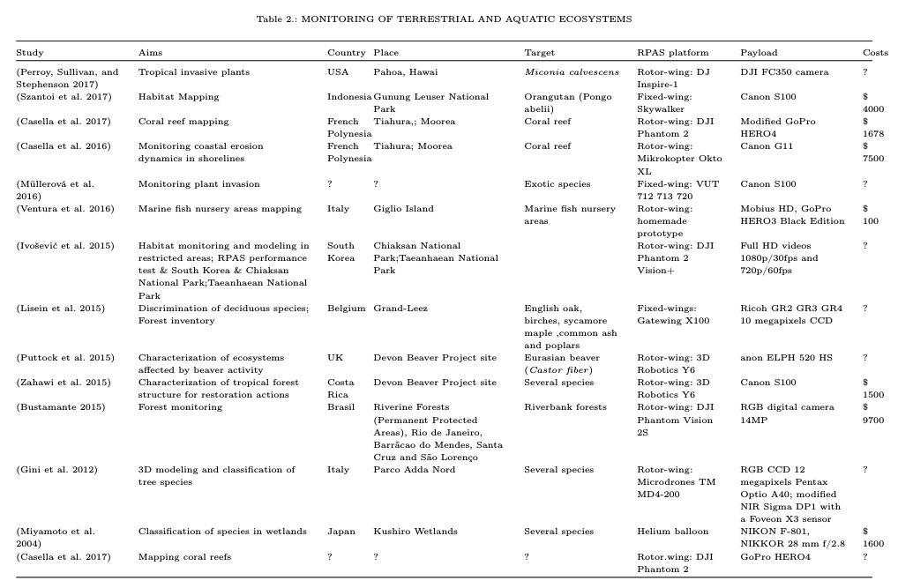

Slide 11
Applications: Infrastructure and risk assessment
Infrastructure and risk assessment
Inspection
Preventive measures
Target species
Birds
Research
Visual evaluation of linear electrical structures (Margarita Mulero-Pázmány 2014)
Marks on Wiring collisions avoidance (Lobermeir et al. 2015)
Pre-harvest ground nest inspection (Mulero-Pázmány Margarita 2011)
Considerations
Cost-effective alternative to manual inspection :)
Others: monitoring facilities and roads crossing sensitive areas, coastal ecosystems where vessels strikes with aquatic species :)
Persuade birds from approaching power lines, wind turbines, other potential hazards. :)

Slide 12
Applications: Surveillance and support for compliance with laws in protected areas
Surveillance and support
Law enforcement
Poaching
Illegall activities
Target species
Rhinoceros, others ?.
Research
Novel methods: detect presence of humans and target species (Mulero-Pázmány et al. 2014)
Marine protected areas (MPA) ? (Franco et al. 2016)
Tourist activity surveillance (Sabella et al. 2017)
Considerations
Relative Low autonomy :(
FPV, Infrared sensors on night, Video, Sensor resolution :|
BVLOS forbidden :(
Cost-effective :|
Legal barriers :(

Slide 13
Applications: Ecotourism
Ecotourism
Recreational activities
Search and rescue (SAR)
Visitor monitoring
Target
Tourists
Research
Sector opportunities (King 2014), regulations (Leary 2017)
Considerations
Privacy, security :(
Bussiness :)
RPAS banned :(
Regulations :)
Wildlife disturbance, ecosystem pollution :(

Slide 14
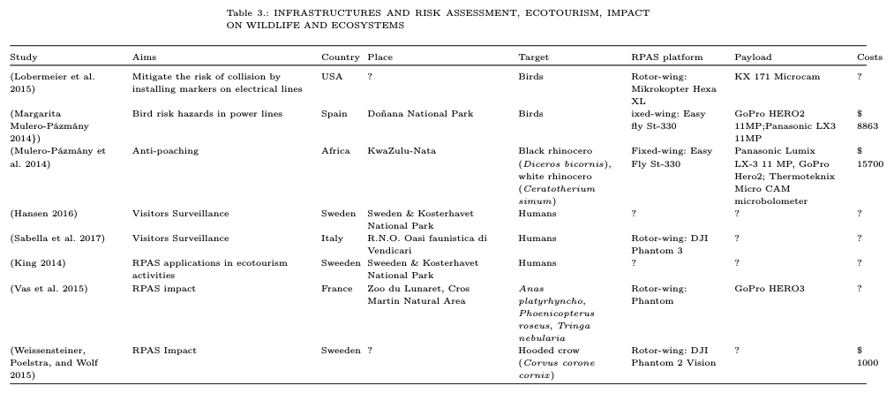

Slide 15
Applications: Environmental management and decision support
Environmental management and decision support
Pollution monitoring
Search and rescue (SAR)
Disaster management
Target
Aquatic ecosystems
Rescue teams
Research
Novel methods: water sampling (Schwarzbach et al. 2014) , pollution mapping (Zang et al. 2012) , aerobiological sampling (Schmale, Dingus, and Reinholtz 2008), zoonotic risk factors (Fornace et al. 2014)
Considerations
Environmental quality control and monitoring in protected areas :)
Fast deployment to handle natural and man-made disaster :)
Great potential: decision making, wildlife management , SAR, pollution monitoring :)

Slide 16
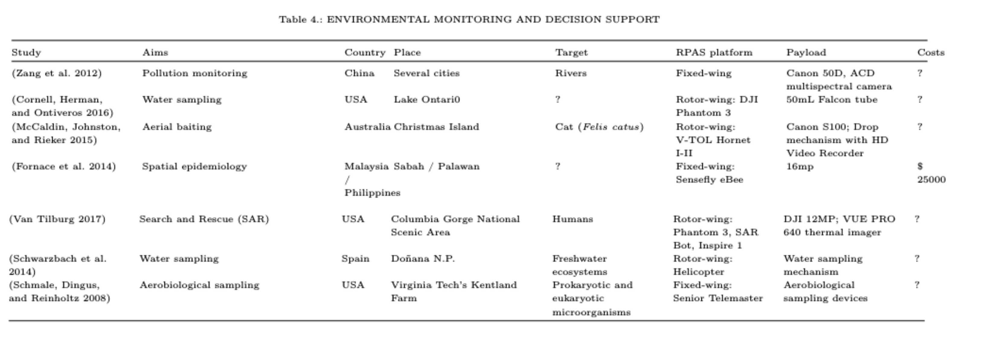

Slide 17
Applications: Impact of RPAS on wildlife and ecosystems
Impact of RPAS on wildlife and ecosystems
Animal welfare
Disturbance assesment
Recommendations
Target species
Birds
Aquatic and terrestrial mammals
Research
Novel methods: comparative study fixed-wing / rotor-wing (McEvoy,Hall, and McDonald 2016) , physiological stress measurement (Ditmer et al. 2015), analisys review (Mulero-Pázmány et al. 2017),
Considerations
Disturbance effect: Noise > distance > angle of flight
Disturbance effect: birds > terrestrial mammals > aquatic mammals
Disturbance effect: life-history stage, level of aggregation
Best practices |:
Further trials :|
Lack of qualified operators

Slide 18
Considerations: Legal barriers
Restrictive regulatory framework
Review of the Current State of UAV Regulations (Stöcker et al. 2017)
Global drone regulations database
https://www.droneregulations.info/
International Association for Unmanned Vehicle Systems (AUVSI)
http://www.auvsi.org

Slide 19
Conclusions
Consolidation of RPAS in Protected Areas:
Continuous technological advances and applications.
This rapidly expanding confluence of factors encourages the emergence of new scenarios with ethical and legal implications.
Most governments have reacted by setting constraints that could have a negative impact on the capacity to integrate RPAS into the civilian sphere.
Future of the RPAS in protected areas is conditioned fundamentally by political and social factors

