Slide 1

Metacritic all time games stats (stats from 1995 to 2018)
Sandy Lee
Song Ying
Seung Won Lee

Slide 2


We are a start up who has had success in mobile/social gaming selling loot boxes to kids using their parent’s credit card
We want to diversify out of this shady practice into something more substantial
We are data led and have commissioned a study on games data over the past 24 years
We have business questions to answer to decide where to put our resources moving forward

Slide 3

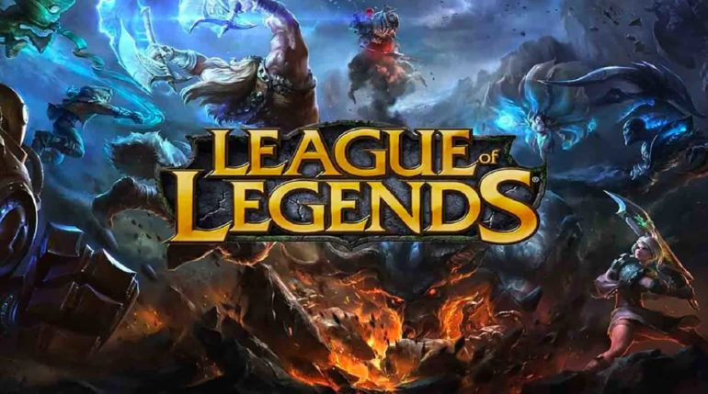

Hypothesis 1 – Introduction of Battle Royal Games in 2015
Mercury is the closest planet to the Sun and the smallest one in the Solar System—it’s only a bit larger than our Moon. The planet’s nme has nothing to do with the liquid metal, since it was named after the Roman messenger god, Mercury

Slide 4
Hypothesis 1 - Test
Action games have long been one of the most popular game genres.
However, I believe that its kingdom is about to fall down, due to new genre of games called “Battle Royale games”. The Battle Royale Games market projected to hit $20 billion in 2019.
* Question : Due to the introduction of new genre in 2015 , expectation of potential customers towards the games is high. Thus, they might give lower rating to Action game.
H0 : The user rating of Action in Year 1 (Year 13-14) , Year 2 (Year 15-16) and Year 3 (Year 17-18) have no differences.
H1 : The user rating of Action in Year 1 (Year 13-14) , Year 2 (Year 15-16) and Year 3 (Year 17-18) have a clear difference.

Slide 5
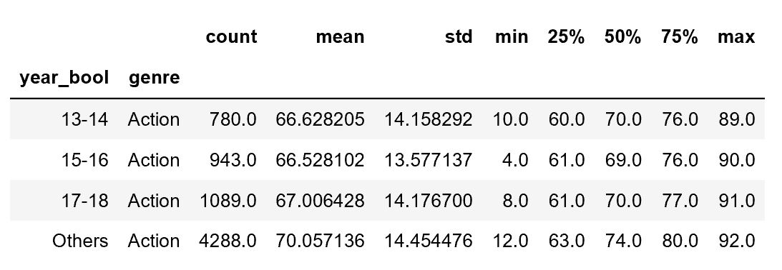
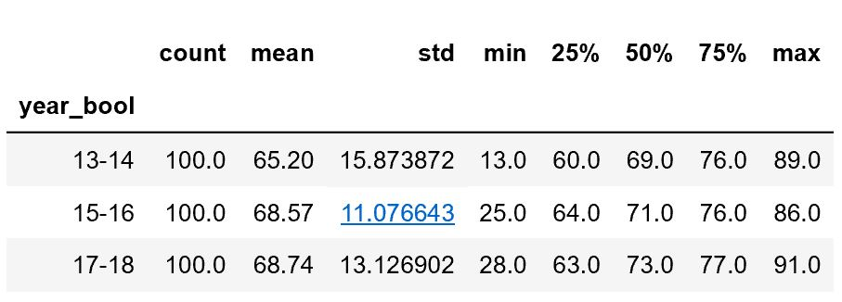
Hypothesis 1 -Procedure
Step 1 Normality test
Step 2
Step 3
S

Slide 6

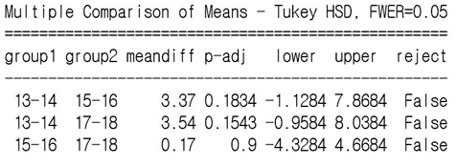
Hypothesis 1 - Conclusion
ANOVA Test result
Result: 0.05 < 0.11.
We cannot reject Null Hypotheses.
Tuckey Test result
Tucey Test also shows the same results. (False, False, False)
Conclusion: The user rating of Action in Year 1 (Year 13-14) , Year 2 (Year 15-16) and Year 3 (Year 17-18) have no difference and People still like “Action Games”.
0.05 < 0.11
Tuckey Test" to see the relationship between years in details

Slide 7

BUSINESS QUESTION
With the rise of consoles since the 00s competition between PCs and consoles has intensified. In addition, the rise of social media and user generated content in selling games has become more important (e.g. Twitch and e-sports). To what extent do professional reviews lead user generated leads? We can manage our PR spend accordingly.

Slide 8
OPERATIONALISATION
Hypothesis Test 2
H0 = ReviewerRatingMean = UserRatingMean on PC
H1 = ReviewerRatingMean > UserRatingMean PC
Effect size (Cohen's D) > 0.8
Type 1 error rate = 0.05
Type 2 error rate = 0.9

Slide 9
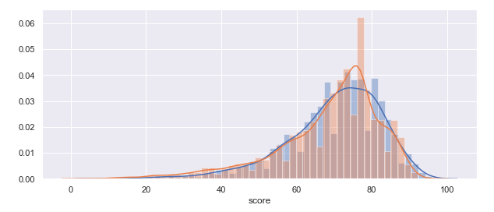
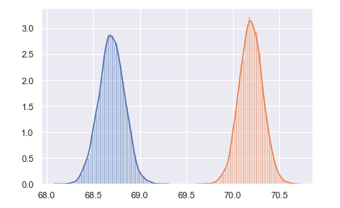
Challenge

Slide 10
Analysis
Welch’s T-Test
P-Value = 0
Reject Null
Cohen’s D = 3.49

Slide 11

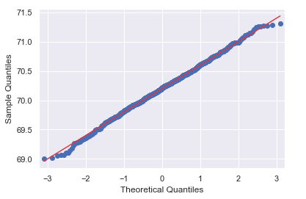
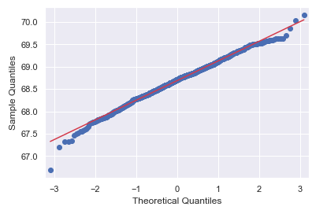
Is the test valid?
Professional reviewer QQ plot
User reviewer QQ plot

Slide 12
So what?
We can confidently say that it is highly likely that not only do reviewers consistently rate PC games higher than users, but they do so significantly. What this means for the business is that we should continue to divert existing levels of PR funding into engaging with professional reviewers.

Slide 13
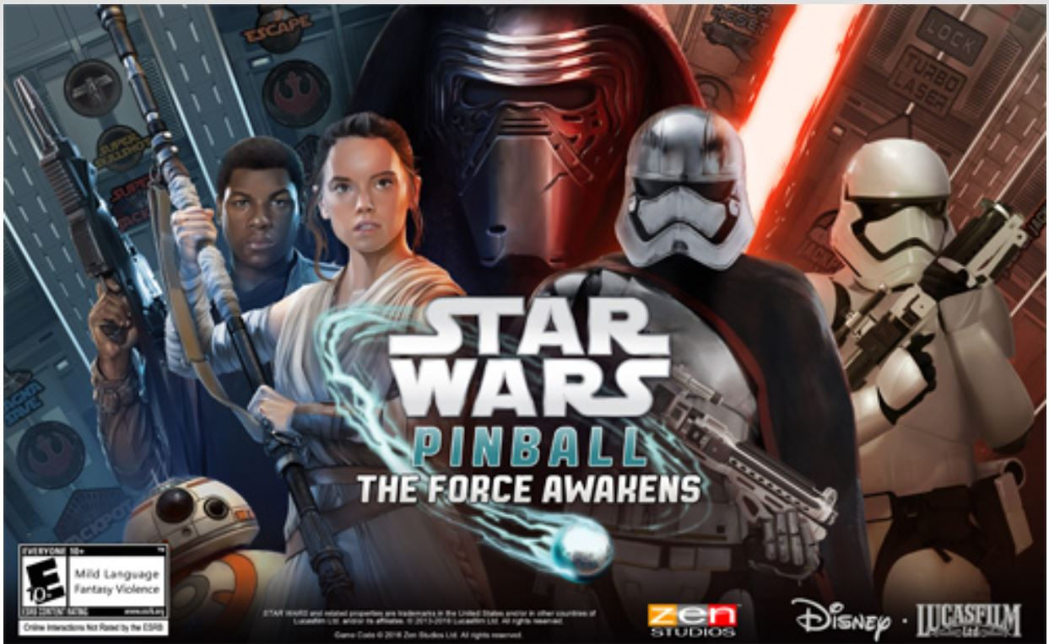


Hypothesis 3 – Three leading Publishers of Games
Mercury is the closest planet to the Sun and the smallest one in the Solar System—it’s only a bit larger than our Moon. The planet’s nme has nothing to do with the liquid metal, since it was named after the Roman messenger god, Mercury

Slide 14
Hypothesis 3 - Test
Hypothesis 3 (ANOVA Test)
As the 3 leading gaming publishers in the industry, our experiment aims to conduct if critics have a preference for games published by specific publishers.
H0: Well-known game publishers (Ubisoft, Atlus, Zen Studios) perform equally well for metascore
H1: Well-known game publishers (Ubisoft, Atlus, Zen Studios) do not perform equally well for metascore

Slide 15
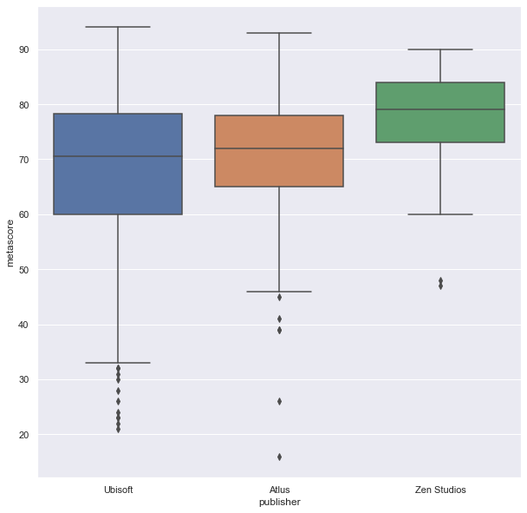
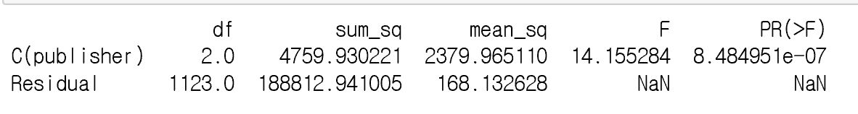
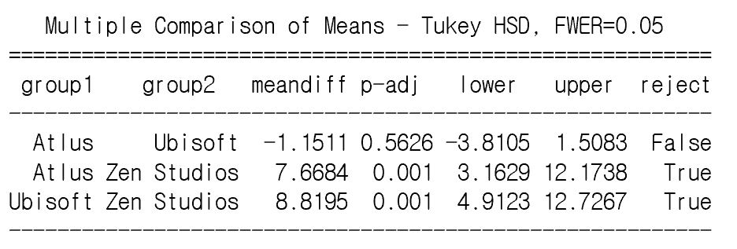
Hypothesis 3 - Procedure
Step 1 Box plot
Comparison
Step 2
Step 3
S

Slide 16
Hypothesis 3- Conclusion
ANOVA Test result
Result: 0.05 < 0.11.
We cannot reject Null Hypotheses.
Tuckey Test result
Tukey Test also shows the same results. (False, False, False)
Conclusion: The user rating of Action in Year 1 (Year 13-14) , Year 2 (Year 15-16) and Year 3 (Year 17-18) have no difference and People still like “Action Games”.
0.05 < 0.11
Tuckey Test" to see the relationship between years in details

Slide 17
Findings and Business Implication
1. Since there is no difference before and after the introduction of “ Battle Royal”
We recommend the gaming company to carry on their genre of games,
However, the growth of Battle ground games are very fast, I recommend them
to monitor it.
2. We can confidently say that it is highly likely that not only do reviewers consistently rate
PC games higher than users, but they do so significantly.
What this means for the business is that we should continue to
divert existing levels of PR funding into engaging with professional reviewers.
3. Zen Studios perform significantly well against Atlus and Ubisoft, so Zen Studios
may be a better publisher for the business upcoming new game,
however more analysis should be done to compare the publishing cost,
distribution channel and sales figure by 3 of the leading gaming publishers.

Slide 18
Thank you for listening
Q & A

