Slide 1
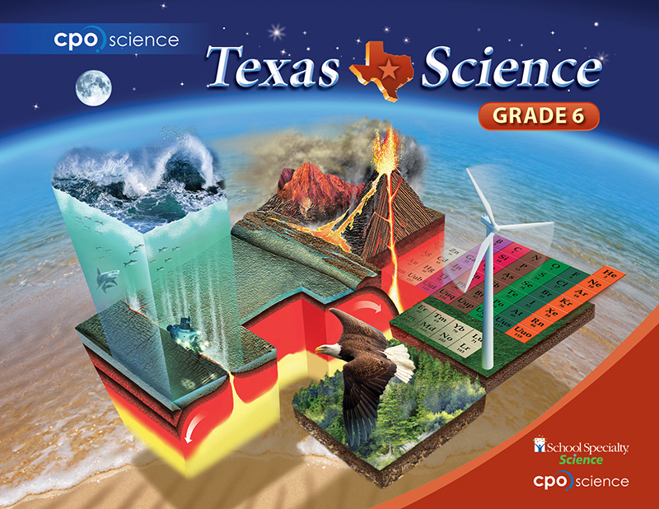

Slide 2

Chapter One: Science Practices
Lesson 1.1 Observing the World
Lesson 1.2 Thinking Like a Scientist
Lesson 1.3 Systems, Experiments, and Models

Slide 3
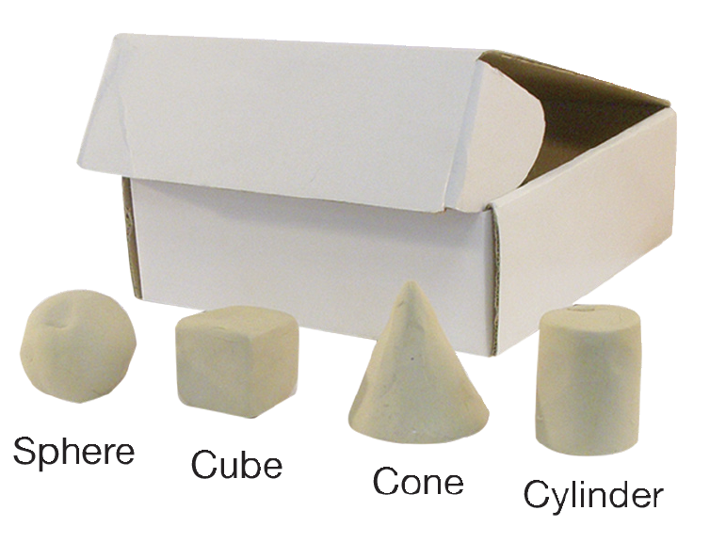
Investigation 1.2
Inquiry and Scientific Evidence
How does a scientist conduct investigations?

Slide 4
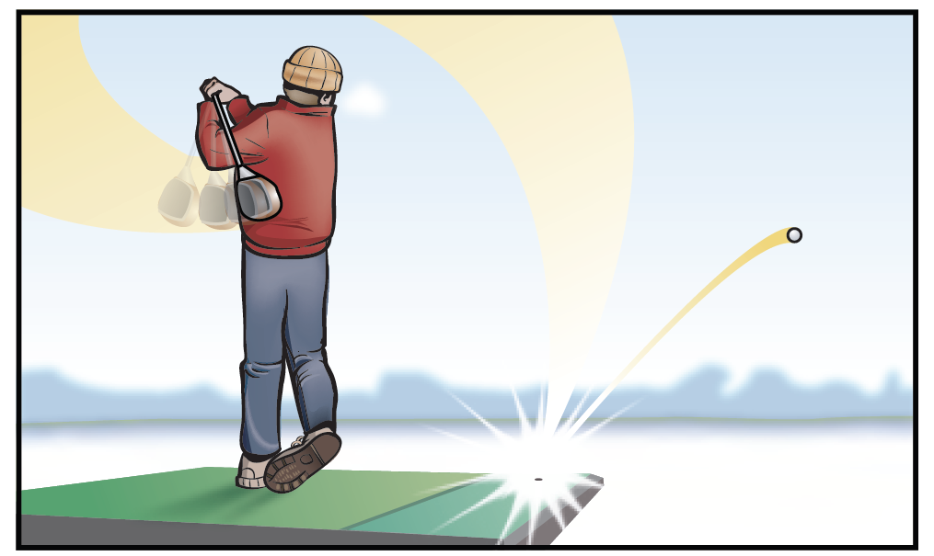
1.2 Thinking Like a Scientist
Sam is hitting golf balls at a driving range on a very cold winter day.

Slide 5
1. Make observations
Sam wonders if warm golf balls would bounce higher than cold ones.

Slide 6
2. Ask a question
His question is:
“Do golf balls bounce differently when they are at different temperatures?”

Slide 7
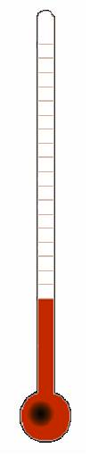
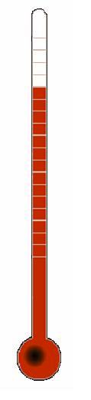
3. State a hypothesis
Based on his observations, Sam states a hypothesis:
If the temperature of a golf ball is increased, then it will bounce higher.
A hypothesis is a possible answer to a scientific question based on observations.

Slide 8
A good hypothesis
Sam’s hypothesis was good because it could be tested with an experiment.
Here are some other testable hypotheses that Sam could have made:
  If the temperature of a golf ball is increased, then it will go farther when hit with a golf club.
  If the temperature of a golf ball is increased, then it will make a different sound when dropped on the floor.

Slide 9
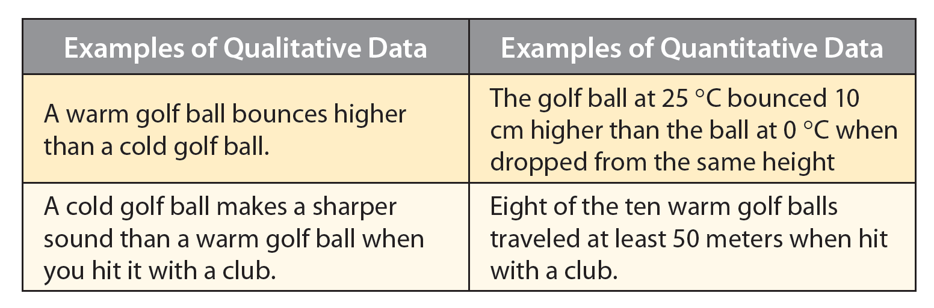
4. Collect data
Pieces of information that are collected in order to test a hypothesis are called data.

Slide 10
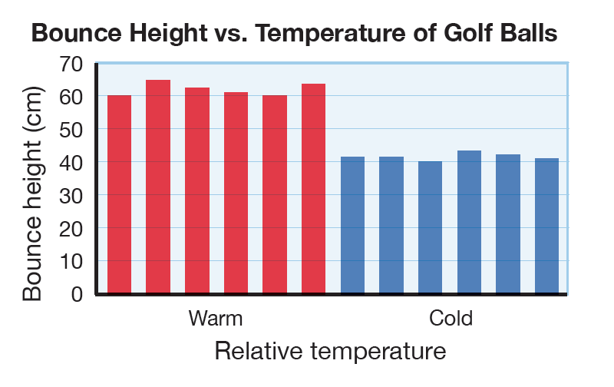
5. Draw conclusions
Sam concludes that his hypothesis is correct.
All six of the warm golf balls bounced higher than the cold golf balls.

Slide 11
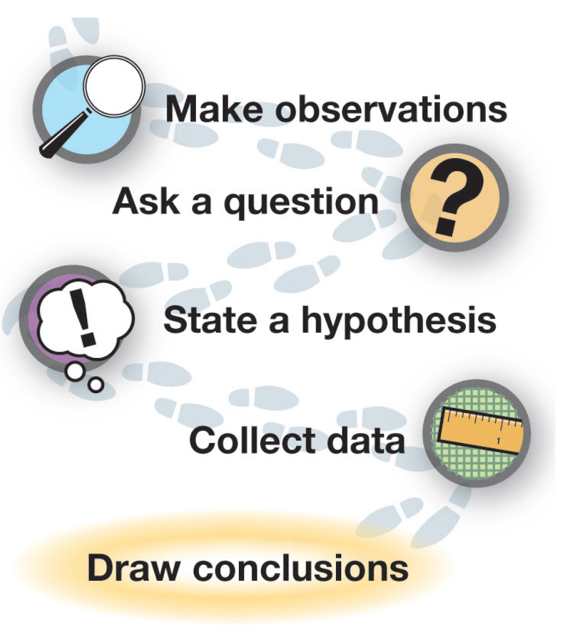
The scientific method
Together, these steps are called the scientific method.

Slide 12
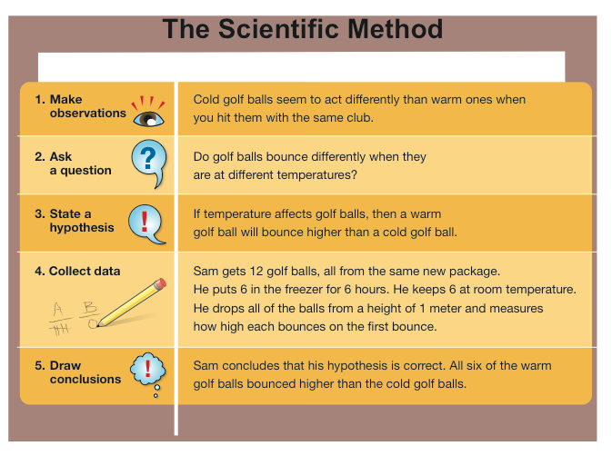

Slide 13
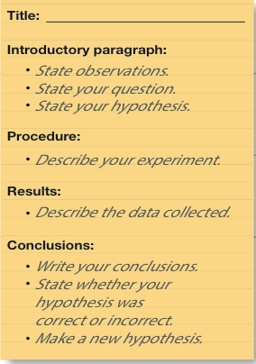
The Lab Report
A lab report follows the steps of the scientific method.
An incorrect hypothesis is another piece of information that you can use to answer a new scientific question.

Slide 14
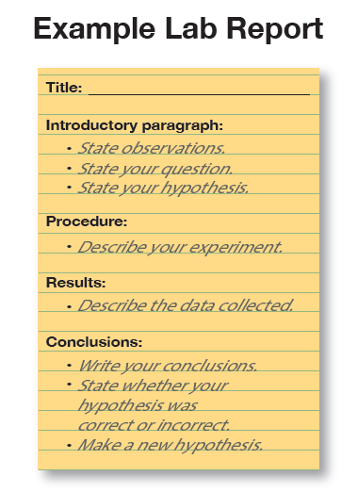

Slide 15
Scientific facts, laws, and theories
Scientific facts are statements that are accepted as being true and have been repeatedly measured or observed.
Here are some scientific facts:
  Plants use the energy of sunlight to make sugar.
  It takes 365.25 Earth days for Earth to orbit around the Sun.

Slide 16
Scientific facts, laws, and theories
Scientific laws and theories are statements that are supported by the observations and evidence from these experiments.
Scientific laws describe, but do not explain, observed phenomena.
An example of a scientific law is the law of gravity.

Slide 17
Scientific facts, laws, and theories
Scientific theories address more complex ideas.
Even accepted scientific laws and theories are constantly tested by new experiments.
An example of a scientific theory is the theory of plate tectonics.

Slide 18
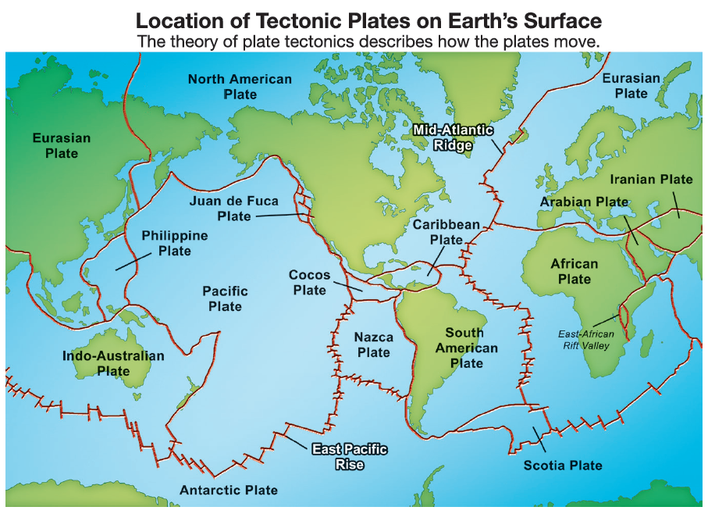

Slide 19
