Slide 1
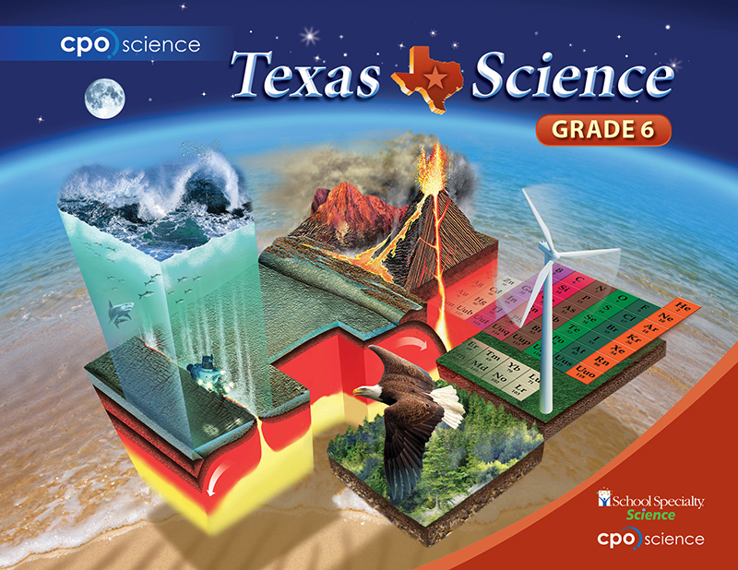

Slide 2
Chapter One: Science Practices
Lesson 1.1 Observing the World
Lesson 1.2 Thinking Like a Scientist
Lesson 1.3 Systems, Experiments, and Models

Slide 3
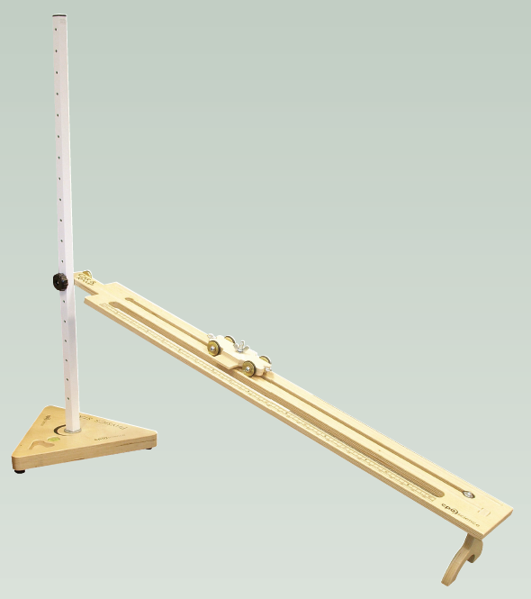
Investigation 1.3
Systems, Experiments, and Variables
Why do we control variables in an experiment?

Slide 4
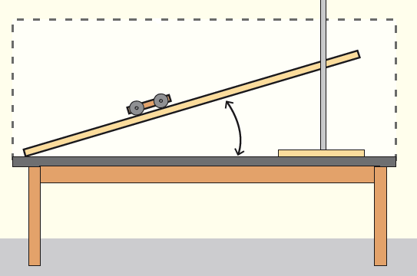
Systems
A system is a group of objects and the factors that affect these objects.
Some examples of systems are listed below:
  the respiratory system in the human body
  a toy car and ramp

Slide 5
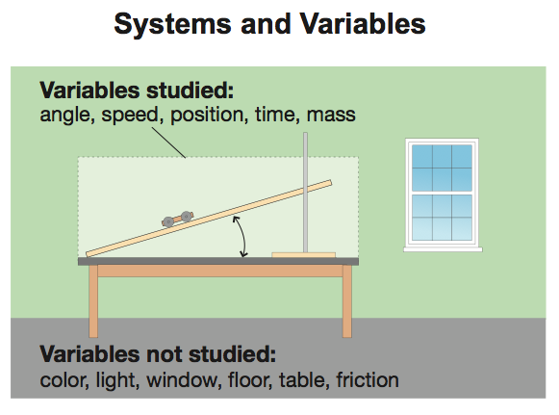

Slide 6
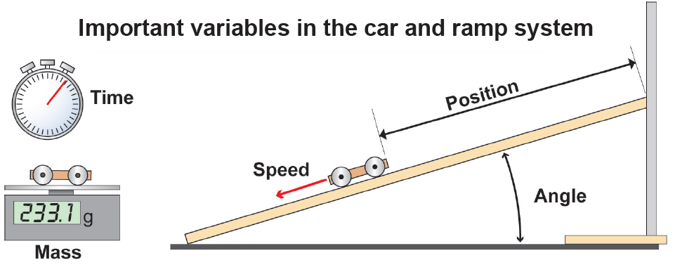
Variables
A factor that affects how a system works is called a variable.

Slide 7
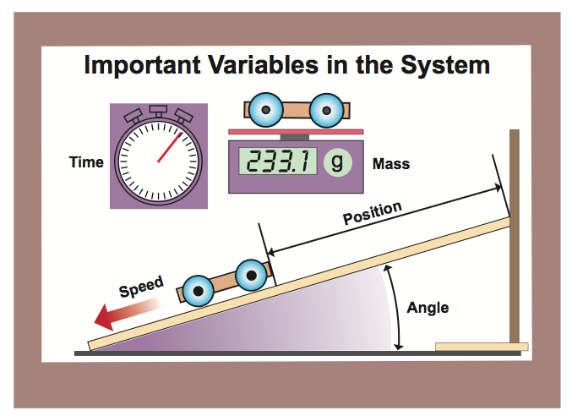

Slide 8
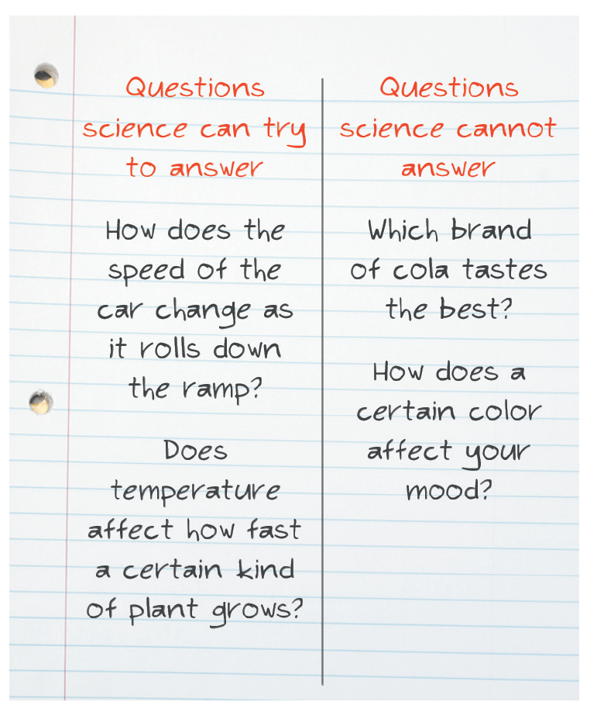
Scientific questions
Questions based on opinions cannot be answered by science.

Slide 9
Descriptive Investigations
One type of investigation is called a descriptive investigation.
A descriptive investigation involves describing and sometimes quantifying parts of a system.
  Example: “What are some things I can change when working with this car and ramp setup?”

Slide 10
Comparative Investigations
A comparative investigation involves collecting data on different populations or organisms, or under different conditions (such as time of year or locations) to make a comparison.
  Example: “Does temperature affect the car and ramp system?”

Slide 11
Experimental Investigations
In an experimental investigation, all variables in the system are controlled except for one.
  Example: “What is the effect of ramp height on car speed?”

Slide 12
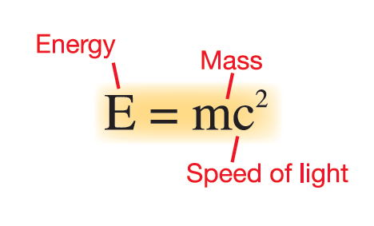
Models
A model is a representation of an object or a system.
There a several types of models in science:
  mental models
  physical models
  conceptual models
  computer or mathematical models

Slide 13
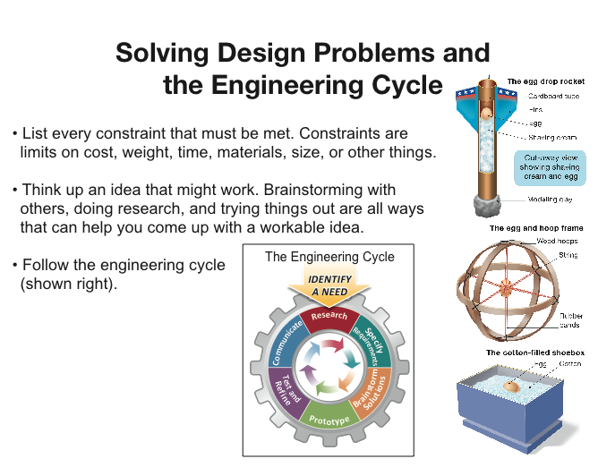

Slide 14

Technology
Technology is the application of science to meet human needs and solve problems.

Slide 15
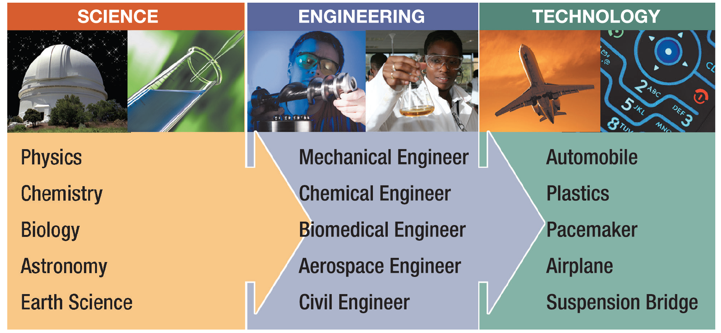
Engineers use scientific knowledge to create or improve inventions that solve problems.

