Slide 1
GLOBAL ELECTRONICS
Data Spark: Illuminating insights on Global Electronics
By,
R JESVIN

Slide 2
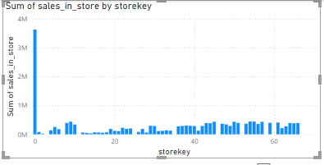
Store analysis 1
Insight Statement:
The majority of sales are conducted in online, representing a significant portion of total revenue. While stores also contribute, they fall short of the online store dominance.
Problem Statement:
The company's revenue is heavily concentrated in Online store. This lack of diversification could lead to financial instability and hinder growth.
Solution Statement:
By using advertisement, we can increase the sales in other stores, which will be highly useful in case of any cyber attacks. As many products available in stores, damage in supply can be greatly reduced.

Slide 3
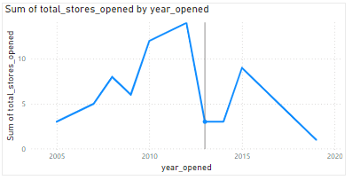
Store analysis 2
Insight Statement:
As majority of sales happens in online, number of new store opened is decreased significantly.
Problem Statement:
The company's revenue is heavily concentrated in Online store. This lack of diversification could lead to financial instability and hinder growth.
Solution Statement:
By using advertisement, we can increase number of electronics, which will be highly useful in case of any cyber attacks. As many products available in stores, damage in supply can be greatly reduced.

Slide 4
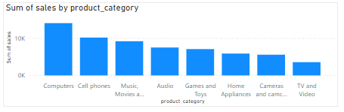
Product Analysis
Insight Statement:
Compared to other product categories computer is the highest preferrable product, TV and Video is the lowest preferrable product among all age group.
Solution Statement:
Most individuals who are buying are in the 18-24 age group are likely college students. To engage them effectively, leverage platforms like Instagram, TikTok, and Snapchat, where they're most active. Develop interactive content such as polls, challenges, and giveaways that promote participation and sharing. This approach will help spark their interest in purchasing products.

Slide 5
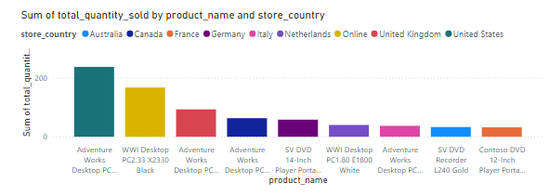
Top Product in each country

Slide 6
Product Analysis 2
Insight Statement:
It shows most preferable product in each country.
Problem statement:
To increase the sale of same product in different country.
Solution statement:
To tackle this issue, analyzing the strategies of top-performing product in particular country and applying similar tactics to the required product could help boost their profitability.

Slide 7
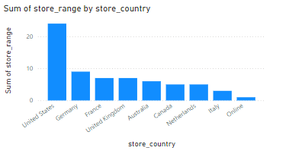
Sales analysis
Insight Statement :
The United States has the highest total sales, exceeding $20M, with a significant number of stores contributing to this total. In contrast, countries like Australia and Canada have fewer stores and generate lower total sales. The online segment shows moderate sales but has fewer stores compared to the United States
Problem Statement:
There is a substantial disparity in total sales. While the United States is performing exceptionally well, other countries like Australia, Canada, and the Netherlands have lower sales figures, indicating underperformance or untapped market potential.
Solution statement:
To address the sales disparity, consider expanding the number of stores and enhancing marketing efforts in underperforming countries. For the online segment, improving the online shopping experience and offering exclusive deals could drive higher sales

Slide 8
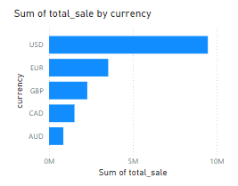
Exchange rate analysis
Insight Statement:
The majority of sales are conducted in USD, representing a significant portion of total revenue. While other currencies like EUR and GBP also contribute, they fall short of the USD's dominance.
Problem Statement:
The company's revenue is heavily concentrated in USD, leaving it vulnerable to fluctuations in exchange rates and potentially limiting market reach. This lack of diversification could lead to financial instability and hinder growth in non-USD markets
Solution Statement:
Expanding sales efforts into other currencies beyond USD would reduce risk and increase revenue potential. Strategies could include adapting pricing and payment options, investing in international marketing campaigns, building strategic partnership

