Slide 1
Autism Spectrum Disorder Detection from Structural MRI
A leakage-free, patient-level machine learning pipeline
Frozen EfficientNet embeddings + handcrafted GLCM / LBP texture + clinical features → Random Forest
ABIDE structural MRI cohort · branch rebuild/patient-safe-effnet-rf
Mini Project · 2026

Slide 2
Objective
Classify each person (not each slice) as ASD vs control — honestly
▪ Build a training pipeline that can never leak a patient's images across train/validation/test.
▪ Combine three complementary feature families:
  – Deep — frozen ImageNet EfficientNet (B0 / B5) embeddings, no supervised fine-tuning
  – Handcrafted — masked GLCM (energy, homogeneity, contrast, correlation, entropy…) + multi-radius LBP
  – Clinical — age, sex, FIQ only (no diagnostic scores, no site, no IDs)
▪ Classifier: Random Forest with fold-local PCA / imputation / threshold tuning.
▪ Target: > 80% held-out patient accuracy — measured once, on a locked test set.
Why this matters
▪ Previous run reported 96.5% accuracy — but slices of the same patient appeared on both sides of the split.
▪ Re-evaluated at patient level it was 62.5%.
▪ This project rebuilds evaluation so the number you see is real.

Slide 3
Dataset — ABIDE structural MRI
Audited before any model work
1,004
504 / 500
1,003
20+
skull-stripped T1 scans
control / ASD
unique people (audit)
acquisition sites
Audit check | Outcome
Patient IDs vs phenotype table | 1,004 / 1,004 matched, labels 100% consistent
Volume orientation / affine | All valid 3-D LAS affines → canonicalized to RAS
Mixed voxel spacings | Detected → all resampled to 1 mm isotropic
Clinical fields (age, sex, FIQ) | Age/sex complete; 64 missing FIQ (flagged)
Duplicate scan content | 50279 = 50286 (UM_1) → grouped as one person
Real anomaly found
▪ Two patient IDs point to byte-identical scans with different sex, age and FIQ records.
▪ Both kept — but forced into one partition via a shared person_id.
▪ Same brain can never appear on both sides of an evaluation.

Slide 4
The leakage problem
Why a rebuild was necessary
Slices are not independent — all slices of one brain are correlated. Splitting by slice inflates results.
Slice-level split (old)
Patient-level split (this work)
96.5% accuracy
71.6% accuracy
▪ Same patient's slices in train AND validation
▪ Model recognizes the person, not the disease
▪ Zero patient overlap — enforced and hashed
▪ The honest number (old grouped baseline: 62.5%)

Slide 5
Pipeline overview
Fresh preprocessing → three feature streams → Random Forest → patient decision
EfficientNet B0/B5
frozen ImageNet
embeddings 7,680 / 12,288
Raw skull-stripped
T1 MRI (.nii.gz)
Preprocessing
Random Forest
500 trees
P(ASD)
per patient
LAS · mixed spacings
RAS · 1 mm iso · in-mask
1–99th pct norm · 9 slices × 3 views
fold-local PCA + median impute · threshold on inner OOF
GLCM + LBP texture
42 + 54 per slice
→ 576 per patient
Clinical
age · sex · FIQ
+ missingness flags
One prediction per person — slices are only ever features of that person's record.

Slide 6
Fresh MRI preprocessing
No legacy caches or filtered volumes reused
Step | Specification
Orientation | Canonicalize every scan to RAS
Resampling | Axis-aligned 1 mm isotropic grid (linear image / nearest mask)
Brain mask | Foreground from skull-stripped voxels; re-applied after resampling
Normalization | Per-patient in-mask 1st–99th percentile → clip [0, 1]
Slice selection | 9 unique slices × axial / coronal / sagittal, central 20–80% extent
Quality gates | ≥ 256 brain pixels/slice, ≥ 32 safe LBP centers — failures are explicit
CNN input | Aspect-preserving letterbox → 224 (B0) / 456 (B5), ImageNet normalization
Deliberately excluded
▪ No slice-level splitting (removed entirely)
▪ No atlas / MNI registration
▪ No learned harmonization or augmentation
▪ No test-time augmentation
▪ No reuse of legacy filtered volumes or caches
▪ No supervised fine-tuning of EfficientNet

Slide 7
Feature stack
Deep + handcrafted + clinical — 710 predictors after fold-local PCA
Deep — EfficientNet
Handcrafted — GLCM + LBP
Clinical
frozen ImageNet features
on 1 mm normalized slices
allowlisted inputs only
▪ Classifier head removed → global conv representation
▪ 1,280 (B0) / 2,048 (B5) dims × 27 slices
▪ Mean + std pooled per anatomical view → 7,680 / 12,288 per patient
▪ Fold-local StandardScaler + PCA → 128 components
▪ GLCM @ 32 levels, d = 1/2/4, 4 angles, masked pairs only:
  – contrast, dissimilarity, homogeneity, ASM, energy, correlation, entropy → 42/slice
▪ Uniform LBP r = 1/2/3 (P = 8/16/24) in-mask centers → 54/slice
▪ Mean + std per view → 576 per patient
▪ Age · sex · FIQ + three missingness flags → 6 features
▪ Fold-local median imputation
▪ Never used: ID, filename, site, diagnosis, ADOS/ADI/SRS/SCQ/AQ
▪ Combined input: 128 + 576 + 6 = 710 predictors

Slide 8
Leakage-safe evaluation protocol
Nothing ever fits on validation or test patients
Locked split (seed 42)
Guarantees enforced in code
▪ Zero patient/person overlap asserted between every partition
▪ Every fit records its exact patient membership (leakage spies in tests)
▪ SHA-256 fingerprints: source files, voxel content, config, weights, bundles
▪ Feature cache refused if recipe, weights or source changes
▪ Test evaluation verified to perform zero .fit() calls
▪ 163 regression tests · smoke run on 16 dev patients before the study
▪ 80% development / 20% test — patient & person level, site+label stratified
▪ 803 dev / 201 test · immutable registry; reuse refused if cohort changes
▪ Test set scored exactly once, after models were frozen
Nested cross-validation (dev only)
▪ 5 outer × 3 inner patient-grouped folds
▪ PCA, scaler, imputer, RF hyperparameters and the decision threshold are fit inside each training scope only

Slide 9
Development results (nested CV)
Model selection — these are estimates, not the final claim
Backbone (combined) | Accuracy | Balanced acc | ROC-AUC
EfficientNet-B0 | 0.715 ± 0.024 | 0.714 | 0.784
EfficientNet-B5 | 0.710 ± 0.027 | 0.710 | 0.770
What the ablations show
▪ B0 selected — B5's extra capacity did not help at this cohort size.
▪ Texture and deep features carry complementary signal; combining them is best.
▪ Clinical alone is weak (0.57) — the model is genuinely reading the MRI.
▪ Every ablation shares the same folds and settings — a fair comparison.
Ablation (B0) | Accuracy | ROC-AUC
Combined (primary) | 0.715 | 0.784
MRI-only hybrid | 0.697 | 0.754
Texture only (GLCM+LBP) | 0.696 | 0.741
Deep only (EffNet+PCA) | 0.679 | 0.751
Clinical only (age/sex/FIQ) | 0.572 | 0.605

Slide 10
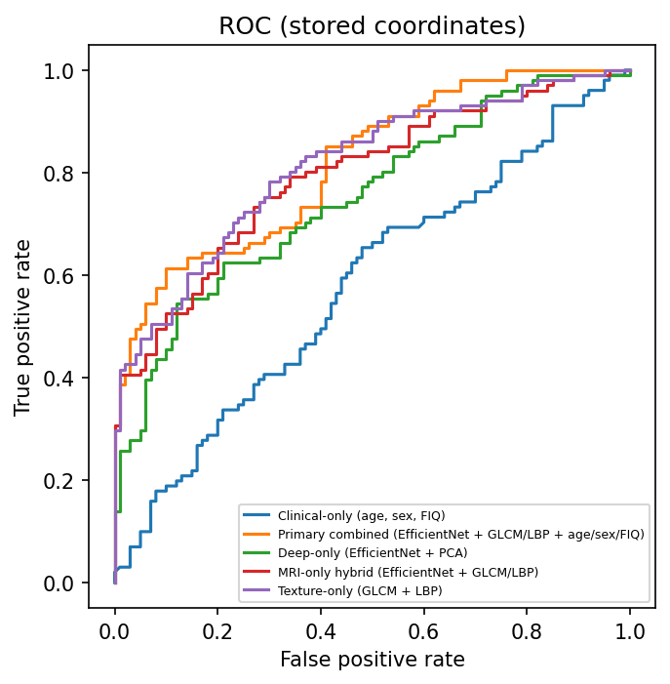
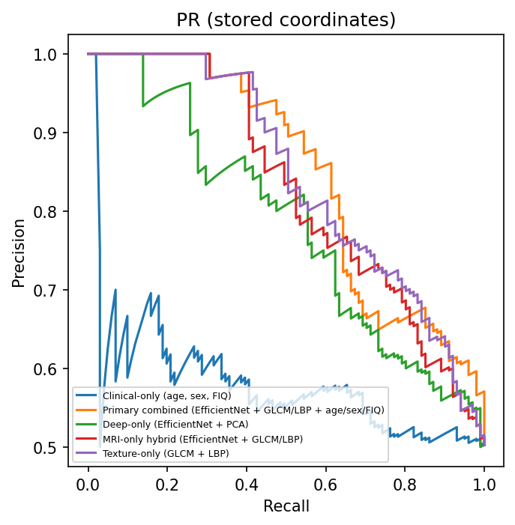
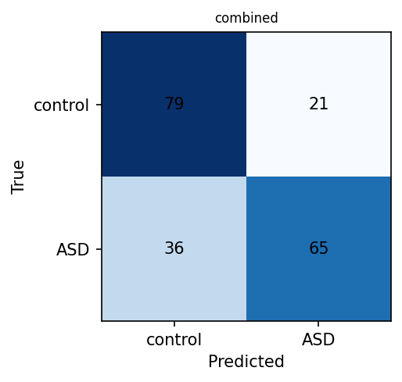
Locked test set — evaluated once
201 held-out patients · frozen models · threshold 0.44
0.7164
0.8183
0.644 / 0.790
0.847
Accuracy [0.651, 0.774]
ROC-AUC [0.760, 0.872]
Sensitivity / Specificity
PR-AUC
TN 79 · FP 21 · FN 36 · TP 65
Curves compare all five frozen model families (stored coordinates).

Slide 11
Honest conclusion
The number is real — and below target
>80% target NOT met — 71.6% held-out patient accuracy. We report the measured result rather than weakening the evaluation to inflate it.
▪ This is honest progress: 62.5% (old grouped baseline) → 71.6% with a far stronger protocol.
▪ The old 96.5% number was an artifact of slice-level leakage, not a real result.
▪ ASD-from-sMRI at ~72% accuracy / 0.82 AUC is consistent with the published literature on this cohort size.
Limitations
▪ Internal holdout — same cohort used in earlier experiments, not external validation
▪ Scanner sites overlap dev/test; no unseen-site guarantee
▪ Primary model uses age/sex/FIQ — not MRI-only
▪ Research classifier — not a clinical diagnostic tool

Slide 12
Future work
Ways to close the gap honestly
▪ Patient-level supervised fine-tuning of the encoder (development folds only).
▪ Volumetric / 3-D encoders or pretrained medical-imaging backbones.
▪ Site harmonization (ComBat) under fold-local fitting.
▪ Larger, multi-cohort training data; external site holdout for true generalization.
▪ Gradient boosting / calibrated ensembling over the same feature stack.
What is already delivered
▪ Reproducible, tested, leakage-safe training package (asd_training)
▪ Immutable split registry + content fingerprints
▪ Frozen model bundles that reproduce predictions exactly
▪ Frozen test evaluation, metrics, intervals and report (runs/hybrid/r2)
▪ 163 regression tests — including leakage-spy and zero-fit guarantees
Questions?

