Slide 1
Autism Spectrum Disorder Detection
from Structural MRI
A hybrid machine learning pipeline
EfficientNet deep features + GLCM / LBP texture + clinical data → Random Forest
ABIDE structural MRI cohort · patient-level classification
Mini Project · 2026

Slide 2
Introduction
Why machine learning on structural MRI?
▪ Autism Spectrum Disorder (ASD) is a neurodevelopmental condition; early, objective detection supports timely intervention.
▪ Diagnosis today relies on behavioral assessment — subjective, time-consuming, and variable between clinicians.
▪ Structural MRI captures subtle neuroanatomical differences associated with ASD.
▪ Machine learning can learn patterns in MRI that are difficult to observe directly.
▪ Goal: an automated classifier that outputs P(ASD) for each scanned patient.
Project objectives
▪ Combine deep and handcrafted image features
▪ Add approved clinical inputs (age, sex, FIQ)
▪ Patient-level classification — one decision per person
▪ Rigorous, reproducible evaluation protocol

Slide 3
Dataset — ABIDE structural MRI
Skull-stripped T1-weighted scans
1,004
504 / 500
20+
803 / 201
MRI scans
control / ASD
acquisition sites
development / test
Property | Details
Modality | Skull-stripped T1-weighted structural MRI (.nii.gz)
Classes | Control (0) vs ASD (1) — nearly balanced
Phenotype inputs used | Age, sex, FIQ (allowlisted; no diagnostic scores)
Acquisition | Multi-site — mixed orientations and voxel spacings
Split | 80 / 20 patient-level, stratified by site and label
Data quality checks
▪ All IDs verified against the phenotype table
▪ Valid 3-D geometry confirmed for every scan
▪ File- and voxel-level fingerprints recorded
▪ Missing clinical values flagged explicitly

Slide 4
Method overview
From raw MRI to one decision per patient
EfficientNet B0/B5
ImageNet embeddings
per slice → pooled
Skull-stripped
T1 MRI (.nii.gz)
Preprocessing
Random Forest
500 trees
P(ASD)
per patient
mixed spacings
RAS · 1 mm iso · intensity norm · 9 slices × 3 views
hyperparameter search + probability threshold
GLCM + LBP texture
energy, homogeneity,
contrast, entropy …
Clinical
age · sex · FIQ
Three complementary views of each patient are fused into a single classifier.

Slide 5
MRI preprocessing
Standardizing every scan before feature extraction
Step | Specification
Orientation | Canonicalize every scan to RAS
Resampling | Axis-aligned 1 mm isotropic grid (linear image / nearest mask)
Brain mask | Foreground from skull-stripped voxels, re-applied after resampling
Normalization | Per-patient in-mask 1st–99th percentile → clip [0, 1]
Slice selection | 9 slices × axial / coronal / sagittal, central 20–80% extent
Quality gates | ≥ 256 brain pixels/slice; failures reported explicitly
CNN input | Aspect-preserving letterbox → 224 (B0) / 456 (B5)
Design choices
▪ Fresh processing from original scans — no stale caches
▪ Slices are sampled across axial, coronal and sagittal anatomy
▪ Intensity scale normalized inside the brain mask only
▪ Deterministic recipe — every scan gets the identical pipeline

Slide 6
Deep features — EfficientNet
Transfer learning from ImageNet
▪ Pretrained EfficientNet used as a fixed feature extractor (B0 first, B5 compared).
▪ Classifier head removed → global convolutional embedding per slice:
  – 1,280 dimensions (B0) · 2,048 dimensions (B5)
▪ 27 slices per patient (9 × 3 views) → mean + std pooled per view:
  – 7,680 (B0) / 12,288 (B5) deep features per patient
▪ Fold-local standardization + PCA → 128 compact deep features.
▪ Grayscale replicated to 3 channels, ImageNet mean/std normalization.
Why EfficientNet?
▪ Compound-scaled architecture — strong accuracy per parameter
▪ ImageNet features transfer well as generic image descriptors
▪ Frozen encoder → reproducible, fast, no GPU-heavy training
▪ Two sizes compared fairly on the same folds

Slide 7
Handcrafted + clinical features
Interpretable descriptors alongside deep features
GLCM texture (Gray-Level Co-occurrence)
Clinical inputs
▪ Contrast · dissimilarity · homogeneity · ASM · energy · correlation · entropy
▪ 32 intensity levels, distances 1/2/4, four angles, brain-mask pairs only
▪ 42 features per slice
▪ Age · sex · Full-scale IQ (FIQ)
▪ Three explicit missingness flags; median imputation
▪ Only allowlisted fields — no site, ID, or diagnostic scores
LBP texture (Local Binary Patterns)
Combined predictor
128 deep (PCA) + 576 texture + 6 clinical = 710 features per patient
▪ Uniform LBP at radii 1/2/3 (P = 8/16/24) inside the brain mask → 54 features/slice
▪ Mean + std pooled per view → 576 texture features per patient

Slide 8
Classifier — Random Forest
Ensemble of 500 decision trees
▪ 500 trees, bootstrap sampling, class_weight = balanced_subsample.
▪ Hyperparameter search (8 candidates) over:
  – max depth, min samples per leaf, max features, max samples
▪ 5 outer × 3 inner cross-validation folds for model selection.
▪ Decision threshold tuned on inner out-of-fold probabilities.
▪ Ablations trained on identical folds: MRI-only, deep-only, texture-only, clinical-only.
Why Random Forest?
▪ Handles heterogeneous feature scales well
▪ Robust to overfitting on moderate cohorts
▪ Calibrated class probabilities → tunable threshold
▪ Feature-importance analysis is straightforward
▪ Well-suited to fusing deep + handcrafted + clinical blocks

Slide 9
Evaluation protocol
How the model was measured
Patient-level split
Reproducibility
▪ Fixed seed (42) — deterministic splits and models
▪ Frozen model bundles reproduce recorded predictions exactly
▪ Feature and weight fingerprints verify cache validity
▪ 163 automated regression tests
▪ Full run artifacts and report preserved (runs/hybrid/r2)
▪ 803 development / 201 test patients, stratified by site and label
▪ All slices of a patient stay together — evaluation is per person
▪ Test set evaluated once, after the models were frozen
Metrics
▪ Accuracy, sensitivity, specificity, balanced accuracy, precision, F1
▪ ROC-AUC, PR-AUC, confusion matrix, 95% confidence intervals

Slide 10
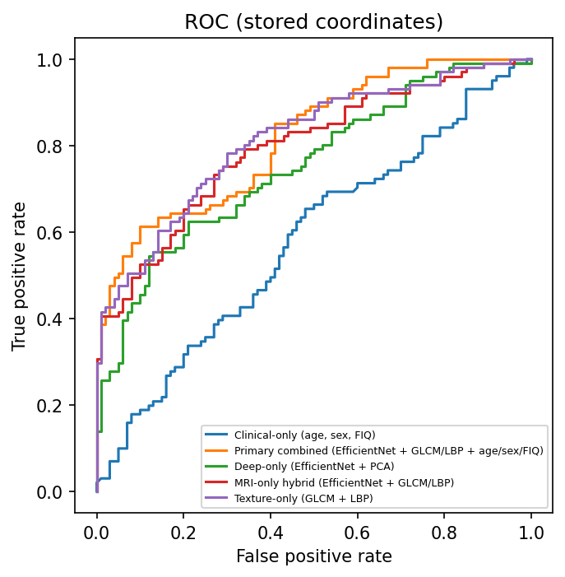
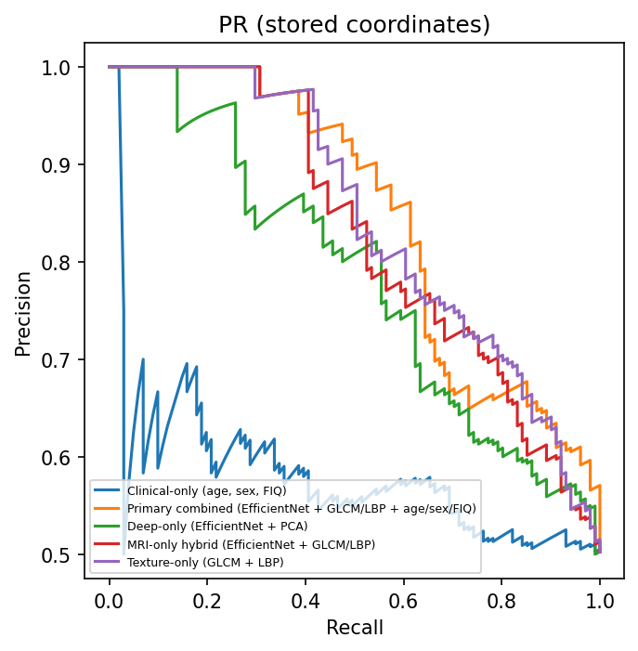
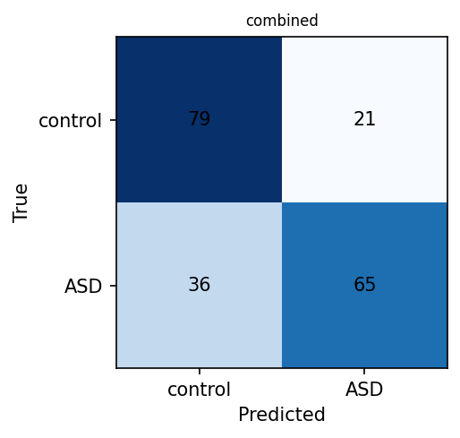
Results — held-out test set
201 unseen patients · primary combined model
0.7164
0.8183
0.644 / 0.790
0.847
Accuracy [0.651, 0.774]
ROC-AUC [0.760, 0.872]
Sensitivity / Specificity
PR-AUC
TN 79 · FP 21 · FN 36 · TP 65

Slide 11
Ablation analysis
Contribution of each feature family (same folds)
Model | Test accuracy | ROC-AUC
Combined (primary) | 0.716 | 0.818
MRI-only hybrid | 0.707 | 0.790
Texture only (GLCM+LBP) | 0.701 | 0.777
Deep only (EffNet+PCA) | 0.692 | 0.765
Clinical only (age/sex/FIQ) | 0.547 | 0.578
Observations
▪ Combining all three sources gives the best result.
▪ Texture and deep features are complementary — each adds signal.
▪ Clinical inputs alone are weak; MRI carries the decision.
▪ B0 outperformed B5 — the larger model did not help at this cohort size.

Slide 12
Conclusion & future work
▪ Built a complete hybrid ASD classifier: EfficientNet embeddings + GLCM/LBP texture + clinical → Random Forest.
▪ Achieved 71.6% patient-level accuracy and 0.82 ROC-AUC on the held-out test set.
▪ The full pipeline — preprocessing, features, model, evaluation — is reproducible and fully tested.
▪ Future directions:
  – Supervised fine-tuning of the encoder on development patients
  – 3-D / volumetric encoders or medical-imaging pretrained backbones
  – Gradient boosting / calibrated ensembling
  – Larger multi-cohort data and external-site validation
Deliverables
▪ Reproducible training package (asd_training)
▪ Documented preprocessing + feature recipe
▪ Frozen model bundles with exact predictions
▪ Complete metrics, intervals, figures and report
▪ 163 automated tests covering the full workflow
Thank you — Questions?

