Slide 1













Mcdonald and Garden​
Bread Ordering Systems
Ng Yat Lung​
Sin Yuk Wang​
Young Kai Lam, Hugo​
Fong Jessie Siu Ying​

Slide 2





Proposed MVP Overview
Characteristics:
User Centric approach
Core Functionality
Fast development
Minimal resources
Iterative Development

Slide 3


Proposed MVP Overview
Core features:
Data exchange within two business parties (McDonald's and Garden)
Minimal viable design
Data display and visualization

Slide 4
Programming language
Client side:
HTML
JavaScript
CSS
Server side:
Express.js
Node.js

Slide 5

Development Process

Slide 6
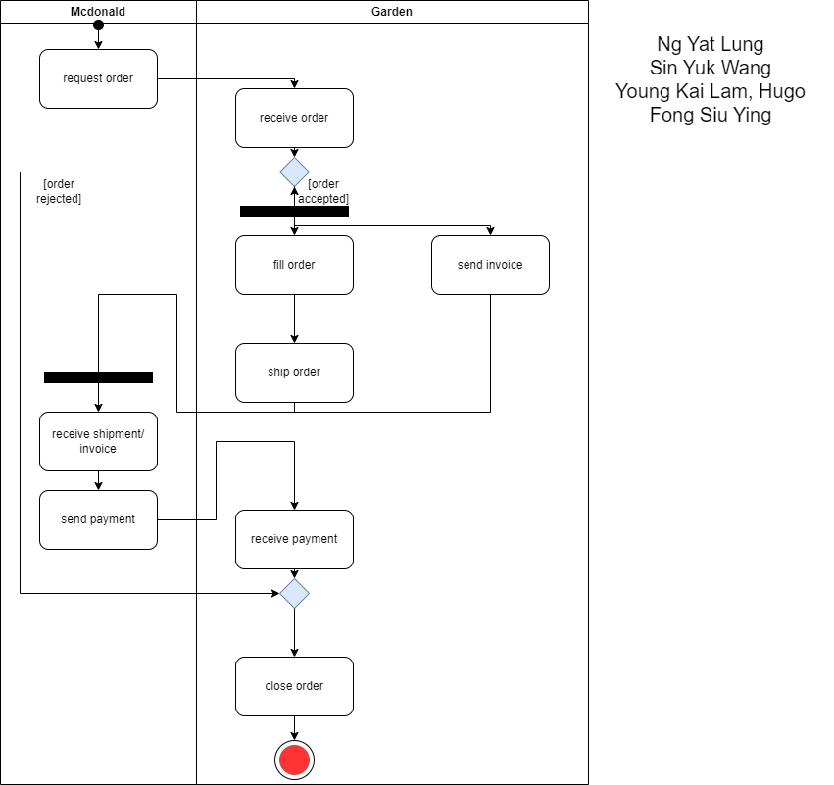

Activity Diagram

Slide 7
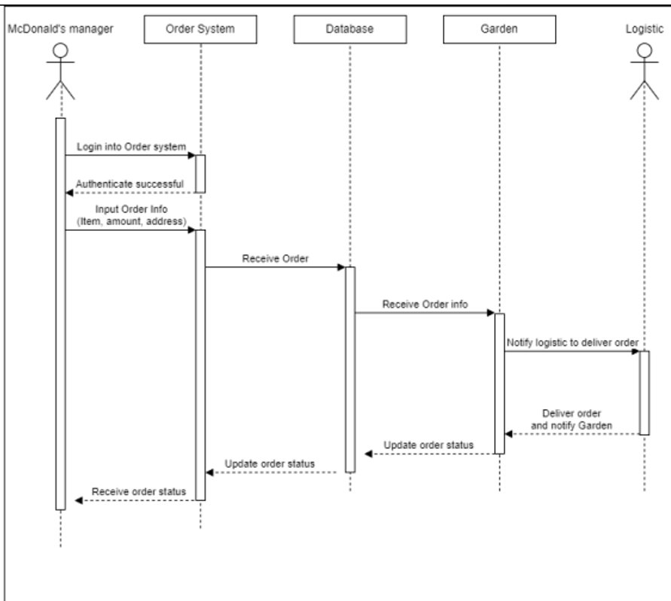
Sequence Diagram

Slide 8
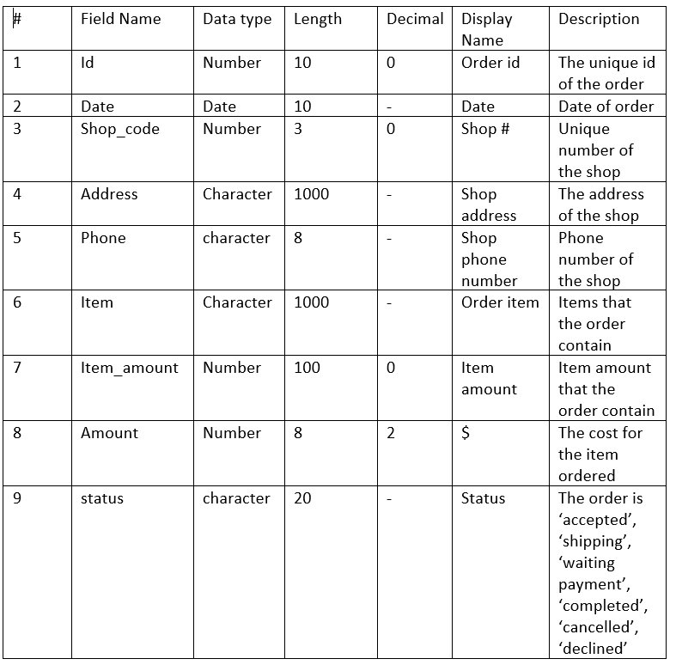
Record layout of
data exchange

Slide 9



Figma
Mc donalds demo
Garden side

Slide 10


Demo of Data Exchange
Client Side
Server Side

Slide 11
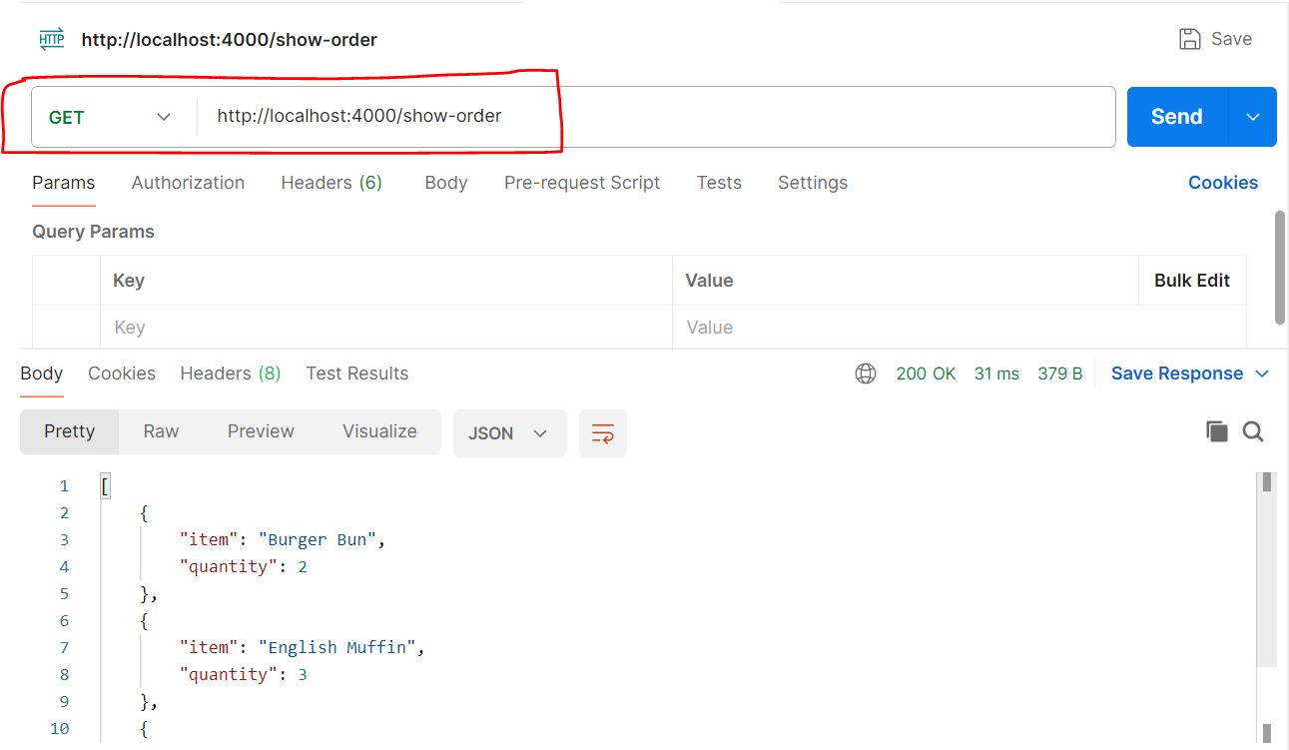
API Testing with Postman

Slide 12
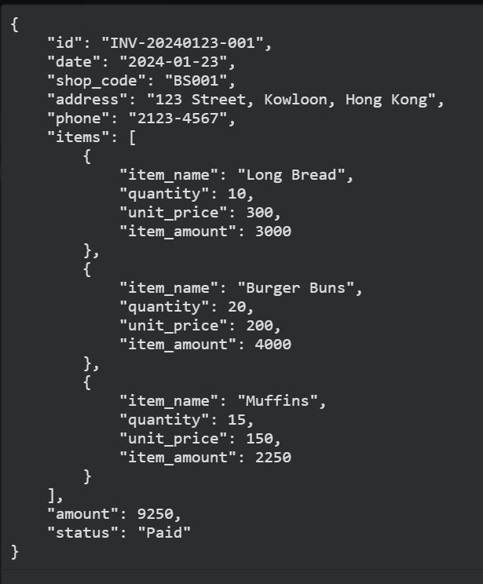
JSON for Data Exchange

Slide 13
THANK YOU

