Slide 1
CosMX Run 2- γH2AX + FOVs
4T1 Timecourse

Slide 2
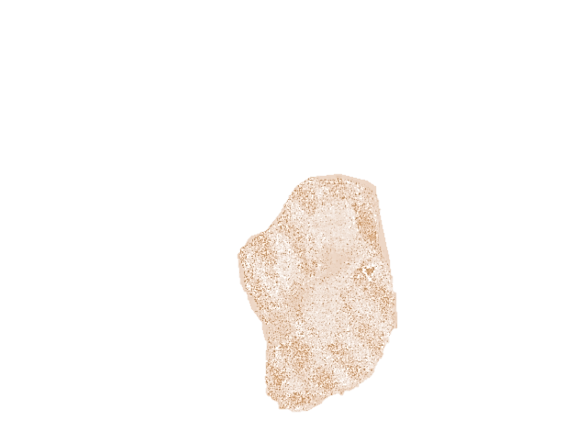
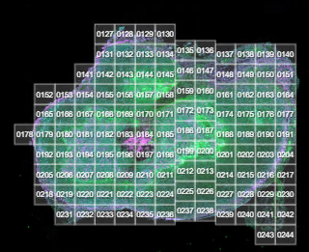
Slide 1 #34 MBRT 2d

Slide 3

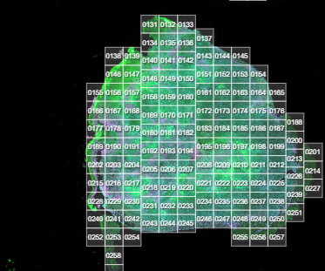
Slide 2 #35 MBRT 2d

Slide 4

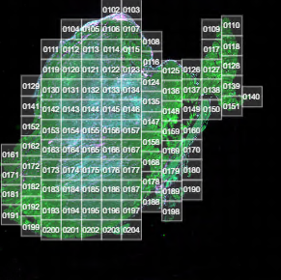
Slide 3 #19 MBRT 4hrs

Slide 5

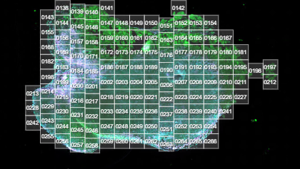
Slide 4 #20 MBRT 4hrs

