Slide 1
Itinerary in Motion
Your itinerary listens to the world and re-plans itself in seconds.
2026 / May / 15 | Robert Hsieh & Jet Huang (Team H²)

Slide 2
Why It Matters?
The Problem
Today, when a travel agency's customer (FIT or custom-itinerary travelers) is hit by a flight delay, the only thing they usually get is a single "your flight is delayed" SMS. Everything after that message is the traveler's problem:
Hotel check-in, airport transfer, tours, and restaurants — all left unresolved.
The only fallback is the agency hotline, which overloads during disruptions.
Our Approach
An event-driven platform the agency embeds into its own product, turning one disruption into a fully re-coordinated itinerary in seconds.
Single event fans out in parallel to flights, hotels, tours, and rainy-day alternatives.
Travelers get one coherent update inside the agency's own app or LINE OA.
Why Solace
Solace's event backbone coordinates every supplier in real time — no middleware to build.
Event Mesh connects everything from upstream to downstream modules.
Agent Mesh coordinates modern Agentic AI systems to automatically handles airlines, hotels, ground handlers, and vice versa.
Prospects:
Lion Travel
Richmond Travel
Cola Tour

Slide 3
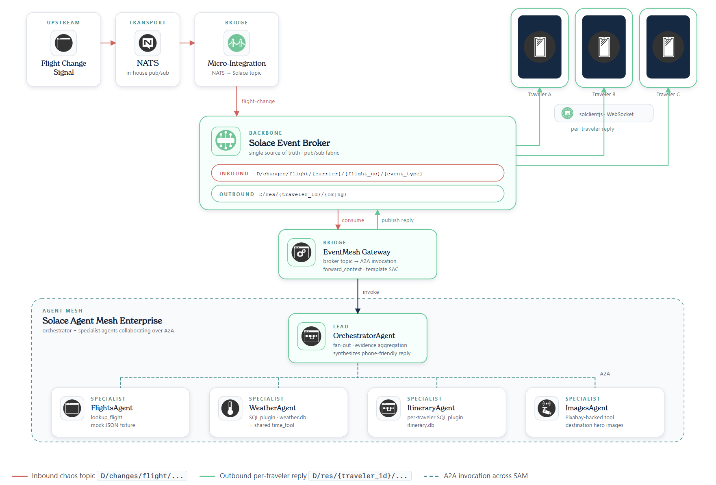
Architecture

Slide 4
Setup
Source code and setup instruction have been placed in the repository.

Slide 5
Live Demo

Slide 8
Appendix

