Slide 1



Mobility Models for UAV Group Reconnaissance Applications
University of Bordeaux 1 - Science and Technology
Erik Kuiper & Simin Nadjm-Tehrani
IEEE lecture 2006
By Paziewski Hayley, Etcheverry Jérémy, Tessier Alexis, Testa Mickaël, Castagnet Florian
22/01/2014
Responsible of Directed Works :
CHAUMETTE Serge and AUTEFAGE Vincent
Master 2 Computer Science
Study and Research Project
2013-2014

Slide 2
Plan
Context
Problematic
Study of existing
Our article
Models of our study
Experiments
Comparison of 2 models
Our Implementation
Conclusion

Slide 3
Context
UAV
Swarm of UAVs
Mobility models
➔ How do they move ?

Slide 4
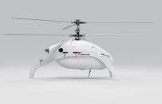
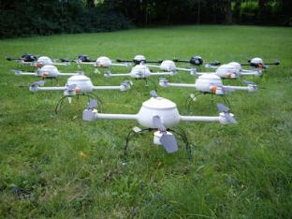
Problematic
Figure 1 . Source : "http://www.swiss-uav.com "
How well scan an area ?
As much and as quickly possible, in a limited time and at least,
once every hour.
Figure 2. Source : " http://technorati.com "

Slide 5

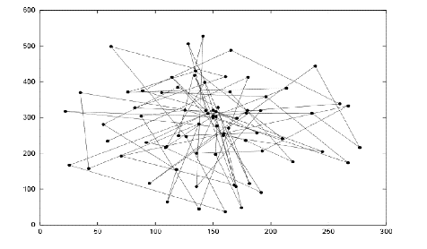
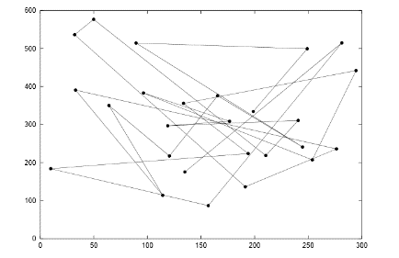
Study of existing
Existing Models
Random Walk
Random WayPoint
[1] : Result pattern of Random Walk
[2] : Result pattern of Random Walk

Slide 6
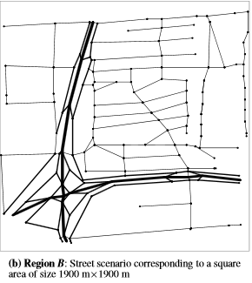
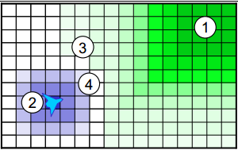
Study of existing
City Section
Distributed Pheromone Repel
[4] : Attractive and Repulsive Pheromones For Surveillance
Blue : repulsive
Green : attractive
[3] :

Slide 7
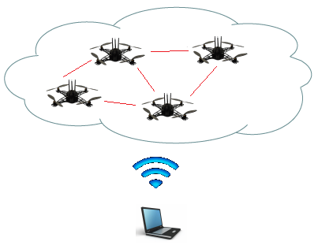
Our Article
Introduction
MANET
Mobile Ad Hoc Network
Networks of mobile entities
Collect, process and transmit data
UAV
Application of mobility models with UAVs
2 differents mobilities models
Random Waypoint
Distributed Pheromone Repel

Slide 8

Models of our study
Random Waypoint model
Each drones are independant
No backup position
Random target

Slide 9
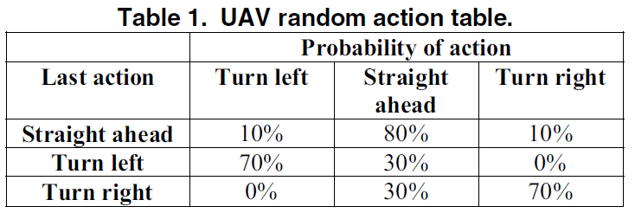
Models of our study
Random Waypoint model
From : “Mobility Models for UAV Group Reconnaissance Applications”
By : E. Kuiper and S. Nadjm-Tehrani.

Slide 10
Models of our study
Distributed Pheromone Repel model
Coordination of UAVs thanks to pheromones
Dynamic UAV

Slide 11
Models of our study
Distributed Pheromone Repel model
One pheromone map per UAV
Marks the areas when they have been scanned
Broadcast regularly a local area pheromone map (when a distance is inferior to 8 km)

Slide 12
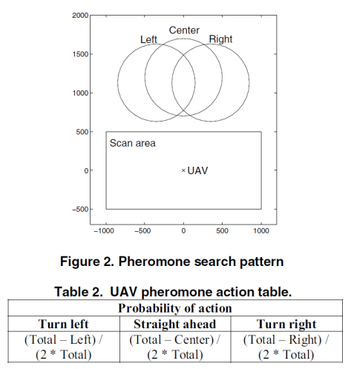
Models of our study
Distributed Pheromone Repel model
From : “Mobility Models for UAV Group Reconnaissance Applications”
By : E. Kuiper and S. Nadjm-Tehrani.

Slide 13
Experiments
Scenarios for the 2 models
Characteristics
Square with a side length of 30 Km
10 UAVs per run
Fixed wing aircraft
Requirements
Data must be returned to the C&C
No excessive use of bandwidth
(communication of 1 message/s/UAV)

Slide 14
Experiments
Expected results :
Scan the area in 40 min
Obtained results :
Mobilities Models | RandomWayPoint | Pheromone
Time to scan the area | 80% of the area in 120 min | 90% of the area in 50 min
Connectivity | Low | Low

Slide 15
Experiments
Limitations
Speed and shift (direction)
Coverage and connectivity of communications are two conflicting objectives.
Absolutely unrealistic !!!!!!

Slide 16
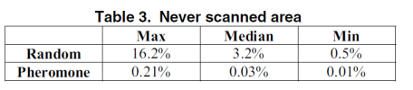
Comparison of 2 models
Scan characteristic
Both models manage quite well to avoid rescanning a recently scanned area.
From : “Mobility Models for UAV Group Reconnaissance Applications”
By : E. Kuiper and S. Nadjm-Tehrani.

Slide 17
Our Implementation
All models
Pheromone model
Everything was done
10 nodes/models
Margin calculation
Percentage of scan
Tracking display
Presence of C&C does not move
Communication

Slide 18
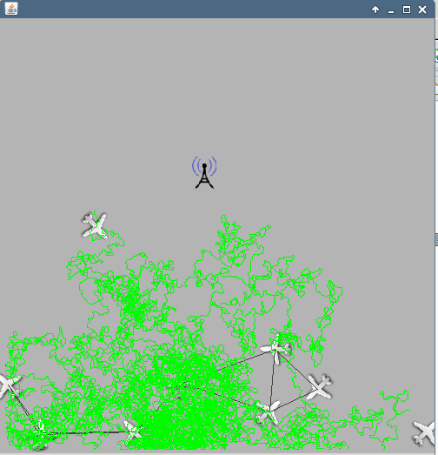
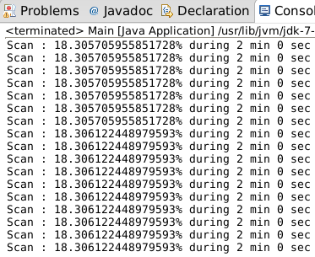
Our Implementation
JBotSim
Pheromone model

Slide 19
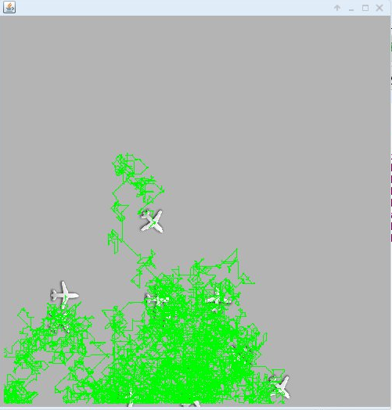
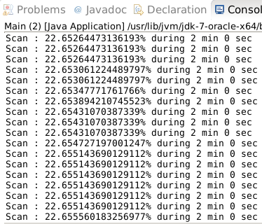
Our Implementation
JBotSim
Random Walk model

Slide 20
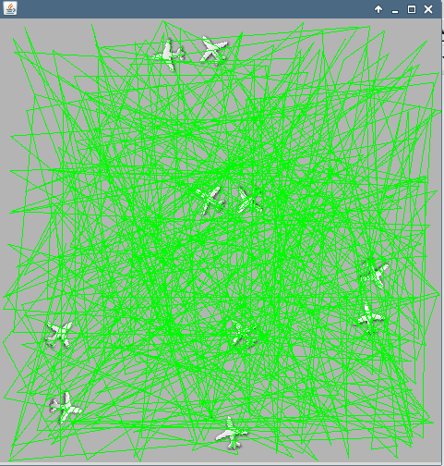
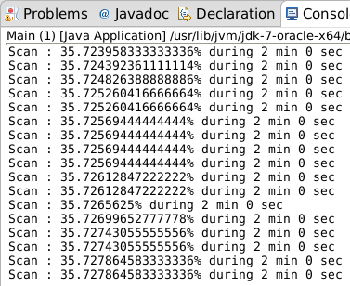
Our Implementation
JBotSim
Random Waypoint model

Slide 21
Our Implementation
Interpretation of results
At the beginning, Random model more efficiency
Pheromone : sharp increase because of C&C communication
At the end, random models are stable
Pheromone model is more effective that the others models to reach 100% of scan.

Slide 22
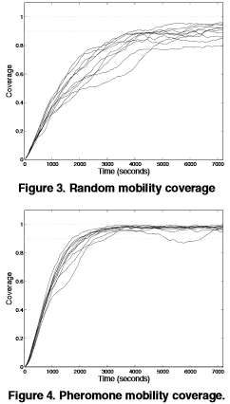
Our Implementation
Comparison with article

Slide 23
Our Implementation
Importance of the Mobility Model choosen
Mobility Model Scenarios | Semi-Random-Circular-Movement | Distributed Pheromone Repel | Smooth turn
Scan Coverage | X | X
Airborne Networks |  |  | X

Slide 24

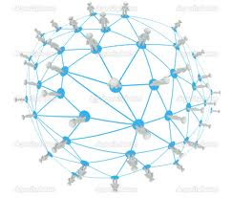
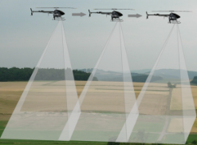
Conclusion
Good model for scan coverage and reconnaissance scenario.
Absolutely unrealistic
Possiblity amelioration is to temporary storage data and relax the limited bandwidth.
Figure 4. Source : " http://fr.depositphotos.com "
Figure 3. Source : " http://www.vikingaero.com "

Slide 25
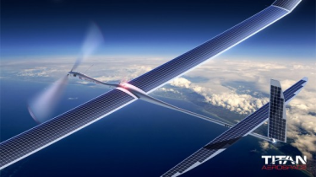
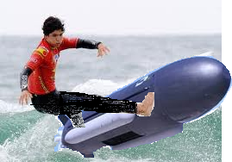
Do you have any questions ?
Figure 5. Source : " http://titanaerospace.com "
Figure 6.

Slide 26
Ressources
E. Kuiper and S. Nadjm-Tehrani.
Mobility models for uav group reconnaissance applications. In Wireless and Mobile Communications, 2006. ICWMC ’06. International Conference on, page 33, July 2006.
"http://dept-info.labri.fr/~desbarat/PER/sujets/Autefage1-article.pdf "
[1] && [2] : A. Jardosh, E. M. Belding-Royer, K. C. Almeroth, S. Suri. Towards Realistic Mobility Models for Mobile Ad Hoc Networks. 9th annual International Conference on Mobile Computing and Networking. September 2003. ACM Press
[3] A. K. Saha, D. B. Johnson. Modeling Mobility for Vehicular Ad Hoc Networks. First ACM Workshop on
Vehicular Ad Hoc Networks. October 2004. ACM Press
[4] J. A. Sauter, R. Matthews, H. V. D. Parunak, S. A.Brueckner. Performance of Digital Pheromones for Swarming Vehicle Control. Fourth International Joint Conference on Autonomous Agents and Multi-Agent
Systems. July, 2005. ACM Press

