Slide 1


Mobility Models for UAV Group Reconnaissance Applications
University of Bordeaux 1 - Science and Technology
By Paziewski Hayley, Etcheverry Jérémy, Tessier Alexis, Testa Mickaël, Castagnet Florian
26/11/2013
Responsible of TD:
Desbarats Pascal
Responsible of Directed Works :
CHAUMETTE Serge and AUTEFAGE Vincent
Master 2 Computer Science
Study and Research Project
2013-2014

Slide 2
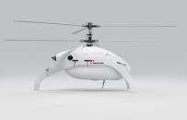
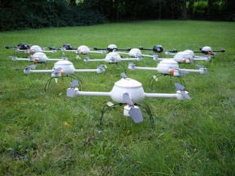
Problematic
Use mobility model that most closely matches the results of real-world scenario.

Slide 3

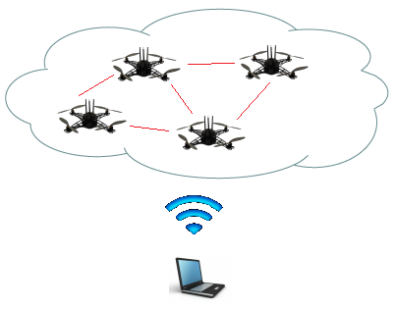
Introduction
MANET
Mobile Ad Hoc Network
Networks of mobile entities
Collect, process and transmit data
UAV
Application of mobility models with UAVs
2 differents mobility models
Random Waypoint
Distributed Pheromone Repel

Slide 4
Scenarios
Objectives
Scan area in a limited time
Scan the entire area regularly, but at least once every hour
Characteristics
Square with a side length of 30 Km
10 UAVs per run
Fixed wing aircraft
UAVs start at the middle of south edge

Slide 5

Scenarios
Requirements
UAVs are autonomous
Regularly scans
Randomness element in mobility models
Data must be returned to the C&C
Lost or unaivalable UAVs is not important
Communication bandwidth is limited

Slide 6
Models
Properties
Min an Max air speed and can’t changed direction in an instant
No collisions thanks to altitude adjustements
Flight altitude: 3500 meters (11 000 feet)
Flight speed: 150 km/h (41.7 m/s, 81.0 knots)
Turn radius: 500 meters
Infinite bandwidth between 2 UAV’s within 8000m
Scan zone 2000x1000 m

Slide 7
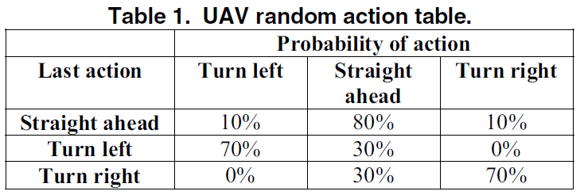
Models
Random Mobility Model

Slide 8
Models
Pheromone models
One pheromone map per UAV
Marks the areas when they have been scanned
Broadcast regularly a local area pheromone map

Slide 9
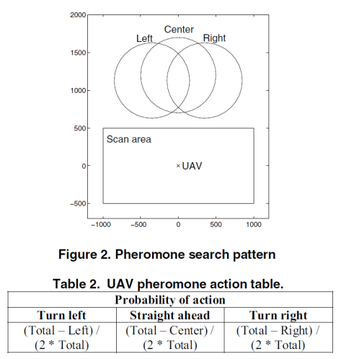
Models
Pheromone models

Slide 10

Evaluations
Scan coverage
Scan charateristic
Communication

Slide 11
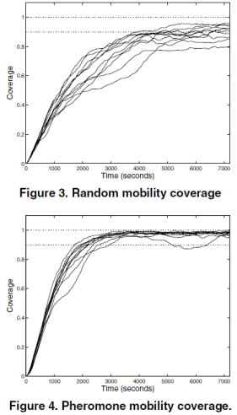
Evaluations
Scan Coverage
Theory : 900km² in 18 min
Prevision : 40 min because of several turnings
Rapidity of scanning : 0,083 km²/s per UAV

Slide 12
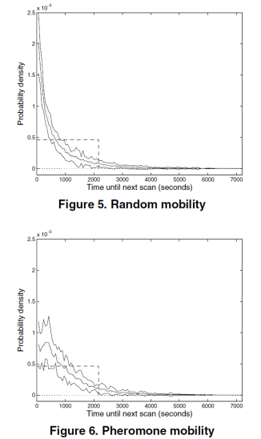
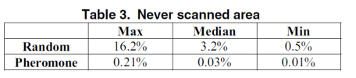
Evaluations
Scan characteristic
Both models manage quite well to avoid rescanning a recently scanned area
Pheromone > Random

Slide 13
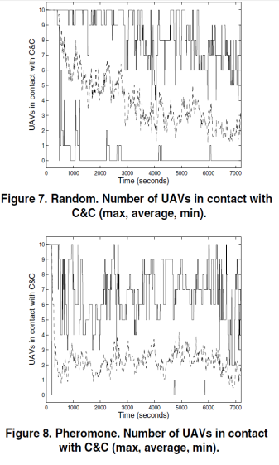
Evaluations
Communication
Low constant connectivity
More UAVs for a fully network connected

Slide 14

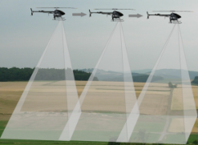
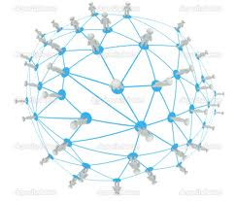
Conclusion
Good model for scan coverage and reconnaissance scenario …
… But coverage and connectivity of communications are two conflicting objectives.
Possiblity amelioration is to temporary storage data and relax the limited bandwidth.

Slide 15
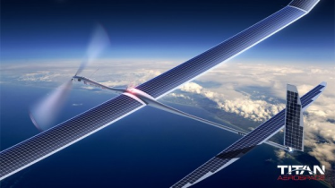
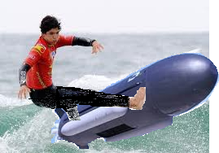
Do you have any questions ?

Slide 16
Notes:
Voici un autre exemple de diapositive de vue d’ensemble.

Slide 17
Nouveau travail
Notes:
Utiliser un en-tête de section pour chacun des sujets afin de définir une transition claire pour l’audience.

Slide 18
Notes:
Ajoutez des diapositives à chaque section de sujet, y compris des diapositives contenant des tableaux, des graphiques et des images.
Voir exemple dans la section suivante de tableau, de graphique, d’image et de vidéo.

Slide 19
Ressources
<Texte du site intranet ici> <lien hypertexte ici>
<Texte de support de lecture supplémentaire ici> <lien hypertexte ici>
Cet ensemble de diapositives et ressources connexes : <lien hypertexte ici>

Slide 20
Annexe
Notes:
Votre présentation est-elle aussi claire que possible ? Pensez à placer du contenu supplémentaire dans l’annexe.
Utilisez des diapositives en annexe pour y placer du contenu auquel vous pouvez faire référence pendant la diapositive relative aux questions ou que les participants peuvent approfondir ultérieurement.

