Slide 1


Mobility Models for UAV Group Reconnaissance Applications
Study and Research Project on paper
Erik Kuiper & Simin Nadjm-Tehrani
ICWMC 2006
By Castagnet Florian, Etcheverry Jérémy, Paziewski Hayley, Tessier Alexis,Testa Mickaël
Directors of tutorial classes :
AUTEFAGE Vincent and CHAUMETTE Serge
Master 2 Computer Science, Networks, Systems and Mobility
22/01/2014
2013-2014

Slide 2
Outline
Domain
Article
Our implementation
Conclusion

Slide 3
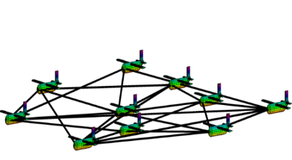
Domain
Article
Implementation
Conclusion
Context
UAV
Swarm of UAVs
Mobility models
➔ How do they move ?
Source : « http://rain.aa.washington.edu »

Slide 4
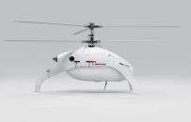
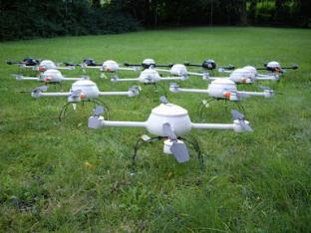
Domain
Article
Implementation
Conclusion
Problematics
Source : "http://www.swiss-uav.com "
How to scan an area properly ?
As much and as quickly possible, in a limited time and at least,
once every hour
Source : " http://technorati.com "

Slide 5

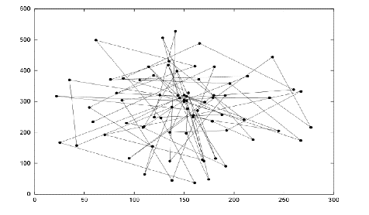
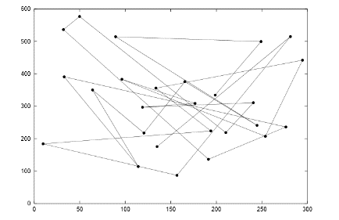
Domain
Article
Implementation
Conclusion
Study of existing models
Existing Models
Random Walk
Random WayPoint
Result pattern of random walk [2]
Result pattern of random waypoint [2]

Slide 6
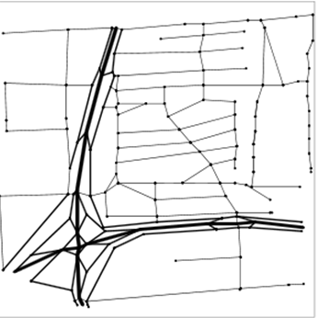
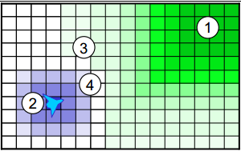
Domain
Article
Implementation
Conclusion
Study of existing models
City Section
Distributed Pheromone
Attractive and repulsive pheromones for surveillance [4]
Blue : repulsive
Green : attractive
Street scenario corresponding to a square area size 1900x1900 [3]

Slide 7
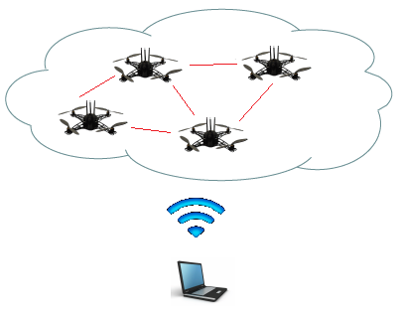

Domain
Article
Implementation
Conclusion
About the article
Introduction
MANET
Mobile Ad Hoc Network
Networks of mobile entities
Collect, process and transmit data
UAV
Application of mobility models with UAVs
2 different mobility models
Random Walk
Distributed Pheromone Repel

Slide 8
Domain
Article
Implementation
Conclusion
Models studied in the article
Random Walk model
Each drone is independent
No backup position
Random target
Result pattern of random walk [2]

Slide 9
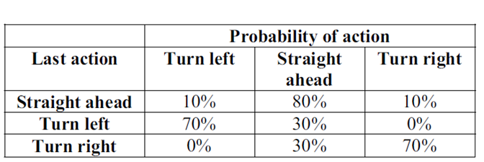
Domain
Article
Implementation
Conclusion
Models studied in the article
Random Walk model
UAV random action table [2]

Slide 10
Domain
Article
Implementation
Conclusion
Models studied in the article
Distributed Pheromone Repel model
Coordination of UAVs thanks to pheromones
Adaptative UAV

Slide 11
Domain
Article
Implementation
Conclusion
Models studied in the article
Distributed Pheromone Repel model
One pheromone map per UAV
Marks the areas when they have been scanned
Regularly broadcast a local area pheromone map (when a distance is inferior to 8 km between two UAVs)

Slide 12
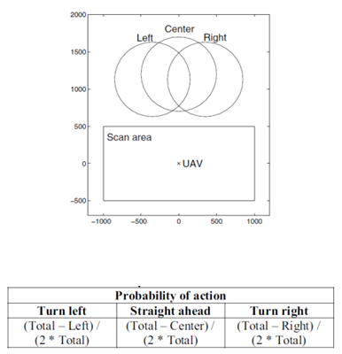
Domain
Article
Implementation
Conclusion
Models studied in the article
Distributed Pheromone Repel model
Pheromone search pattern [1]
UAV pheromone action table [1]

Slide 13
Domain
Article
Implementation
Conclusion
Experiments
Scenarios for the 2 models
Characteristics
Square with a side length of 30 Km
10 UAVs per run
Fixed wing aircraft
Requirements
Data must be returned to the C&C
No excessive use of bandwidth
(no quantification in the article)
1
1 : Command and Controler center

Slide 14
Domain
Article
Implementation
Conclusion
Experiments
Expected results :
Scan the area in 40 min
Obtained results :
Mobilities Models | RandomWalk | Pheromone
Time to scan the area | 80% of the area in 120 min | 90% of the area in 50 min
Connectivity | Low | Low

Slide 15
Domain
Article
Implementation
Conclusion
Experiments
Our point of view about limitations
Speed and shift (direction)
Coverage and connectivity of communications are two conflicting objectives
Comparison between pheromone and random model is not adapted
Communication between UAVs are unrealistic

Slide 16

Domain
Article
Implementation
Conclusion
Comparison of 2 models
Scan characteristic
Both models manage quite well to avoid rescanning a recently scanned area
Never scanned area [1]

Slide 17
Domain
Article
Implementation
Conclusion
Our Implementation
All models
Pheromone model
Everything was done
10 nodes/models
Rebound method
Percentage of scan
Tracking display
Communication between UAVs

Slide 18
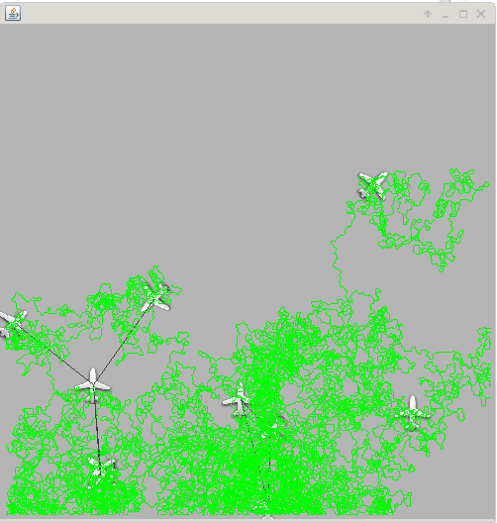
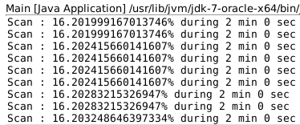
Domain
Article
Implementation
Conclusion
Our Implementation
JBotSim view
Pheromone model

Slide 19
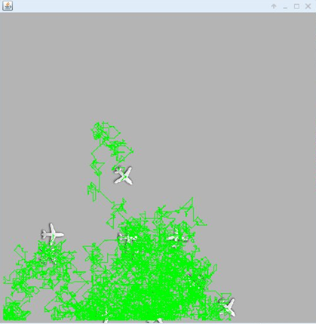
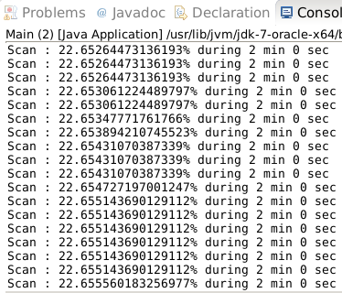
Domain
Article
Implementation
Conclusion
Our Implementation
JBotSim view
Random Walk model

Slide 20
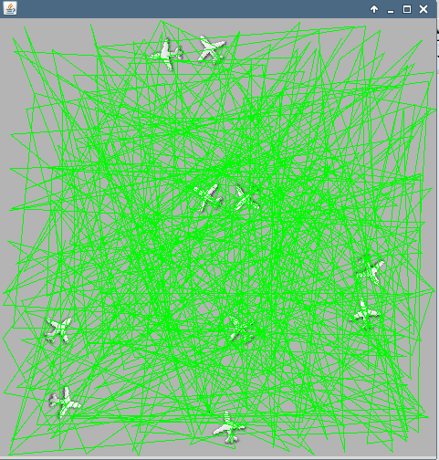
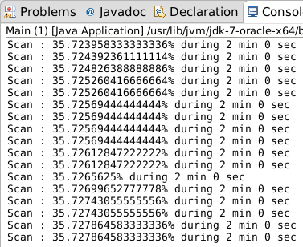
Domain
Article
Implementation
Conclusion
Our Implementation
JBotSim view
Random Waypoint model

Slide 21
Domain
Article
Implementation
Conclusion
Our Implementation
Interpretation of results
At the beginning, the Random models are more efficients
At the end, random models are stable
Pheromone model is more effective than the others models to reach 100% of scan

Slide 22
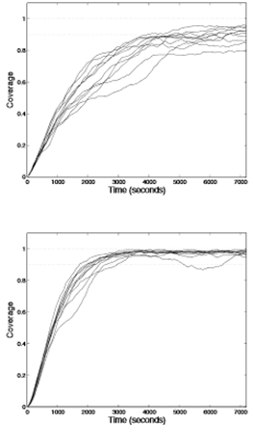
Domain
Article
Implementation
Conclusion
Our Implementation
Comparison with article
Random mobility coverage [1]
Pheromone mobility coverage [1]

Slide 23
Domain
Article
Implementation
Conclusion
Our Implementation
Importance of the Mobility Model choosen
Mobility Model Scenarios | Semi-Random-Circular-Movement | Distributed Pheromone Repel | Smooth turn
Scan Coverage | ✓ | ✓
Airborne Networks |  |  | ✓

Slide 24

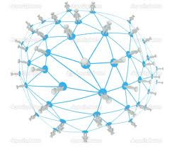
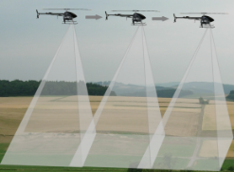
Domain
Article
Implementation
Conclusion
Conclusion
Good model for scan coverage and reconnaissance scenario
Characteristics of evaluation and experiments are unrealistic
Possible improvement is to store and forward data and relax the limited bandwidth
Source : " http://www.vikingaero.com "
Source : " http://fr.depositphotos.com "

Slide 25
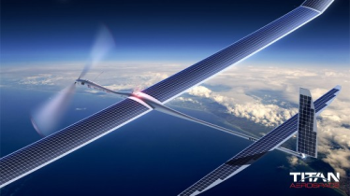
Do you have any questions ?
Source : " http://titanaerospace.com "

Slide 26
References
E. Kuiper and S. Nadjm-Tehrani.
[1] Mobility models for uav group reconnaissance applications. In Wireless and Mobile Communications, 2006. ICWMC ’06. International Conference on, page 33, July 2006.
"http://dept-info.labri.fr/~desbarat/PER/sujets/Autefage1-article.pdf "
[2] : A. Jardosh, E. M. Belding-Royer, K. C. Almeroth, S. Suri. Towards Realistic Mobility Models for Mobile Ad Hoc Networks. 9th annual International Conference on Mobile Computing and Networking. September 2003. ACM Press
[3] A. K. Saha, D. B. Johnson. Modeling Mobility for Vehicular Ad Hoc Networks. First ACM Workshop on
Vehicular Ad Hoc Networks. October 2004. ACM Press
[4] J. A. Sauter, R. Matthews, H. V. D. Parunak, S. A.Brueckner. Performance of Digital Pheromones for Swarming Vehicle Control. Fourth International Joint Conference on Autonomous Agents and Multi-Agent
Systems. July, 2005. ACM Press

