Slide 1


Mobility Models for UAV Group Reconnaissance Applications
Study and Research Project on paper
Erik Kuiper & Simin Nadjm-Tehrani
ICWM 2006
By Castagnet Florian, Etcheverry Jérémy, Paziewski Hayley, Tessier Alexis,Testa Mickaël
Directors of tutorial classes :
AUTEFAGE Vincent and CHAUMETTE Serge
Master 2 Computer Science, Network, System and Mobility
22/01/2014
2013-2014

Slide 2
Outline
Context
Problematics
Study of existing models
Our article studied
Models of our study
Experiments
Comparison of 2 models
Our Implementation
Conclusion

Slide 3
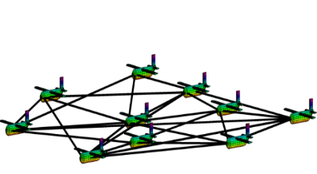
Context
UAV
Swarm of UAVs
Mobility models
➔ How do they move ?
Figure 1. Source : http://rain.aa.washington.edu"

Slide 4
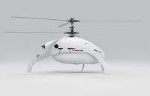
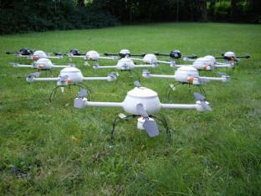
Problematics
Figure 2 . Source : "http://www.swiss-uav.com "
How to scan an area properly ?
As much and as quickly possible, in a limited time and at least,
once every hour.
Figure 3. Source : " http://technorati.com "

Slide 5

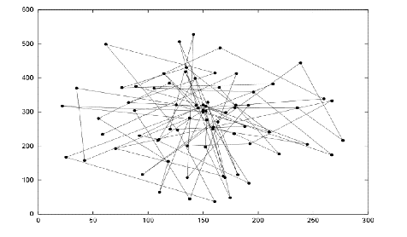
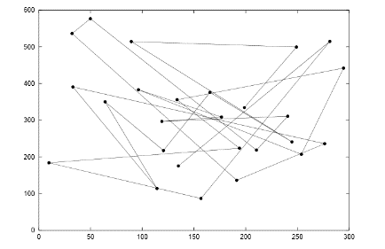
Study of existing models
Existing Models
Random Walk
Random WayPoint
[1] : Result pattern of Random Walk
[2] : Result pattern of Random Waypoint

Slide 6
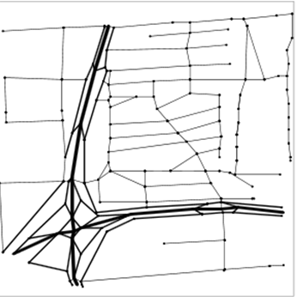
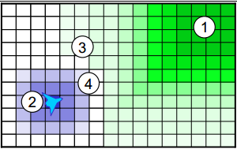
Study of existing models
City Section
Distributed Pheromone
[4] : Attractive and Repulsive Pheromones For Surveillance
Blue : repulsive
Green : attractive
[3] : Street scenario corresponding to a square area size 1900x1900

Slide 7
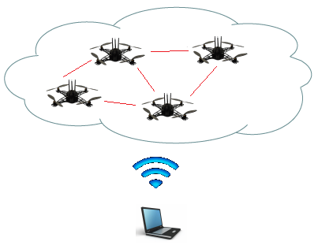
About the article
Introduction
MANET
Mobile Ad Hoc Network
Networks of mobile entities
Collect, process and transmit data
UAV
Application of mobility models with UAVs
2 different mobility models
Random Waypoint
Distributed Pheromone Repel

Slide 8

Models from the article
Models of our study
Random Waypoint model
Each drone is independent
No backup position
Random target

Slide 9
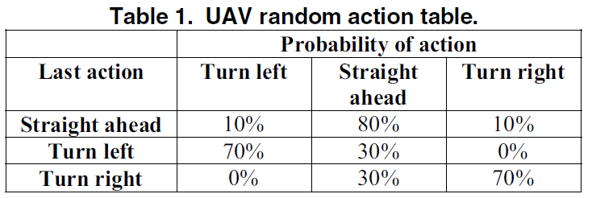
Models from the article
Models of our study
Random Waypoint model
From : “Mobility Models for UAV Group Reconnaissance Applications”
By : E. Kuiper and S. Nadjm-Tehrani.

Slide 10
Models from the article
Models of our study
Distributed Pheromone Repel model
Coordination of UAVs thanks to pheromones
Adaptative
UAV
[2] : Result pattern of Random Waypoint

Slide 11
Models from the article
Models of our study
Distributed Pheromone Repel model
One pheromone map per UAV
Marks the areas when they have been scanned
Regularly broadcast a local area pheromone map (when a distance is inferior to 8 km between two UAVs)

Slide 12
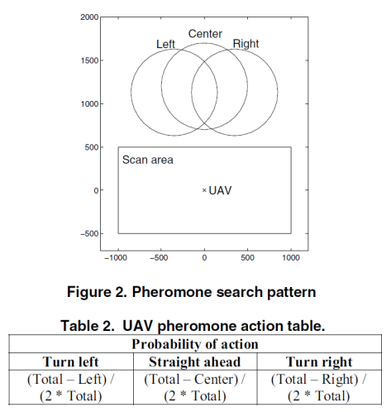
Models from the article
Models of our study
Distributed Pheromone Repel model
From : “Mobility Models for UAV Group Reconnaissance Applications”
By : E. Kuiper and S. Nadjm-Tehrani.

Slide 13
Experiments from the article
Experiments
Scenarios for the 2 models
Characteristics
Square with a side length of 30 Km
10 UAVs per run
Fixed wing aircraft
Requirements
Data must be returned to the C&C
No excessive use of bandwidth
(no quantification in the article)
1
1 : Command and Controler center

Slide 14
Experiments from the article
Experiments
Expected results :
Scan the area in 40 min
Obtained results :
Mobilities Models | RandomWalk | Pheromone
Time to scan the area | 80% of the area in 120 min | 90% of the area in 50 min
Connectivity | Low | Low

Slide 15
Experiments from the article
Experiments
Our point of view about limitations
Speed and shift (direction)
Coverage and connectivity of communications are two conflicting objectives.
Comparison between pheromone and random model not adapted
Communication between UAVs are unrealistic

Slide 16
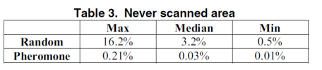
Experiments from the article
Comparison of 2 models
Scan characteristic
Both models manage quite well to avoid rescanning a recently scanned area.
From : “Mobility Models for UAV Group Reconnaissance Applications”
By : E. Kuiper and S. Nadjm-Tehrani.

Slide 17
Our Work
Our Implementation
All models
Pheromone model
Everything was done
10 nodes/models
Rebound method
Percentage of scan
Tracking display
Presence of C&C does not move
Communication

Slide 18
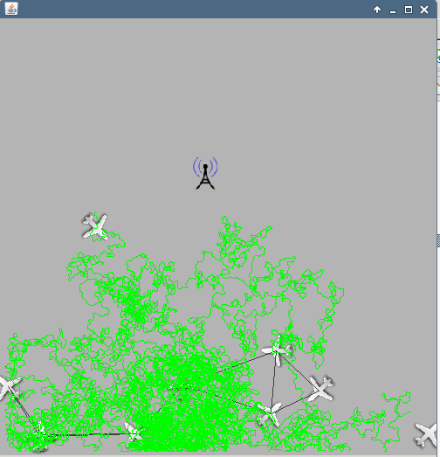
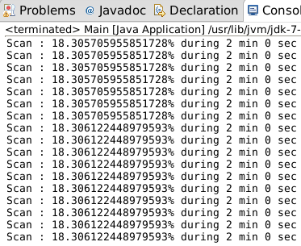
Our Work
Our Implementation
JBotSim
Pheromone model

Slide 19
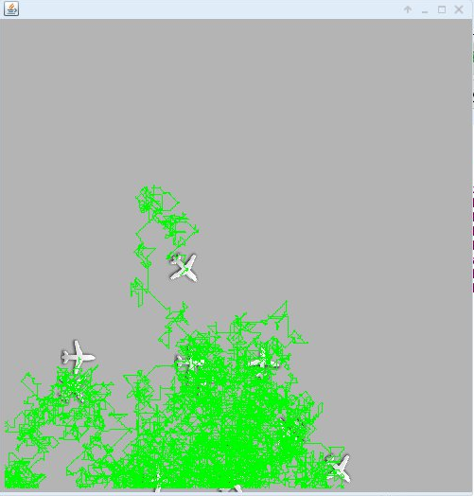
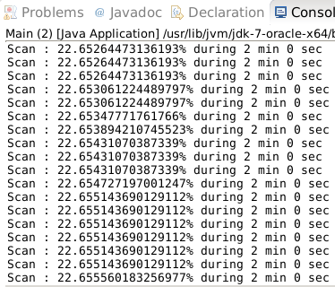
Our Work
Our Implementation
JBotSim
Random Walk model

Slide 20
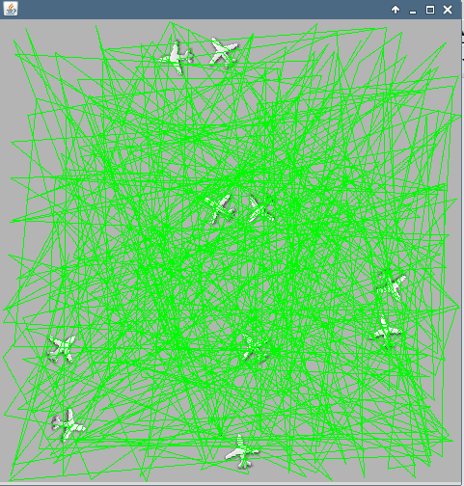
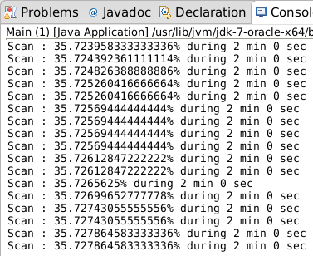
Our Work
Our Implementation
JBotSim
Random Waypoint model

Slide 21
Our Work
Our Implementation
Interpretation of results
At the beginning, the Random models are more efficients
At the end, random models are stable
Pheromone model is more effective than the others models to reach 100% of scan.

Slide 22
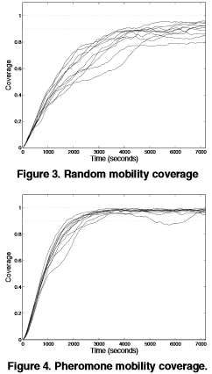
Our Work
Our Implementation
Comparison with article

Slide 23
Our Work
Our Implementation
Importance of the Mobility Model choosen
Mobility Model Scenarios | Semi-Random-Circular-Movement | Distributed Pheromone Repel | Smooth turn
Scan Coverage | X | X
Airborne Networks |  |  | X

Slide 24

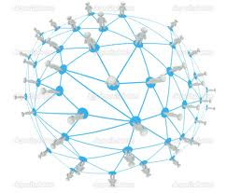
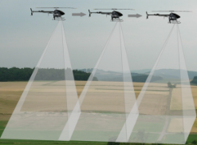
Conclusion
Good model for scan coverage and reconnaissance scenario.
Characteristics of evaluation and experiments are unrealistic
Possible improvement is to store and forward data and relax the limited bandwidth.
Figure 4. Source : " http://fr.depositphotos.com "
Figure 5. Source : " http://www.vikingaero.com "

Slide 25
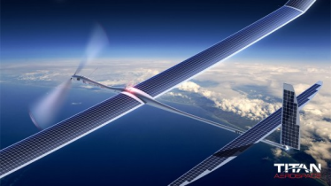
Do you have any questions ?
Figure 6. Source : " http://titanaerospace.com "

Slide 26
References
E. Kuiper and S. Nadjm-Tehrani.
Mobility models for uav group reconnaissance applications. In Wireless and Mobile Communications, 2006. ICWMC ’06. International Conference on, page 33, July 2006.
"http://dept-info.labri.fr/~desbarat/PER/sujets/Autefage1-article.pdf "
[1] && [2] : A. Jardosh, E. M. Belding-Royer, K. C. Almeroth, S. Suri. Towards Realistic Mobility Models for Mobile Ad Hoc Networks. 9th annual International Conference on Mobile Computing and Networking. September 2003. ACM Press
[3] A. K. Saha, D. B. Johnson. Modeling Mobility for Vehicular Ad Hoc Networks. First ACM Workshop on
Vehicular Ad Hoc Networks. October 2004. ACM Press
[4] J. A. Sauter, R. Matthews, H. V. D. Parunak, S. A.Brueckner. Performance of Digital Pheromones for Swarming Vehicle Control. Fourth International Joint Conference on Autonomous Agents and Multi-Agent
Systems. July, 2005. ACM Press

