Slide 1
SER598 Project Presentation
Advanced Browser Features: Web Extensions

Slide 2
A Comprehensive Guide to Browser Extensions
Core Objective: To teach developers exactly what browser extensions are and how to build them from scratch.
Phase 1: Getting Started:
  A comprehensive "Follow Along" tutorial.
  Building a basic extension to understand the architecture.
Phase 2: Capabilities:
  exploring what modern extensions can actually do (beyond just bookmarks).
Phase 3: Real-Time Analytics:
  The Final Build: Creating a powerful tool that monitors and visualizes network traffic in real-time.

Slide 3



What is an Extension?
The 3 Ingredients:
How to Run It:
Manifest File: The settings & permissions.
Scripts: The logic (JavaScript).
Popup: The look & feel (HTML/CSS).
Turn on "Developer Mode" in Chrome.
Click "Load Unpacked".
Done!
It's basically just a small website that lives inside your browser.

Slide 4
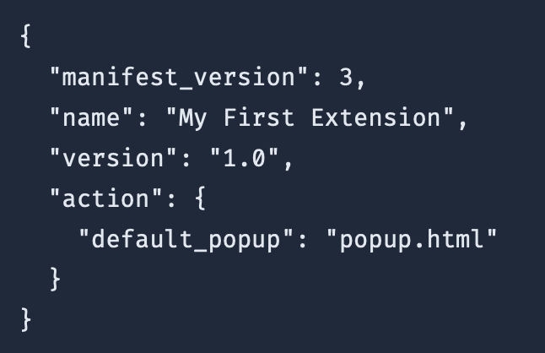
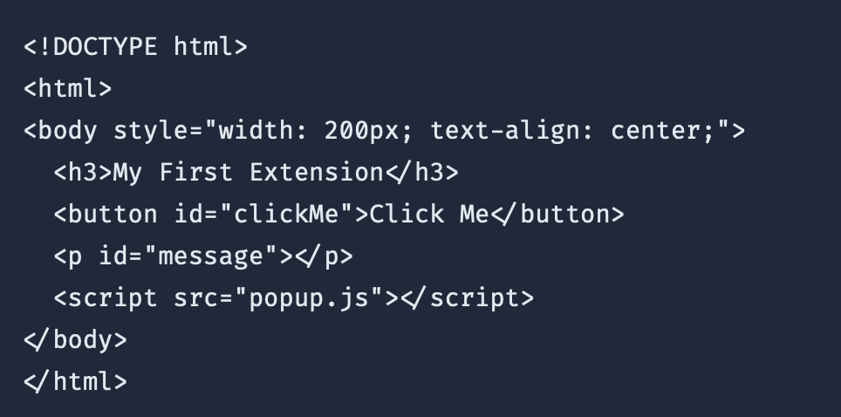
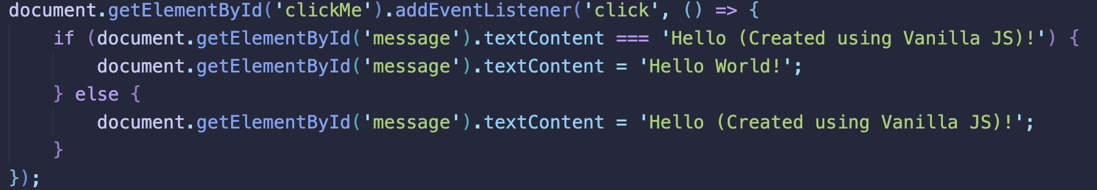
Code for manifest.json, popup.html, pop.js
Notes:
Here is the actual code. It's incredibly minimal.
On the left, you see the structure. You purely need a folder with a few files.
On the right is the Manifest V3. This is the heart of the extension.
We declare
manifest_version: 3
(the modern standard).
We give it a name.
And we tell Chrome: 'When the user clicks the icon, show
popup.html'.
That's literally all you need to get started.

Slide 5
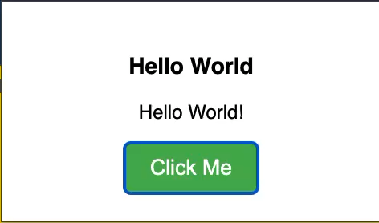
How the extension should look and work like

Slide 6
Real World Capabilities
It's More Than Just Popups:
  Extensions can interact with the browser in powerful ways.
Core Capabilities (The APIs):
  Storage API: Saving user settings (Syncs across devices).
  Content Scripts: Injecting code into other websites (e.g., changing colors on Google.com).
  Context Menus: Adding custom right-click options.
The Foundation: Use these building blocks to create complex apps.
Notes:
So we have a basic popup, but real extensions do much more.
In the tutorial, we explore three powerful capabilities:
Storage, which lets us save data that syncs across all your computers.
Content Scripts, which let us inject our own code into websites like Google or Facebook to modify them.
Context Menus, adding custom right-click actions.
These are the building blocks we need for our final project.

Slide 7
Project: Web Analytics/Web Observability Tool
We Built a "Web Observability" tool.
The Problem:
  Websites load dozens of invisible trackers (Ads, Analytics, Beacons).
  Users have no visibility into this traffic.
Our Solution:
  Listen: Use
  chrome.webRequest
  to watch network traffic in real-time.
  Analyze: Detect 3rd-party domains.
  Visualize: Use Vue.js 3 to render a live dashboard.
Notes:
For the final capstone of the tutorial, we build something real: A Web Analytics Tool.
The problem is that the modern web is opaque. You visit a news site, and 50 different trackers load in the background.
Our extension solves this by acting as a network monitor.
It listens to every network request leaving the browser.
It analyzes the destination.
And it uses a modern Vue.js interface to visualize that data in real-time, giving the user total transparency.

Slide 8
A Brief History
The Dark Ages:
  IE: Used C++ (ActiveX). Secure? No.
  Firefox: Used XUL (XML). Compatible? No.
  Chrome: Built the proprietary precursor to modern extensions.
The Turning Point:
  W3C WebExtensions Standard:
  Apple, Google, Microsoft, and Mozilla agreed on a Standard.
  Now: Code Once, Run Everywhere (mostly).
Notes:
I want to take a step back and talk about why this is impressive. Ten years ago, writing an extension was a nightmare. You had to write C++ for Internet Explorer and weird XML for Firefox. nothing was compatible. Today, thanks to the W3C standard, we can write standard JavaScript that runs on Chrome, Edge, Safari, and Firefox. That standardization is what made this project possible.

Slide 9
Manifest V2 vs V3
The Shift: Moving from Persistent Background Pages to Service Workers.
Why Change?
  Performance: Service workers sleep when not in use (Saves RAM).
  Security: Remote Code (CDNs) is now DISALLOWED.
The "AdBlock" Problem:
  Old: Pause request → Checked by JS → Blocked. (Slow).
  New: Provide a Rule List → Browser Blocks. (Fast & Private).
Notes:
However, the ecosystem is currently going through a massive shift called Manifest V3. It fundamentally changes the architecture. Extensions don't run forever anymore; they are 'Serverless'—they wake up, do work, and die to save memory. It also bans remote code and changes how AdBlocking works, prioritizing user privacy over extension power. This is why V3 has been so controversial.

Slide 10


Conclusion
What We Learned:
Final Thoughts:
Architecture: Service Worker Lifecycle.
Async Logic: Promises vs Callbacks.
Privacy: The power of ’webRequest’ observability.
Extensions are the most powerful tool a web developer has to control their experience.
Notes:
In conclusion, building this project taught me that the browser is a complex operating system. We learned about the ephemeral lifecycle of Service Workers, the strict security of CSP, and the power of observability. I'll leave you with a quick demo of the final tool working in action. Thank you.

