Slide 1
Before Normalization
Doctor Table
DOCTOR_ID | DOCTOR_NAME | DOCTOR_PHONE | SPECIALTY | SPECIALTY_NUM
Patient Table
PATIENT_ID | PATIENT_NAME | PATIENT_PHONE | PATIENT_EMAIL | PATIENT_ADDRESS | DATE＿ADDED | ALLERGY | DOCTOR_ID
Appointment Table
APPOINTMENT_ID | APPOINTMENT_DATE | PATIENT_ID | DOCTOR_ID | TREATMENT_INFO | PULSE | BLOOD_PRESSURE | MEDICINE

Slide 2
Issue of current tables
Doctor Table
DOCTOR_ID | DOCTOR_NAME | DOCTOR_PHONE | SPECIALTY | SPECIALTY_NUM
Patient Table
PATIENT_ID | PATIENT_NAME | PATIENT_PHONE | PATIENT_EMAIL | PATIENT_ADDRESS | DATE＿ADDED | ALLERGY | DOCTOR_ID
Appointment Table
APPOINTMENT_ID | APPOINTMENT_DATE | PATIENT_ID | DOCTOR_ID | TREATMENT_INFO | PULSE | BLOOD_PRESSURE | MEDICINE
The issue at this phase is the list value of ALLEGY and MEDICINE in patient and appointment tables. Those attributes store the value as repeated data in one cell, which should be solved with 1 normalization form.

Slide 3
1NF added two tables for each allergy and medicine list which has n number of columns depending on the business requirement from hospital. Instead of allergy and medicine attributes, HAS_ALLERGY and HAS_MEDICINE are added. Those types are boolean and these value can be used to control the data manipulation to the allergy and medicine tables. For instance, if HAS_ALLERGY is false, users are not allowed to add data to the allergy table with the id.
After 1 Normalization Form
Doctor Table
DOCTOR_ID | DOCTOR_NAME | DOCTOR_PHONE | SPECIALTY | SPECIALTY_NUM
Patient Table
PATIENT_ID | PATIENT_NAME | PATIENT_PHONE | PATIENT_EMAIL | PATIENT_ADDRESS | DATE＿ADDED | HAS_ALLERGY | DOCTOR_ID
Appointment Table
APPOINTMENT_ID | APPOINTMENT_DATE | PATIENT_ID | DOCTOR_ID | TREATMENT_INFO | PULSE | BLOOD_PRESSURE | HAS_MEDICINE
Allergy Table
Medicine Table
PATIENT_ID | Allergy_1 | Allergy_2
Allergy_n
APPOINTMENT_ID | Medicine_1 | Medicine_2
Medicine_n
…
…

Slide 4
Already 2 Normalization Form
Obviously, there is only one primary key for each table, which means there is no partial functional dependency. Therefore, the tables can be said to be 2 NF already.
Doctor Table
DOCTOR_ID | DOCTOR_NAME | DOCTOR_PHONE | SPECIALTY | SPECIALTY_NUM
Patient Table
PATIENT_ID | PATIENT_NAME | PATIENT_PHONE | PATIENT_EMAIL | PATIENT_ADDRESS | DATE＿ADDED | HAS_ALLERGY | DOCTOR_ID
Appointment Table
APPOINTMENT_ID | APPOINTMENT_DATE | PATIENT_ID | DOCTOR_ID | TREATMENT_INFO | PULSE | BLOOD_PRESSURE | HAS_MEDICINE
Allergy Table
Medicine Table
PATIENT_ID | Allergy_1 | Allergy_2
Allergy_n
APPOINTMENT_ID | Medicine_1 | Medicine_2
Medicine_n
…
…

Slide 5
Before 3 Normalization Form
There are a few attribute that have dependencies on attributes other than primary key, which means there is a necessity of 3 normalization form. But I need to be care full about over-normalization. I circled one dependency that should be separated.
Doctor Table
DOCTOR_ID | DOCTOR_NAME | DOCTOR_PHONE | SPECIALTY | SPECIALTY_NUM
Patient Table
PATIENT_ID | PATIENT_NAME | PATIENT_PHONE | PATIENT_EMAIL | PATIENT_ADDRESS | DATE＿ADDED | HAS_ALLERGY | DOCTOR_ID
Appointment Table
APPOINTMENT_ID | APPOINTMENT_DATE | PATIENT_ID | DOCTOR_ID | TREATMENT_INFO | PULSE | BLOOD_PRESSURE | HAS_MEDICINE
Allergy Table
Medicine Table
PATIENT_ID | Allergy_1 | Allergy_2
Allergy_n
APPOINTMENT_ID | Medicine_1 | Medicine_2
Medicine_n
…
…

Slide 6
As the red circle below shows, I added specialty table with specialty number as primary key. The reason why I chose the specialty number as primary key is data type integer must be smaller size than strings type, specialty itself.
After 3 Normalization Form
Doctor Table
Specialty Table
DOCTOR_ID | DOCTOR_NAME | DOCTOR_PHONE | SPECIALTY_NUM
SPECIALTY_NUM | Specialty_1 | Specialty_2
Specialty_n
…
Patient Table
PATIENT_ID | PATIENT_NAME | PATIENT_PHONE | PATIENT_EMAIL | PATIENT_ADDRESS | DATE＿ADDED | HAS_ALLERGY | DOCTOR_ID
Appointment Table
APPOINTMENT_ID | APPOINTMENT_DATE | PATIENT_ID | DOCTOR_ID | TREATMENT_INFO | PULSE | BLOOD_PRESSURE | HAS_MEDICINE
Allergy Table
Medicine Table
PATIENT_ID | Allergy_1 | Allergy_2
Allergy_n
APPOINTMENT_ID | Medicine_1 | Medicine_2
Medicine_n
…
…

Slide 7
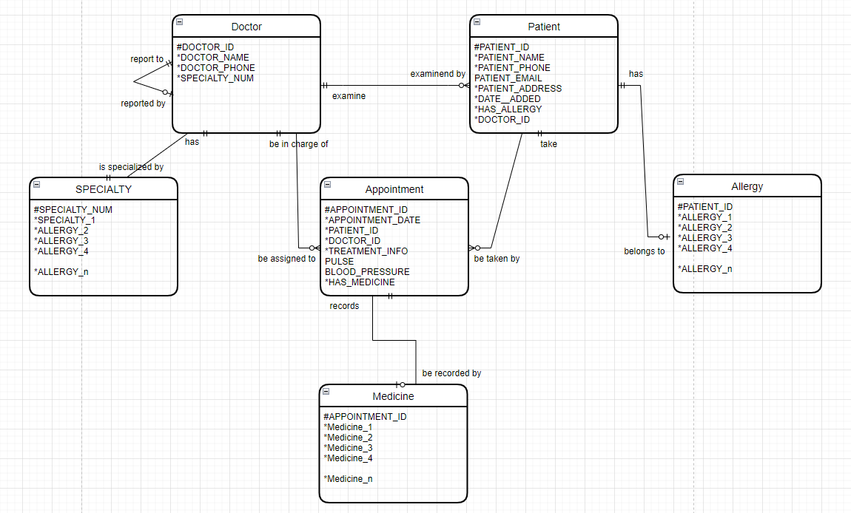
Entity diagram after normalizations

