Slide 1
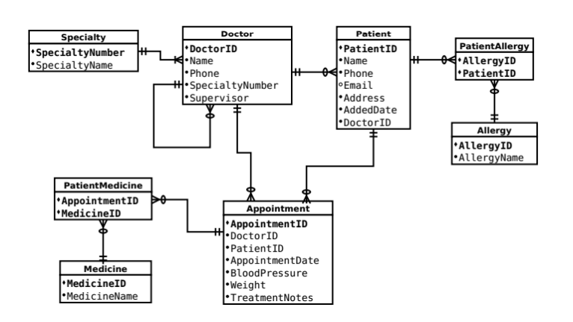
3
10
11
1
5
7
13
2
14
6
9
12
4
8
16
23
27
24
15
28
25
17
26
20
18
35
19
36
22
29
21
30
33
34
31
32

Slide 2
One doctor must have a maximum of one specialty
One doctor must have a valid specialty and it must not be null
A specialty can have many doctors
A specialty must have a valid doctor and it must not be null
One patient must be associated with a maximum of one doctor
One patient must have a valid doctor and it must not be null
A doctor can have many patients
A doctor does not need to have patients to be a doctor
One patient allergy data must have a maximum of one patient
One patient allergy must have a valid patient and it must not be null
A patient can have many patient allergy since one patient can have more than one allergies.
A patient does not need to have allergies to be a patient
One patient allergy data must have a maximum of one allergy data
One patient allergy must have a valid allergy data and it must not be null
An allergy can have many patient allergy data since an allergy is not specific to the one people
An allergy does not need to have patient allergy data to be an allergy
One appointment must have a maximum of one patient
One appointment must have a valid patient and it must not be null
A patient can have many appointments since one patient can have more than one appointments.
A patient does not need to have appointments to be a patient
One appointment must have a maximum of one doctor
One appointment must have a valid doctor and it must not be null
A doctor can have many appointments since one doctor can have more than one appointments.
A doctor does not need to have appointments to be a doctor
One doctor must have a maximum of one doctor as a supervisor
One doctor must have a valid doctor as a supervisor and it must not be null
A doctor as a supervisor can have many doctors since one doctor can supervise more than one doctors.
A doctor does not need to have doctors to supervisor to be a doctor
One medicine patient data must have a maximum of one appointment
One medicine patient data must have a valid appointment and it must not be null
An appointment can have many medicine patient data since in one appointment more than one medicines can be prescribed to patients
An appointment does not need to have patient medicine data to be recorded as an appointment
One medicine patient data must have a maximum of one medicine data
One medicine patient data must have a valid medicine data and it must not be null
A medicine can have many medicine patient data since a medicine is not specific to the one people
A medicine does not need to have medicine patient data to be recorded a medicine since there can be a medicine that has never been prescribed to patients.

Slide 3
Explain why the PatientMedicine and PatientAllergy relations were created
It can be explained quite well with my submit that had a mistake on this point. In my assignment, I prepared the table of allergy that contained attributes, patientID and allergy_1, allergy_2, allergy_N. And I associated this table to a patient. In this form of table, the same type of allergies can be repeated in tables across various number of patients, which can be said as a multiple – multiple relationship. In other words, one patient can more than one allergies, while one allergy can occur to more than one patients. Therefore, in order to normalize the table in proper way, PatientAllergy as well as PatientMedicine , should be created as an intermediate table. This is why those two tables are created.

