Slide 1
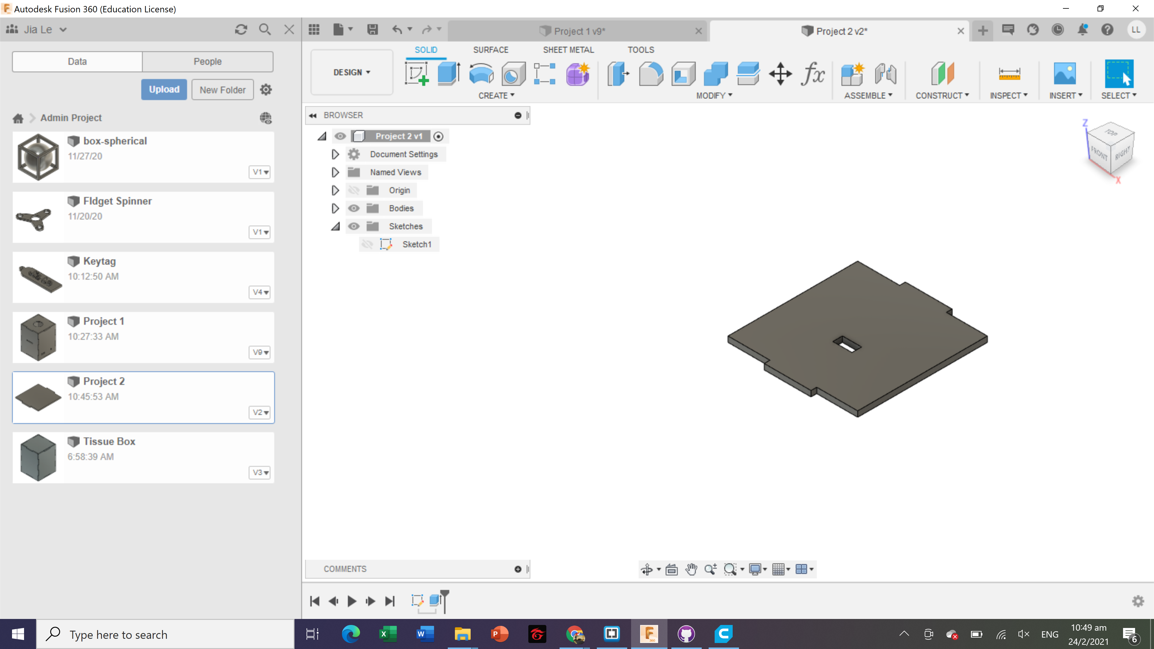
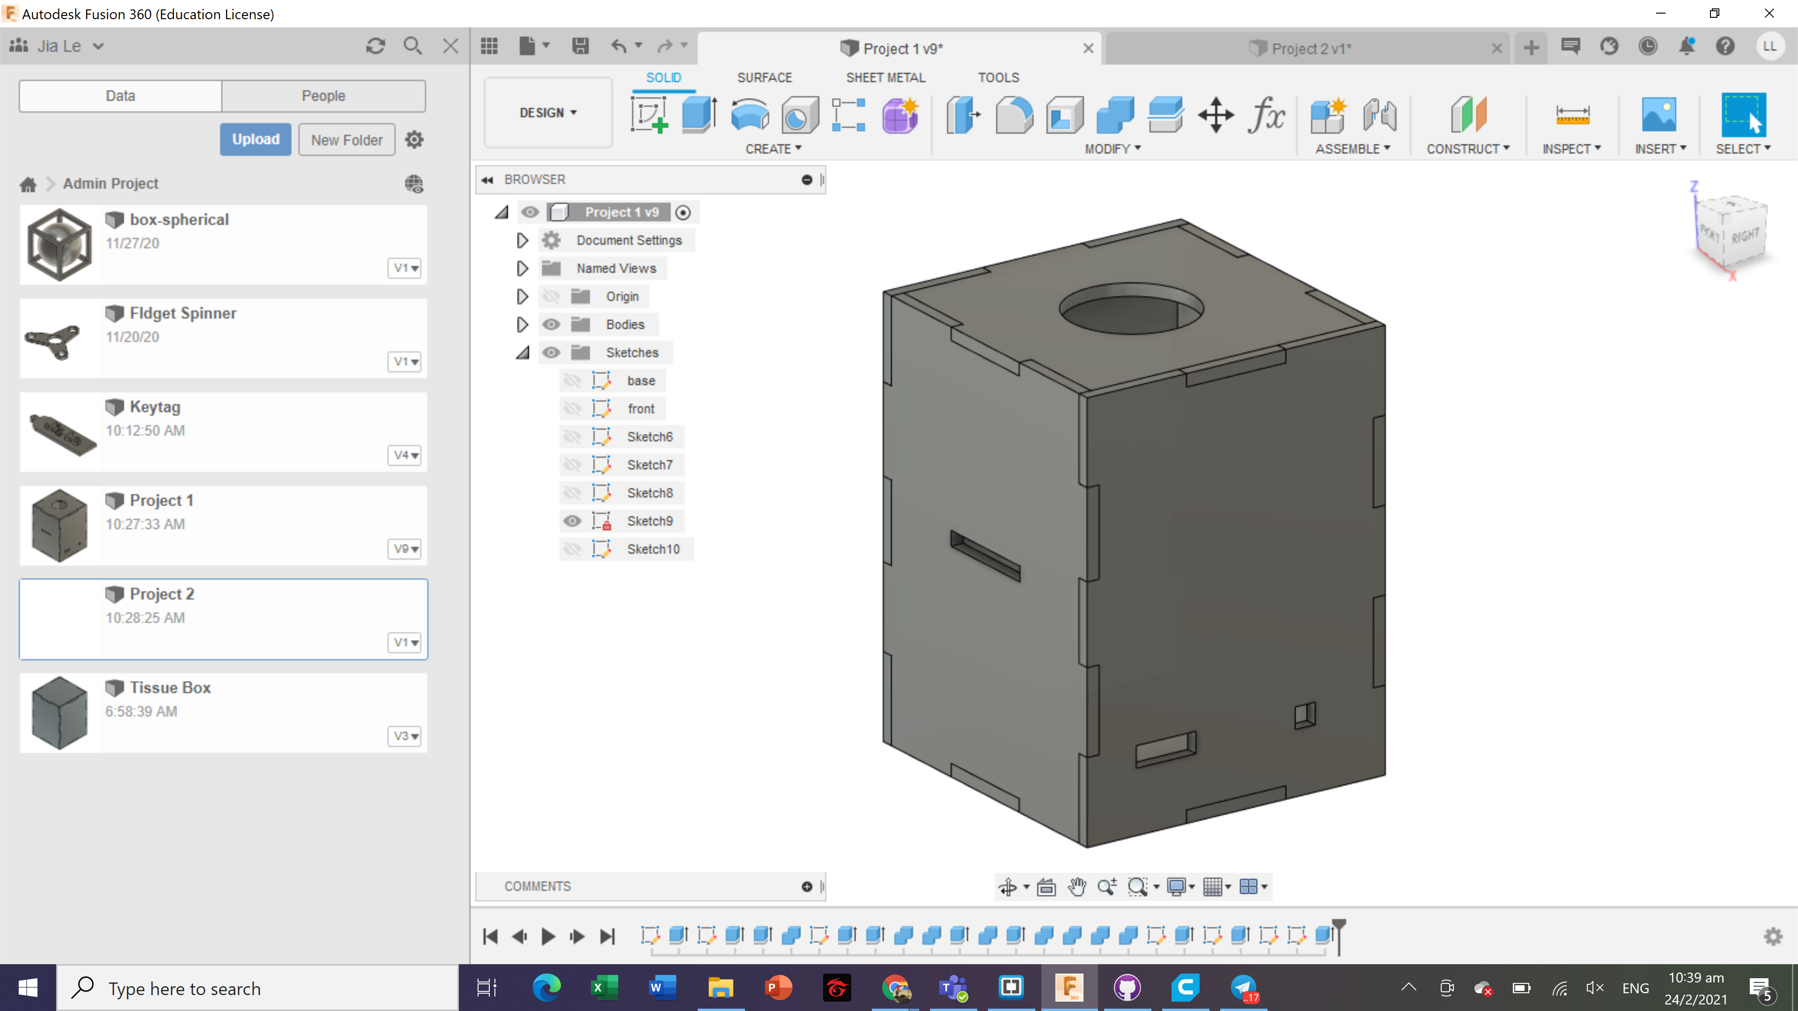
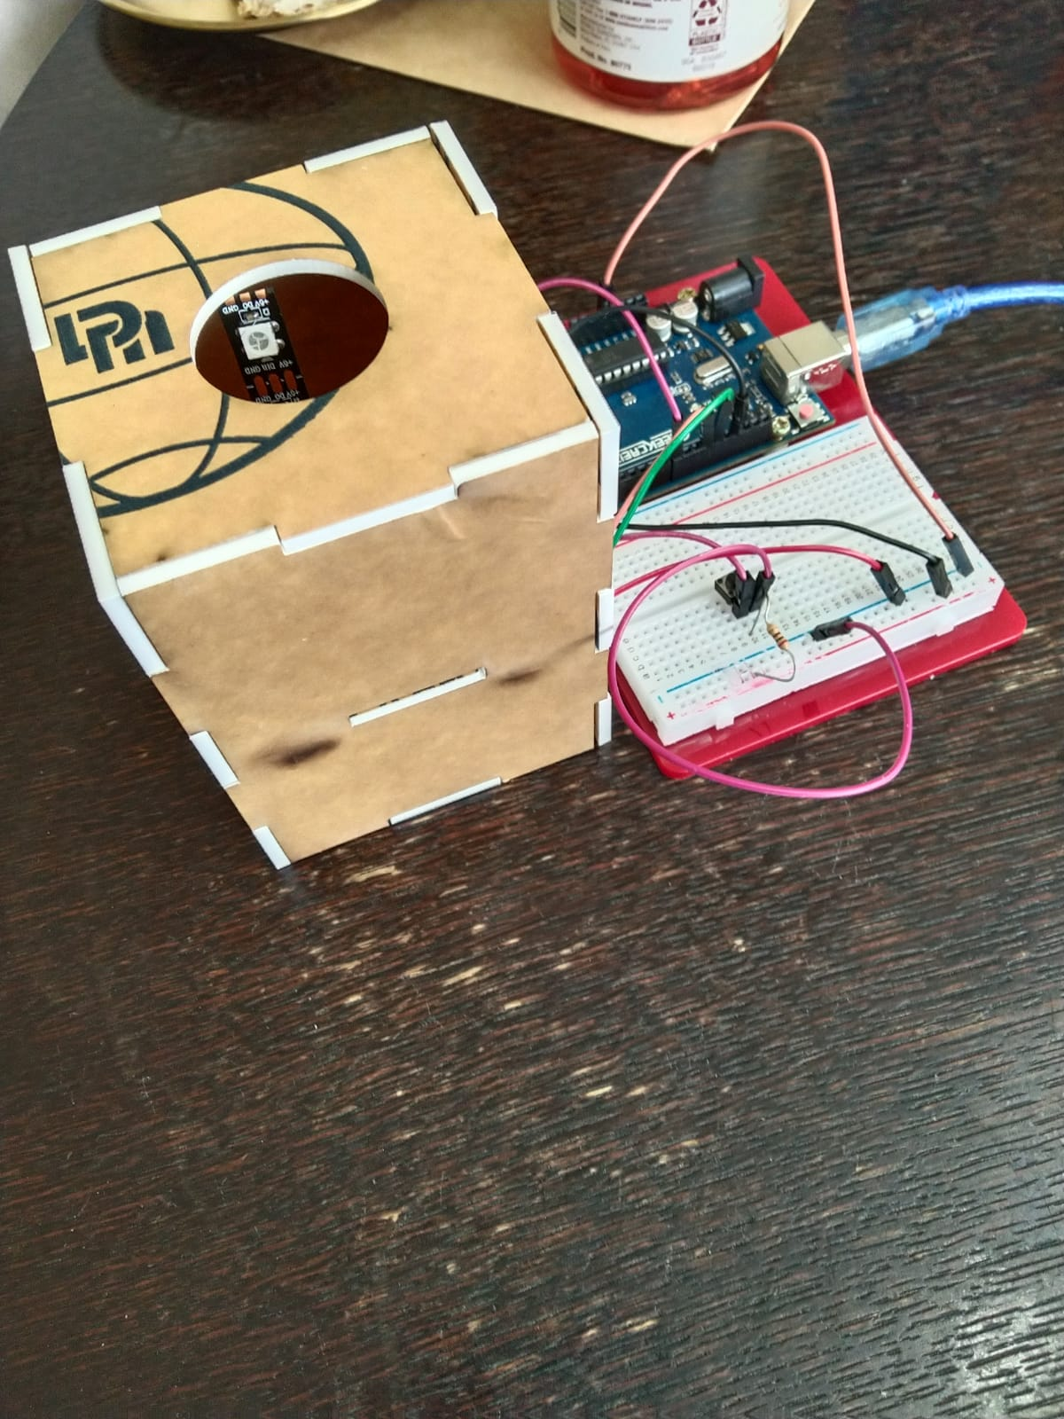
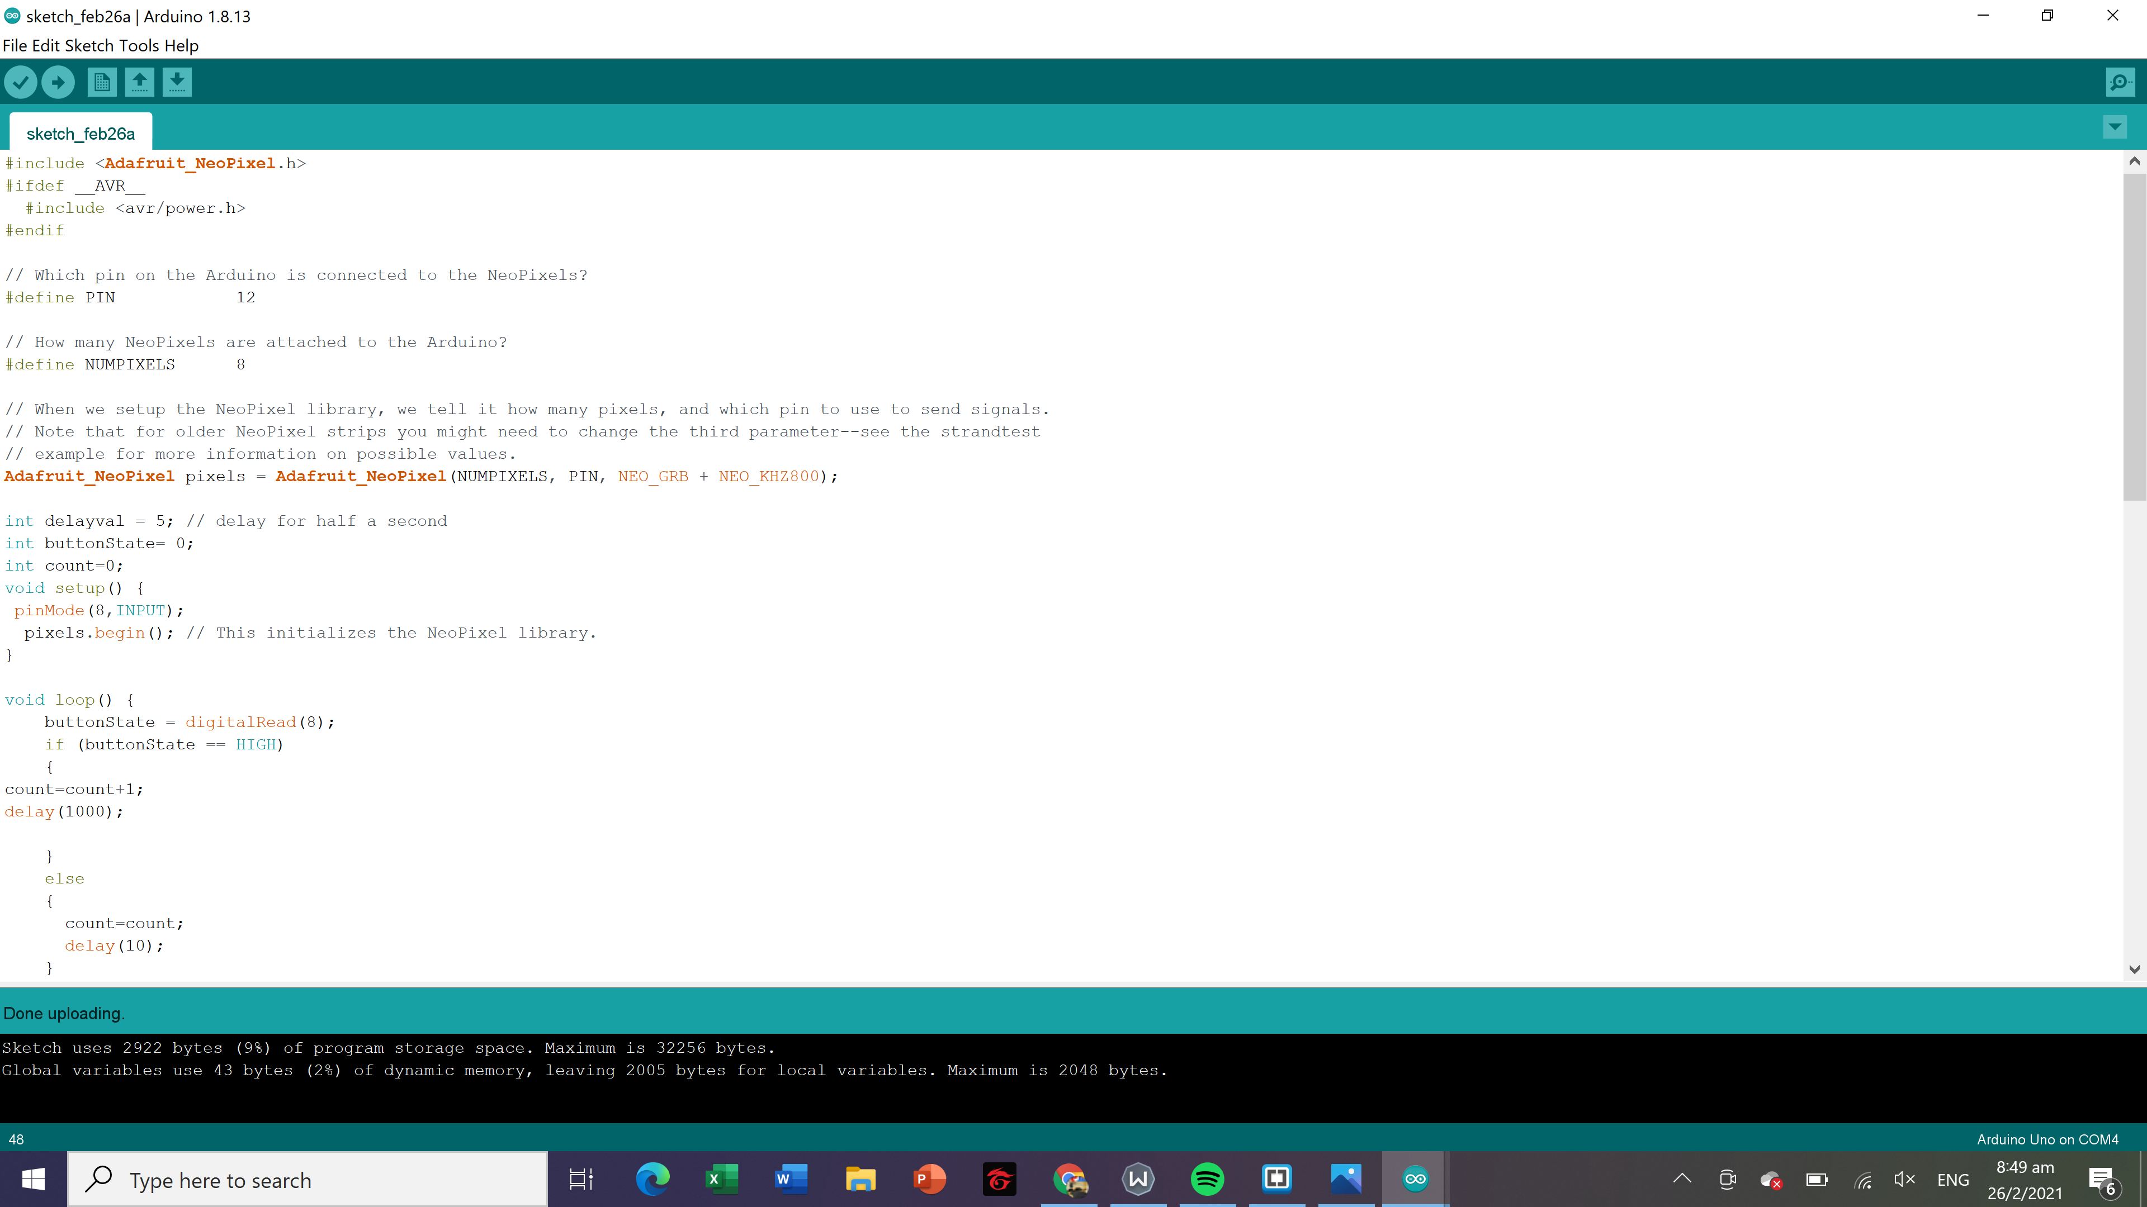
Jia Le’s Mood lamp
Lim Jia Le
2021 Sem 2
Common Business
What it can do?
It allows the light to change colors when the push button is pushed and the light comes from the top of the box
Features of the lamp:
-Easy to use
-Nice decoration piece
-Lights up your room!!

